Slide 1

Communication Mainstreaming Strategy Next Steps
ARGOS | Regione Emilia-Romagna | Luca Chiodini
Communication Meeting| Microsoft Team| 28 january 2021

Slide 2
Events planned for the upcoming Communication Programme «Next Gen Adriatic Cooperation»
Titolo | Partecipanti | Oggetto
1.Situazione degli stock ittici e della pesca. | Incontro tecnico solo tra esperti scientifici ( CNR, IOF, OGS) e chi è interessato alla governance. | Situazione dal punto di vista scientifico
2.Economia ittica in una prospettiva di sostenibilità. | Incontro anche con i pescatori, un esperto in economia e in marketing. Parti scientifiche (CNR, IOF,OGS, etc..) | Quali le criticità. Valore dell’economia ittica nell’Adriatico. Futuri sviluppi della pesca nell’Adriatico (rientra anche la l’attività economica dei molluschi). Differenze tra piccola pesca e strascico. Far capire a che cosa servono i progetti comunitari.
3. Governare l’Adriatico per una politica comune. | Far partecipare anche la parte politica. Gli assessori regionali e anche il Ministero. | L’ Adriatico è uno

Slide 3
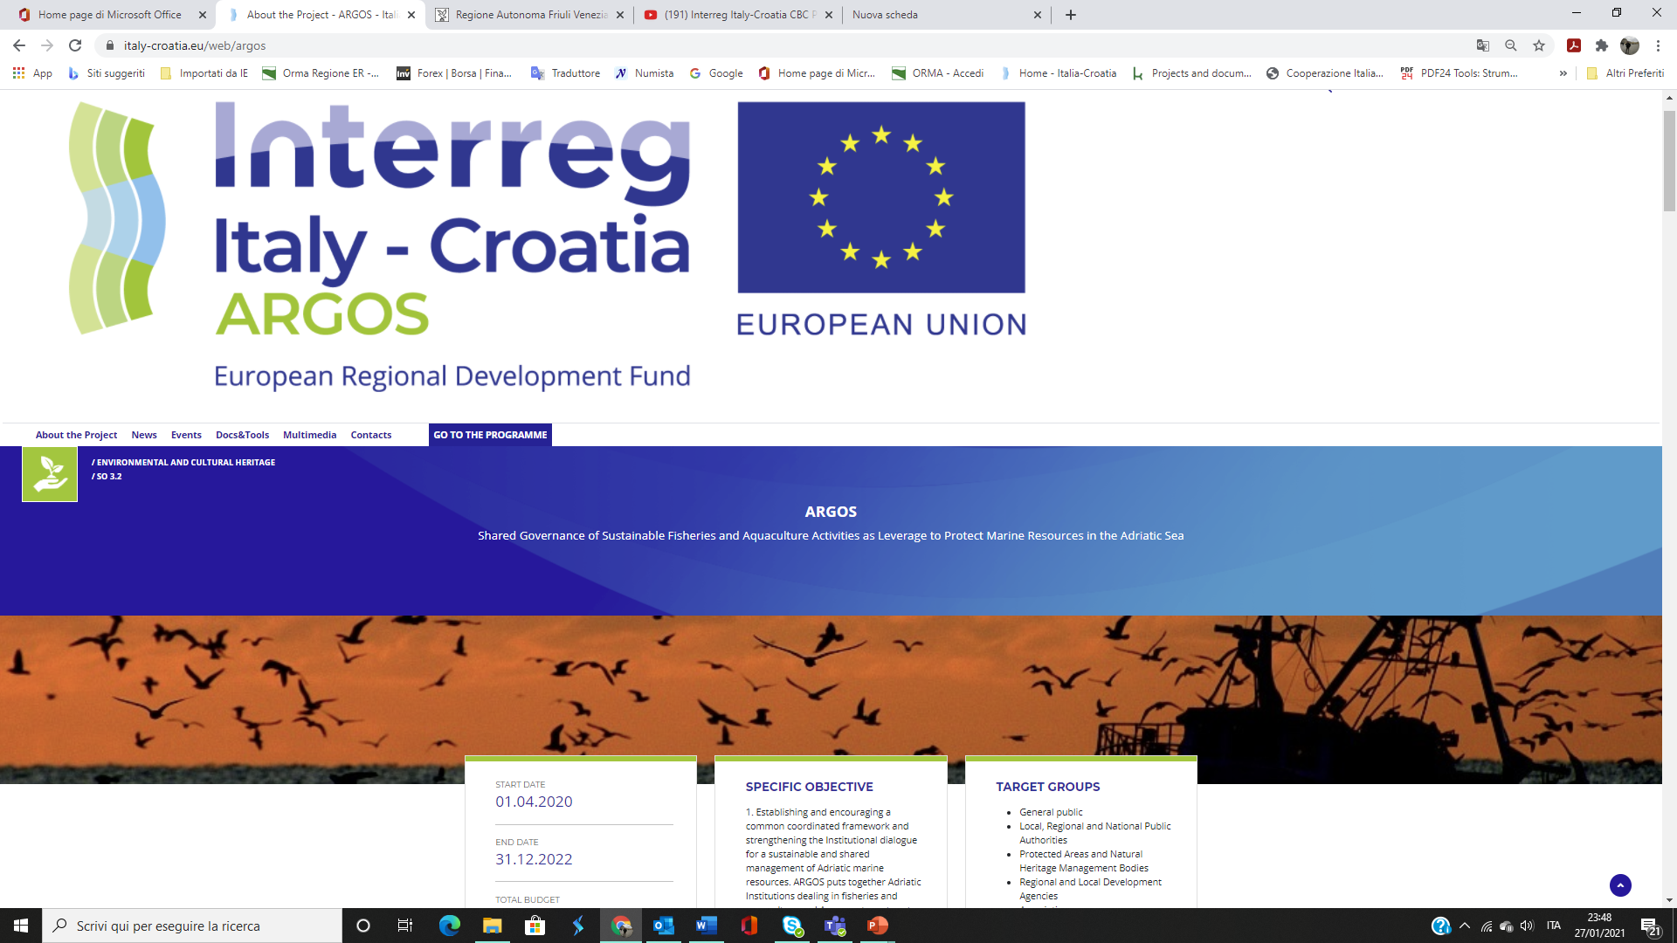
https://www.italy-croatia.eu/web/argos

Slide 4
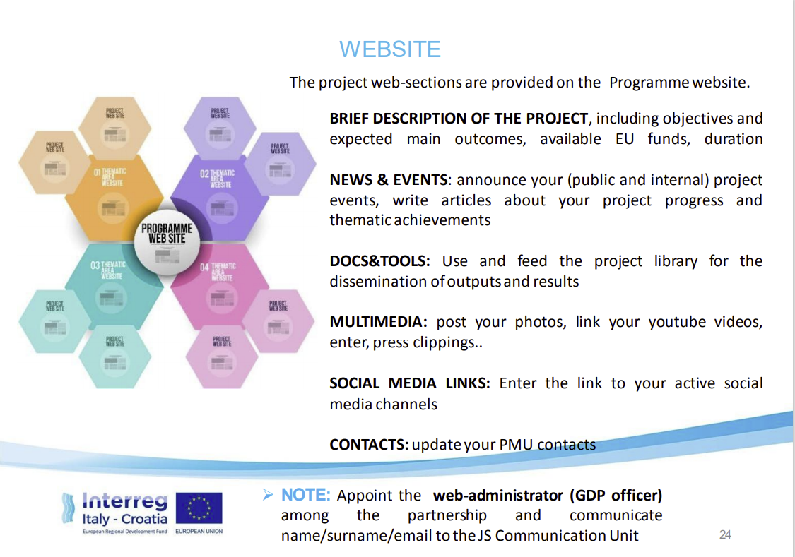

Slide 5
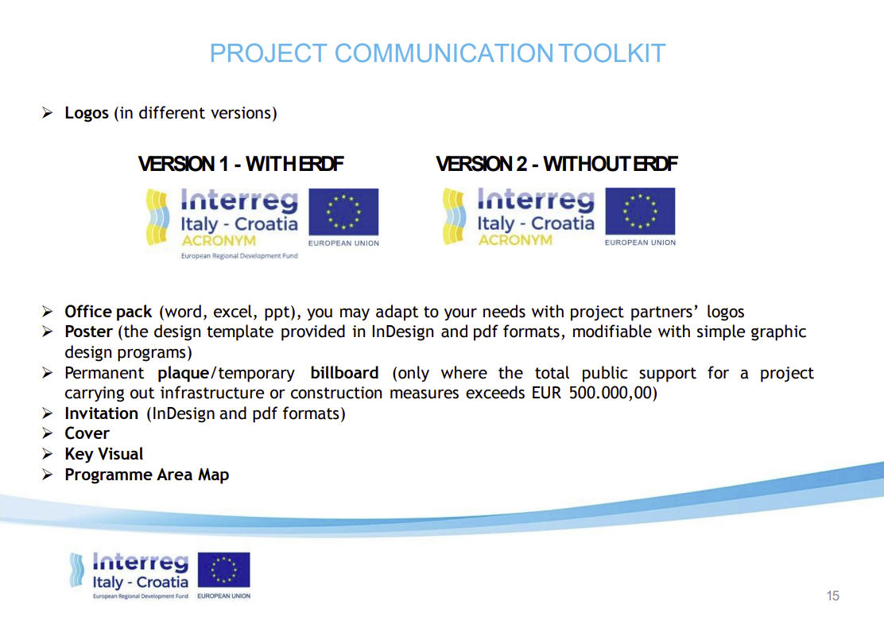

Slide 6
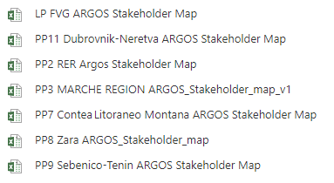
Stakeholder Maps
Partners who sent the map

Slide 7
Upcoming Tasks
    Adriatic Advisory Committee Situation and Composition
First level Controller Situation
Steering Committee Next Meeting on 2nd March
Not yet convocated
Communication Report To be sent until 15th February
Lead Partner already sent the template to fill
Team Channell? Soon

Slide 8
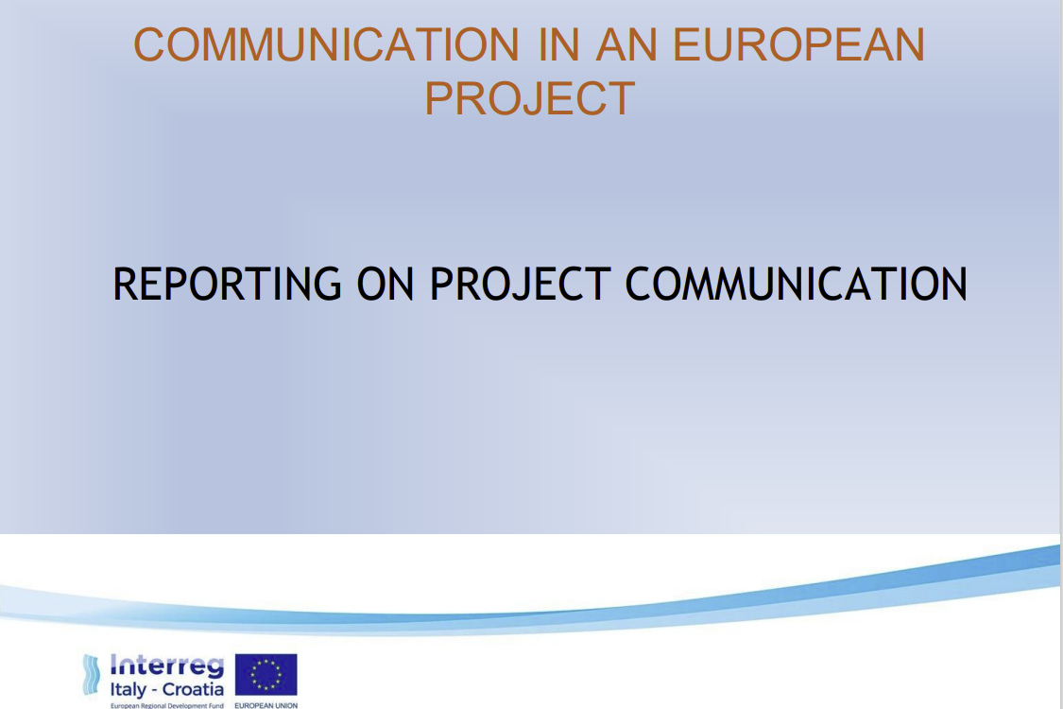

Slide 9
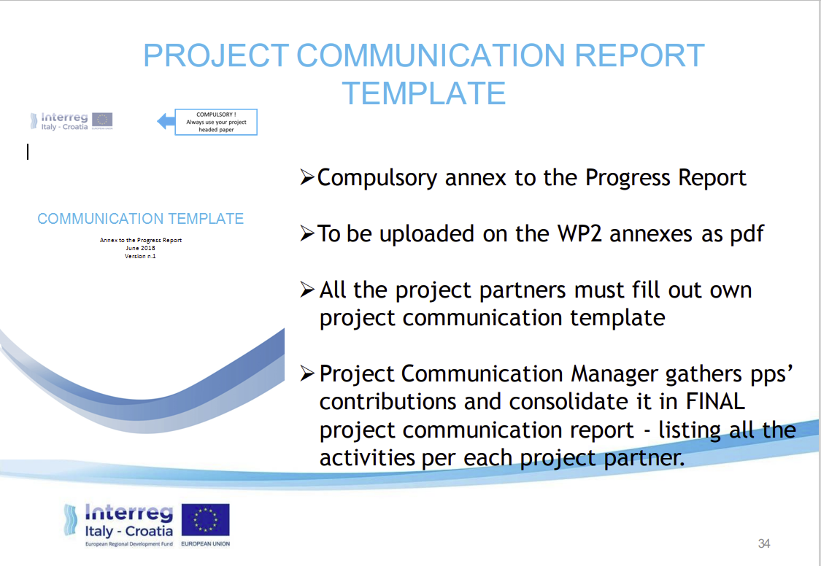

Slide 10
Upcoming Tasks
    Poster & Flyer Few pictures by your office’s premises
    Gadgets We have purchased a first batch that soon we will provide to deliver to PP because we are not planning yet any meeting in presence until the COVID - 19 will leave us

Slide 11
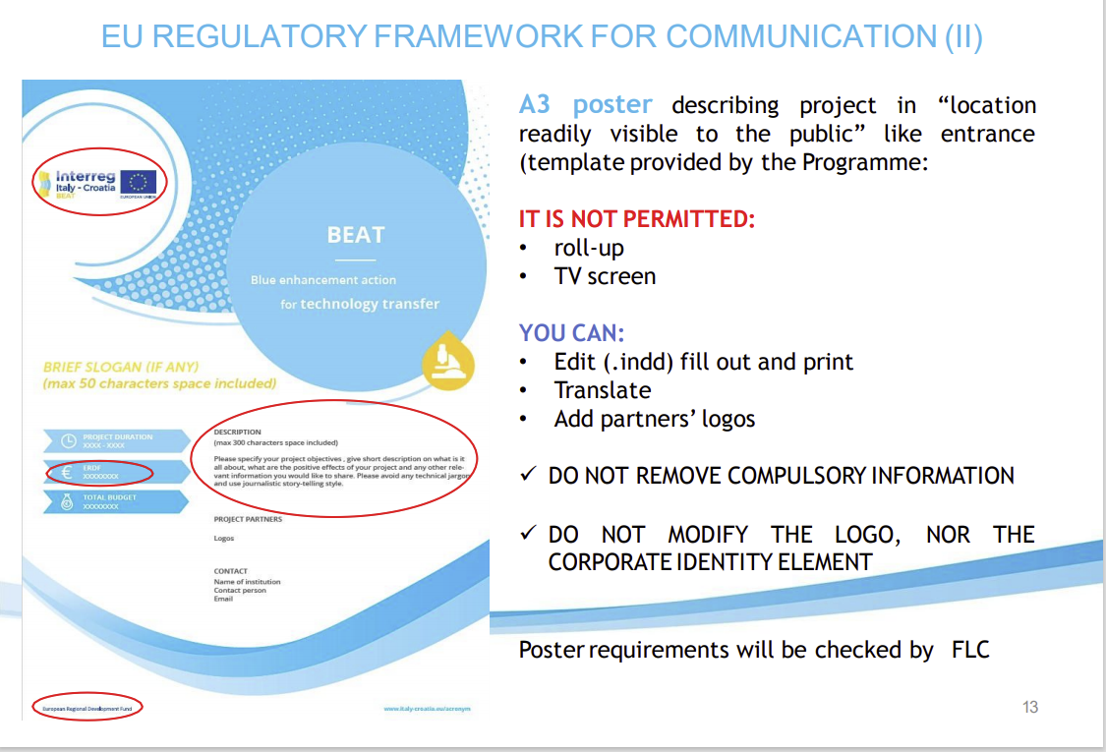

Slide 12
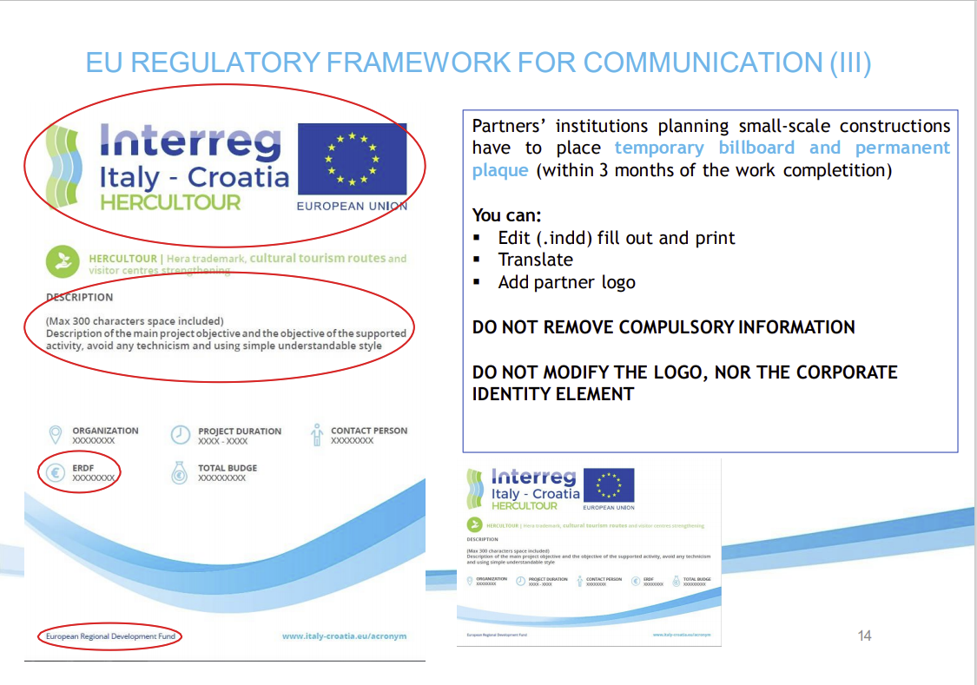

Slide 13
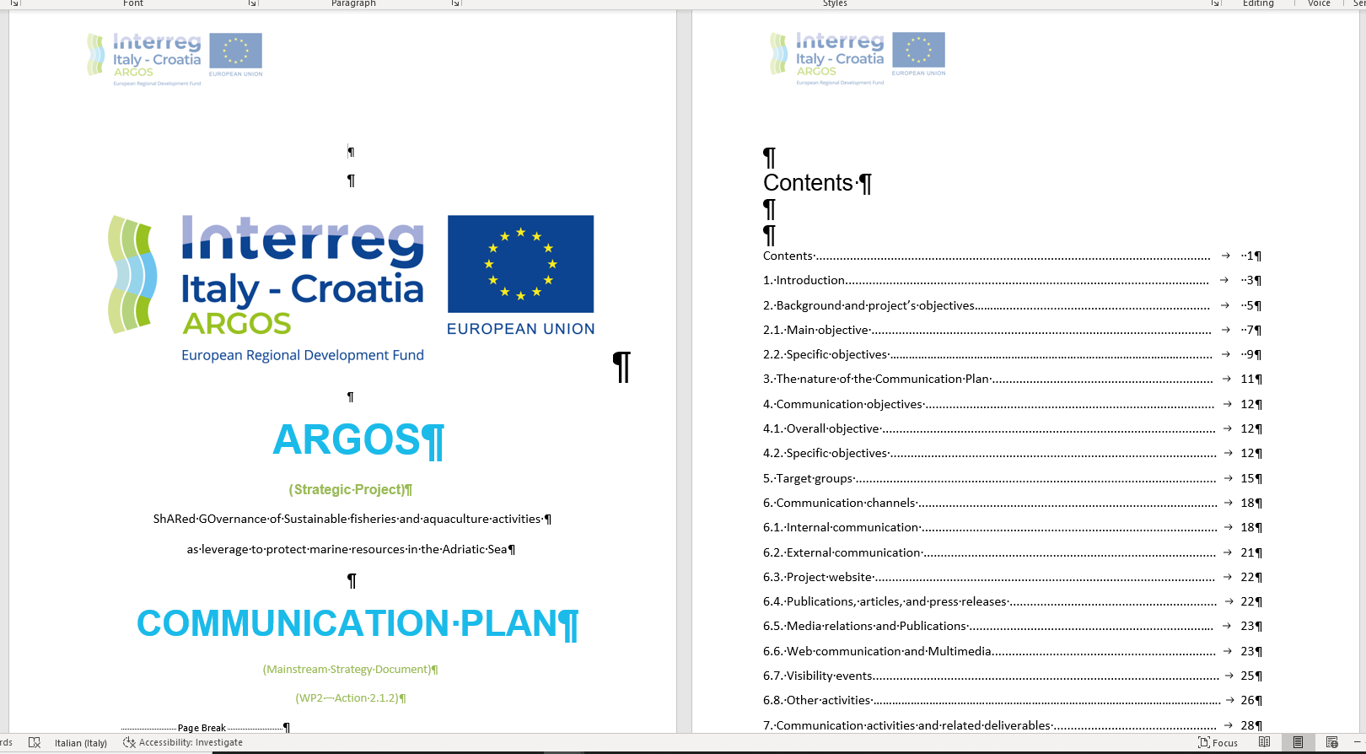
Mainstreaming Strategy Document
WP2 –Action 2.1.2

Slide 14
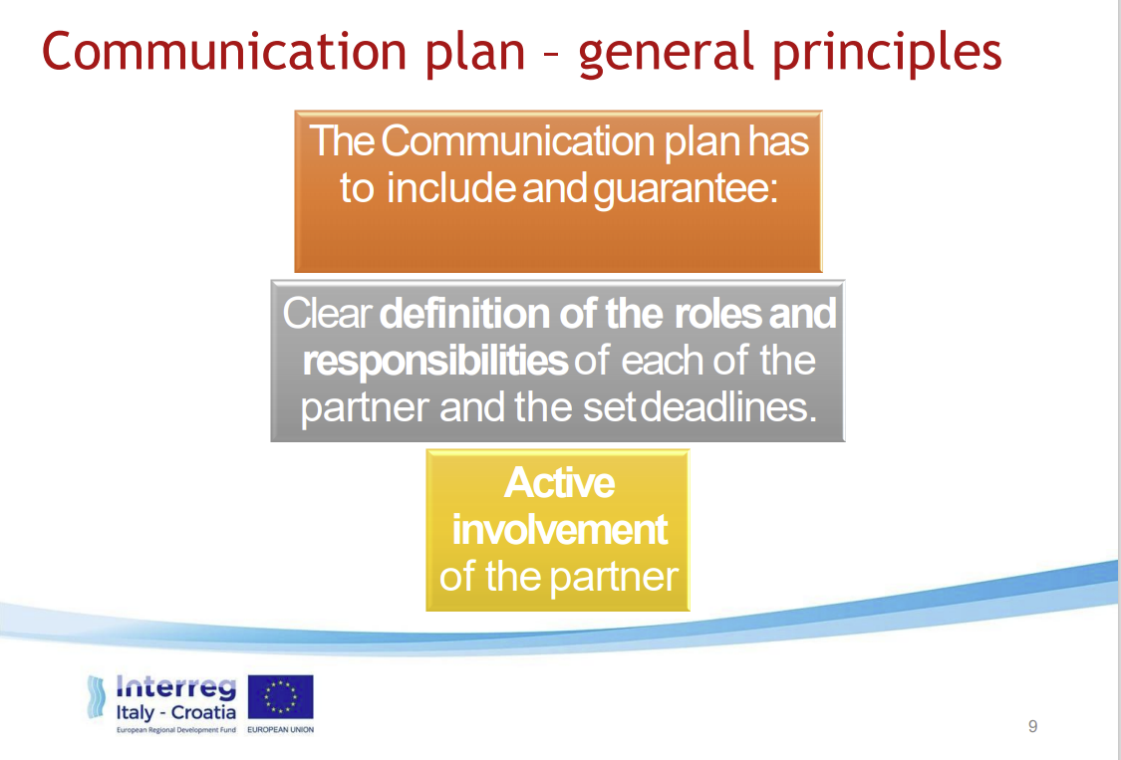

Slide 15
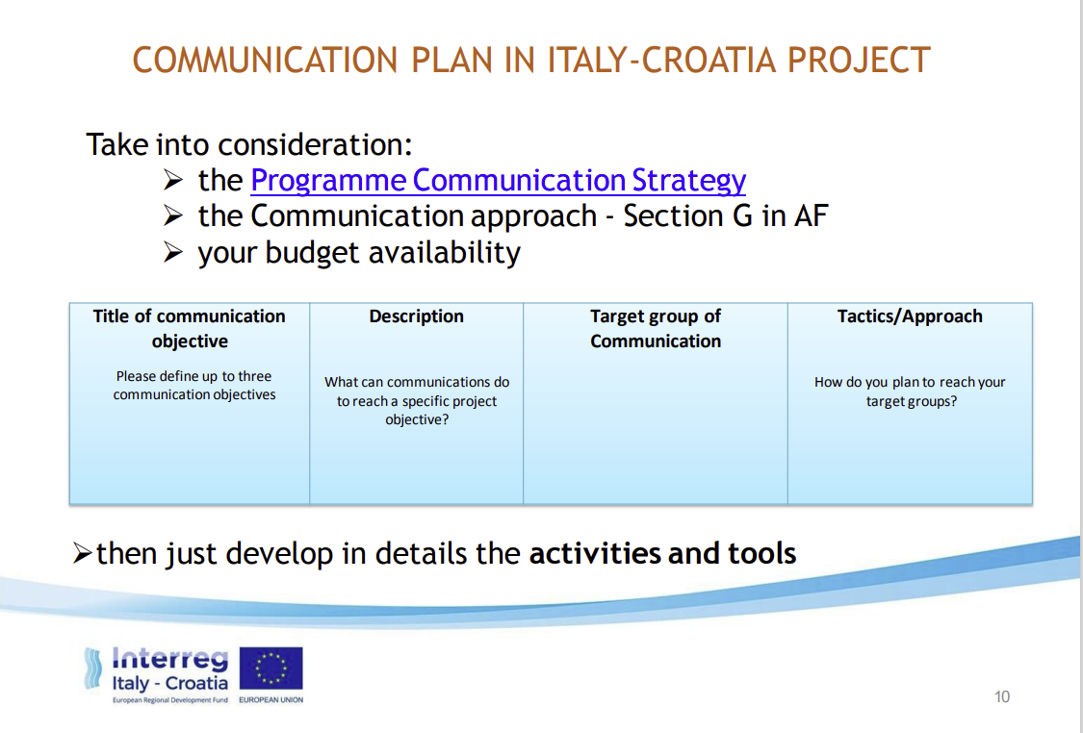

Slide 16
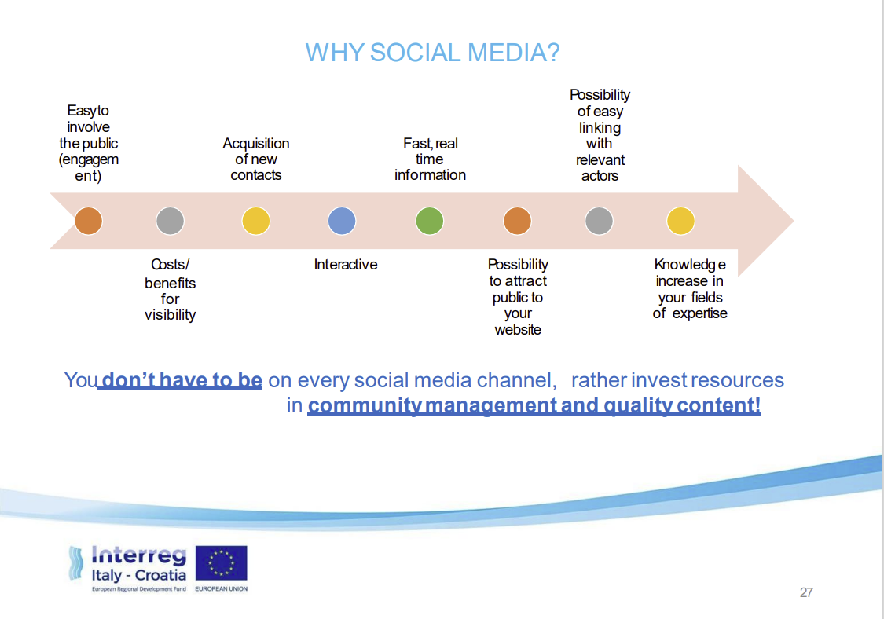

Slide 17
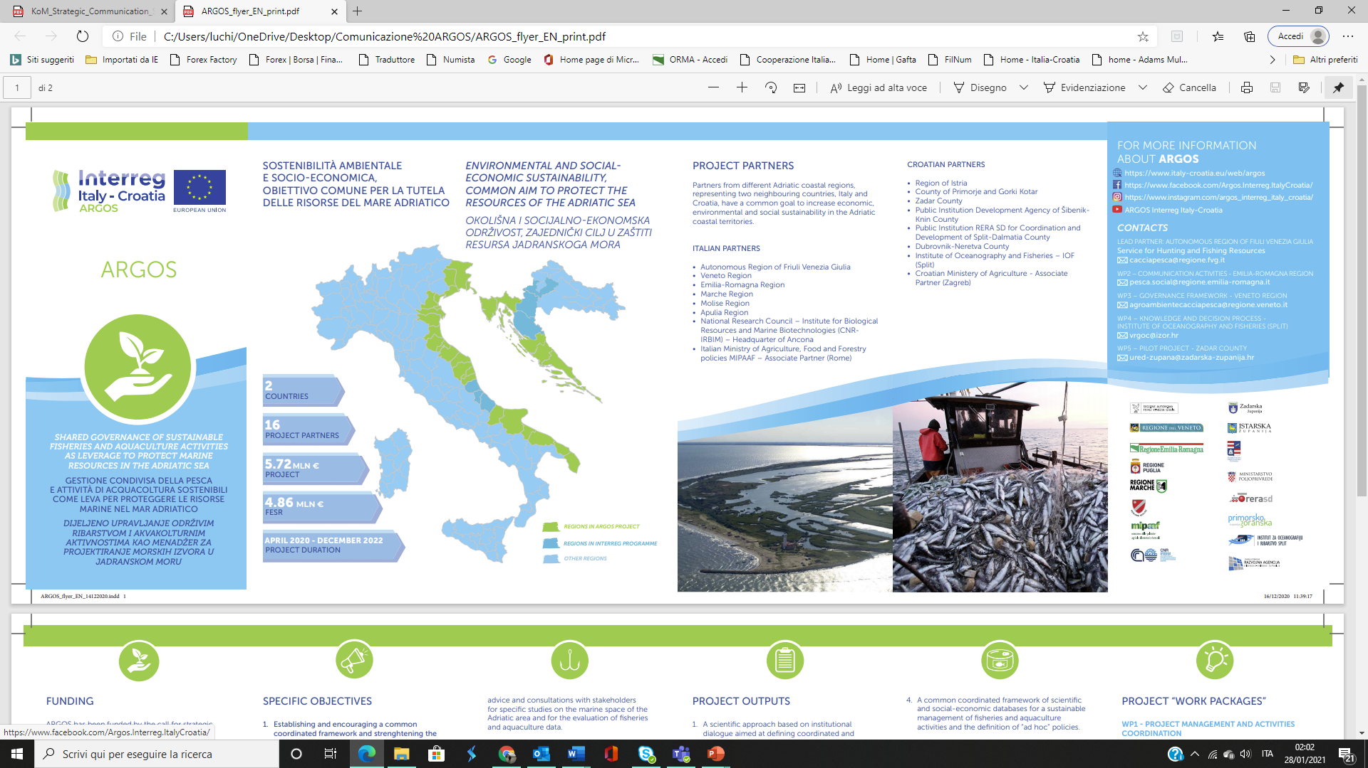
ARGOS’ Social Media adresses

Slide 18
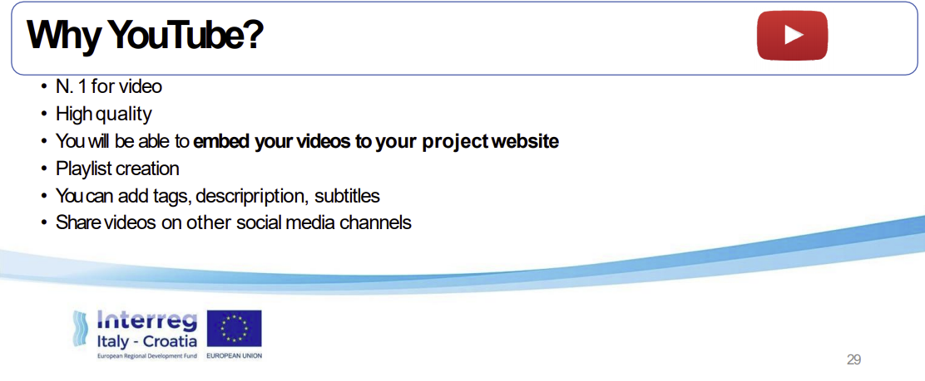

Slide 19
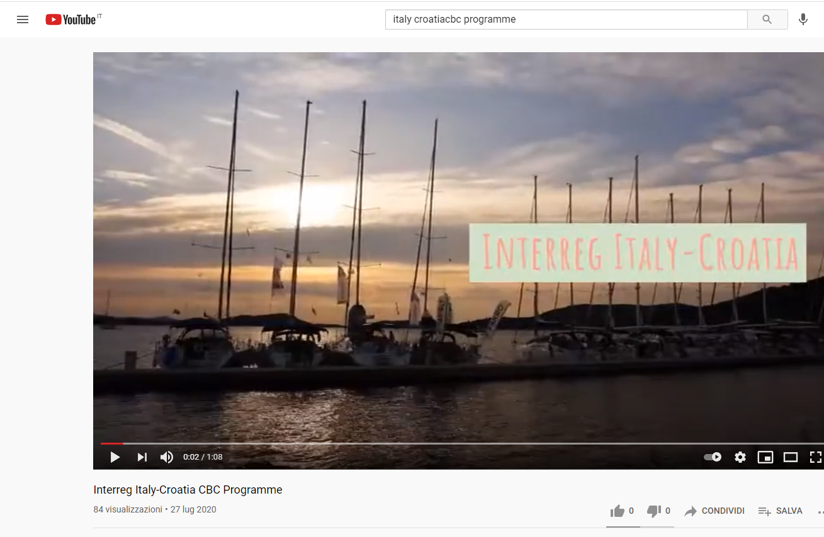

Slide 20
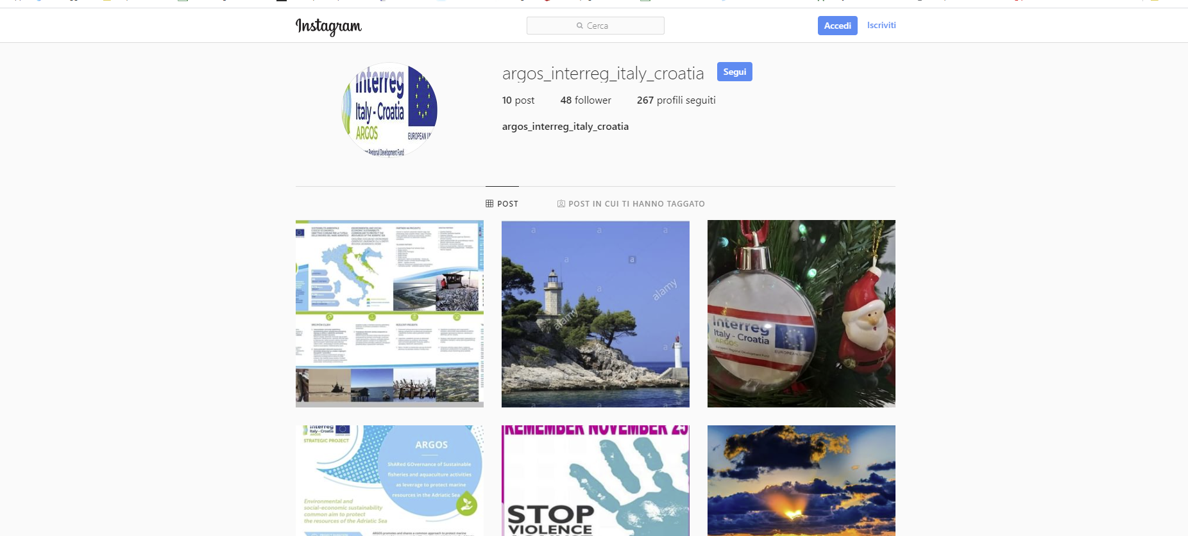
Social Media
Instagram

Slide 21
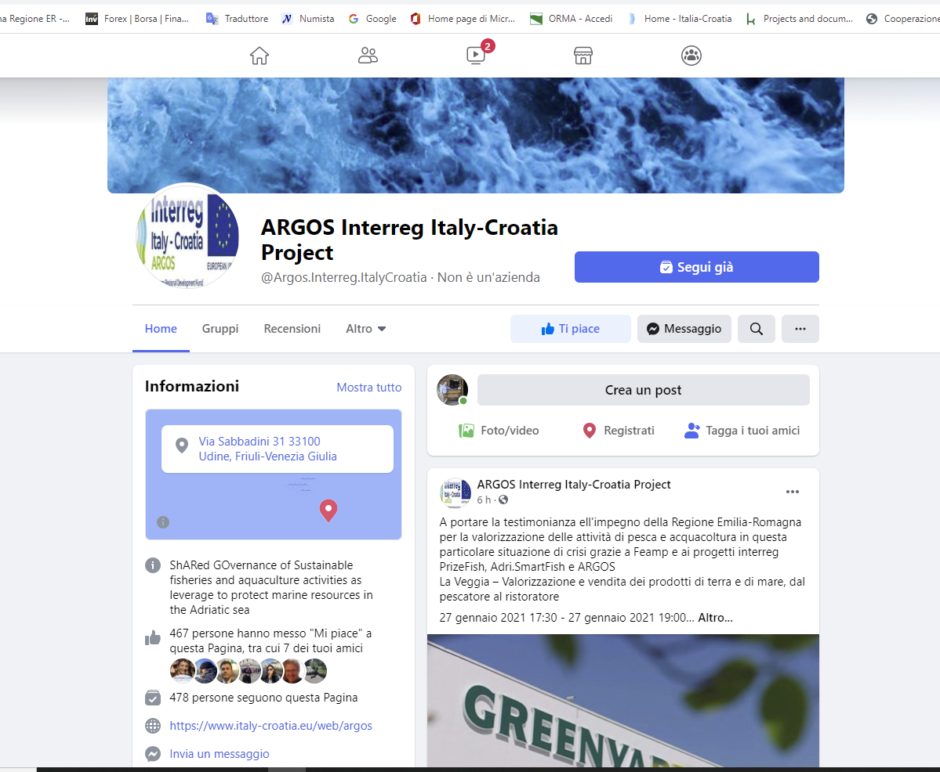
Social Media
Facebook

Slide 22
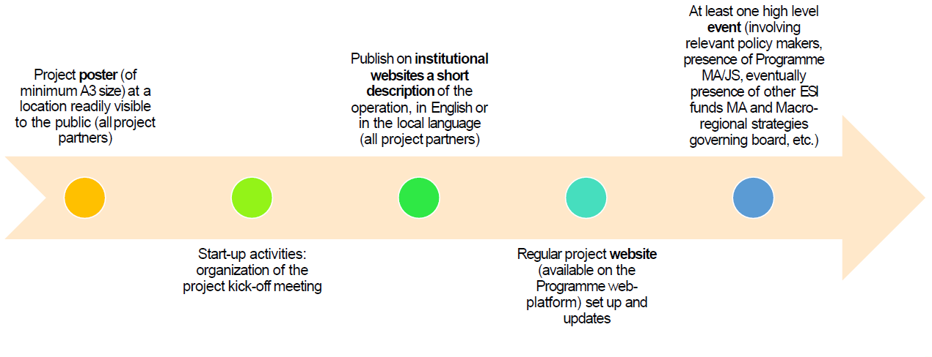
Minimum Required Activities

Slide 23
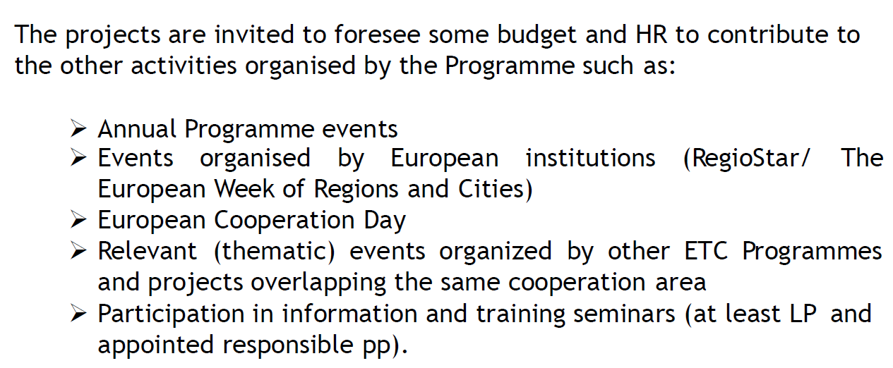
What else is Programme expecting from Projects

Slide 24
Project Branding Rules
Programme Brand Manual requirements:
Project logo and design templates for promotional materials and publications
Project poster min. A3 size
Promotional gadgets compliant with programme requirements
Presence on social media
Other deliverables - CK

Slide 25
Activity 2.1
Start-up Activities and Communication Strategy
2.1.1: Stakeholder Map (n.1) – based on Influence-Interest grid. The grid will help to detect categories demanding for priority attention, detail and name project target audience for each territory, at Programme and EU level. The grid will be prepared by PP2 and filled by each PP.
2.1.2: Mainstreaming Strategy Document (n.1) – detailing how to engage stakeholders in project activities, to ensure project outputs are known and understood by relevant entities and can provide input for further actions, programmes and strategies. The document will list available resources, and Partners role and responsibility. The MS document is drafted by the PP2 with contributions by all Partners.
2.1.3: Kick-off Event (n.1) – public conference to launch the project strategy and share key actions towards the main target groups. The event will be held in Trieste (IT) contextually to the first PSC meeting and preceded by a launch press conference. LP with support of PP2 will organize the event and press conference, and all the PPs will contribute.
2.1.4: Informative Poster (n.1 per PP, 16 total) – written in English and national languages, it will present key project messages. The design is defined by PP2 according to Programme common branding indications and shared with the Partners

Slide 26
Activity 2.2
Web Communication and Multimedia
2.2.1: Social media profile and regular updates – Social media are set up by PP2 with the support all PPs. PP2 coordinates contents updating, proper hashtags and feeding timetable, all the Partners contribute following PP2 indications. PP2 also ensures visibility of Project-related events on the social media, and coordinates active participation to the Programme Social Media.
2.2.2: Regular project Website (n.1) – It will present updated project information, news, events, networking activities and project deliverables, and implemented on the common Programme platform. PP2 coordinates contents updating with the contribution of all Partners.
2.2.3: Storytelling video (n.1) – The storytelling video presenting project achievements will be produced in both project’s languages and subtitled in English. Storytelling video will be developed by PP2, with LP supervision and PPs providing contents, translation for subtitles and online dissemination through their own institutional websites. The video will not be distributed on physical media, instead it will be made available online only, for sustainability reasons.
2.2.4: Others multimedia products and innovative appealing citizen friendly solutions like for exemple videos, video tutorial and other web documentary about activities and goals of the project.

Slide 27
Activity 2.3
Visibility Events
2.3.1: The high level Conference in Triest (n.1) will be in charge of LP and the second one (n.1) in Zara by PP 8.
2.3.2: The participation at the international and national Fishing fairs (n.3) : at European Seafood Exhibition - ESE at Barcelona on April 2021 and 2022, at the AQUAFARM fair in Pordenone on February 2021 and 2022 and at CROFISH fair in Poreč in November 2021 and 2022, under the responsibility of LP and PP2 .

Slide 28
Activity 2.4
Media relations and Publications
2.4.1: Final publication (n.1) in English and National languages by P2, with LP supervision, with collaboration of all PPs.
2.4.2: Infographic Flyer (n.3000)–in English and national languages. Flyers will be distributed during local meetings with stakeholders, promotional and networking events. Design is defined by P2 according to Programme graphics indications.
2.4.3: Articles and Publications (n.10)– on local generalist press and on specialized EU magazines and platforms. Each PPs will publish at least 1 article at local level to inform the general public and promote the involvement of local stakeholders. P12 with P13 will publish at least 1 paper in a scientific journal of international level.
2.4.4: Press Conferences (n.2) – One organized by LP during the Kick-off event in Trieste, to launch the project strategy and the mainstreaming process; another one organized by P11 during the Final event to raise awareness on project results and propose means for further actions and strategies.
2.4.5: Mainstreaming Document (n.1) – It will be based on the guidelines defined in the MS, summarising the lessons learned within the Project and defining the guidelines to implement the results into relevant Policies. It will give attention to the transfer of Project Results outside the Project and Programme Area.
2.4.6 : Promotional gadgets and material (n. 8.000/10.000) branded with the Project and Programme logo, distributed throughout communication events. P2 is in charge for activity

Slide 29
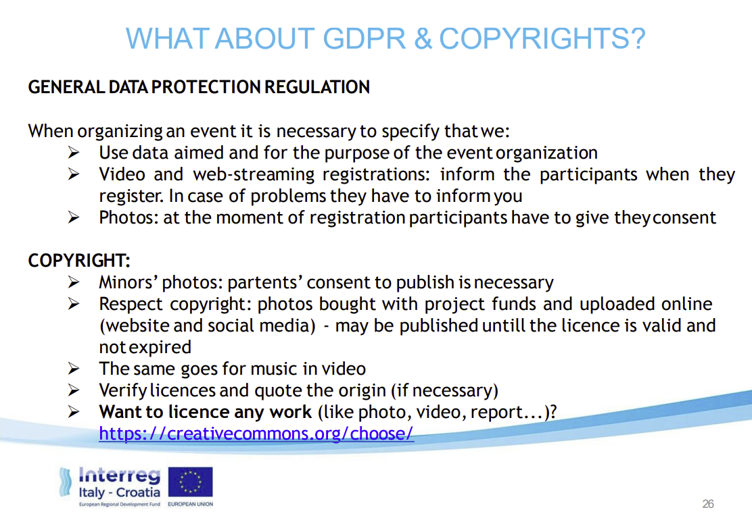

Slide 30


Slide 32
WP2 - Responsible
Organisation name: Emilia-Romagna Region
Contact persons: Piergiorgio Vasi (Project Manager)
Luca Chiodini (Communication Manager)
Greta Santagostino (Social Media & Communication)
Address Viale della Fiera, 8 - Bologna
email@ luca.chiodini@regione.emilia-romagna.it
Telephone number +39 051 5274627 (landline) +39 351 9682320 (mobile)
www.italy-croatia.eu/ARGOS

