Slide 1

SMATH project kick-off meeting
ETC in Veneto Region – focus on MED Programme
Venice, 15 June 2018
Anna Franco
Territorial Cooperation and Macroregional Stategies Unit

Slide 2
Veneto Region – ETC internal organization
It sets policies and strategies
Regional
Council
They provide Units with human resources devoted to projects
They give Units advice on partnership agreements or other legal documents
Territorial Cooperation and Macroregional Stategies Unit
(TC)
Human Resources
Legislative Affairs
Buxelles Unit
Accounting
They put in place separate accounting systems for each project
They participate into European networks, they collect thematic information, they help in searching partners
Research and Innovation Unit
Turism
Territorial and strategic planning
Culture
Other Units
TC Unit gives advice on Programmes and thematic Units provide TC Unit with thematic information

Slide 3
Territorial Cooperation and Macroregional Stategies Unit
For internal Structures
  Information
  Coordination
  Monitoring
  Technical support
What we do
For beneficiaries
and potntial applicants
  Information and promotion of territorial cooperation opportunities to local authorities and other organizations
For the national managing system
  Voting member in national committees
  Co-chairing the Central Europe national committee
  Interreg CENTRAL EUROPE National Contact Point

Slide 4
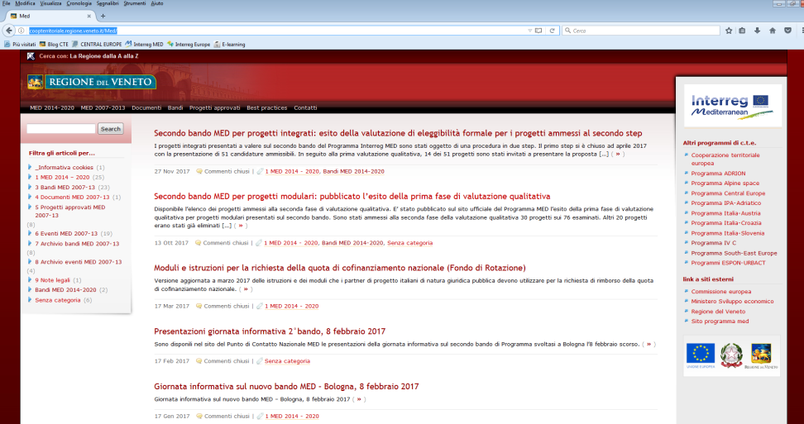
Veneto Region dedicated website http://coopterritoriale.regione.veneto.it/Med/
We generate original contents in Italian language about Programmes’ news.
TARGET:
Italian beneficiaries,
potential applicants,
general public.
We coordinate a Partnership of stakeholders coming from public administrations at different levels, business support organizations and civil society (pursuant to art. 5, Reg. (UE) 1303/2013 and to the European code of conduct on partnership in the framework of ESIF – European Commission, 2014).

Slide 5








Veneto Region into ETC Programmes
Cross-border cooperation:
Transnational cooperation:
Interregional cooperation:

Slide 6
Veneto Region into ETC Programmes
RUNNING PROJECTS | TOTAL BUDGET
30 | € 6.451.550,21

Slide 7
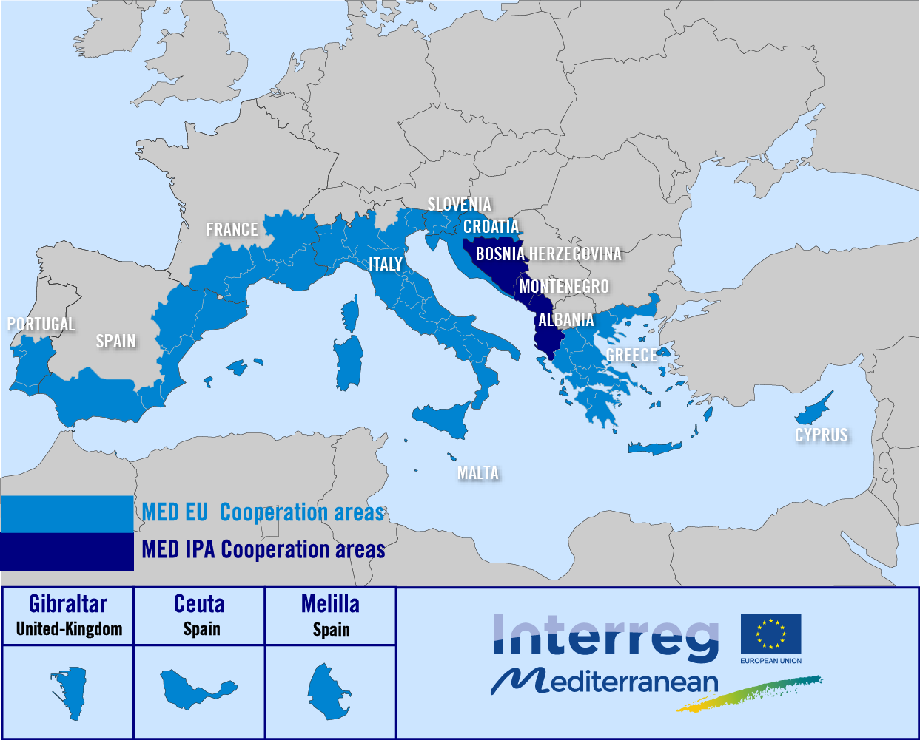
Some figures
13 States and 57 regions from the Mediterranean area
122 M inhabitants (25% EU28)
860 000 km² (20% EU28)
15 000 km maritime coastline
10 EU Member States + 3 EU candidate/potential candidate IPA countries
  Total budget: ~ 276 M € - 85% ERDF/IPA co-financing rate + private co-financing

Slide 8









MED Architecture
Mediterranean SHARED VISION on policies & actions
HORIZONTAL projects
Capitalization of classic projects’ Transnational results by theme
MODULAR projects
Local results/impact
HP Green Growth
2/3
Innovation
HP Blue Growth
Results
1/2/3
HP Social & Creative
HP Efficient Buildings
1/2/3
Low-carbon
economy
Clustered
Results
HP Urban Transport
Axis 4 – PANORAMED
Strategic projects
Results
HP Renewable Energy
HP Sustainable Tourism
2/3
Natural
and cultural
Resources
HP Biodiversity Protection
Results
1/2/3

Slide 9








Veneto Region in MED
Green Growth
AXIS 1
Blue Growth
GRASPINNO
Social & Creative
CO-CREATE, ODEON (LP), SMATH (LP), +RESILIENT (LP)
Efficient Buildings
AXIS 2
Urban Transport
Renewable Energy
Sustainable Tourism
CASTWATER
AXIS 3
Biodiversity Protection
WETNET (LP)

Slide 10
Total budget ERDF allocated so far
 | ERDF in €
Total budget at Programme level | 224.322.525
Allocated so far to projects other than TA | 162.768.105
Allocated to Italy | 46.694.792
Allocated to Veneto Region | 1.744.970

Slide 11
Thank you for your attention!
anna.franco@regione.veneto.it

