Slide 1

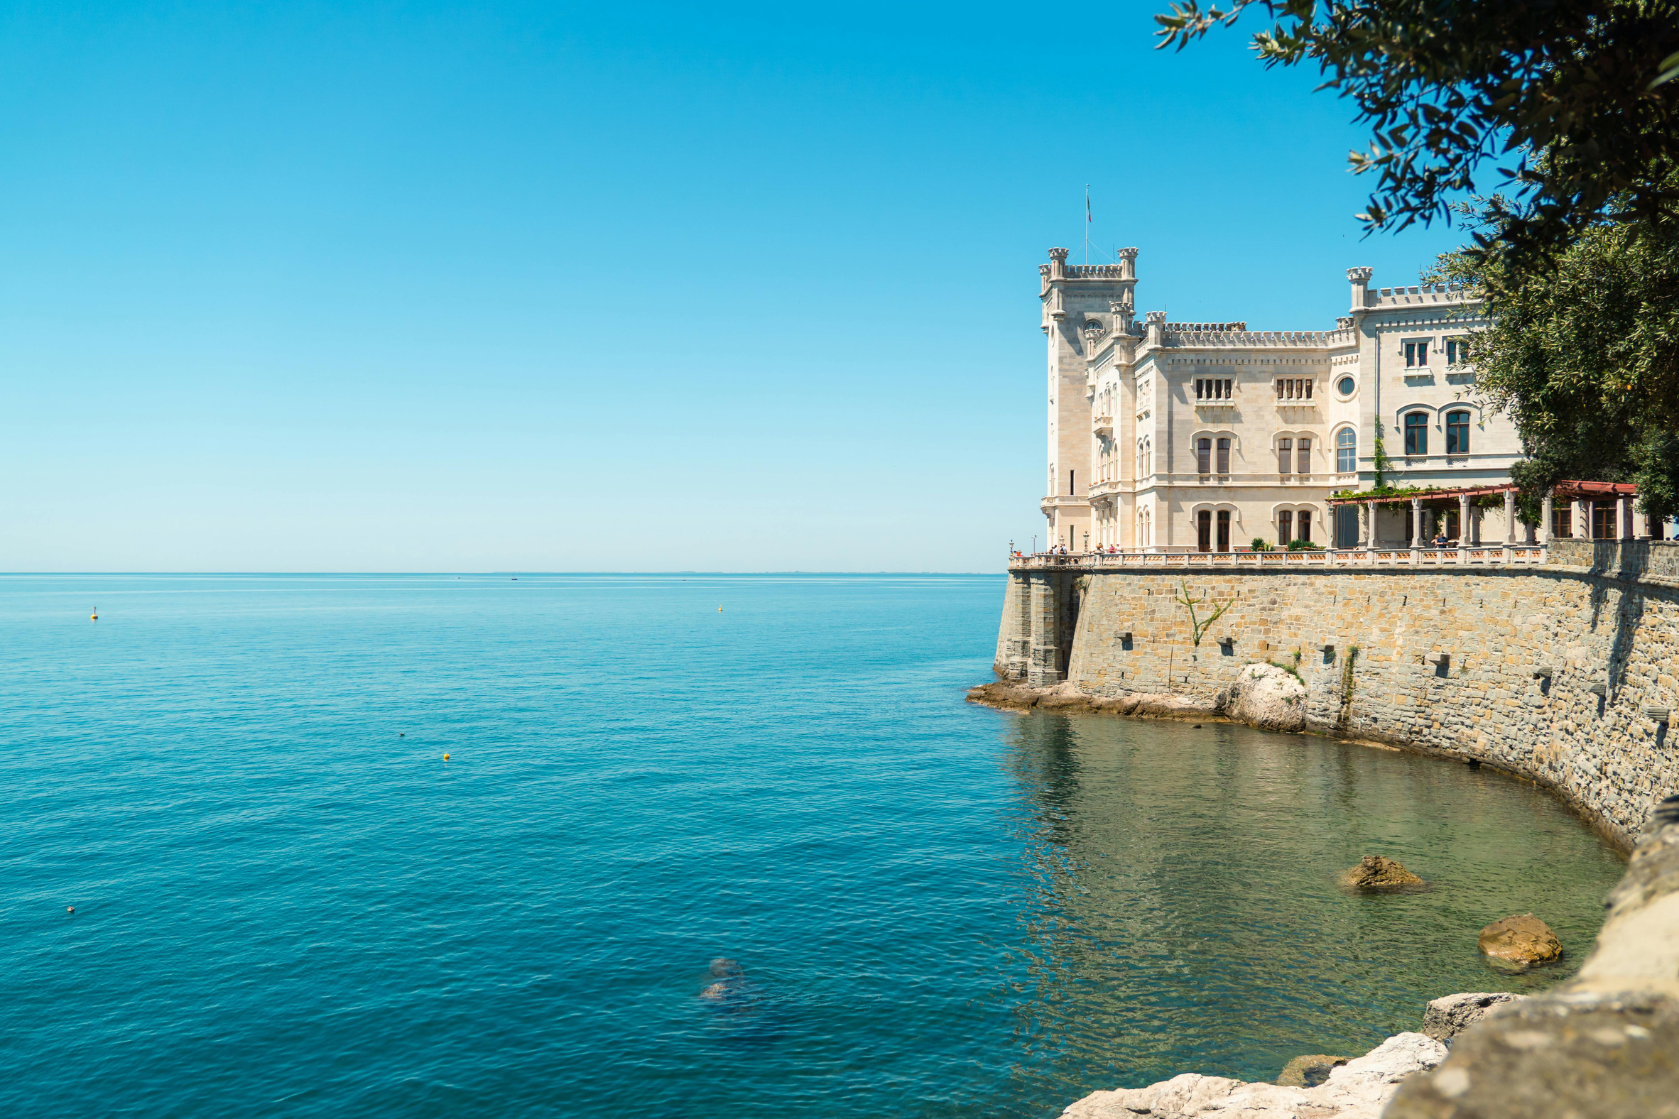
Friuli Venezia Giulia
Autonomous Region
Department for culture and sports
Elena Mengotti
Head of Unit for legal, financial
and EU affairs
AdriACTIVE
KICK OFF MEETING
Venice, 1-2 December 2025

Slide 2
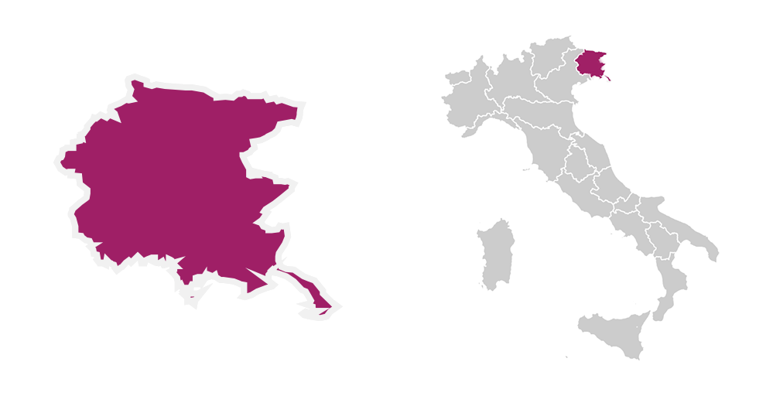
FRIULI VENEZIA GIULIA AUTONOMOUS REGION
Area:
7.932,5 sq.km
Inhabitants:
ca. 1.197.295
5
UNESCO
SITES

Slide 3
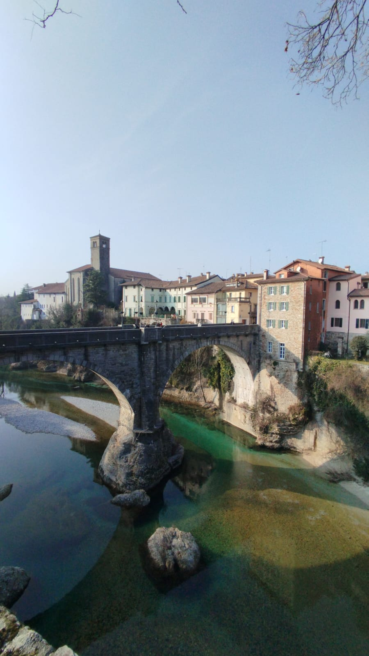


CCI’S IN FVGAR
The cultural and creative production system in FVGAR accounts for 5.6% of the regional economy, with over 2.3
billion euros
The sector involves nearly 32,000 workers, representing 5.9% of the employed population in the Region
Source: Io sono Cultura 2025
Fondazione SYMBOLA

Slide 4
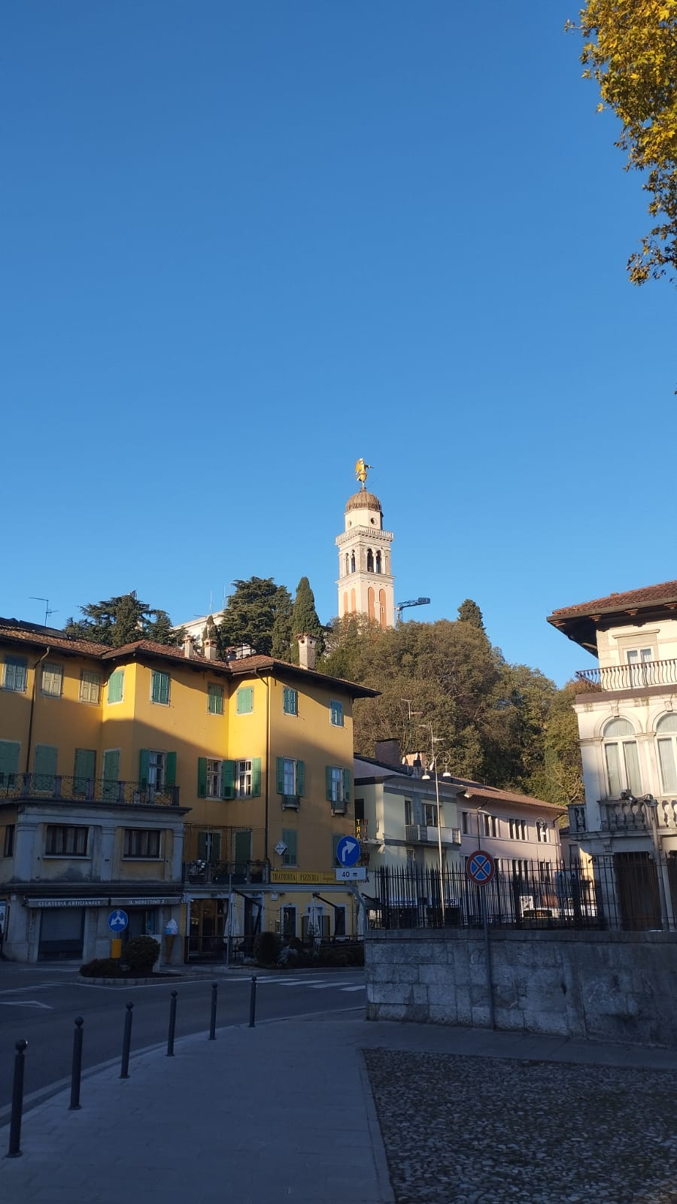
DEPARTMENT FOR CULTURE AND SPORTS
Protection and strengthening of the regional cultural heritage
Targeted support to Cultural and Creative Industries (CCIs) through regional policies
Implementation of cultural tourism in the Region
Promotion of cultural activities

Slide 5
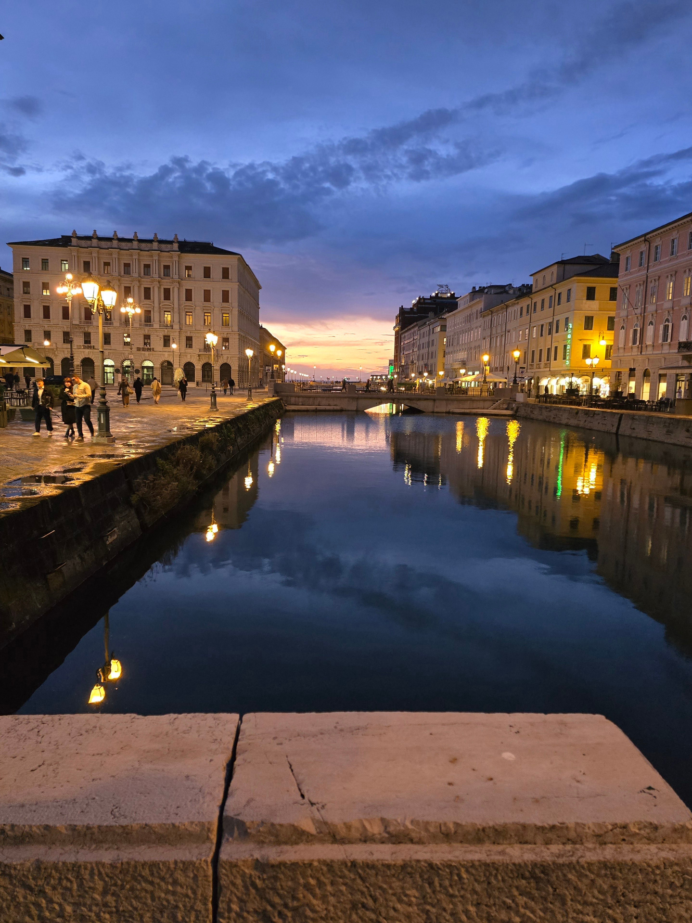
EUROPEAN PROJECTS
1. CHERRY
2. PRIMIS PLUS
3. IN4BLUE
4. DANTE
5. A4SUSTINNO
6. CAR2GO!
7. NITIES
8. RE-ACTIVE
9. AdriACTIVE

Slide 6
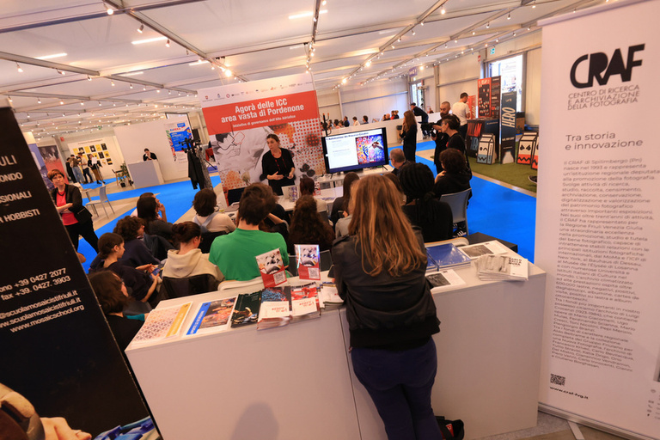

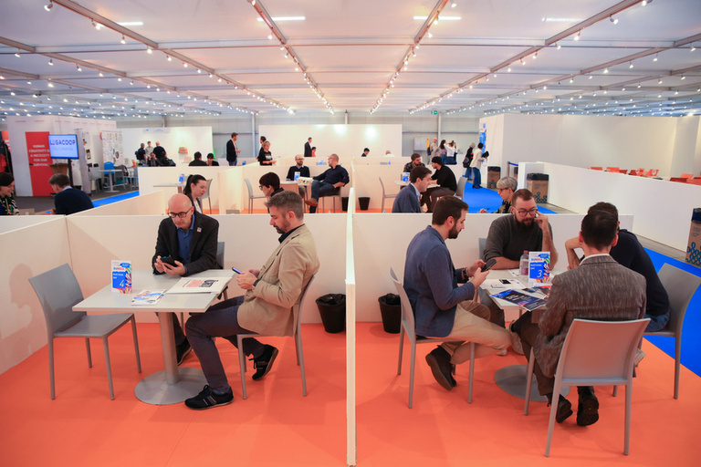
EUREKA - FAIR OF CULTURE AND CREATIVITY
SUPPORTING THE GROWTH OF CULTURAL AND CREATIVE ENTERPRISES
FOSTERING SKILL DEVELOPMENT AND INNOVATION
OPPORTUNITIES FOR NEW COLLABORATIONS AND GROWTH

Slide 7
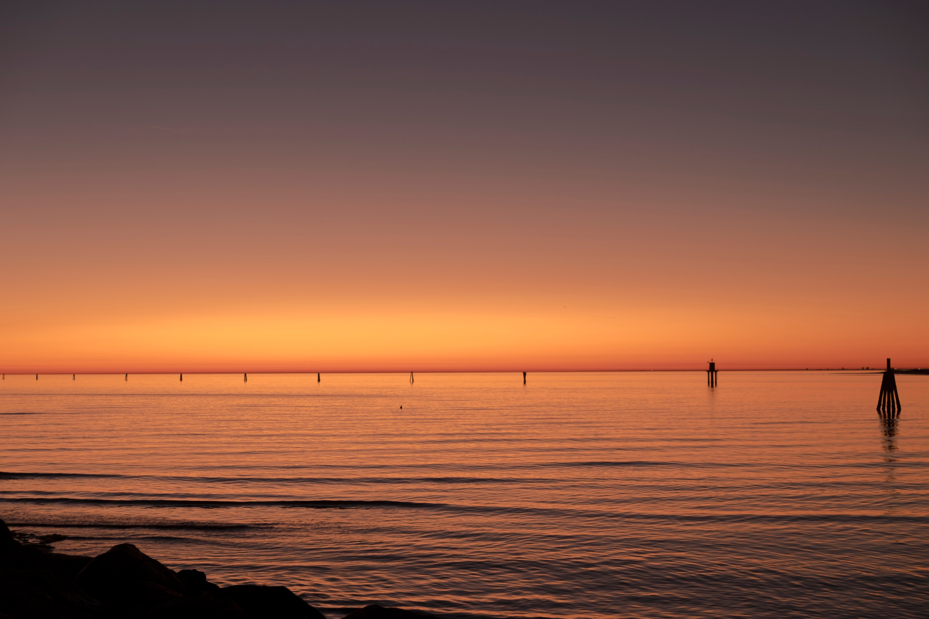
THANKS FOR YOUR ATTENTION
Department for culture and sports
Friuli Venezia Giulia Autonomous Region
Elena Mengotti
Head of Unit for legal, financial
and EU affairs

