Slide 1
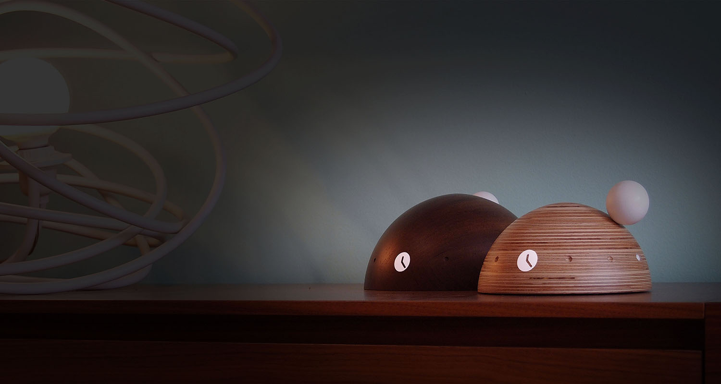

Slide 3
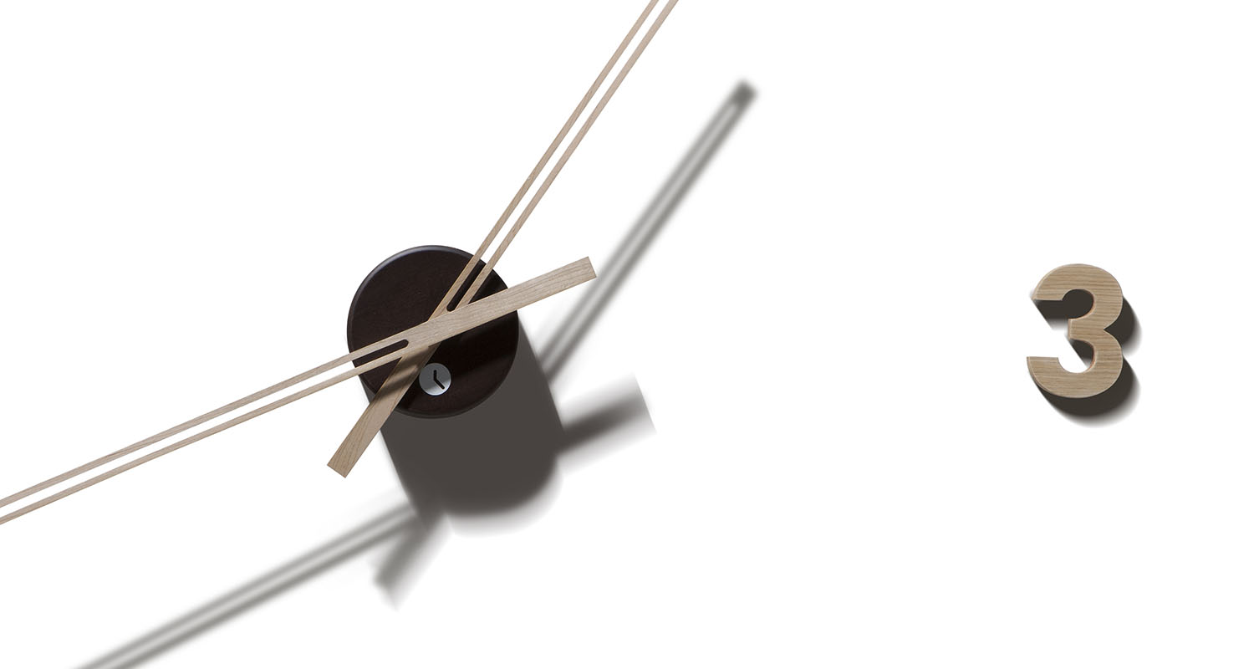

Slide 4
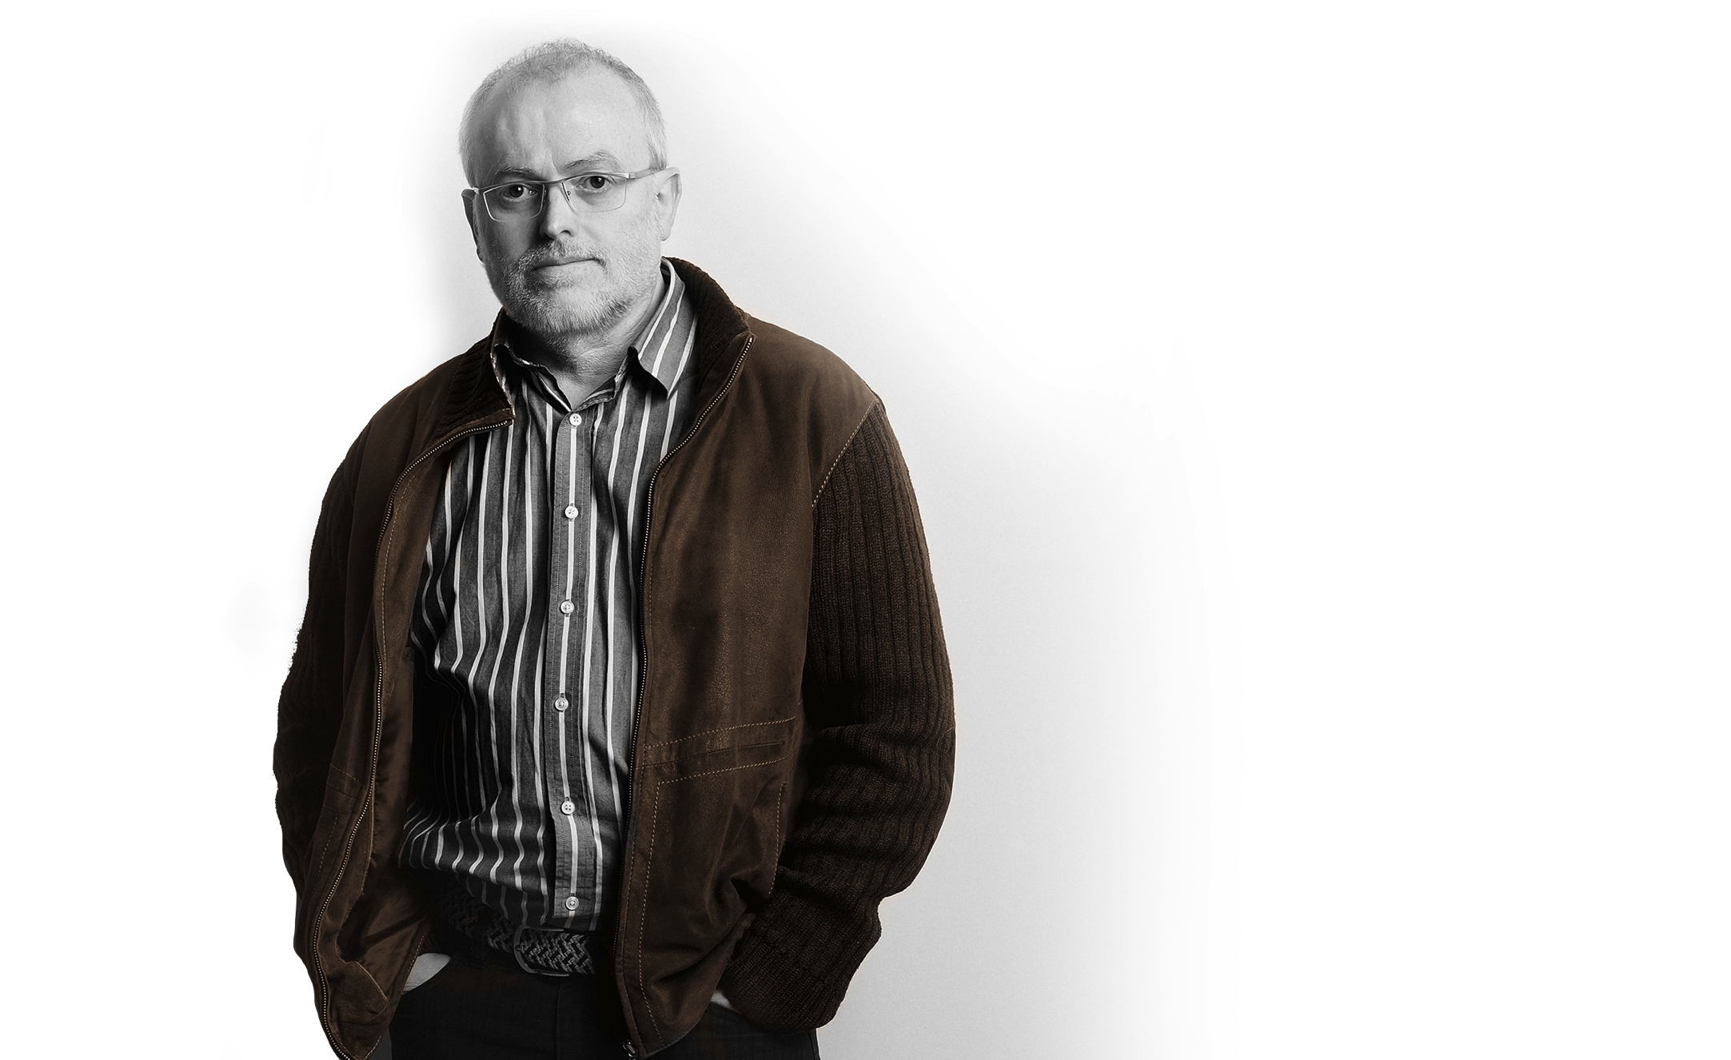
Josep Vera is a designer and CEO of Original Disseny i Comunicació SL. In 2011 gived a shift in his career, which got oriented to clocks design, with a new concept and philosophy.
After developing the ideas and the project, at the beginning of 2012 constitutes the brand Tothora and starts designing activity, manufacturing and clocks comercialization.

Slide 5
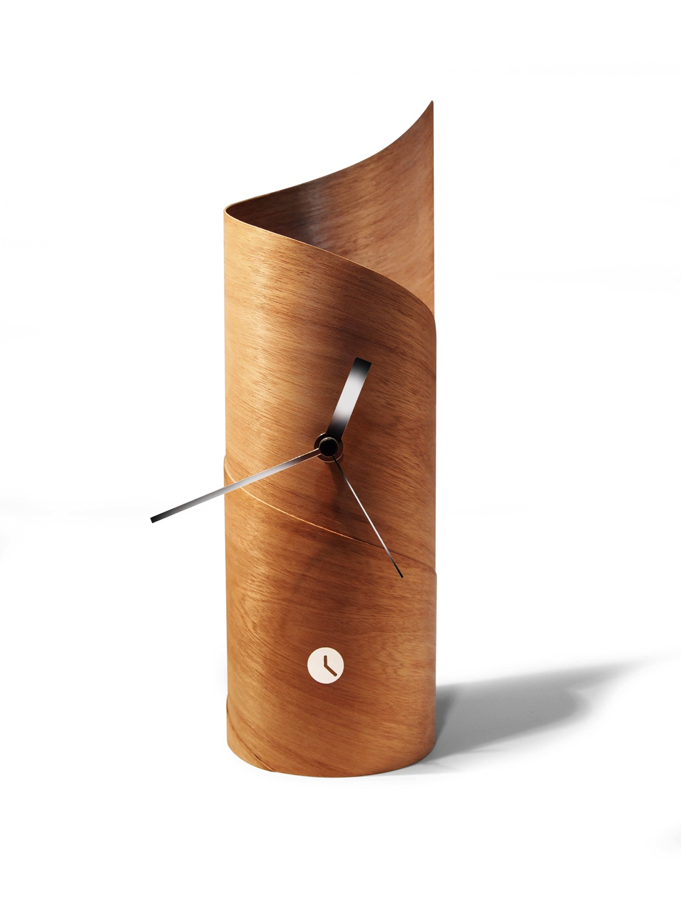
In Tothora we are time passionate, and this brings us to design and manufacture Time Sculptures. Becoming the first creating exclusive pieces and unique for you that also value time and art. Exclusive for its design and unique because they are handmade manufactured by veritable professional carpenter. Pieces with real mediterranean character and made in Barcelona with German machinery , signed by its creator, certifying its authenticity and exclusivity so you can enjoy time completely.

Slide 6
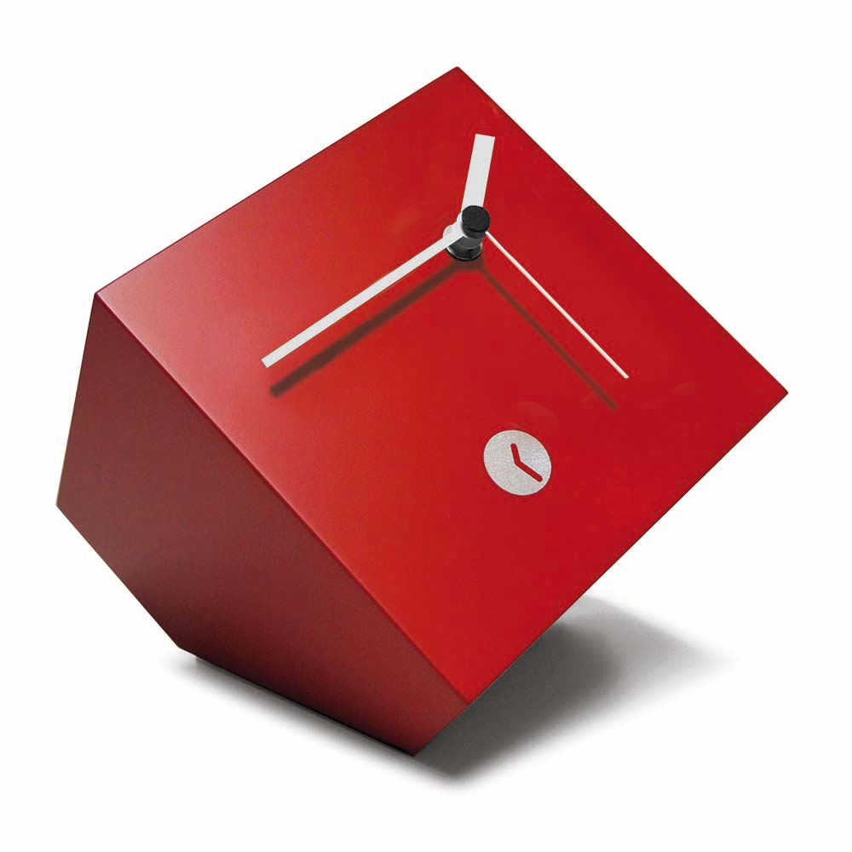
Tothora, time sculptures
Handmade with tradition, creativity, geometric and minimalist shapes, with wood as the protagonist. Time that we want to remember and to revive, concreting scenes that transport us to the most nostalgic memories, pure visual poetry with new scenes to enjoy.

Slide 7
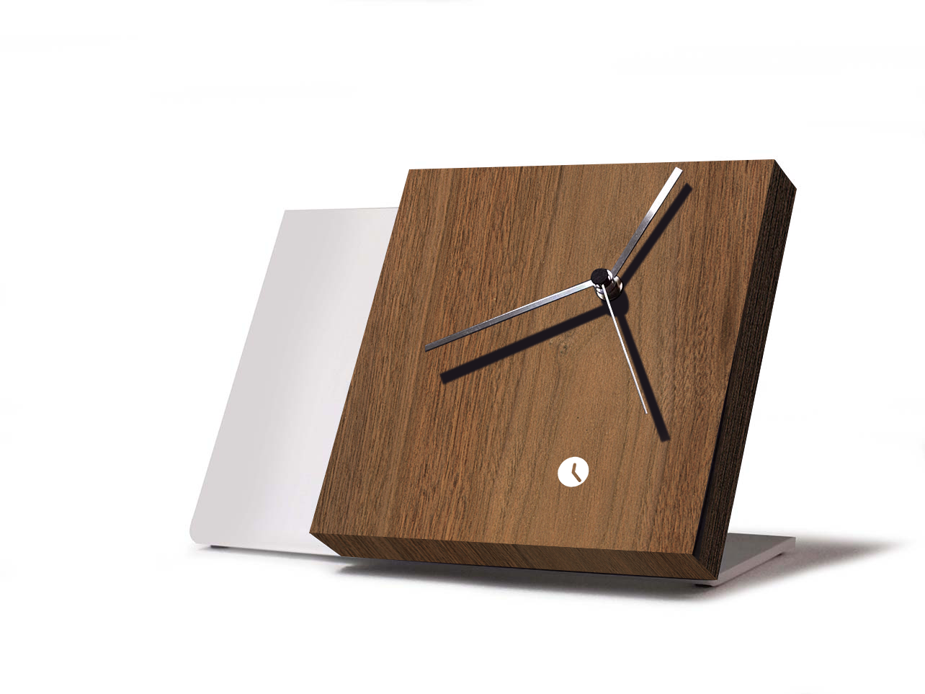
This project was born after the reflections about the measurement and time transcendence. As I explain, “time is a thing that we always miss and that we search continuosly, even if it were possible, we would buy it to have more. Time is a great good for all of us and it's limited, as described by wise, artists and writers. We offer time to live, in different shapes and with a new form of seeing".

Slide 8
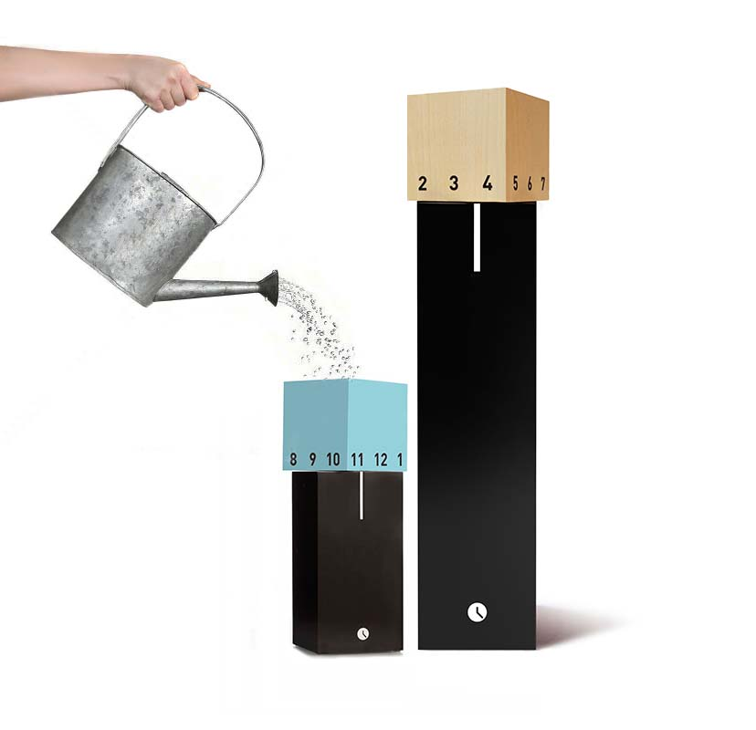
Josep Vera, who defines himself as a time searcher, started a new adventure. And opened a new way in clocks designing world, with the goal to bring to a Tothora clock owner a new time dimension.

Slide 10
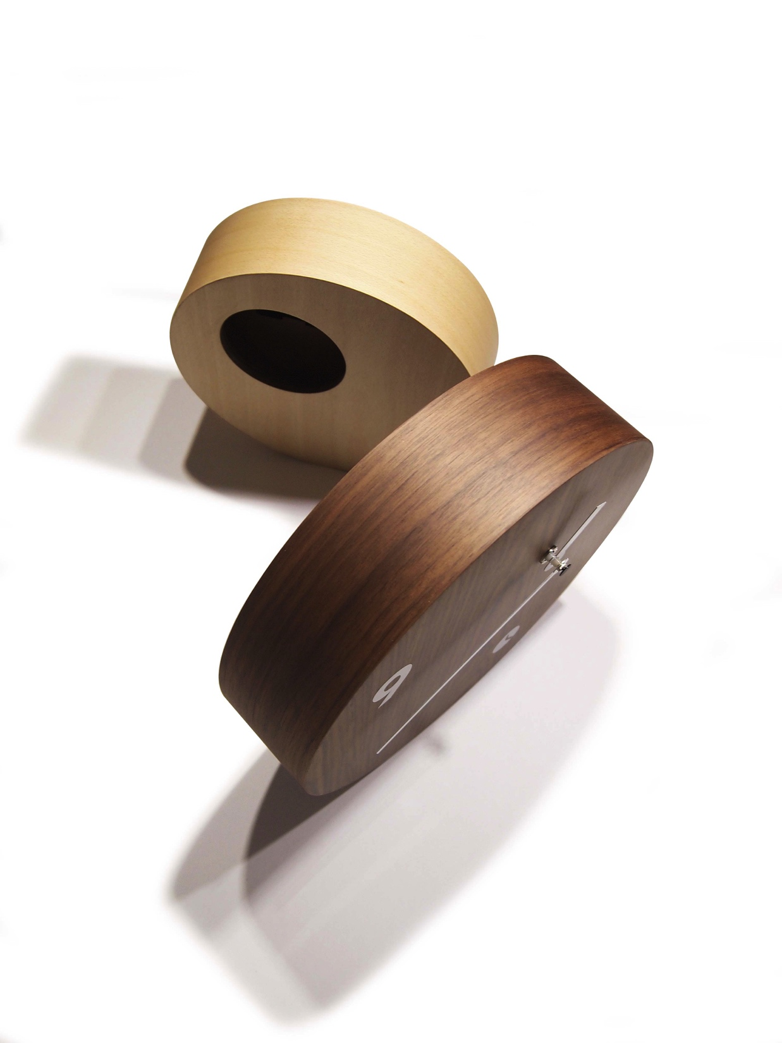
With Tothora, you discover different shapes and materials that give life to objects capable of enchanting, thanks to the essence that seems to find the perfect meeting point between classic and modern style.

Slide 11
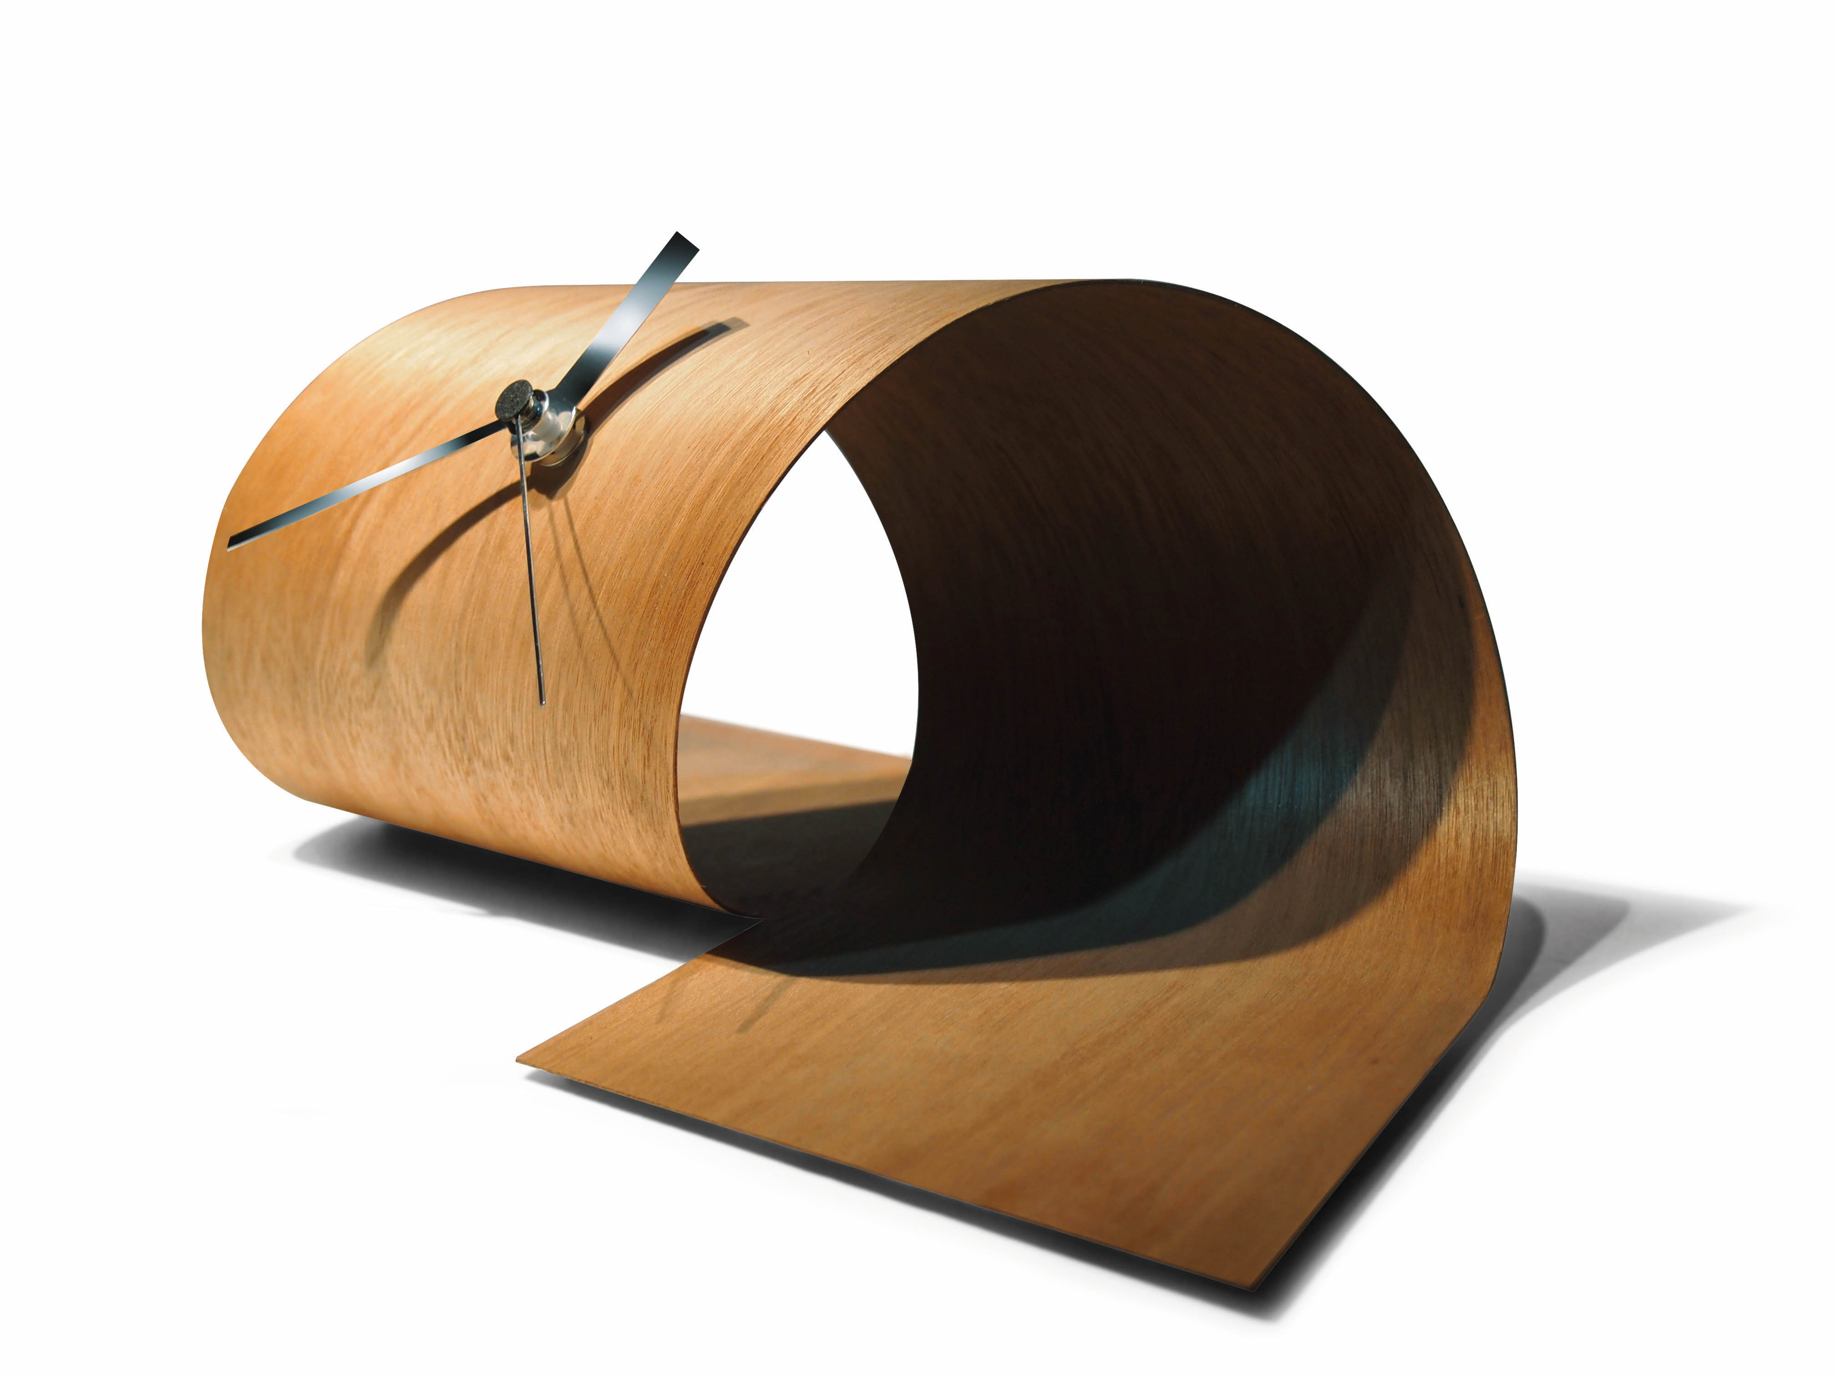
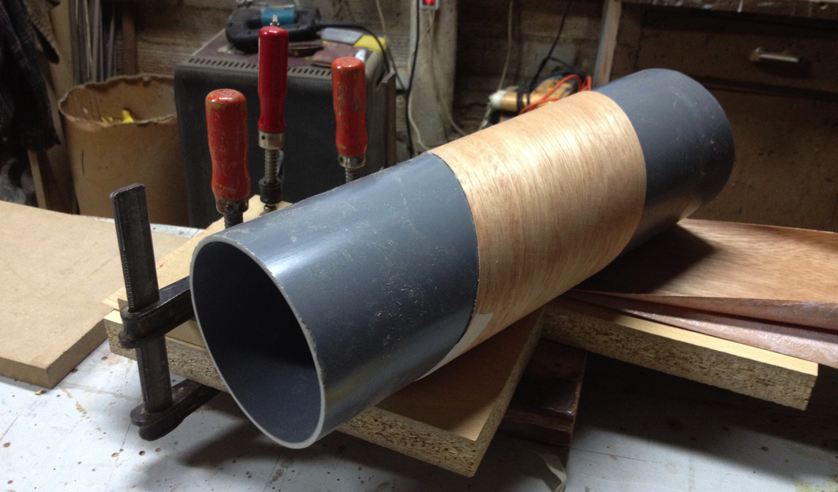
Hand made with high quality wood such as beech, wenge, walnut or teak.
All woods used are 100% natural, from countries with controlled logging from reforested forest, thus ensuring sustainability policy of our environment.

Slide 12
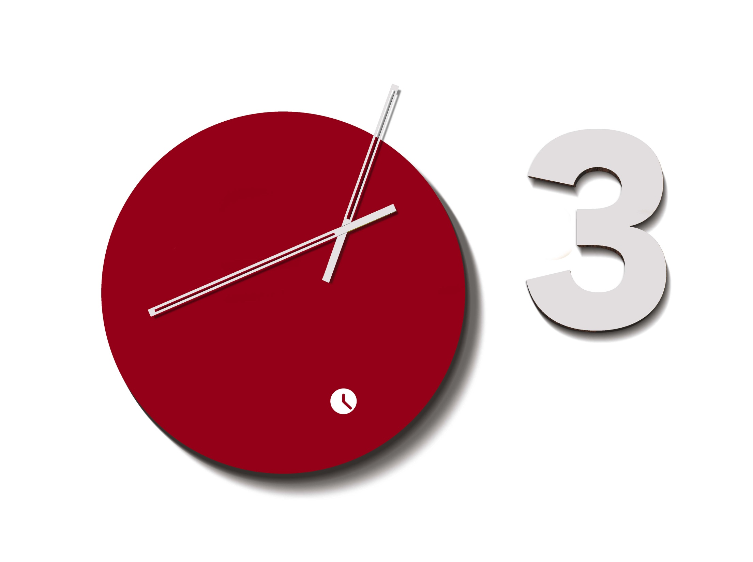
Design with asymmetric needles (displaced of the device center), this is one of the singularities of Tothora clocks and an innovative characteristic patented in Europe.
Needles, in lacquered or plated chrome finishes, also bring a renovated and traditional stamp.

Slide 13
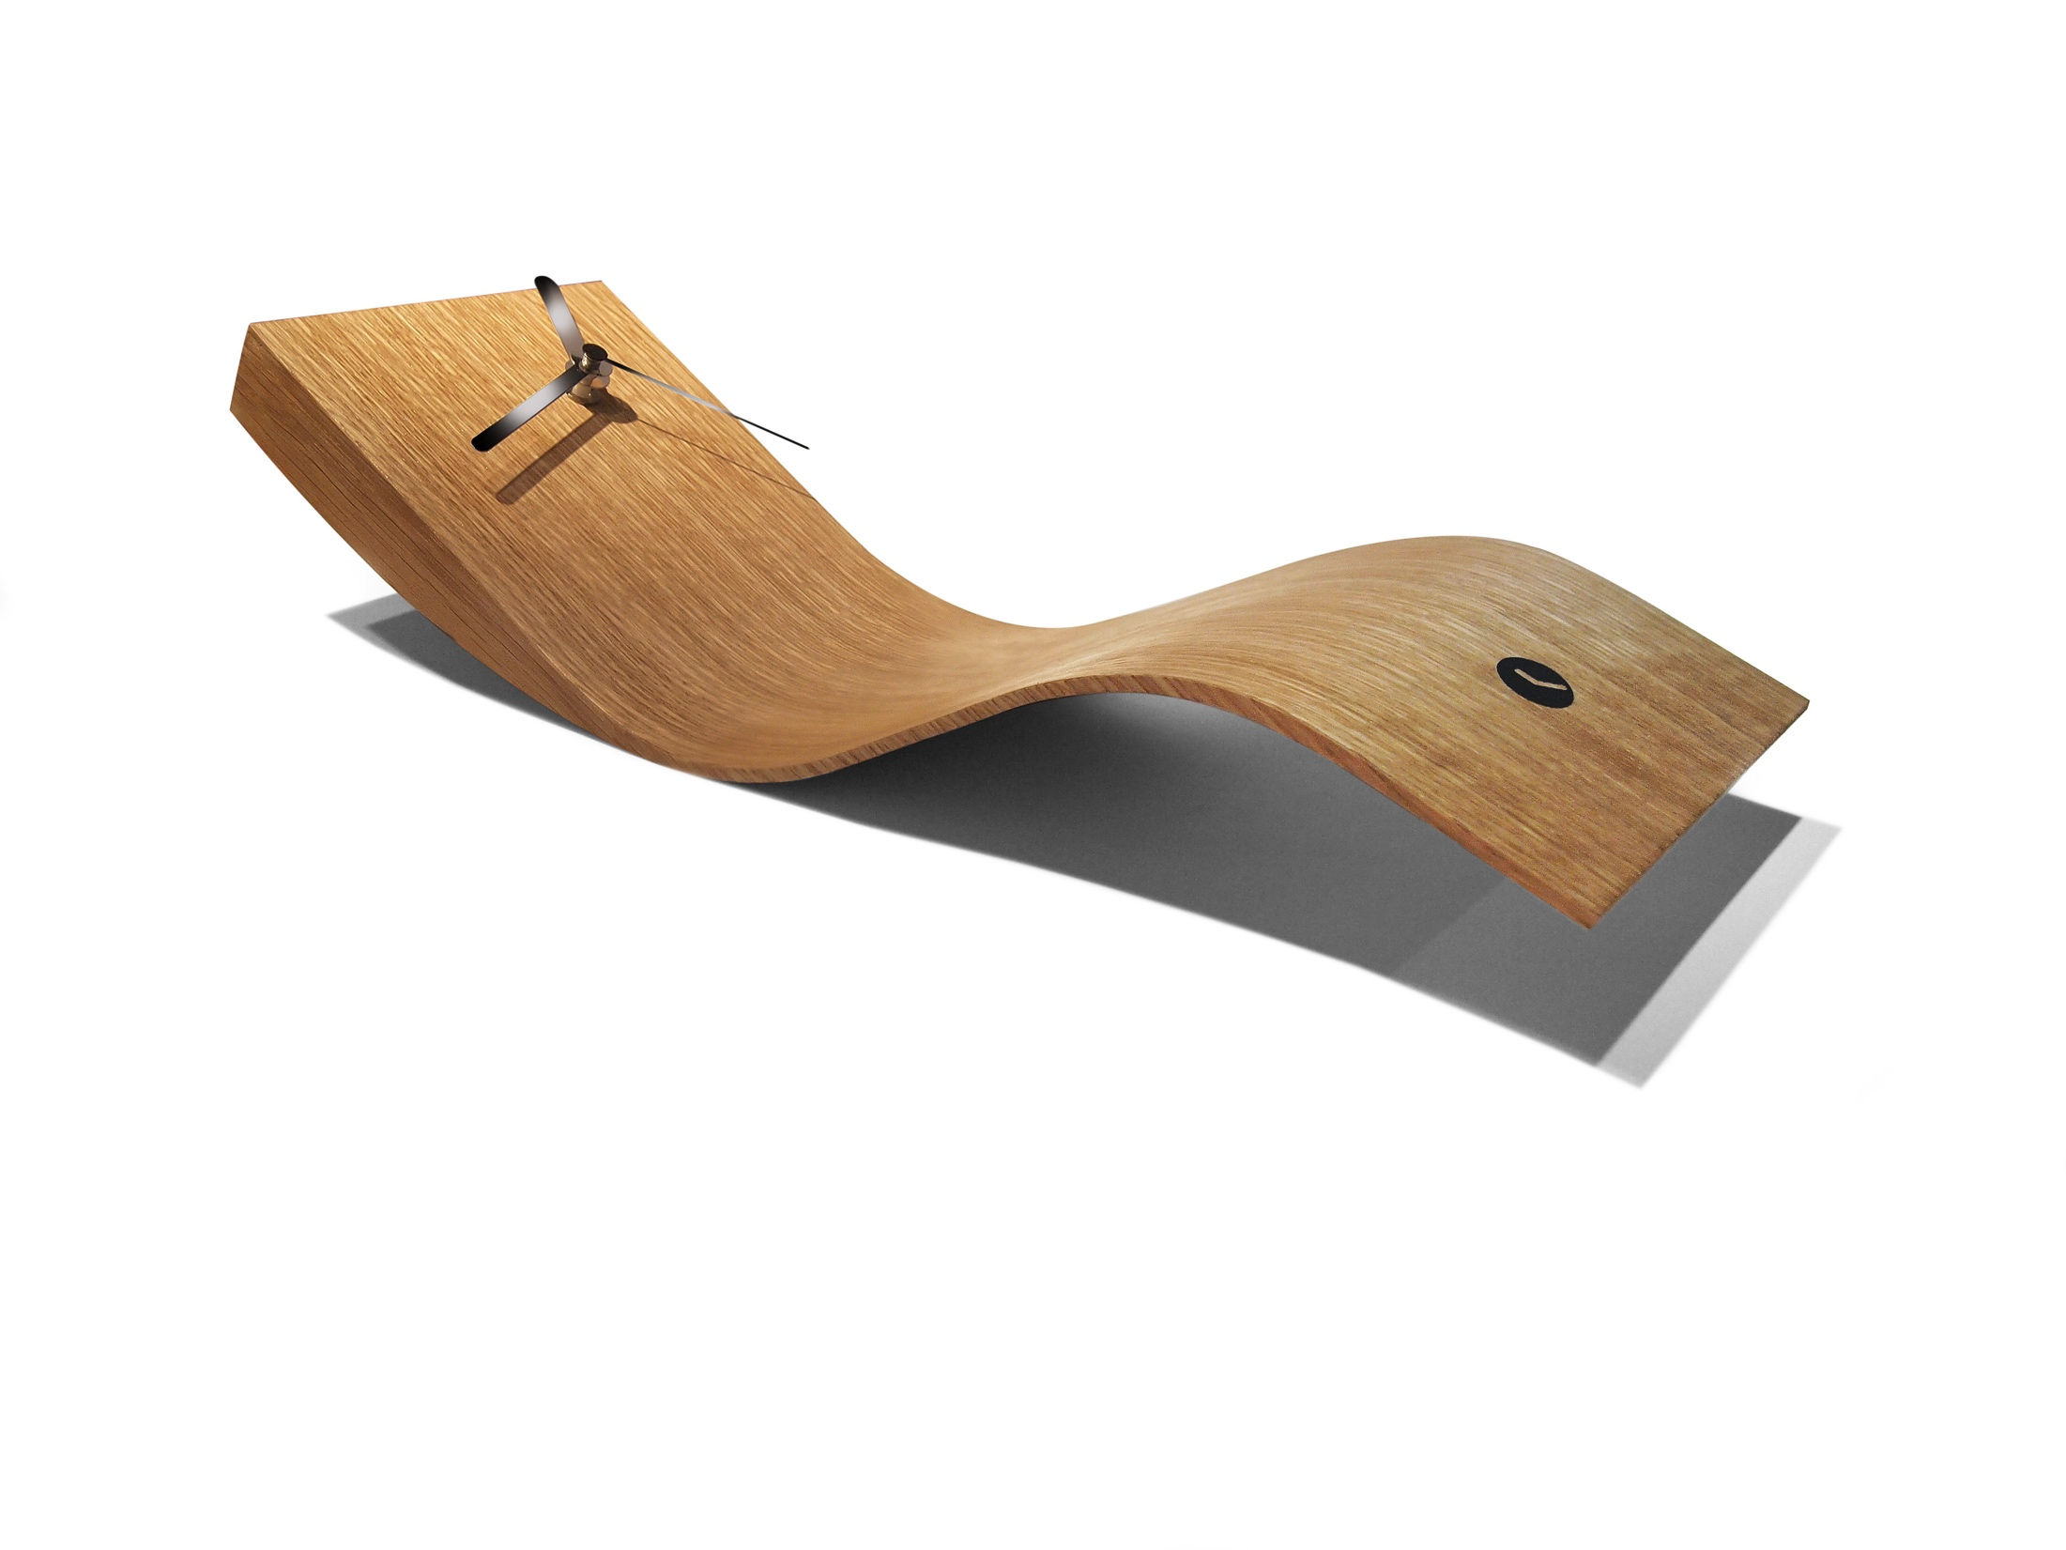
Our range is composed of more than
30 models with exclusive decoration on desktop, wall and floor.

Slide 14
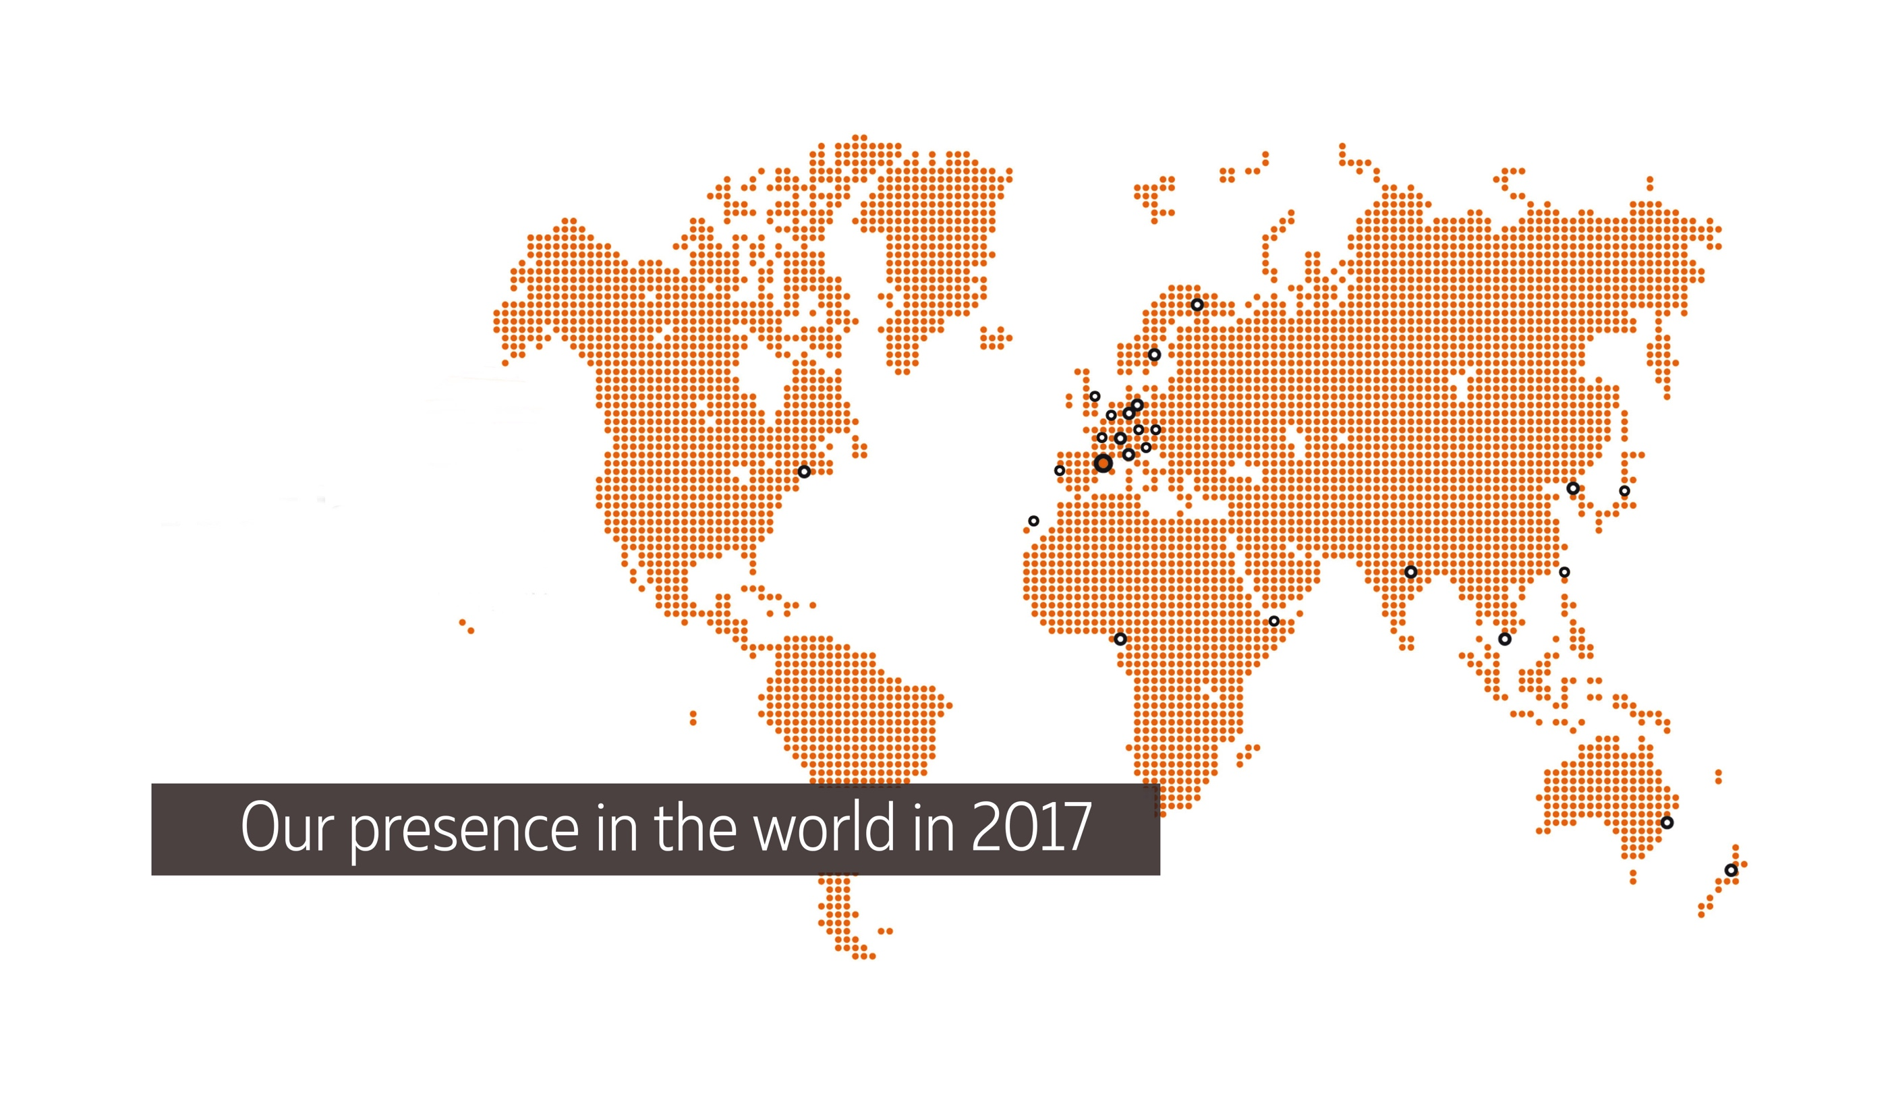
Tothora, you discover different shapes and materials that give life to objects capable of enchanting thanks to the essence that seems to find the perfect meeting point between the classic and the modern.

Slide 15
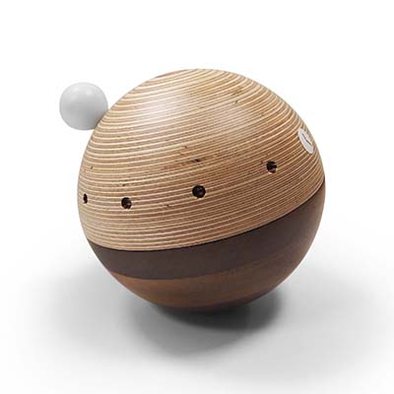
These are some of the countries
where they are present.
· Catalonia
· Canary Islands
· Andorra
· Australia & New Zealand
· Czech Republic
· Finland
· France
· Germany
· India
· Italy
· Japan
· Netherland
· Nigeria
· Poland
· Portugal
· Republik Osterreich
· Slovenia
· Spain
· Sultanate of Oman
· Sweden
· Switzerland
· Taiwan
· UK & Ireland
· United Arab Emirates
· Ukraine
· United States...

Slide 17
Tothora online
and social networks
The company also promotes the shop online, as a distribution and difussion channel of its clocks.
And is also present at the main
social networks.

Slide 18
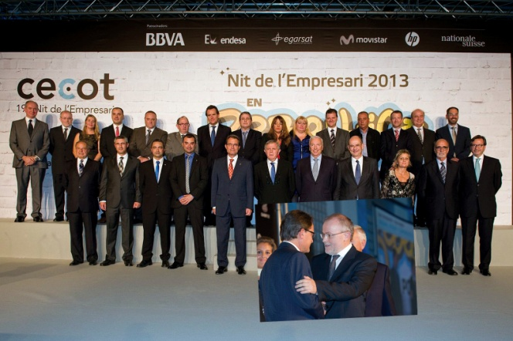
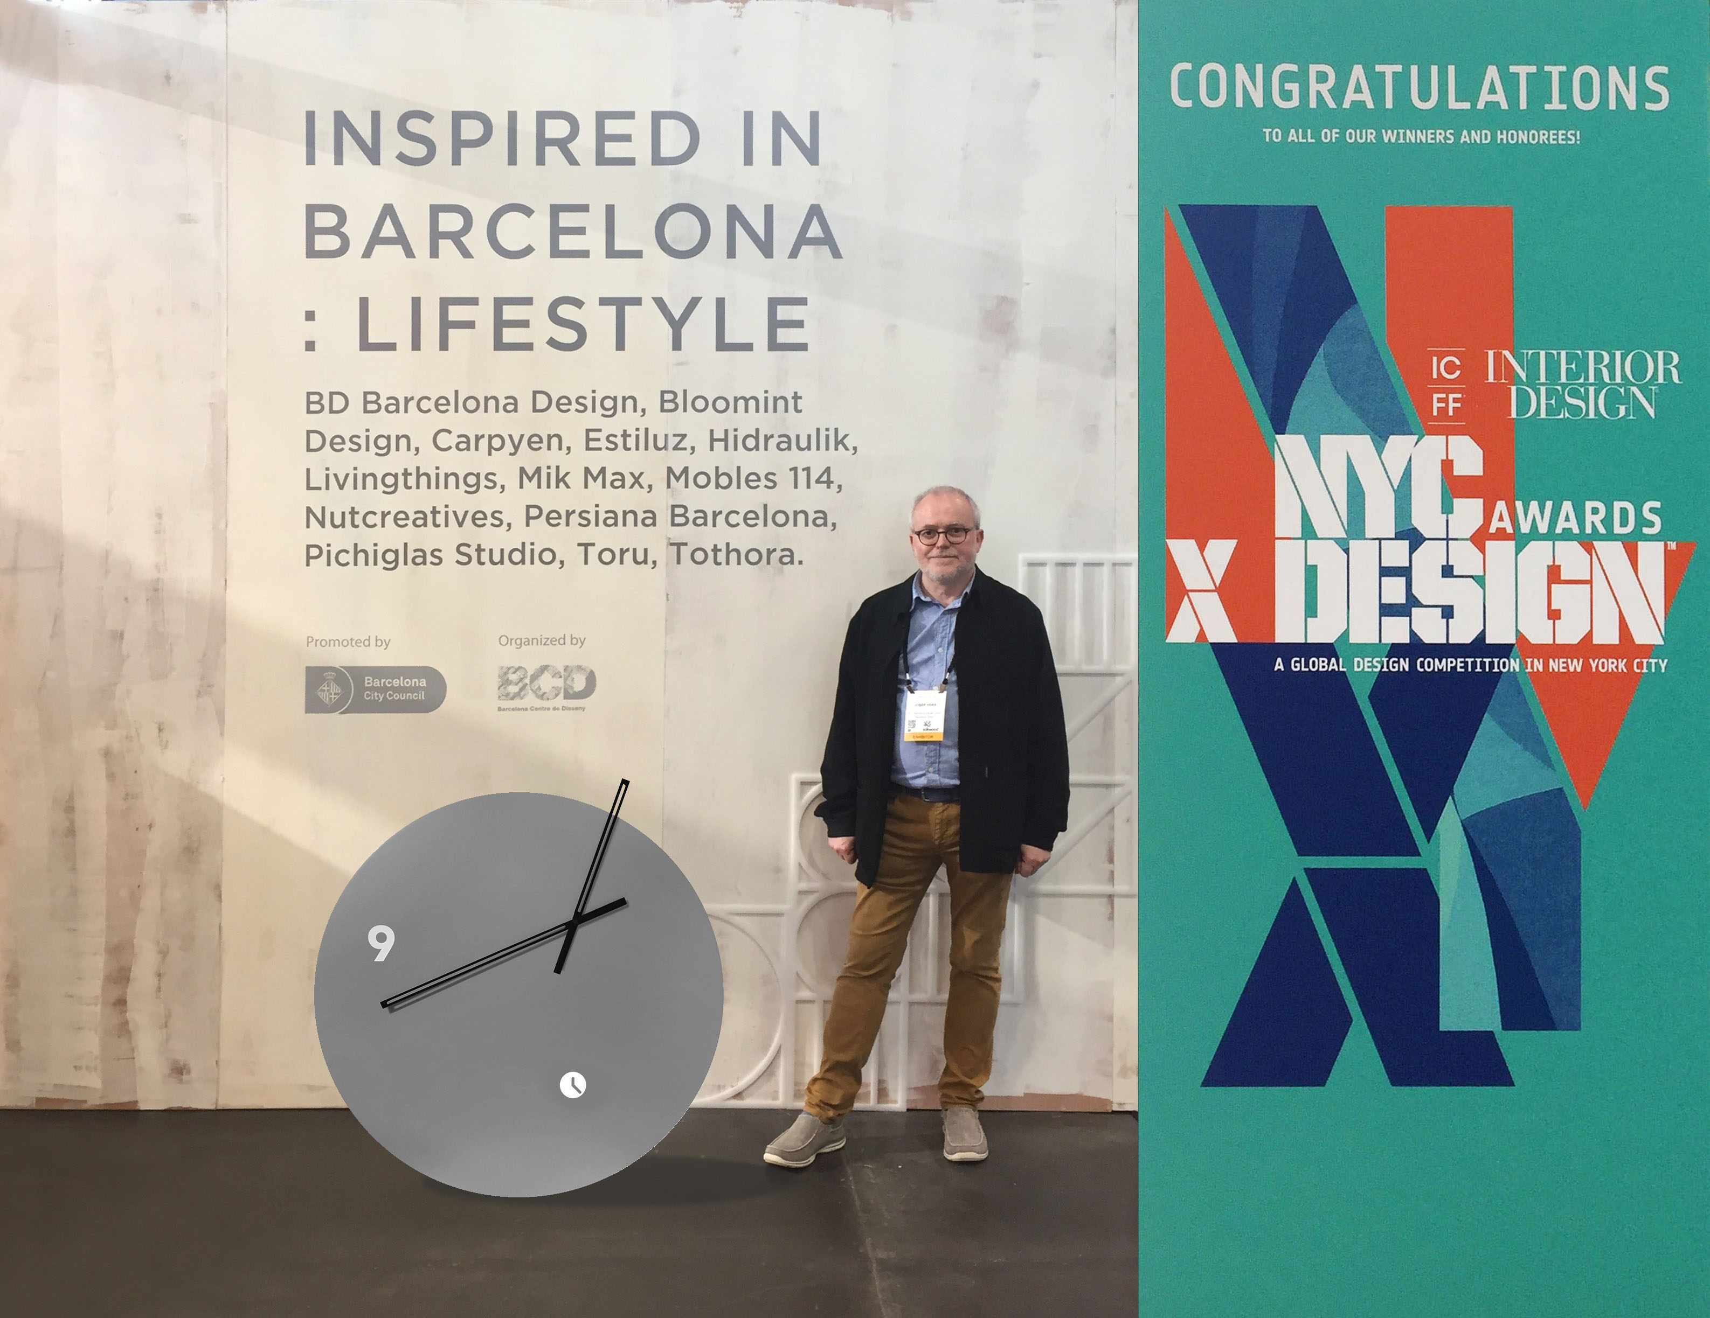
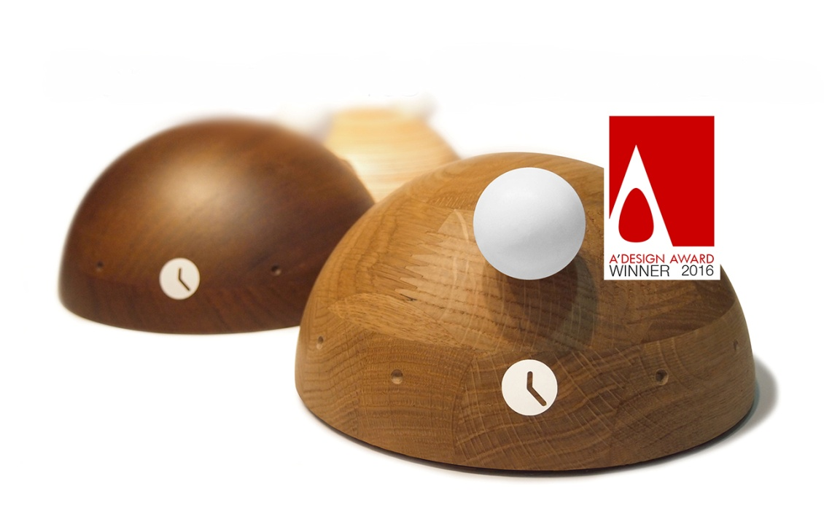
Awards and honour
International awards and recognitions granted are the result of continuous innovation and creativity. This is one of our fundamental values.
In 2013, the company was recognized by CECOT, as “courage to entrepeneur", at the Entrepreneur's Night celebrated in the city of Terrassa.

Slide 19
Tothora press releases

Slide 20
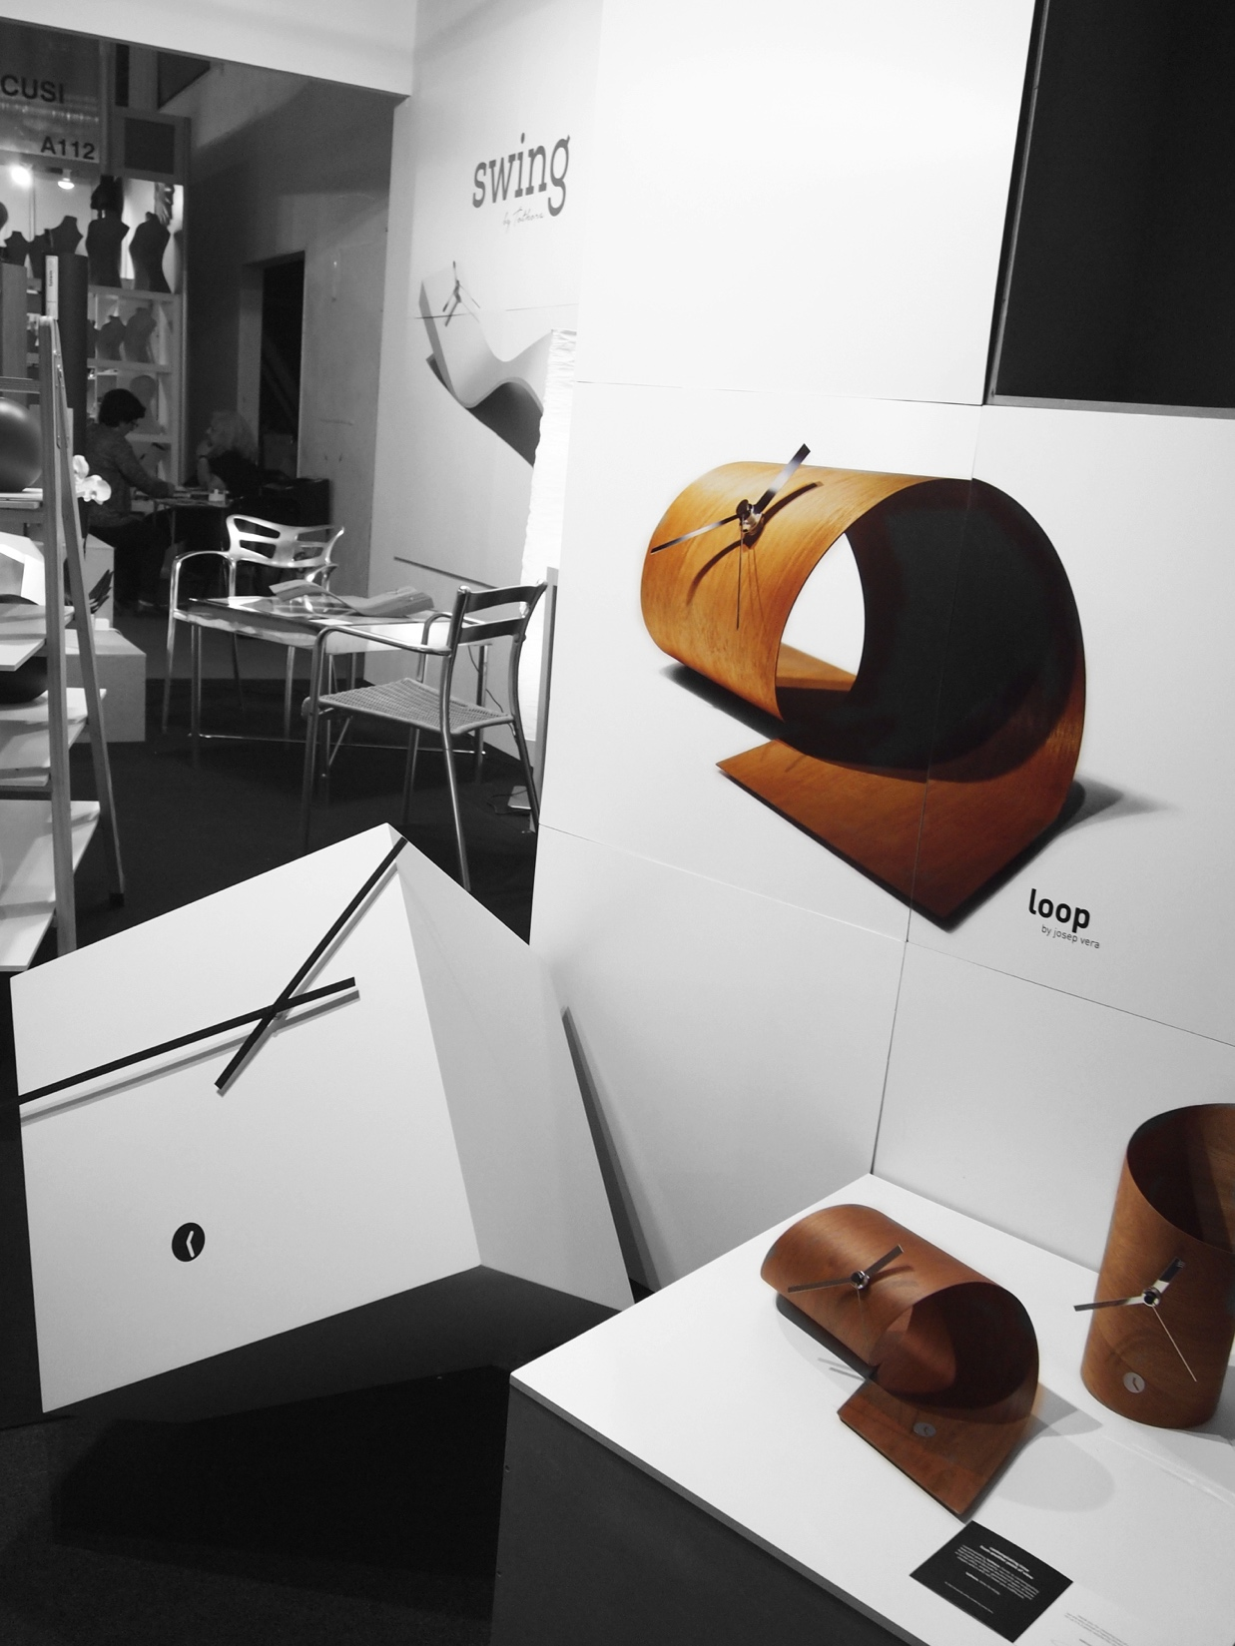
Tothora exhibits in the most important fairs in Europe, Asia and United Estates.
EXPOHOGAR
Barcelona

Slide 21
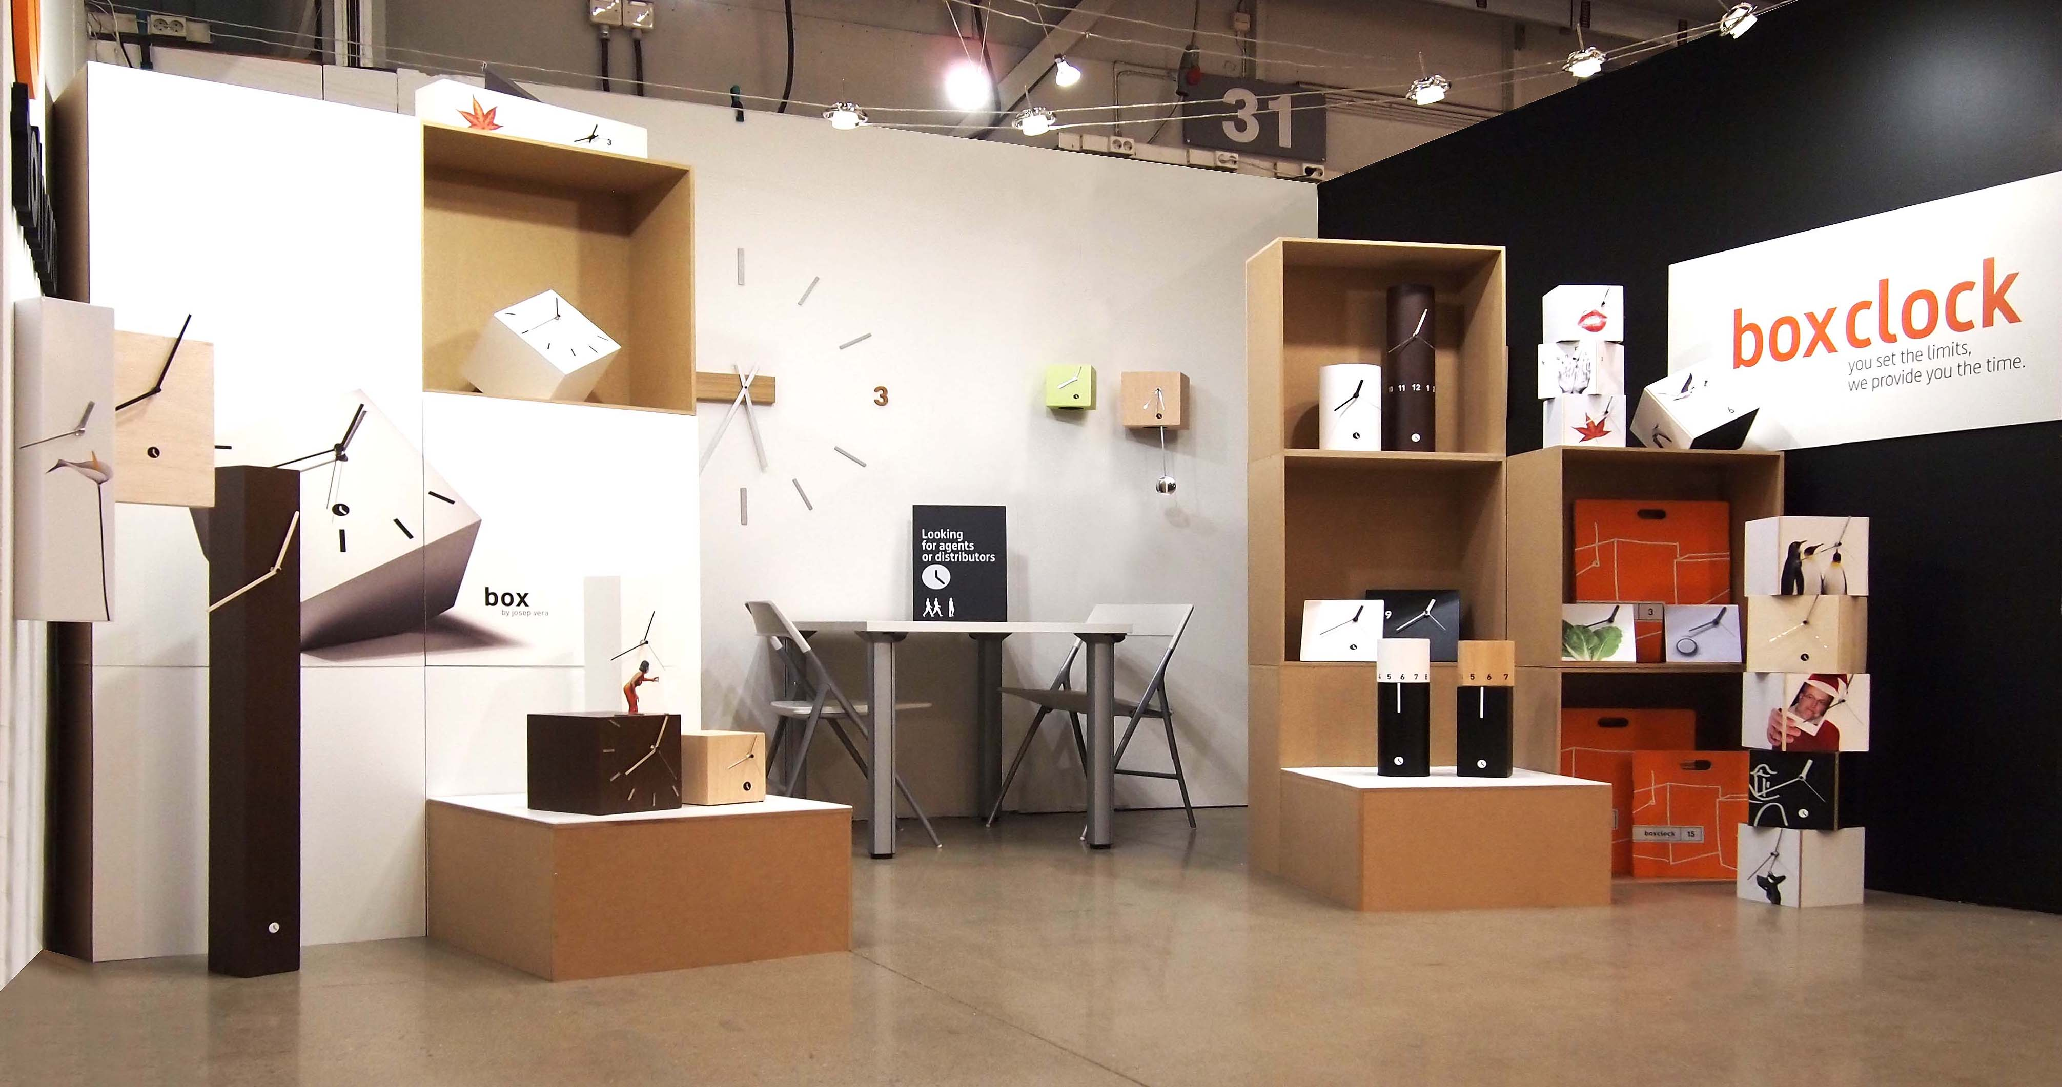
FORMEX . Stockholm

Slide 22
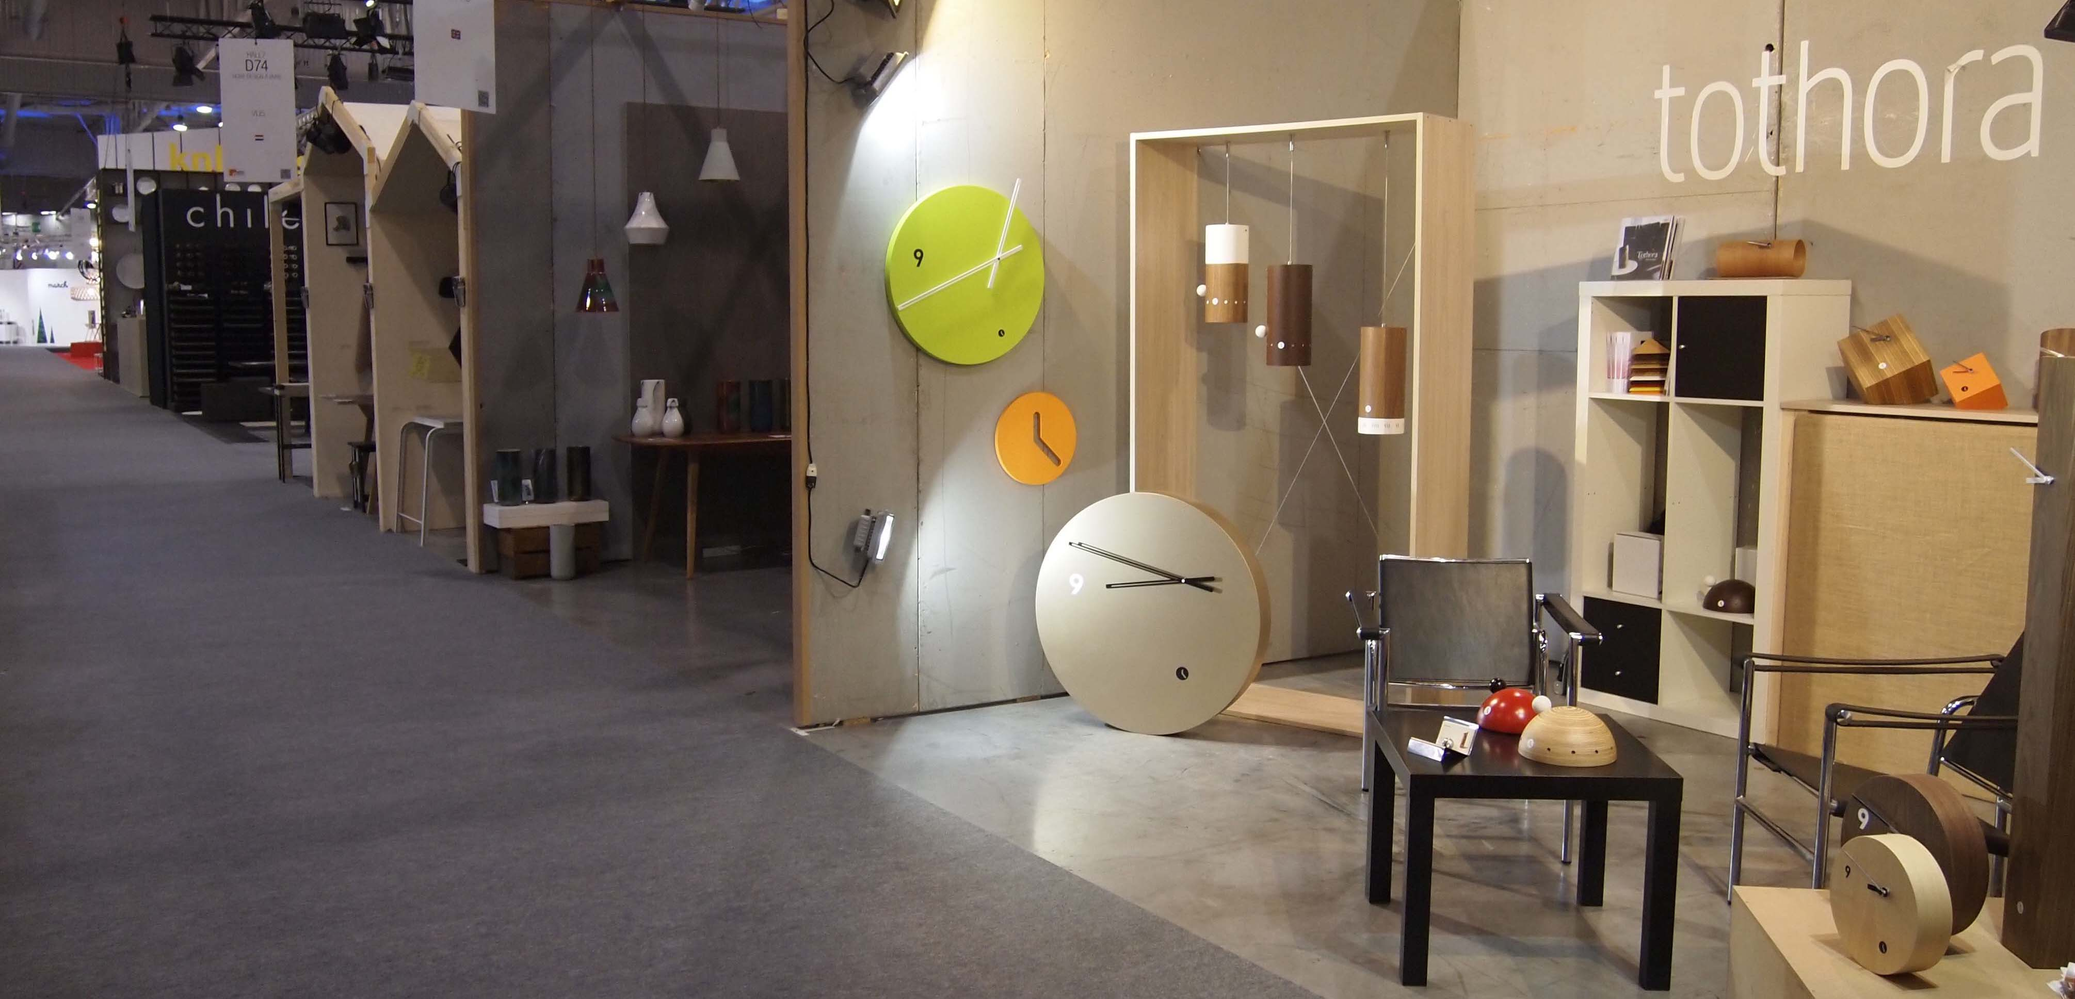
MAISON & OBJET . París

Slide 23
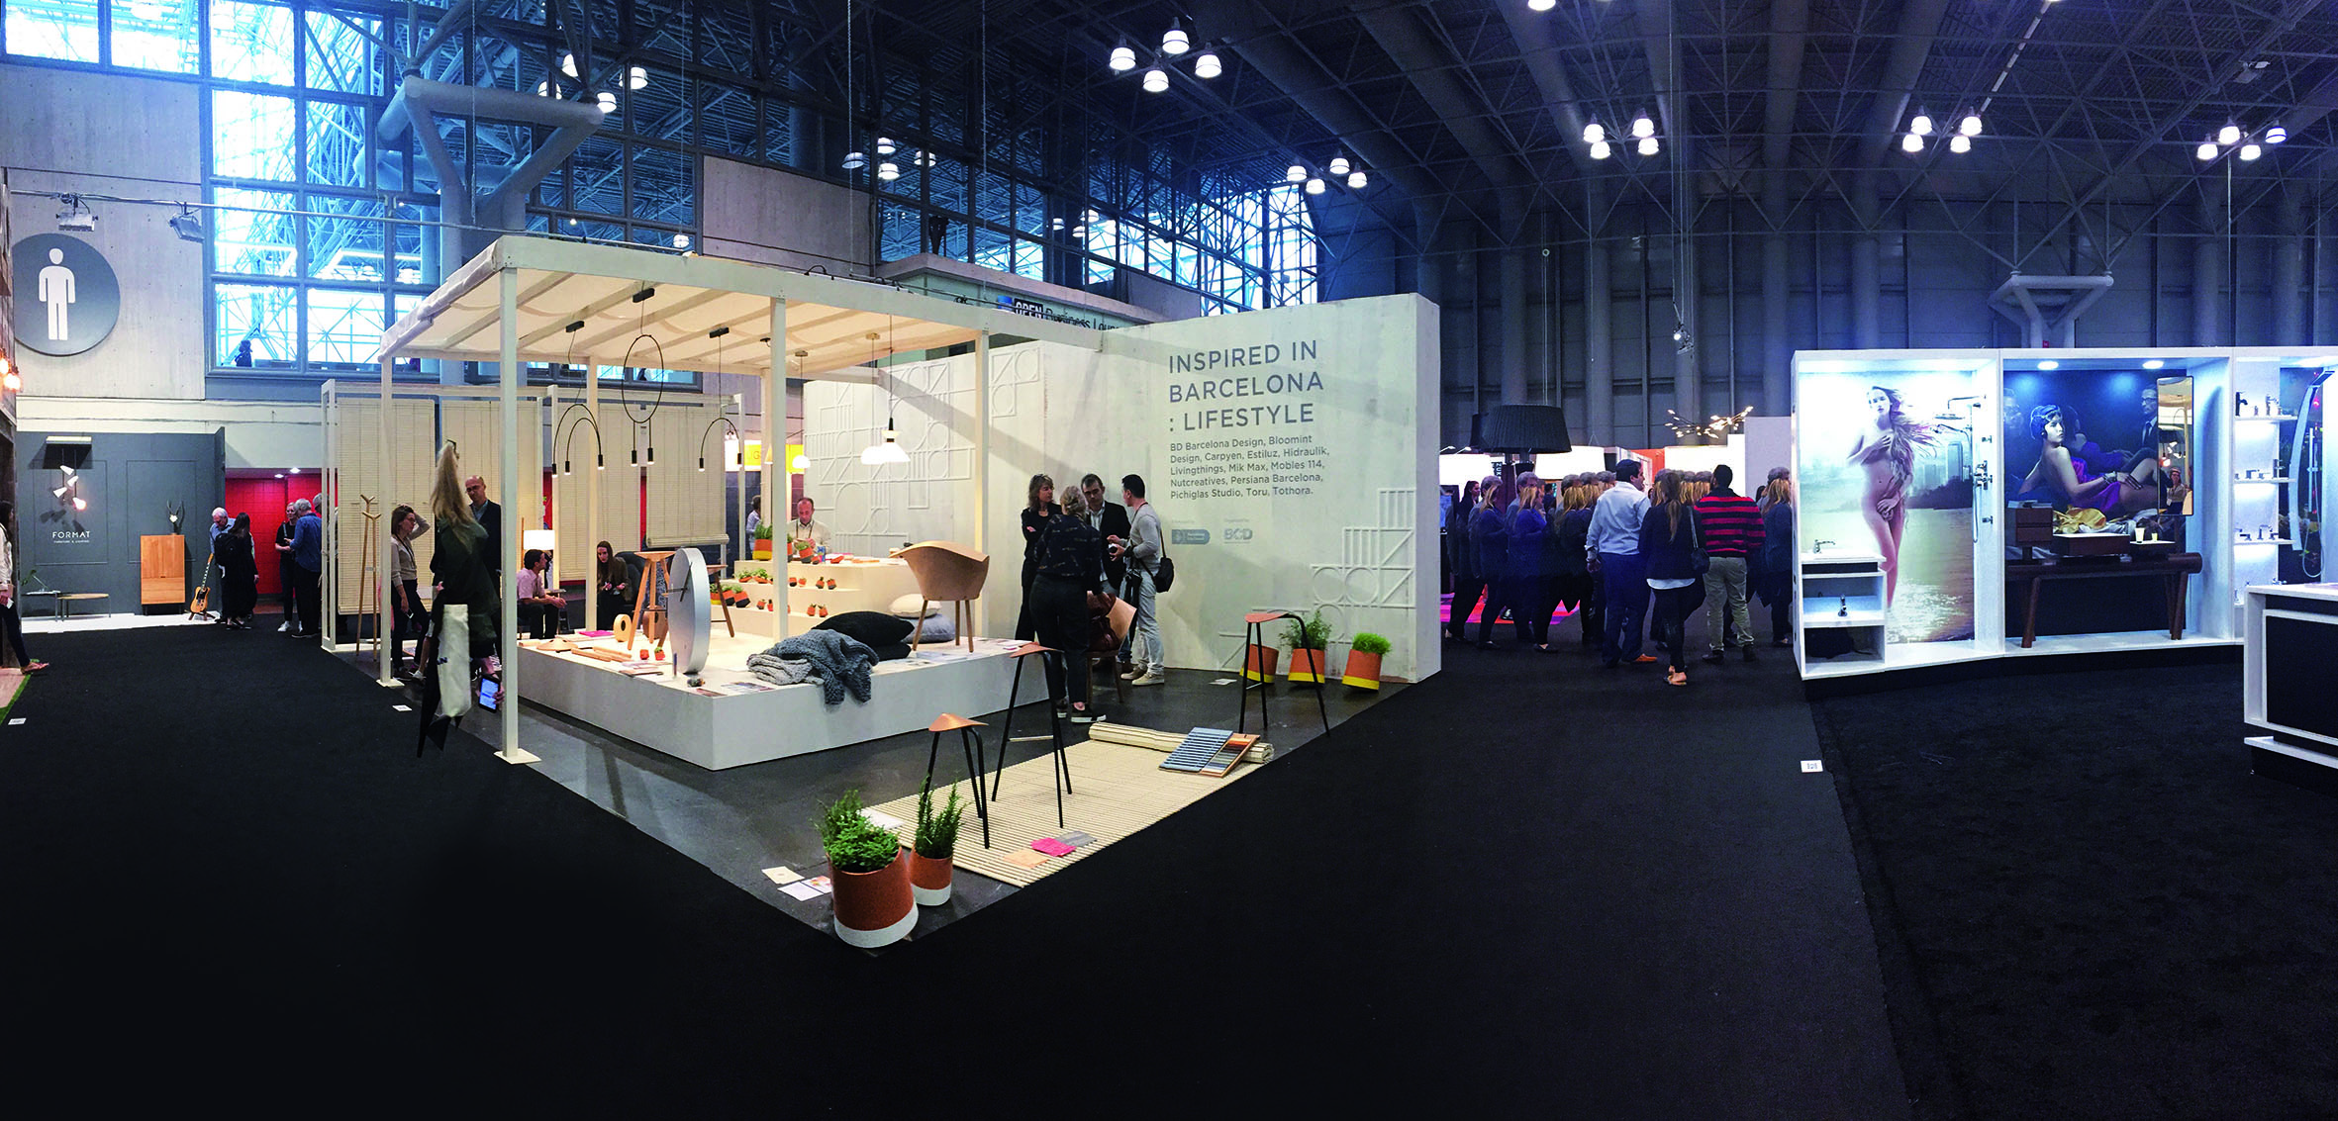
ICFF . New York

Slide 24
Corporate Videos

Slide 27
Thank you!

Slide 28
. com

