Slide 1
Technology park Ljubljana
Building innovation bridges

Slide 2
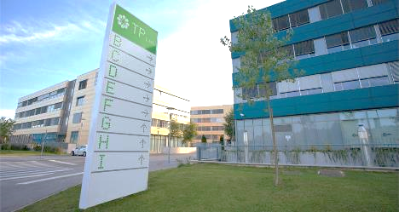
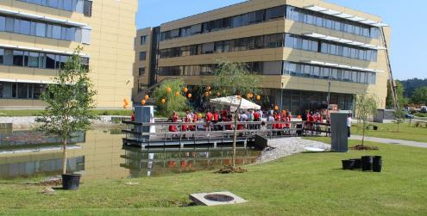
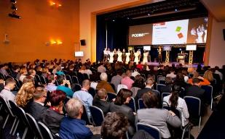
Largest innovation ecosystem for
commercialization of knowledge and technology in SE Europe & lead partner of START:UP Initiative Slovenia

Slide 3
PRIORITY AREAS OF OPERATION
Smart – factories, buildings, living, cities
Health – digital health, cutting edge technologies, advanced medicinal therapies and innovative approaches
Green – manufacturing, living, new environmentally friendly business models.
Creativity – supporting young talents, design thinking processes

Slide 4
TARGET GROUPS AND PARTNERS
Start-ups
SMEs
Policymakers
Research institutions
International networks

Slide 5
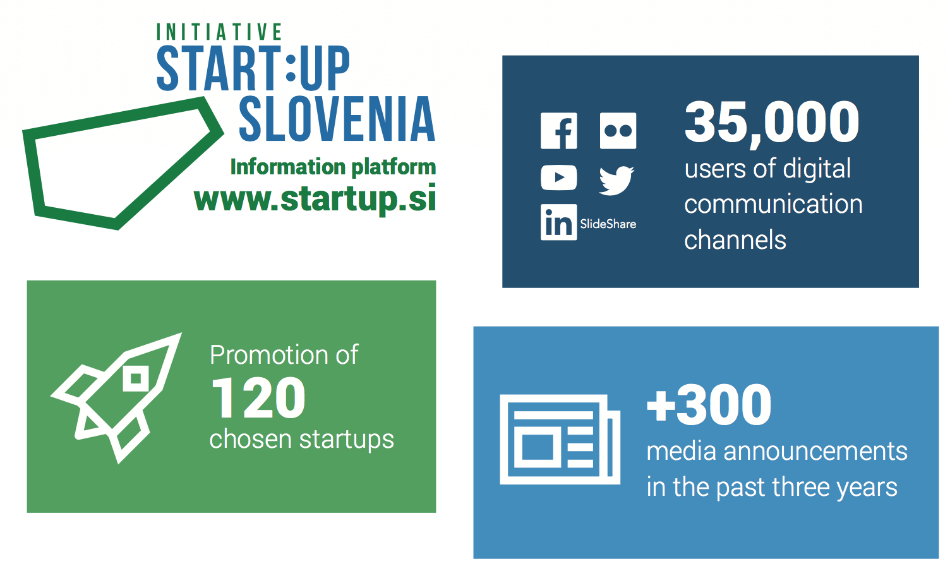
National communication startup platform

Slide 6
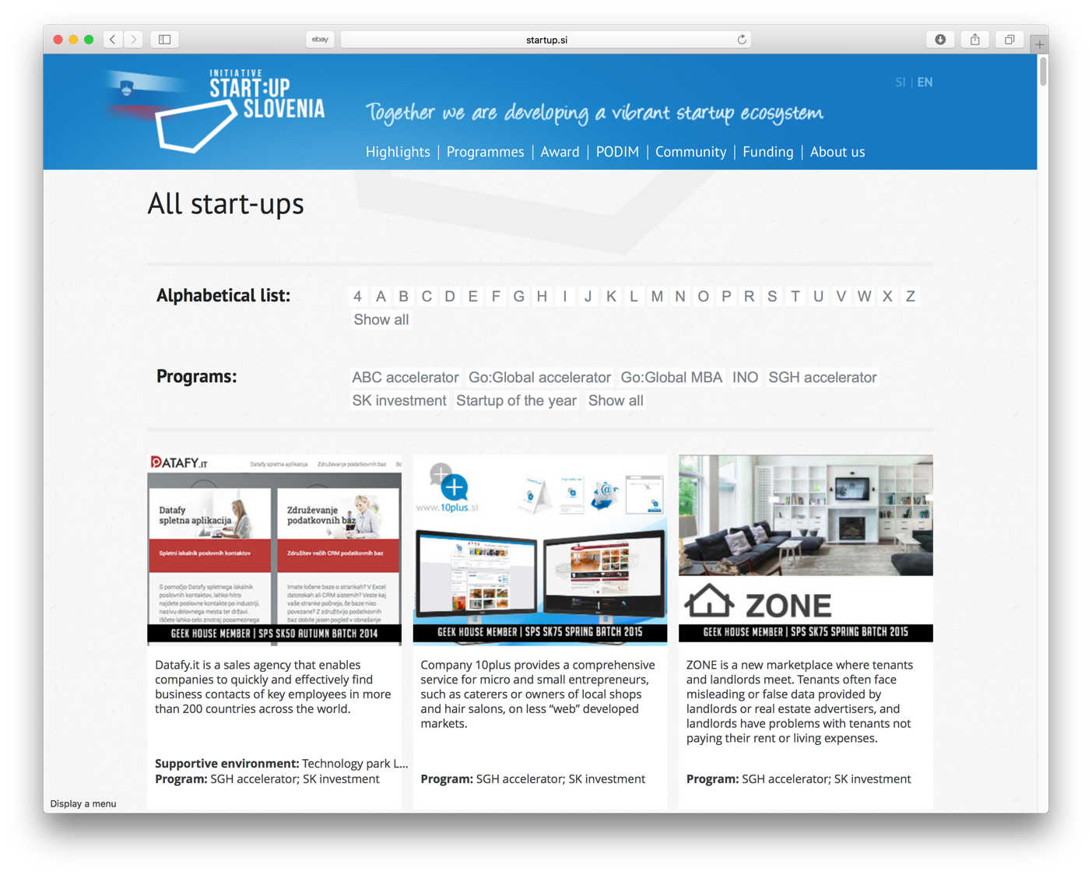
Startup map

Slide 7
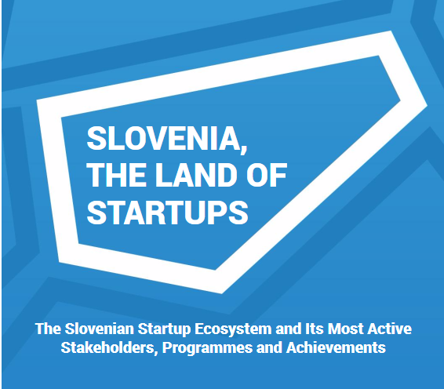
About START:UP initiative

Slide 8
Key partner in public programes for startups – grant P2 and seed capital SK75 in SK 200
P2
+120 supported startups
62 finalist for award Start:up of the year
6 mio € startup grants
SK75
67 invested companies
5 mio € invested capital by SPS
+2 mio € obtained private capital
SK200
11 invested companies
2,2 mio € invested capital by SPS
+1 mio € obtained private capital

Slide 9
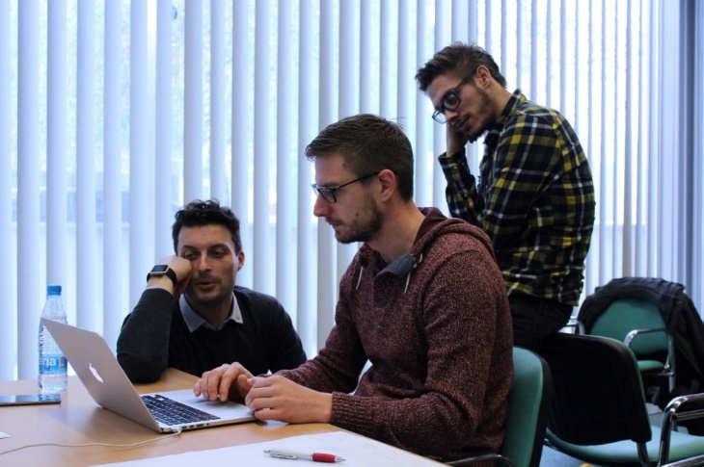
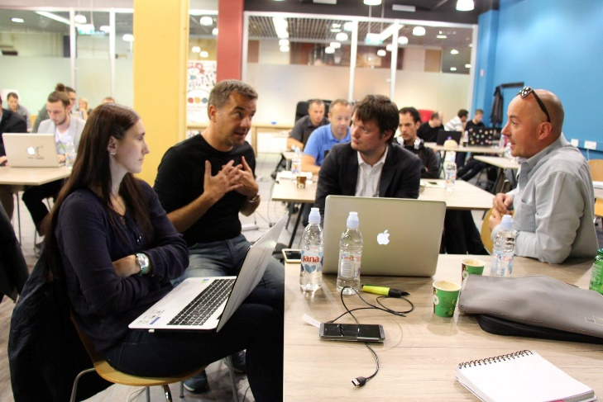
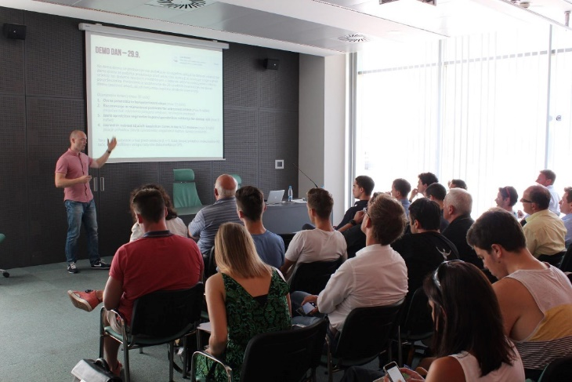
Before seed capital investment
Roadshow events around Slovenia
Pre-selection process
Demo day rehearsal
Demo day
Final selection for obtainment of grants – public loans and seed capital.

Slide 10
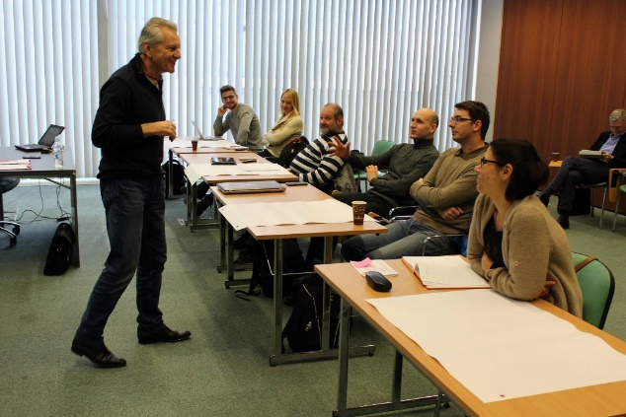
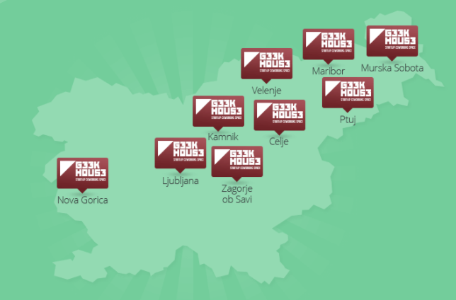
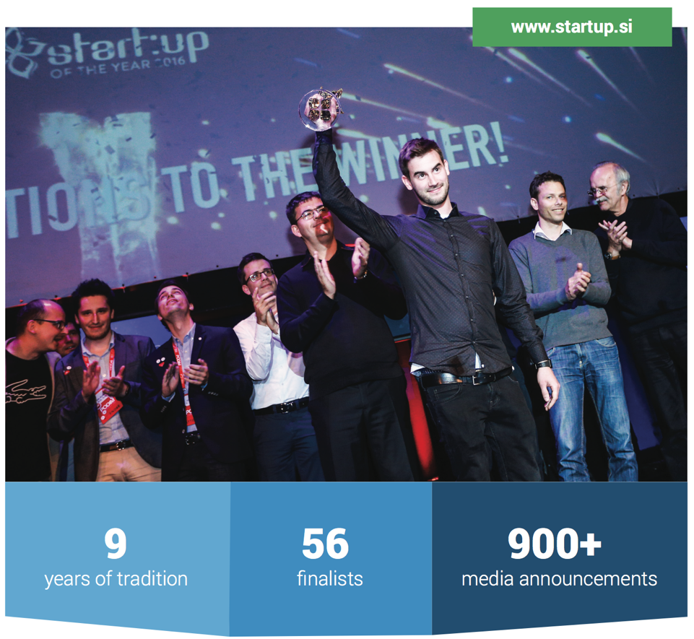
After seed capital investment
Start:up Bootcamp
Startup mentor
Monthly progress monitoring
Facilities around Slovenia
SK teambuilding
Local and global promotion

Slide 12
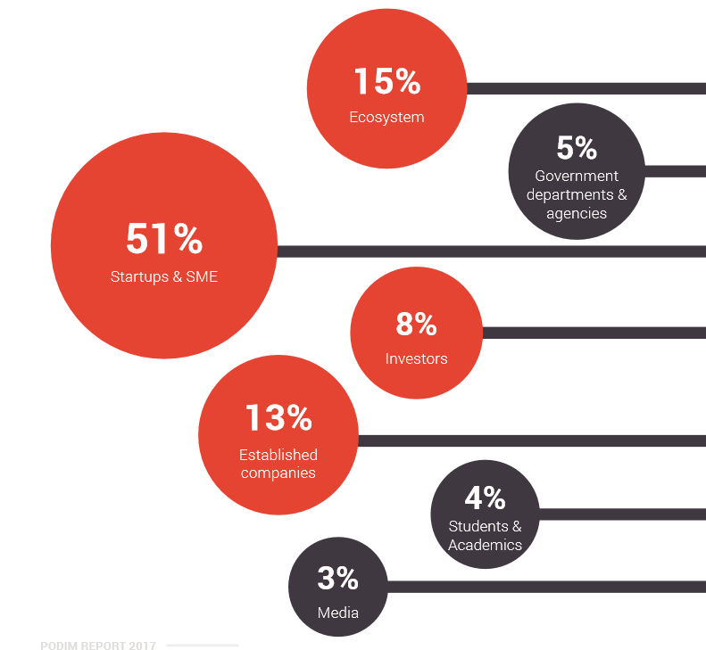
PODIM Conference 826 ATTENDEES FROM 33 COUNTRIES

Slide 13
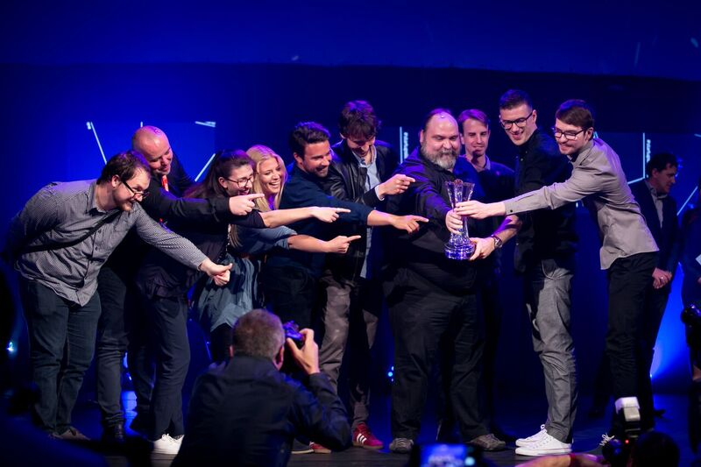
Slovenian Startup of the Year Award We are looking for, highlighting and awarding ambassadors of Slovenian startup entrepreneurship
VIAR – Startup of the year 2017

Slide 14
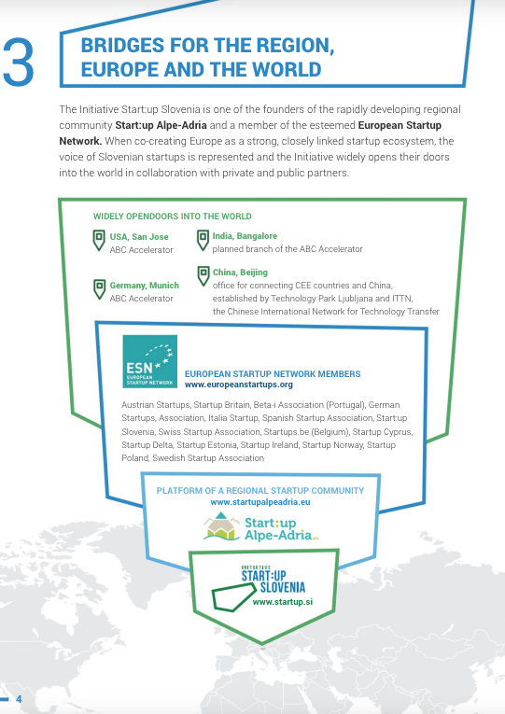
From local to global

Slide 15
THANK YOU FOR YOUR ATTENTION!
Marjana Majerič, deputy general manager
Marjana.Majeric@tp-lj.si

