Slide 1


TALIA MED PROJECT INTERNATIONAL SEMINAR
“INNOVATION AND CLUSTERING IN THE CREATIVE AND CULTURAL INDUSTRIES”
THE INTERNATIONAL SEMINAR PURPOSE
By Thanos Contargyris – UHCC Expert
Ljubljana, October 4th, 2017

Slide 2

The TALIA project
The TALIA project, is an Horizontal of Interreg MED programme on Creativity and Social Innovation, started in late 2016 and ending in late 2019
The project is led by Apulia Region (IT) with 5 partners:
  Fernando de los Ríos Consortium (Spain)
  European Network of Living Labs (Belgium)
  Union of Hellenic Chambers of Commerce & Industry (Greece)
  Agency for Economic Development of City of Prijedor (Bosnia-Herzegovina)
  National Institute for Research in Computer Science and Applied Mathematics (France)

Slide 3
TALIA mission
The TALIA project is aiming at building and developing the Social & Creative community within the Interreg MED Programme, by boosting cohesion, coherence & synergies among Interreg-MED projects promoting creativity and social innovation in Culture and Creative Industries (CCI).
TALIA deals currently with 6 projects involved in this field, covering a wide part of it.
TALIA supports them in exchanging their experiences and their results, in sharing common concerns and vision, in promoting their policy recommendations and in unifying their local and trans-local networks.

Slide 4
TALIA Focus – Currently 6 projects
Project | Full title | Keywords
CHIMERA | Innovative cultural and creative clusters in the MED area | CCI Innovation system/strategy; Innovative tools&services; Innovative financial instruments; Services for internationalization and innovation;Innovation business plan
Co-Create | Setting up a network of COmpetitive MED Clusters with the contribution of CREATive industriEs | Cross-innovation; innovative tools&services; Innovative financial instruments; IPR instruments; Creative cumps tools; Innovation processes and products
CoWorkMed | Social Innovation Research On Coworking Clusters | Coworking/HuBs; Innovative ideas; Open innovation; Innovative tools&services
CreativeWear | Creative Clothing for the Mediterranean Space | Cross-innovation; Coworking /HUBs; Creativity-based business model innovation
Open DOORS | Designing a network of cOOperating cReative communities for developing a Sharing economy | Sharing Economy; Coworking/HuBs; Innovative tools&services; Innovative financial instruments/Crowding
Prominent MED | Public pROcureMent of INnovation boosting greEN growTh in MED area | Public Procurement of Innovation (PPI); Innovative financial instruments; Innovative ideas; Innovative products

Slide 5
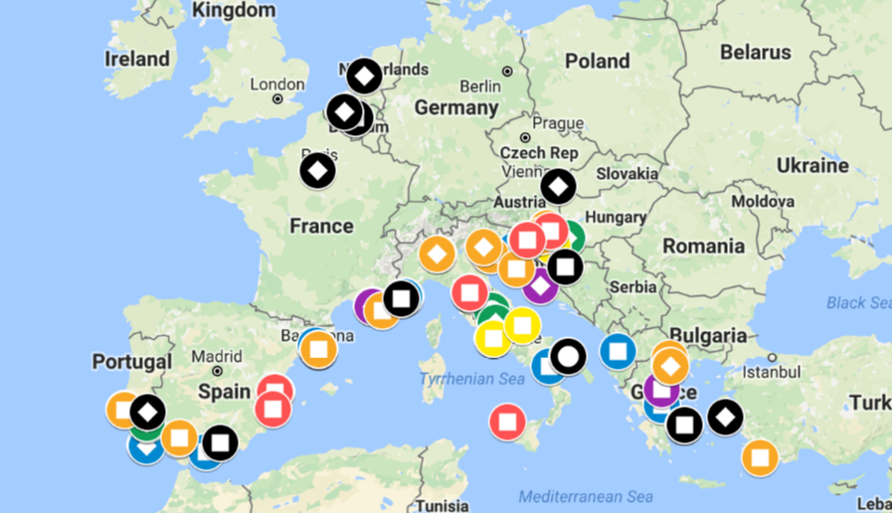
TALIA Community: large and growing
https://www.google.com/maps/d/edit?mid=1pcHJrGpDkcLznhC-RAsFbhbmfVA&ll=44.1688703812966%2C9.491878850000035&z=5

Slide 6
TALIA support to the Community
Scaling Up Consolidation of results | Scaling Out Geographical extension of results
Policy Learning What goes through | Policy Impact What is (will be) used to transform policies

Slide 7
This Seminar: A high to low level approach
We propose a follow-up of the work of the MED thematic communities framework “Modular and Horizontal projects, a living architecture”.
We expect to develop cohesion of the Social & Creative community by facilitating engagement of the local clusters of stakeholders in Slovenia (SMEs, Academia, Public actors, etc.) involved in the Cultural and Creative Industries and Social Innovation developments in transnational clustering processes.
We intend to highlight innovation and to cluster evidence on the creative and cultural industries from a specific project (→ the seminar is organized during the ChIMERA modular project meeting) on a specific topic (→ the seminar is backed to an International Conference “Creative exchange and investment forum for Cultural and Creative sector”)

Slide 8
Agenda – part 1 - opening
Purpose of the Seminar | Thanos Contargyris - UHCC Expert | 10’
TALIA Project: the Social & Creative community | Gaetano Graso - Puglia Region | 10’
TALIA Vision and relevance of ChIMERA practices in the Social & Creative community | Jesse Marsh - ENoLL Expert | 10’
Improve innovation capacities and clustering evidence in Creative and Cultural Industries | Thematic Community Think Tank – A panel composed of TALIA associated partners: Waag, Impact Hub, Francophone Living Labs Networks MED Modular projects partners: ChIMERA, Co-create, Prominent, CreatveWear Moderated by Jesse Marsh | 60’

Slide 9
Agenda – part 2 – focusing and closing
CCI in S3 | Francesco Molinari | 10’
Share working example and tested models of transnational and/or transregional network of CCI clusters Evaluate tailored services (training key actors, mentoring new entrepreneurs, international trade/ partnering, financial opportunities and schemes, etc.) to meet innovation needs Identify/prioritize suitable public supply or demand side measures | Open Discussion with Modular Projects, Horizontal Projects and Local Stakeholders | 15’
Wrap up and conclusions | Marco Di Ciano InnovaPuglia, in-house company of Puglia Region | 10’

Slide 10


