Slide 1
CCI in S3
Francesco Molinari, mail@francescomolinari.it
Ljubljana, 4 October 2017

Slide 2
Contents
CCI definition(s)
A few known facts
CCI impacts overview
CCI in EU regional/national S3
Some reflections
Conclusions and way forward

Slide 3
Source: Austrian Institute for SME Research & VVA Europe, 2016

Slide 5
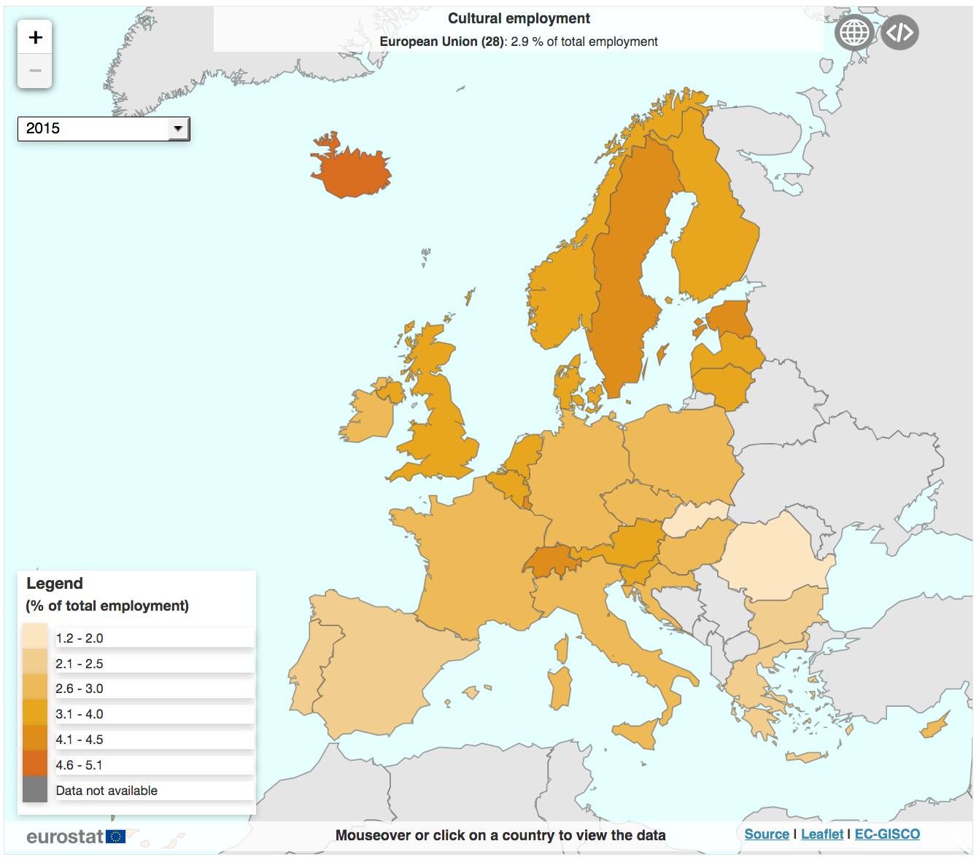
A few known facts
There are about 6.5 million “CCI jobs” in the EU, being 2.9% of total employment, and their growth outperformed that of “conventional jobs” especially during the years of crisis, i.e. from 2008 to 2010 (source: Eurostat, 2017. Data referred to 2015).
Above the EU average stand countries like Sweden and Estonia and non-EU Member States like Iceland and Switzerland.

Slide 6
A few known facts (2)
If we add to the “core” CCI definition the fashion industry and (in part) the high-end industries where creativity has an impact, active workers in the EU become more than 12 million, which is 7.5% of all persons employed in the total economy.
Source: Austrian Institute for SME Research & VVA Europe, 2016 (data referred to 2013).

Slide 7
A few known facts (3)
Based on several statistical sources and own calculations, the Austrian Institute for SME Research & VVA Europe estimate market-oriented enterprises in EU “core” CCI to be about 2 million in 2013, accounting for 18% of all services enterprises, or around 8% of the total business economy.
It is also demonstrated that these enterprises (mostly micro) are comparatively far more productive than the average.

Slide 8
A few known facts (4)
CCI are also an important contributor to the EU GVA with a share of 4.9% in 2014 (source: Eurostat, 2017) and a further 4% probably generated within the high-end industries (source: Austrian Institute for SME Research & VVA Europe, 2016).

Slide 9
Literature on
CCI impacts
Source: Rausell, P. & Abeledo, R. (2012) “Culture as a Factor for Economic and Social Innovation”

Slide 10
CCI in S3
106 entries in the S3 Database:
9 Member States with a national CCI priority (AT, BG, DK, MT, PL, PT, RO, SI, SK)
9 Member States without any CCI priority, even at regional level (CY, CZ, EE, HR, HU, IE, LT, LU, LV)
10 Member States with regional CCI priorities (BE, DE, EL, ES, FR, IT, NE, FI, SE, UK)
Source: EYE@RIS3,
http://s3platform.jrc.ec.europa.eu/

Slide 11
CCI in S3 – foll.
Recommendations from a 2012 OMC EC/MS WG:
Create favourable conditions for CCI establishment
Strengthen CCI competitiveness and exports
Promote spill-over effects to economy & society
Source: Policy Handbook
http://ec.europa.eu/assets/eac/culture/library/reports/policy-handbook_en.pdf
Most attended regional/national S3 objectives:
Development of regional CCI (88 instances)
Support to link CCI to traditional industries (72 instances)
Source: EYE@RIS3,
http://s3platform.jrc.ec.europa.eu/

Slide 12
Some reflections
1) As the previous slide exhibits, there is perfect alignment (at least in the majority of cases) with the EU “mainstream thinking”, concerning:
The need for CCI empowerment and capacity building
The value of “spill-over effects”
2) However, the geographical distribution of S3 priorities does not match that of CCI employment share in full, probably because:
Many S3 have interpreted CCI as opportunities rather than realities
The concept of “sectorial specialisation” badly applies to CCI, while the cross-sectorial or “niche” innovation does
This scenario can also be a by product of diffused and deep exercises in entrepreneurial discovery at regional/national levels

Slide 13
Access to grants is not decisive
Based on the 2016 study by the Austrian Institute for SME Research & VVA Europe and other evidence, several issues affect CCI that do not easily fit into the logic of “fund them and they will prosper”:
Micro average size of the CCI enterprise (3 employees according to some sub-sectorial studies)
High mortality rates (55% after 5 years according to Eurostat, 2009-14) and low propensity to grow in size and internationalize
Problematic access to ordinary finance (e.g. private banking and venture capital)
Difficult acquisition of skilled resources, hard matchmaking
Limited protection of IPR from the existing framework
Logistic problems (garage innovation) etc.

Slide 14
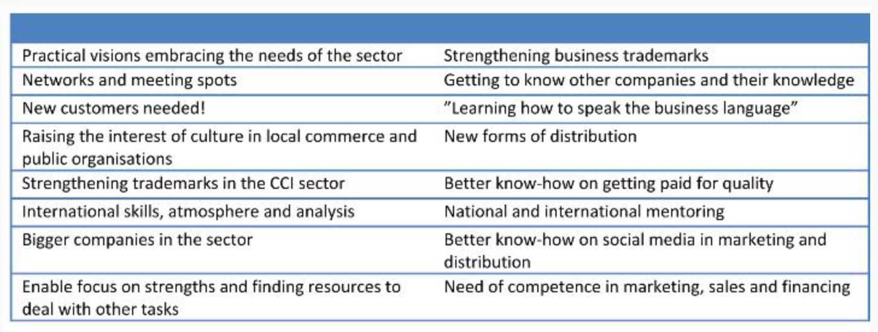
A possibly neglected aspect?
Source: Skoglund and Jonsson (2012),
https://www.idunn.no/nkt/2012/02/the_potential_of_cultural_and_creative_industries_in_remote

Slide 15
Global
International networks/clusters
Regional
Intermediary organisations
Clustering of Cities
Local
Actor Networks within Cities
Matchmaking initiatives
Creative clusters
Project based collaborations

Slide 16
Conclusions and Way Forward
The importance for CCI development of enterprise participation in external networks is probably not in the focus of ESIF due to the “inward looking” vision of most OP and the informal division of work with other, centrally managed programmes like Creative Europe and H2020 itself
The promotion of enterprise partnerships seems to be limited to the high end industries that can take benefit from CCI outputs and collaborations
The TALIA vision highlights the good “propensity to network” that most MED regional actors document with their behaviours
A research question is whether and how TALIA resources can promote an evidence based shift from local to trans-local partnership building within the regional policy approaches
Projects like CHIMERA represent a valid contribution in that direction.

Slide 17
Thank you Francesco Molinari, mail@francescomolinari.it

