Slide 2
Who we are?
Sanje was funded in 1997, it started with one project - o book of poems - that became a bestseller.
Sanje is today one of finest publishers in Slovenia, producing over 50 titles per year.
It also acts as a music publisher, producer and organizer of events. Since 2002 has launched 1st Festival Sanje - over 4.000 events in a field of literature, music, fairytales, science.
It represents and manages world rights for some outstanding works and authors.
The imagination, even at its simplest form, has a power of changing the world of civilization.

Slide 3
Selected projects
EMZIN – Institute for creative productions | arts magazine (1997-2014)
PHOTOGRAPHY OF THE YEAR (1993-2014)
SANJE | SANJE PUBLISHING (since 1997)
FESTIVAL SANJE (2002-- ongoing)
NOČ KNJIGE | Book Night International in Slovenia. Since 2014.
Initiator:
CAMPAIGN AGAINST TAX ON BOOKS IN SLOVENIA (2006-ongoing)
PROTESTIVAL movement
DIRECT DEMOCRACY NETWORK (Slovenia), 2012-ongoing
SKUPAJ ZA KNJIGO (zavezništvo za skupino MKZ d. d.) | TOGETHER FOR A BOOK
Selected websites:
sanje.si | sanjepublishing.com | festival.sanje.si
emzin.si | nocknjige.si | peticija.si | booknightinternational.com

Slide 4
“If you talk to a man in a language he understands, that goes to his head. If you talk to him in his language, that goes to his heart.”
~Nelson Mandela
An ethnologist says there are now 7,105 living languages, with 906 “dying” and 1,481 “in trouble.” In truth, nobody knows exactly how many languages there are because so many of them are undocumented…
From an interview with Alexander Arguelles.
Book Night is a world-wide project that connects and empowers cultures and languages across the globe!
Join us dreaming anywhere – on the internet, in a dream, in your imagination … anywhere on planet Earth, or beyond!

Slide 5
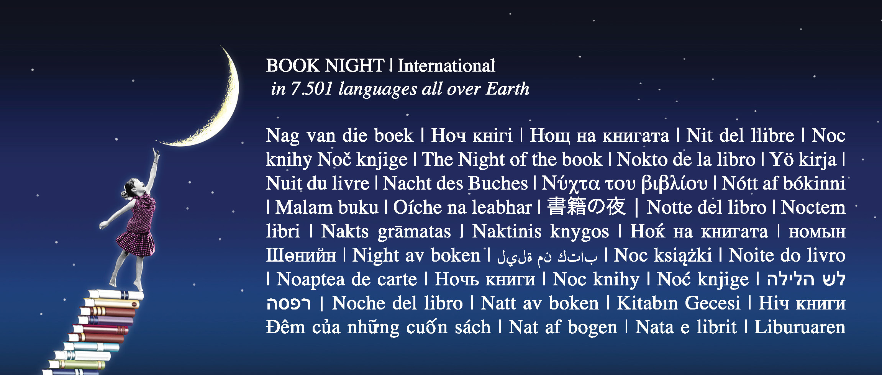

Slide 6


Slide 7


Slide 8
The Little Sleepy Star (by Frane Milčinski Ježek and Gorazd Vahen)
The illustrated story that has bewitched generations in Slovenia for over half of a century.
When night falls, the stars go to work, showing the way to travellers, inspiring poets... Except for the Little Sleepy Star who is always late. But the absence of a star in the sky causes strange things to happen on Earth... In order to punish her and teach her responsibility, Uncle Moon sends her to Earth. Before she can return to the sky, she will have to experience the di culties of life down here, learn that nothing is to be had without money and teach a terrible brigand with a stone instead of a heart to spell the word “dear” so he can write to his mother.
As all good fairy tales do, Little Sleepy Star gives direct but unintrusive lessons on values such as responsibility, love and acceptance. e poetry and warm humour su using the text have bewitched generations of Slovenian children for over half of a century.

Slide 9



Slide 10
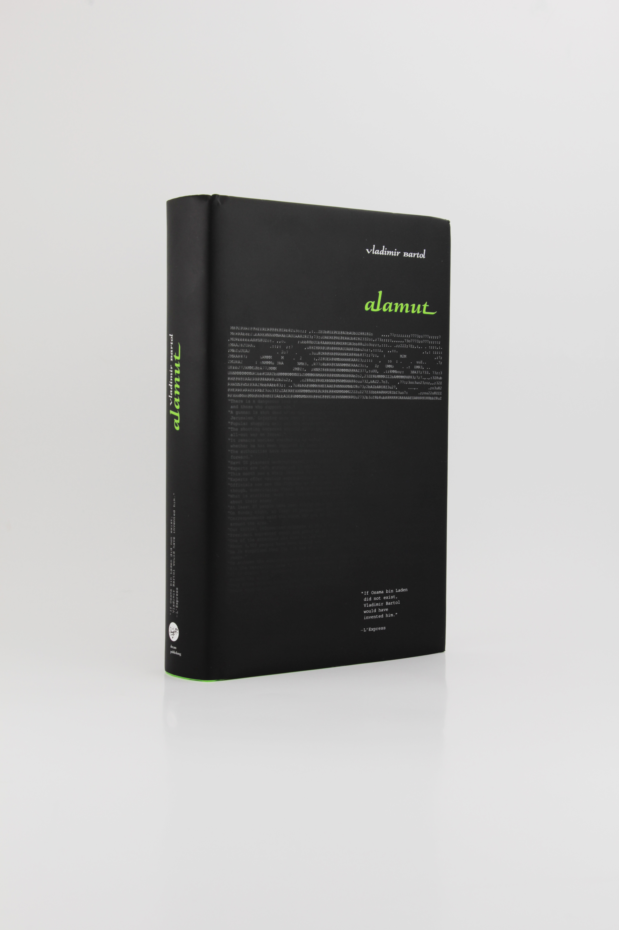

Slide 11
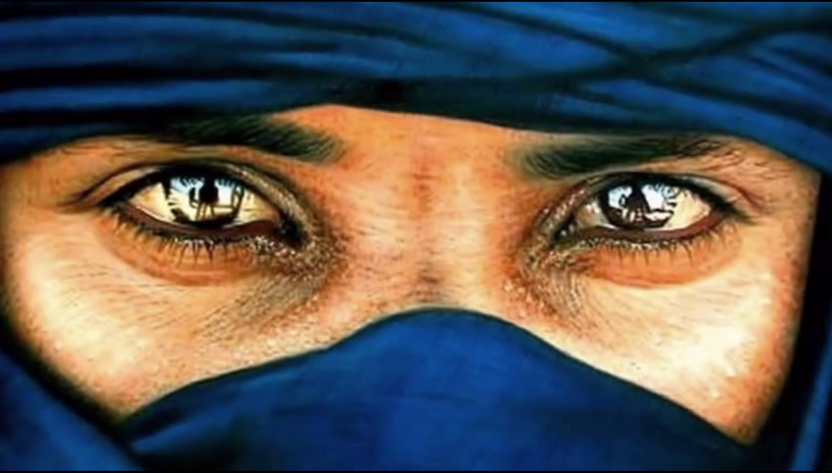

Slide 12


Slide 13




Slide 15


