Slide 1
InnoRenew Centre of Excellence:
Creative Industries and the Forest Sector Value Chains
1st Conference in the Field of Creative and Cultural Industries,
Museum of Architecture and Design - MAO
Barbara Rovere, MA (Project Manager & Assistant Researcher)
Ljubljana, October 4, 2017

Slide 2
InnoRenew CoE: Horizon 2020 Teaming Project
The gap between member states in research excellence is not decreasing
Horizon 2020 – “Spreading Excellence, Widening participation”
  Instruments: Teaming, Twinning and ERA Chairs
  ‘Widening’/low-performing countries: Bulgaria, Croatia, Cyprus, Czech Republic, Estonia, Hungary, Latvia, Lithuania, Luxembourg, Malta, Poland, Portugal, Romania, Slovakia and Slovenia.
  new or upgraded ‘Centres of Excellence for basic and applied scientific research with fast industry uptake of research results and commercialization

Slide 3
InnoRenew CoE: Sustainable Research Institution
InnoRenew CoE: 5-year Teaming project & R&D institution (2017)
Founders: University of Primorska, Frauenhofer WKI, ZVKDS, ZAG
InnoRenew CoE: World leader in the application and implementation of renewable materials and sustainable building research
EU grant 15 mio EUR, national co-financing to create synergies with structural and cohesion funds (infrastructure and large equipment)

Slide 4
InnoRenew CoE: Infrastructure & Equipment

Slide 5
InnoRenew CoE and Creative Industries
Target industries: Forestry - wood value chains
Basic value chains: (1) Forestry, (2) wood products, (3) pulp & paper products, (4) bioenergy, (5) specialties (including wood bio refinery concept)
Wood products: ‘living with wood’, ‘building with wood’
Furniture & interior design, construction → architecture & design

Slide 6
Start-up/ Boost projects (8)
“Revitalising a traditional industry: Open Innovation in the Furniture Industry”
Literature Review
  Open Innovation in design-intensive industries
Market & Industry Research
Use Case: Develop & pitch (SME Instrument or similar)
Innovation Management Workshops for industry

Slide 7
InnoRenew CoE Living Lab
fostering open innovation and developing new value chains and business models that meet user identified needs.
70 members, 21 countries, 4 members from creative industries
  MVA architects, Dekleva Gregoric architects, +-30, Pia Studio
  Faculty of Design, Associate Member of University of Primorska
“Fostering Creativity in the Furniture Sector”, International Expert Workshop, (October 11th, Izola)

Slide 8
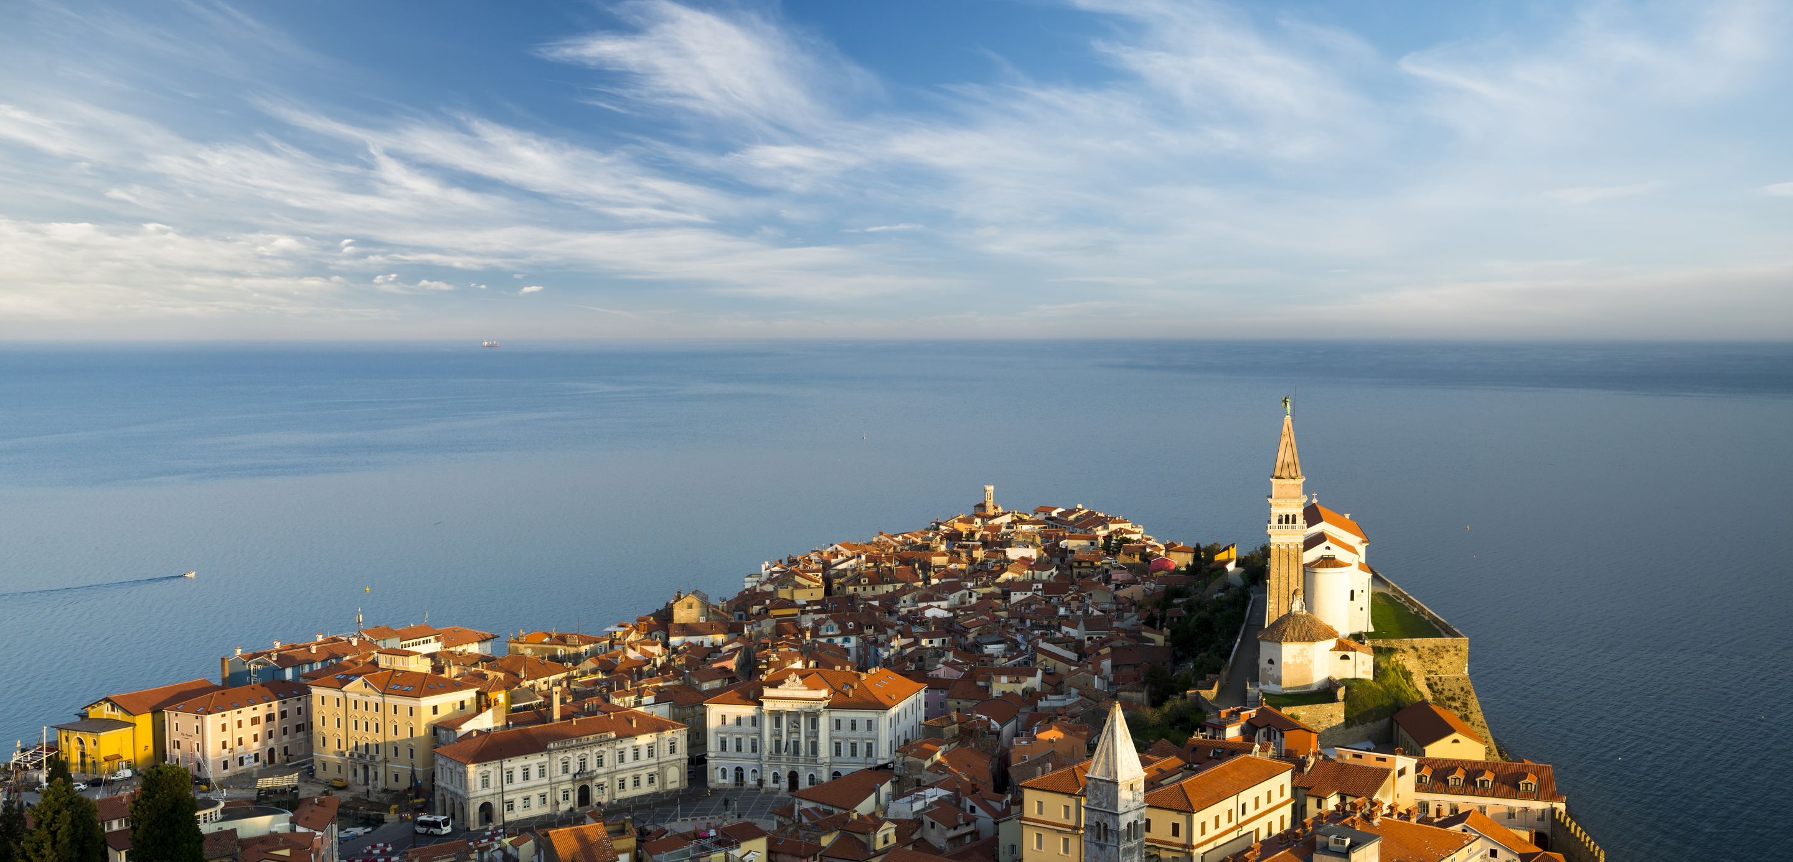
Thank you for your time.

Slide 9
Direction of future work

Slide 17
Table title
9:00 – 9:30 | Welcome with coffee
9:30 – 10:00 | Presentation of the InnoRenew CoE (research plan, employees, status update); Andreja Kutnar
10:00 – 10:30 | Presentation of the Living Lab InnoRenew Membership packages; Michael Burnard
10:30 – 10:50 | Technology Transfer Best Practices at Fraunhofer WKI (Bohumil Kasal, director of Fraunhofer WKI)
10:50 – 11:30 | Opportunities to participate in ongoing InnoRenew CoE research work; Project leaders
11:30 – 13:00 | Discussion/Presentations of Living Lab stakeholders
13:00 – 14:00 | Lunch

Slide 18
