Slide 1
IDEA Consult
“We believe that knowledge and innovation are driving forces behind sustainable societal progress”

Slide 2
But knowledge is fragmented or locked in academic circles
Notes:
Society is becoming more and more complex. The demand for knowledge and innovative approaches is stronger than ever before. Xxxxxxxxxxxxxxxxxx IDEA applies and connects knowledge to drive sustainable societal progress

Slide 3
Knowledge
Society
Notes:
Regions, EU, local municipalities, organisations (museums-mission & vision) as well as intermediary organisations.

Slide 4
Independent and solid advice in all phases of the policy cycle
Strong concepts
(vision and strategy)
Adapted instruments
(supporting implementation and projects)
Impact studies
(Evaluation and monitoring)
New insights
(research and analysis)
Notes:
Through research, in house expertise and innovative methodologies we provide indipendent and solid advice

Slide 5
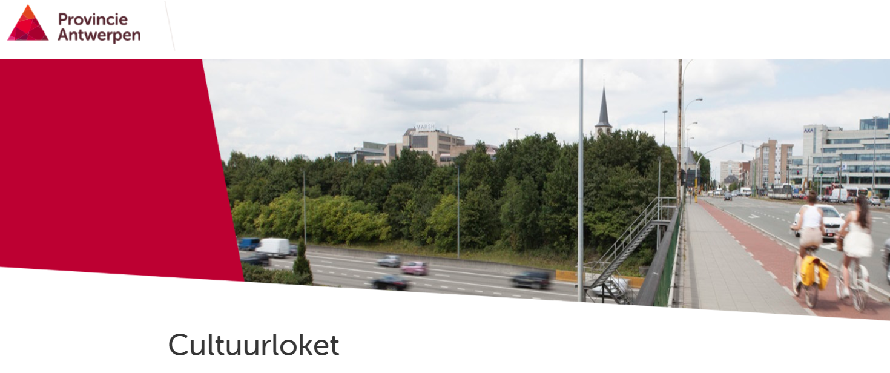
City of Antwerp
Strong concepts
(vision and strategy)
IDEA Consult developed the concept & monitoring system of Cultuurloket, the cultural centre for the city of Antwerp.
-> concept note "A long-term vision for additional funding and entrepreneurship in the Flemish cultural sector" by Minister of Culture

Slide 6
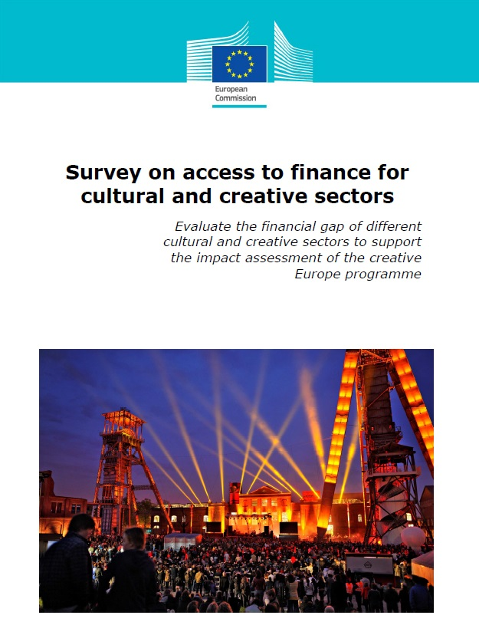
European Commission
Adapted instruments
(supporting implementation and projects)

Slide 7
Regional Gov.
Impact studies
(Evaluation and monitoring)
Evaluation of financial landscape of CCS in Flanders region
Exploratory study on giving to culture
Set-up a new cultural agency to support CCS on entrepreneurship and finance
Identified new instruments to replace CultuurInvest –> CultuurBank

Slide 8
Multidisciplinary Methodology
New insights
(research and analysis)
Stakeholder engagement in different phases of the project !

Slide 9
The baseline "Thinking Ahead" reflects IDEA's unique value proposition:
Connected professionals (involved in society, access to knowledge sources and networks)
Evidence based advice (applied scientific research, based on validated methods)
Future oriented and sustainable solutions

Slide 10
Dedicated professionals
IDEA Consult was founded in 1998 and is located in Brussels.
A multidisciplinary team of 40 professionals, who are involved in the current societal challenges.
We are connected with a pool of excellent experts “The choice to be a network organisation, allows us to propose for each different question, a tailor-made expert team”

Slide 11
We work in a network model with clients and partners to co-produce new solutions and concepts
Partners
Clients
Notes:
We often work with other experts and try to combine the best expertise for the type of work that is required.

Slide 12
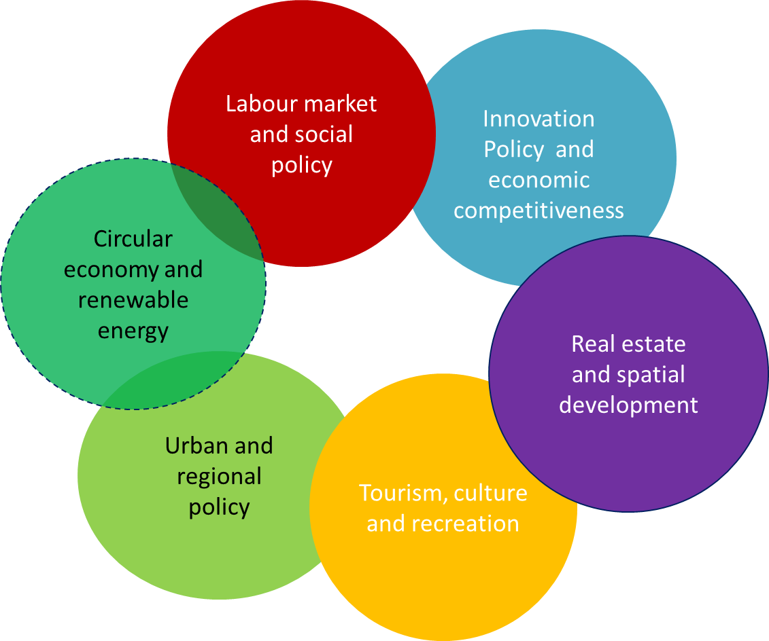
1 company, 6 areas of expertise This expertise is deployed on a multidisciplinary basis
Vanguard Initiative
Industry 4.0
Absorption capacity of KET (3D printing, nanotechnology, robotics, biotech) & impact on value chains
Help SME make transition in 4.0 and deploy new tech
Activation Policy
Unemployment
Inclusive Entrepreneurship (OECD)
Impact of Airbnb in Brussels
Study on sharing Economy
Green business Models
Business Plan & financial feasibility studies on regeneration of areas and industrial buildings
Redevelopment of Media Cluster and incubator
Supporting regions in the Smart Specialisation Strategy by mapping their economic activities and by identifying their strengths
Several evaluations of Interreg & ERDF (i.e. polic development on rural development; Evaluating how regions have spent their money
Sustainable business plans
Marketing strategy and development of cultural institutions/heritage sites (SMACK Ghent; Bozar; Bochreck; Brugges

Slide 13
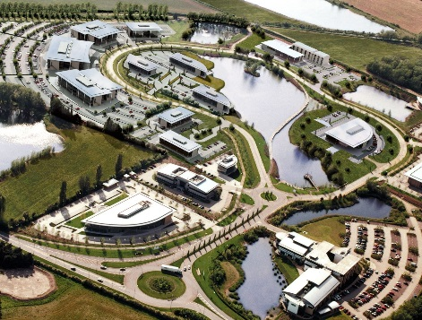
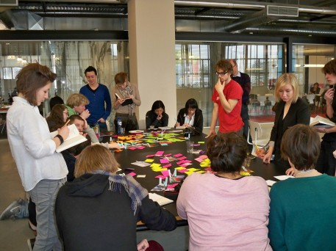
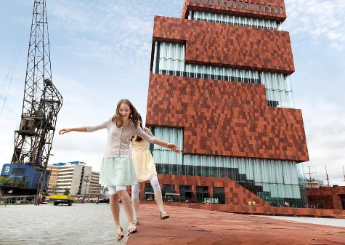
We contribute in a unique way to three societal transitions
 | Socio-economic transformation (smart, sustainable, inclusive)
 | New governance models (coproduction with citizens and private actors, other financing models, multilevel governance)
 | Vitalising regions and places (multi-use of space and buildings, smart specialisation)

Slide 14
Increased importance on Creativity
Notes:
This is something IDEA believes in, that the contribution of CCS in local and regional dev as well as economic development. We directly advice CCS orgnisations and governmentson cultural policy and related policy areas (eco, innovation, entrepreneurship, environment, etc)

Slide 15
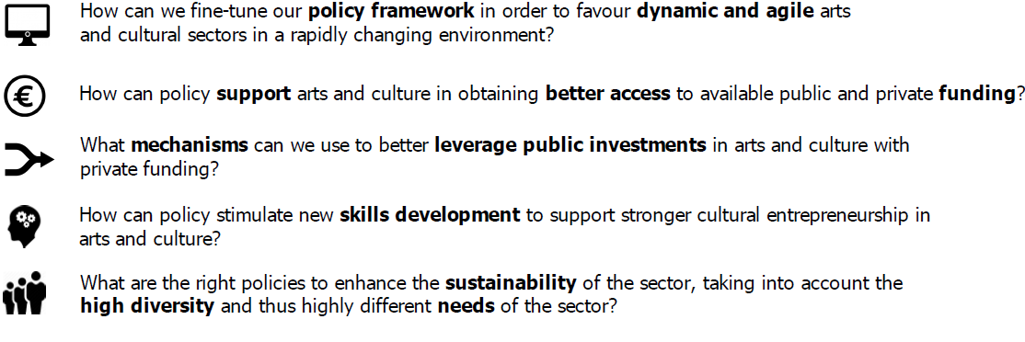
Ongoing CCS questions

Slide 16
Survey on access to finance for cultural and creative sectors (2013)
Looked at:
Financial needs &
Financial gap
CCS use of debt finance
Leveraging the effect of the CCS guarantee facility
Report & policy recommendations
Creative European Guarantee Facility

Slide 17
Crowdfunding: Reshaping the crowd’s engagement in culture (2017)
Looked at:
CF as access2finance tool
Use of CF models by CCS (donation, rewards, equity & peer2peer lending
Country differences
Sector differences
Amounts raised & Success rate
Platform mapping
Case studies
Information hub ->> www.crowdfunding4culture.eu
Report & policy recommendations

Slide 18
Economy of Culture in the Digital Age (2017)
Looked at:
9 sectors
Impact of digitalisation on the creative value chain
Changes in industrial organisation and market dynamics
Role of online intermediaries that challenge the traditional structures (e.g. Google, Amazon, Apple, etc.)
Opportunities and challenges of CCS in the digital context
Remuneration and rights management
Report & policy recommendations

Slide 19
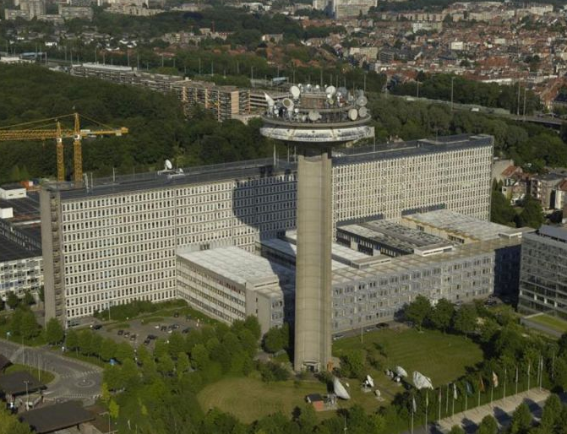
Impact Study on the role of Public Broadcasting- VRT (2017)
Looked at:
Importance of VRT in the whole ecosystem
Re-development of media cluster
Analysis and needs
Evaluated and benchmarked
Spillover effects
Advocated for the need for a media incubation and business centre at the premises of VRT

Slide 20
IDEA’s CCS Support

Slide 21
IDEA’s CCS Support

Slide 22
Contact
Kleitia Zeqo
Kleitia.zeqo@ideaconsult.be
40 Rue Joseph II/Joseph II Straat boîte/bus 1
1000 Bruxelles
02 282 17 10
www.ideaconsult.be

