Slide 1
Innovative private and public financial instruments & How to maximize the impact of public funding in CCS
1st Conference in the
field of Creative and Cultural Industries
4 th – 5 th October 2017 I Museum of Architecture and Design – MAO - Ljubljana

Slide 2
About Cofidi.it
“Cofidi.it” operates on the basis of the principles of mutuality, as non-profit organization, in compliance with relevant legislation (Law n. 326/2003).
As financial intermediary supervised by the Bank of Italy, Cofidi.it supports SMEs in obtaining credit through the issuance of a guarantee on loans granted by banks and safeguarding economic stability as regulated by Basel II.

Slide 3
About Cofidi.it
Cofidi.it was founded in 1996 under the auspices of five Italian Confidi belonging to the local network of SMEs and handcraft associations (CNA Puglia System) and adheres to "Fedart Fidi", the most relevant federation of mutual guarantee institutions in Italy
Cofidi.it , with its head office in BARI – Italy, offers its services thanks to the contribute of its branches and financial agents mainly located in Apulia, Basilicata, Calabria, Campania, Molise and Abruzzo.
Due to the support of its brokers' network, mainly operating in Central Italy, Rome and Lazio included, Cofidi.it is going to expand its market share in other areas of central and northern Italy.

Slide 4
About Cofidi.it
Cofidi.it has recognized the added value of cultural and creative firms and the importance of implementing particular activities and "ad hoc" services, in order to improve the SMEs borrowing capacity and compensate for the lack of a specific operational and political structure on a national scale.
A mission that comes from the presence of more than 300 member companies belonging to the CCS NACE codes, from the relationship with “Art lab” and “Fitzcarraldo” Foundation and from a direct involvement in "Distretto Puglia Creativa".

Slide 5
…“main theme”
Innovative private and public financial instruments & How to maximize the impact of public funding in CCS

Slide 6
What does mean “innovation?
“concept”
“status” definition
“project”
PEOPLE

Slide 7
… and “funding”?
a provision of resources in order to finance “innovation” in “innovative way”.

Slide 8
Challenge for the CCS
Accessing the funds that they need to finance their activities, to grow, and to maintain and increase their competitiveness.

Slide 9
Challenge for the CCS
The intangible nature of their assets;
The prototype profile of their activities and their output;
Their intrinsic need to take risks in order to innovate.

Slide 10
Such risk-taking needs to be understood and supported also by the financial sector

Slide 11
Cofidi.it participated to “the Open Call for Expression of Interest to select Financial Intermediaries under Cultural and Creative Sectors Guarantee Facility” (CCSGF).

Slide 12
The credit risk protection shall be provided through a Counter-Guarantee which shall be issued by EIF acting on behalf of the European Commission for the benefit of a Financial Intermediary .

Slide 13
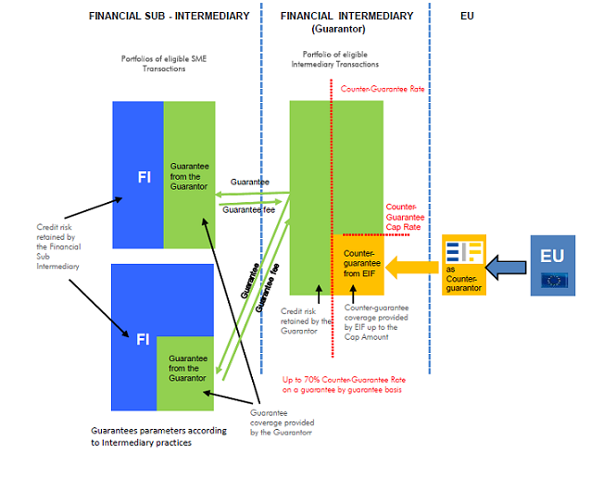
How does the instrument work?
The Counter-guarantee shall cover Losses incurred by the Financial Intermediary (the Guarantor) at a Counter-guarantee Rate (up to 70% of each Intermediary Transaction) subject to the Counter-guarantee Cap Rate (set by EIF at 10%, 18% or 25%).
Losses covered by the Counter-guarantee, in respect of the Portfolio of eligible Intermediary Transactions, shall in aggregate not exceed the Cap Amount stipulated in the counter-guarantee agreement between EIF and the relevant Financial Intermediary.

Slide 14
What types of activities are covered by Cultural and Creative Sectors?
The 'cultural and creative sectors' means all sectors whose activities are based on cultural values and/or artistic and creative expressions (architecture, archives, libraries and museums, artistic crafts, audiovisual (including film, television, video games and multimedia), tangible and intangible cultural heritage, design, festivals, music, literature, performing arts, publishing, radio and visual arts).
(Sub-Annex 1_List of NACE Statistical Codes eligible under CCSGF)

Slide 15
Final Recipient Transaction Eligibility Criteria
The transactions shall be granted for one or more permitted purposes:
investment in tangible and/or intangible assets;
working capital;
business transfers;
The principal amount shall not exceed EUR 2 mln and
shall have a minimum scheduled maturity of 12 months.

Slide 16
What are the main objectives of the financial instrument?
The general objective is:
to foster the safeguarding and promotion of European cultural and linguistic diversity;
Smart growth, developing of an economy based on knowledge and innovation;
Sustainable growth promoting a more resource efficient, greener and more competitive economy;
Inclusive growth fostering a high-employment economy delivering economic, social and territorial cohesion.

Slide 17
What are the main objectives of the financial instrument?
The specific objective is:
to strengthen the financial capacity of the cultural and creative sector;
to find a solution to the problems of information asymmetry.

Slide 18
To respond to these issues, it will be useful
to provide guarantees to banks dealing with cultural and creative
SMEs
to provide expertise/capacity building to the financial institutions (by defining a specific methodology to calculate a tailor made rating system referred to cultural enterprises which have its own budget structure and financial needs)
to increase the number of financial institution which are willing to
work with cultural and creative SMEs

Slide 19
Reasons to invest in CCS
social and economic growth potential;
the enabling role of CCS for innovation;
Economies of scale;
Cross border effect;

Slide 20
Reasons not to provide finance to the CCS
Assets (IPRs) are intangible which makes it difficult to provide collateral for finance;
the perception that the cultural and creative sectors are highly risky (high default risk) and not profitable;
Large fixed costs of loans;
a lack of reliable data in CCS businesses which is necessary to get credit funding;
a lack of business and management skills;
a lack of understanding of financial sources.

Slide 21
What about financial counterparties?
Traditional bank products do not match very well with the financing needs of CCS organizations;
Project based financing requires specialist knowledge of legal structures which is often not belonging to general banks;
A lack of specialist knowledge concerning competitiveness, market shares and trends;
For public institutions: their general mandate (as assigned by government) does not include CCS specifically.

Slide 22
Capacity Building
The CCS GF should, through the Capacity Building scheme, improve the capacity to assess the risks associated with SMEs and micro, small and medium-sized organisations in the cultural and creative sectors and with their projects, including through technical assistance, knowledge-building and networking measures.

Slide 23
Capacity Building
The main parameters that financial institutions consider for a positive feedback on loan requests are:
 Reasons to invest
Return on investment
Loss given default
Judging an application
Cash-flow valuation
 Check if cash-flow valuation guarantees interest payments and loan payments
 Track record of applicant
Collateral
Private equity

Slide 24
Public and not-for-profit institutions
Public institutions mainly concern bodies of government.
On the one hand, these governmental bodies (European, national or regional) should supply grants, donations, or set up tax incentive schemes to stimulate private investment.
On the other hand, Governments can also set up public financial intermediaries, such as public banks, to offer guarantees and loans.

Slide 25
Enjoy your project! Questions and Comments
Passarelli Roberto
robertopassarelli@cofidi.it
www.cofidi.it

