Slide 1


EU Policies for Culture and Creative Industries Interreg CRE:HUB
26 September 2018
Trieste
Philippe Kern

Slide 2


Notes:
KEA creativity tree

Slide 3
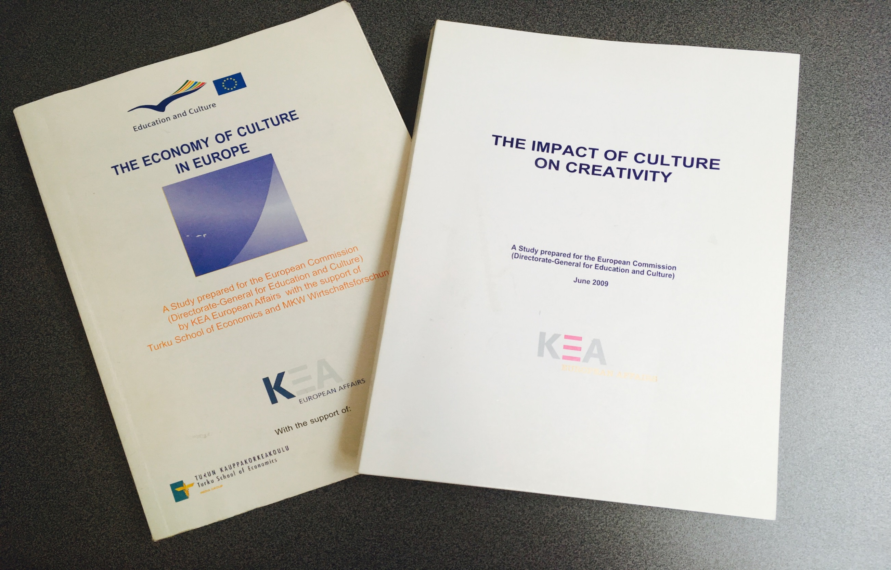
Notes:
Picture of our studies about the economy of culture and culture-based creativity

Slide 4
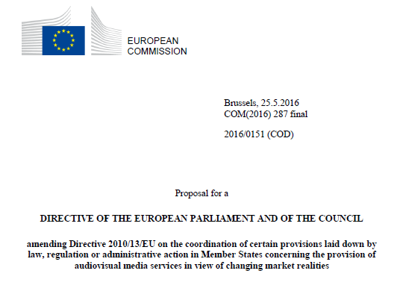
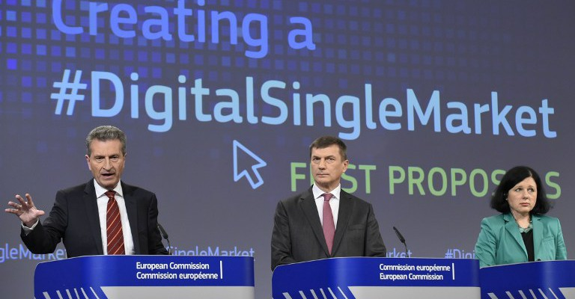
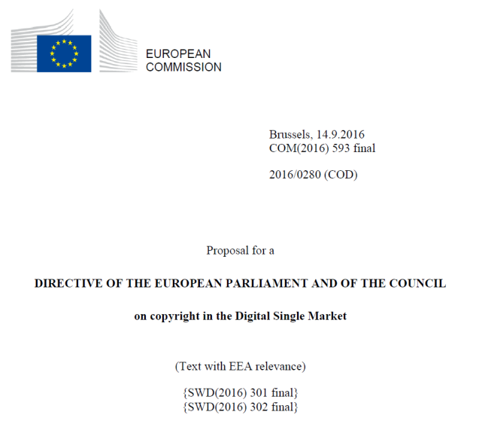
Proposal for a Directive European Parliament and the Council on the coordination of certain provisions laid down by law, regulation or administrative action in Member States concerning the provision of audiovisual media services in view of changing market realities
Proposal for a Directive of the European Parliament and the Council on copyright in the Digital Single Market (14/09/2016)
Notes:
Regulation: title of the last policy documents related to AVMSD and copyright
Proposal for aDirective of the European Parliament and the Council on copyright in the Digital Single Market
Proposal for a Directive European Parliament and the Council on the coordination of certain provisions laid down by law, regulation or administrative action in Member States concerning the provision of audiovisual media services in view of changing market realities
European Parliament Draft report on the proposal for a directive of the European Parliament and of the Council amending Directive 2010/13/EU on the coordination of certain provisions laid down by law, regulation or administrative action in Member States concerning the provision of audiovisual media services in view of changing market realities

Slide 5
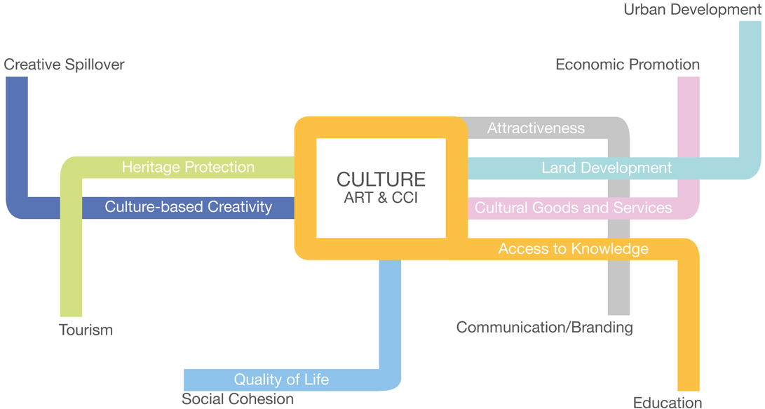

Notes:
L’investissement culturel est d’une autre nature au niveau européen – l’agenda culturel / consanguinité avec le milieu artistique/ fierté nationale à entretenir / competence
Droit d’auteur
Agenda suit domaines d’intervention de l’UE au regard des traités – finalité economique

Slide 6

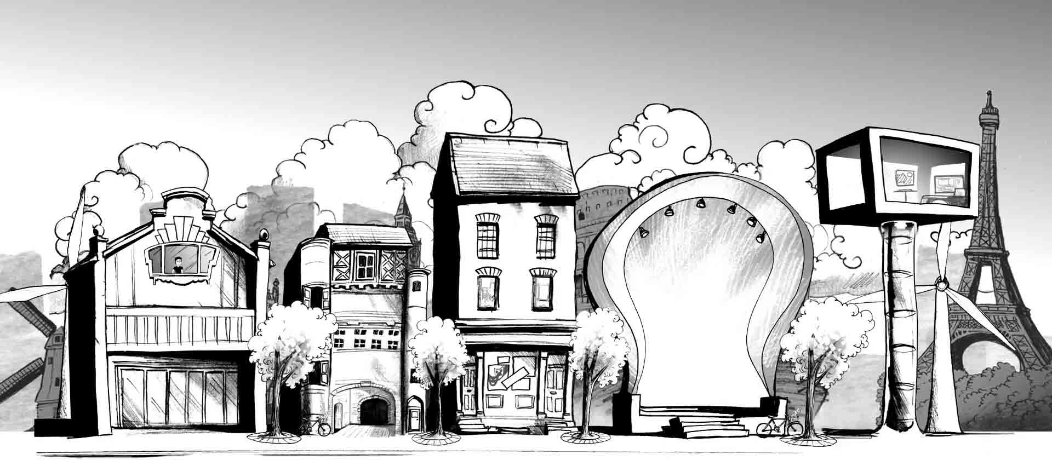


Notes:
Creative Europe
€1.46 billion (9% higher than its predecessors)
- Media
- Culture
- Cross sectoral strand & Financial instrument (Cultural and Creative Sector Guarantee Facility, 2016): €121 million to a financial mechanism acting as insurance to financial intermediaries (e.g. banks) offering financing to cultural and creative sector initiatives, Managed by the European Investment Fund (part of the European Investment Bank Group), on behalf of the European Commission
Pictures:
Banner website Creative Europe
Caption video Creative Europe Culture http://ec.europa.eu/culture/
MEDIA programme 25th anniversary (2016)

Slide 7
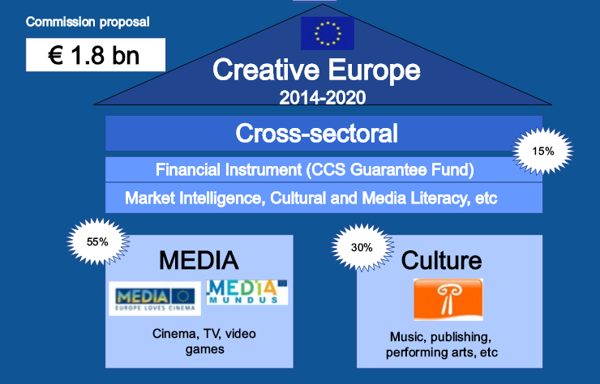
Notes:
A graph summarizing the creative Europe programme

Slide 8
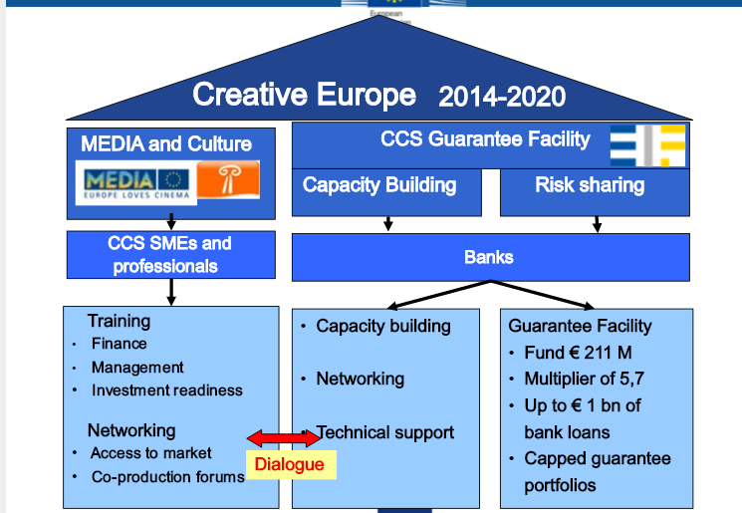
Notes:
A graph summarizing the creative Europe programme

Slide 9
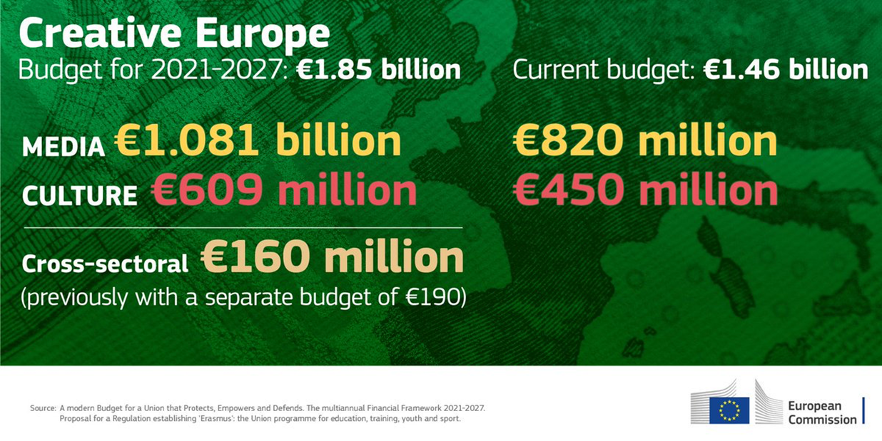

Slide 10


Slide 11

Notes:
Illustration about Smart Specialisation strategies in European Regions

Slide 12


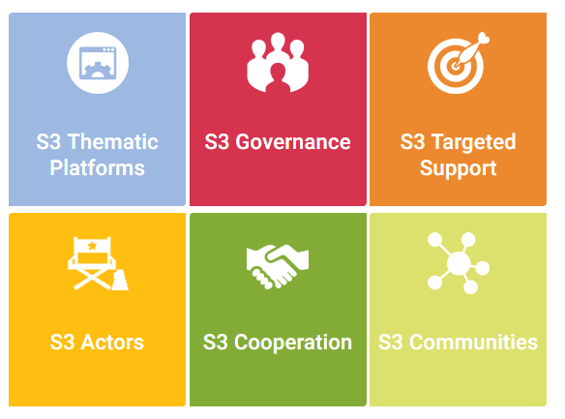
Notes:
CCIs in Regional Smart Specialisation Strategies (RIS3)
a source of creativity and innovation through which regions can pursue innovation objectives, stimulate new forms of innovation and sustainable growth
a strong asset to drive competitiveness based on vibrant cultural communities able to attract more investments and highly skilled people
potential of CCIs to generate social demand, engage the public and address social concerns in rapidly growing markets
Streamline the use of EU funding for CCIs, already adopted by more than 70 European regions with significant impact on smart, sustainable and inclusive growth.
Working on ESIF Operational Programmes (cf. Interreg programmes)
Pictures:
Smart specialization platform (JRC)
Regional Initiative for Culture and Creativity (RICC network lead by regions who have included CCIs in their RIS3 strategies lead by the Basque Country, Emilia Romagna and Friuli Venezia Giulia)

Slide 13




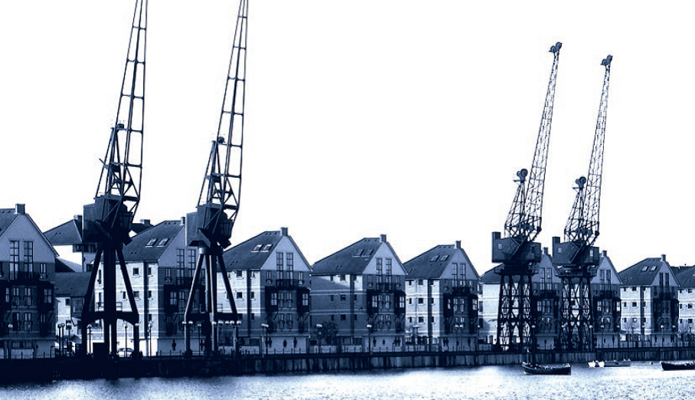
ICT art science
Cultural heritage
Media and digital content
Notes:
Horizon 2020 opportunities for creative industries:
STARTS in WP2016/2017: Mainstreaming and Funding
STARTS H2020 MAINSTREAMING - Art catalysing H2020 innovation
Combining artistic, design, scientific and technological thinking across all H2020 topics
STARTS H2020 Funding - Enhance interaction of S&T and Art world
• STARTS EXPLORATION (3 M EUR innovation action )
• STARTS MATCHING (4 M EUR coordination action)
• STARTS PRIZE (1 M EUR coordination action)
Media and content convergence
IA : contribution of between EUR 2 and 4 million
CSA: contribution of about EUR 1 million
Tools for smart digital content in the creative industries
2017: contribution between EUR 2 and 4 million for a period between 24 and 36 months
Cluster facilitated projects for new industrial value chains
contribution of between EUR 2.5 and 5 million
Contemporary histories of Europe in artistic and creative practices
The contribution in the order of EUR 2.5 million
Participatory approaches and social innovation in culture
RIA : contribution in the order of EUR 2.5 million
CSA: contribution in the order of EUR 1.5 million
Cultural heritage in Horizon 2020
Cultural heritage of European coastal and maritime regions
2017: contribution in the order of EUR 2.5 million
European cultural heritage, access and analysis for a richer interpretation of the past
contribution in the order of EUR 2.5 million
Cultural heritage as a driver for sustainable growth
contribution in the order of EUR 10 million
Innovative financing, business and governance models for adaptive re-use of cultural heritage
contribution in the order of EUR 5 million
Images:
H2020 programme banner
1 image on content and technologies in H2020 https://ec.europa.eu/programmes/horizon2020/en/h2020-section/content-technologies-and-information-management-0
1 image on cultural heritage (from EC report ‘Getting cultural heritage to work for Europe, 2015) https://ec.europa.eu/programmes/horizon2020/en/news/getting-cultural-heritage-work-europe
2 images of art+science+technology (Start Prize) https://starts-prize.aec.at/en/

Slide 14


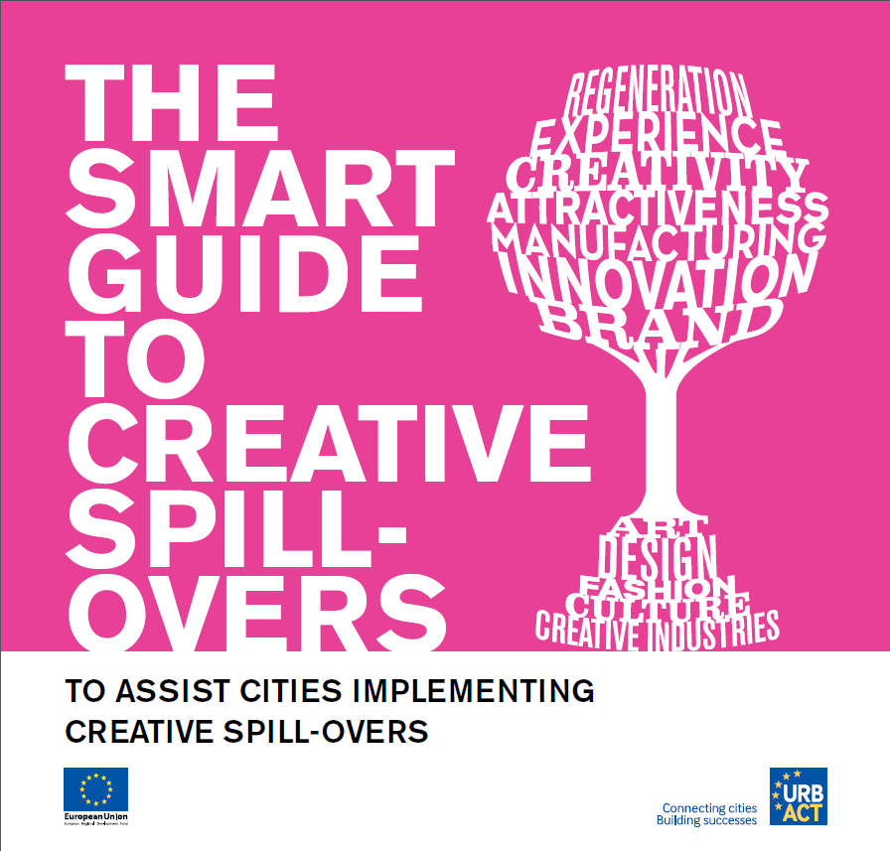
Notes:
URBACT programme and culture
Creative SpiN: a three-year EU funded project (URBACT) gathering 9 cities to define and test tools and methods to best connect CCIs with other sectors of the economy in order to stimulate “creative spillovers” for innovation.
Smart Guide
Snapshop Creative SpiN video on creative spillovers

Slide 15



www.cultureforcitiesandregions.eu

Slide 16



Notes:
b.Creative

Slide 17
EU Budgets potentially for Culture (2014-2020)
Creative Europe (€1.5 Billion )
Innovation and Cohesion Policy (€80 billion and €351 billion)
Support to SMES / Cosme (€3 bl)
Support to developing countries (€51 milliards)
(Neighbourhood/Partnership/ Pré-Accession…. / DG NEAR (5 million)
Foreign policy ( Cultural Diplomacy Platform – European film festival.
Notes:
On comprend la logique de l’intervention européenne – la culture peut en profiter
L’Europe continent de culture -

Slide 18
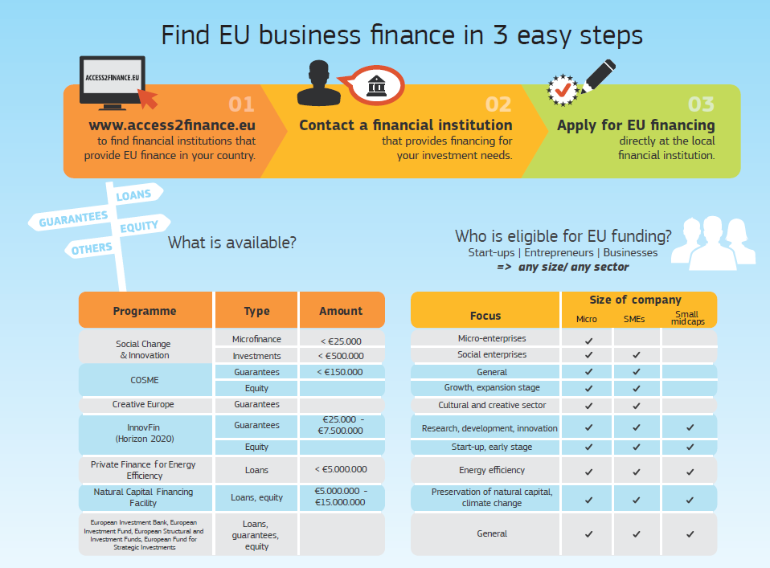
Notes:
EC infographics on financing SMEs 1/2

Slide 19
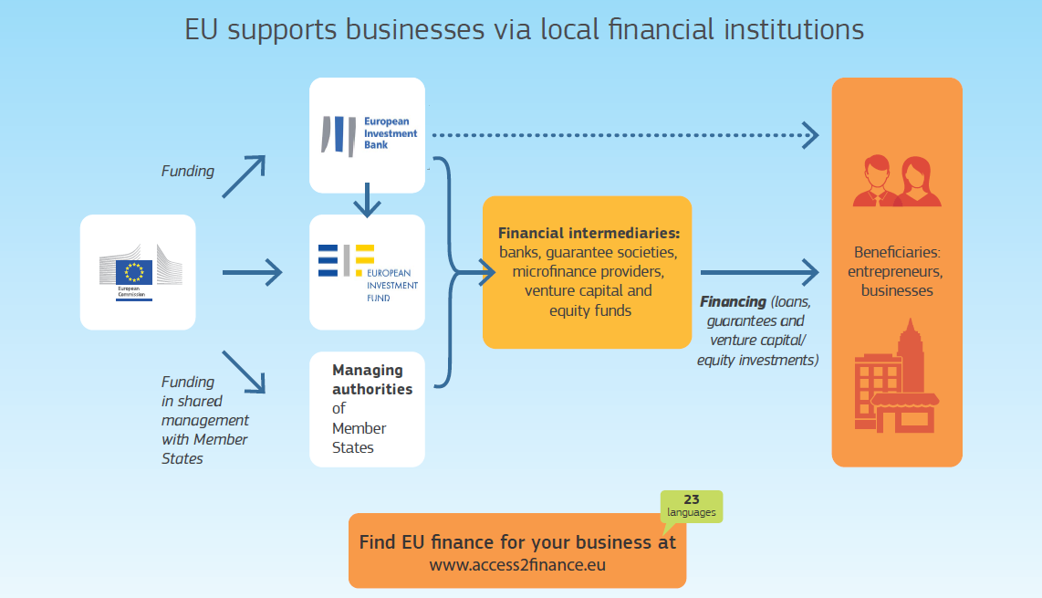
Notes:
EC infographics on financing SMEs 2/2

Slide 20

Notes:
Fish

Slide 21




Thank you!
Philippe Kern, Managing Director
pkern@keanet.eu; @phikern
51 rue du Trône, 1050 Brussels
 +32 2 289 26 00
www.keanet.eu; www.keanet.cn
KEA CREATIVE EUROPE groups
@KEAtweets

