Slide 1
FVG AR Action Plan Implementation
INFORMEST
Friuli Venezia Giulia AR – Department for Culture and Sports
crehub@informest.it
Székesfehérvár, 26th July 2019 – 8th CM and SC Meeting
Event VenueDate

Slide 2

Friuli Venezia Giulia Autonomous Region
Action 1 - Coordination activities aimed at creating synergies among EU funding and regional support to CCIs
  Activities Implemented - Working group to coordinate the remaining actions and calls of ROPs on the 2014-2020 programming period
    Coordination meeting (November 2018) with the Dpt. for productive activities and Dpt. of Work, Training, Education and Family on availability of tools to be used in ERDF ROP to coordinate the measures in support of CCIs.
    Meeting (January 2019) with the Dpt. of Work, Training, Education and Family on the possible synergies, between the ROPs and between the ROPs and regional funds.

Slide 3
Friuli Venezia Giulia Autonomous Region
Action 1 - Coordination activities aimed at creating synergies among EU funding and regional support to CCIs
  Positive Aspects
    Thanks to CRE:HUB project, integrated policies for ICCs were carried out and the regional Departments involved (Dpt. of Work, Training, Education and Family; Dpt. for productive activities; Dpt. for Culture and Sport) understood the need to start close collaboration and to coordinate their actions.
    Involvment of Stakeholders
    The Action is endogenous to the regional administration and nowadays 3 Regional Departments have been involved (Dpt. of Work, Training, Education and Family; Dpt. for productive activities; Dpt. For Culture and Sports)
  Deadlines
    At the moment the action is in line with the deadlines and should respect the project deadline

Slide 4
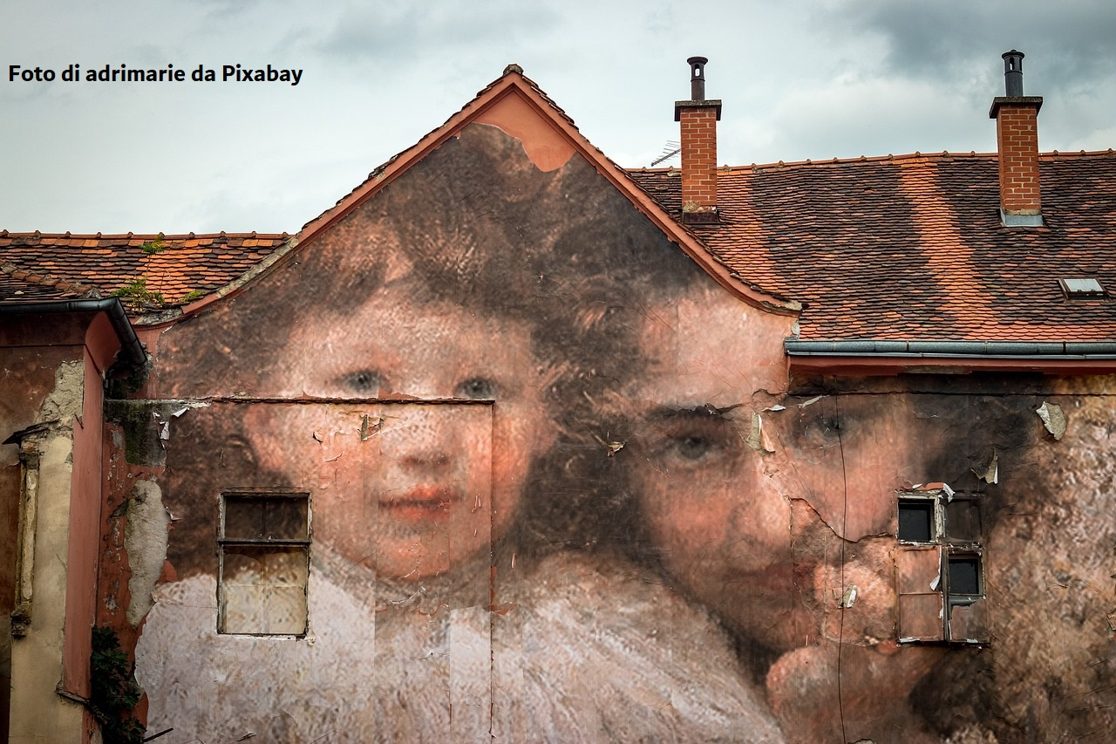
Friuli Venezia Giulia Autonomous Region
Action 2 - CREATION OF A CCIs CLUSTER
  Activities Implemented
    In the Coordination Meeting (November 2018) participant Departments discussed about Nace Rev.2 categories to be included in the CCIs Cluster and on the role of regional training institutions to support Cluster’ services
    In December 2018 the Regional Law 2018/29 was approved. At art.7, paragraph 19, the Law states the creation of the Regional Cluster for Culture and Creativity and provides (art. 7, paragraph 20) for the publication of a Call to collect candidacies aimed at becoming Cluster Managing Organization (CMO)
    The FVG A.R. Regional Government approved on of 4th July 2019 the regional Call for applications aimed at becoming the CMO of the Regional Cluster Culture and Creativity (deadline for applications: 30th of September 2019)

Slide 5
Friuli Venezia Giulia Autonomous Region
Action 2 - CREATION OF A CCIs CLUSTER
  Positive Aspects
  The creation of the Regional Cluster for Culture and Creativity is perceived as an important moment for the FVG cultural and creative system. The Cluster’s services portfolio meets the needs of the sector, identified during the project.
  Involvment of Stakeholders
    The Regional Stakeholders have been involved during several activities, including a cycle of Living Labs, which led to the identification of the services that the cluster will provide.
  Deadlines
  At the moment the action is in line with the deadlines and should respect the project deadline

Slide 6

Friuli Venezia Giulia Autonomous Region
Action 3 - Creation of financial instruments to support CCIs access to credit.
  Activities Implemented
    Meeting (January 2019) with the Regional Office for business access to credit in order to verify the financial tools existing at regional/national level and the feasibility to adapt them to FVG CCIs sector
    Meeting (June 2019) with Bank Mediocredito FVG in order to find ways to improve CCIs credit access by identifying new financial assessment procedures that could help bank in their asset's evaluation.
  Problems
    Bank Mediocredito FVG has pointed out that the greatest difficulty in accessing credit to ICCs is the lack of know-how on the part of credit institutions to evaluate applications (intangible assets; etc.)

Slide 7
Friuli Venezia Giulia Autonomous Region
Action 3 - Creation of financial instruments to support CCIs access to credit.
  Involvment of Stakeholders
    Friuli Venezia Giulia Autonomous Region; Bank Mediocredito FVG (regional body managing a Guarantee Fund); Department for Production Activities – Regional Office for business access to credit
  Deadlines
    The activities related to the first phase (Regional Dept. consultations) have been concluded and the second phase of consultation with the regional Chambers of Commerce system and the business associations must be opened.

Slide 8
Thank you!
www.interregeurope.eu/crehub/

