Slide 1

ChIMERA +
ChIMERA for Urban Sustainability
Kick off Meeting
26/07/2021

Slide 2


OVERVIEW
•Objective & Approach
• Output and result
• Activities
• Budget
• Reporting procedure, FLC, …
+

Slide 3


OBJECTIVE & APPROACH
transferring the ChIMERA process and methodology for the growth of regional CCI subsectors
promoting the sustainable urban development.
The process focuses on
regional working groups
regional CCI sector analysis
frontrunners analysis
guidelines to support the role of CCIs to promote urban sustainability
SAPs
frontrunners analysis
regional CCI sector analysis
RESEARCH
CITIZENS
POLICIES
COMPANIES

Slide 4
OUTPUT and RESULT
Process for the development
of regional CCI sectors as
lever for EU green deal
Increased number of territories where CCIs are a leverage for innovation and sustainable urban development

Slide 5
3.1 Coordination
RAFVG
3.2 Communication
CA Cluster
WPs HELICOPTER VIEW
3.3 Adaptation of ChIMERA methodology
RAFVG
All PPs involved
01/06/2021 – 31/06/2022
3.4 Frontrunner analysis
CA Cluster
3.5 Capacity building
CA Cluster
3.6 Developing common strategies to foster the role of CCIs for urban Sustainability
RAFVG

Slide 6


3.1 Coordination - RAFVG
Steering Committees and technical coordination meetings (1 KoM + 2 meetings)
1 mid-term assessment - 1 final progress report
2 Reporting periods for expenditures: 01/06 - 31/12; 01/01 - 30/06
2 certifications of expenditures (31/03/22; 30/09/22)
All PPs
6 | 7 | 8 | 9 | 10 | 11 | 12 | 1 | 2 | 3 | 4 | 5 | 6

Slide 7

3.2 Communication –
CA Cluster
Communication channels (website, linkedin, FB, twitter, Instagram and telegram)
Development of communication materials
final event (act. 3.6.)
Coordination with HP
All PPs
6 | 7 | 8 | 9 | 10 | 11 | 12 | 1 | 2 | 3 | 4 | 5 | 6

Slide 8

3.3 Adaptation of ChIMERA methodology - RAFVG
Adaptation of ChIMERA methodology to RPs; transfer in an online WS - GPs
Identification of stakeholders dealing with the potential of CCIs for a sust. urban dev. & LWGs - RPs
Needs analysis (support of CCI growth and potential of CCIs to foster sustainable urban development) - RPs.
6 | 7 | 8 | 9 | 10 | 11 | 12 | 1 | 2 | 3 | 4 | 5 | 6

Slide 9

3.4 Frontrunner analysis - CA Cluster
Identification of 3 frontrunners regions/cities on urban sustainability and role of CCIs for sustainability at EU- RPs
Frontrunners analysis (desk analysis and online interviews on main aspects to promote urban sustainability and the role of CCI for sustainability) – RPs.
6 | 7 | 8 | 9 | 10 | 11 | 12 | 1 | 2 | 3 | 4 | 5 | 6

Slide 10

3.5 Capacity building - CA Cluster
4 online WSs on
urban sustainability, potential of CCIs to foster sustainability and
measures to support the development of CCI sector
Speakers-testimonials:
identified frontrunners, GPs and GAPs
LWGs - beneficiaries
6 | 7 | 8 | 9 | 10 | 11 | 12 | 1 | 2 | 3 | 4 | 5 | 6

Slide 11

3.6 Common strategies to foster CCIs role for urban sustainability - RAFVG
Development of Strategic Action Plans to foster CCIs in urban Sust. and to support the development of regional CCI Sector – LWGs and RPs
Outlining guidelines to support the CCI sector and its role in achieving objectives of EU green deal and urban sustainability – GPs + other PPs
Final online transnational event
6 | 7 | 8 | 9 | 10 | 11 | 12 | 1 | 2 | 3 | 4 | 5 | 6

Slide 12
BUDGET

Slide 13
BUDGET Forecast

Slide 14

Reporting procedures
Period 1
01.06.2021-31.12.2021
Reporting by 31.03.2022
Mid term ass.
Period 2
01.01.2022
30.06.2022
Reporting by 30.09.2022
Progress R.
Eligibility of expenditure starts from 26/05/2021
The eligibility rules related to project closure are: All expenditure linked to project implementation should be incurred and invoiced before the official project's ending date. Expenditures can be paid out within two months (30.08.2022) at the project end at the latest. Expenditure linked to project closure (e.g staff costs for drafting the final report, preparing the payment claim, costs of the FLC for the final certificate) can incur, be invoiced and paid out during the two months after project's end. All expenditure paid out after the months delay will be considered ineligible and be rejected.

Slide 15

Reporting procedures
Enter expenditure
Each partner
Lead Partner
Managing Authority & Joint Secretariat
Certifying Authority
Lead Partner
First Level Control
Payment to each partner
Read and follow carefully synergie implementation guide https://interreg-med.eu/documents-tools/synergie-guides/
Validate partners expenditure
CA checks
Control of expenditure and FLC certificate/On the spot checks at least once during project life
MA/JS checks
Submit Payment claim;
Notes:
Each partner: Enters activities and expenditures on SYNERGIE CTE
Lead Partner: Validates the other partners’ expenses on SYNERGIE CTE
First Level Control: Checks partner expenditures-Validates the partner expenditures and fill-in the FLC checklist in SYNERGIE CTE-Validates in SYNERGIE CTE the FLC certificate
National Level: In some Participating States*, the expenditures certified by FLC must be validated at national level before their inclusion in a project payment claim.
Lead Partner: Gathers all the certificates and produce a payment claim + progress report on SYNERGIE CTE - Submits to the JS within the deadlines mentioned in the Subsidy Contract
Joint Secretariat: Verifies the project’s payment claim, address the LP in case of doubts - Prepares the MA certificate
Managing Authority: Performs an additional control and ensures the precision of the payment claim - Validates the MA certificate - Transfers the MA certificate to the Certifying Authority
Certifying Authority: Performs an additional control - Draws up payment order directly to each beneficiary

Slide 16
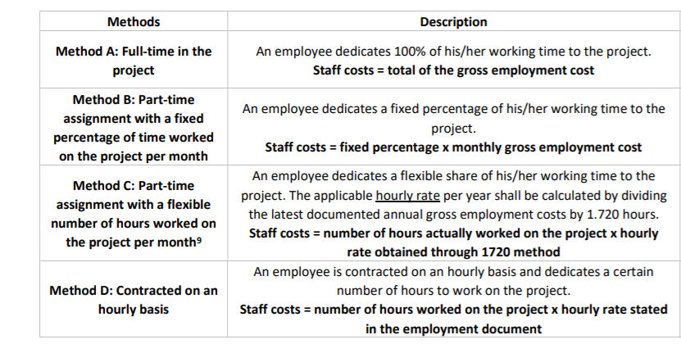
Highlights - eligibility of expenditures
Method “C” for staff costs has been deleted

Slide 17
Highlights - eligibility of expenditures public procurements
Rules may differ depending on the kind of goods/services to be purchased, the value of the purchase and the legal status of the awarding institution.
They are set at the following levels:
EU rules (i.e. public procurement directives1 for ERDF partners)
National rules
Interreg MED Programme rules and recommendations*
* 5.000 € (excl. VAT) < contracting amounts < threshold set by the applicable EU or national rules at least 3 offers (documented proof to be kept)
If the partner must comply with national or internal stricter rules, these stricter rules apply
IPA partner may opt to make use of the Practical Guide to Contract Procedures for EU External Actions (PRAG)

Slide 18
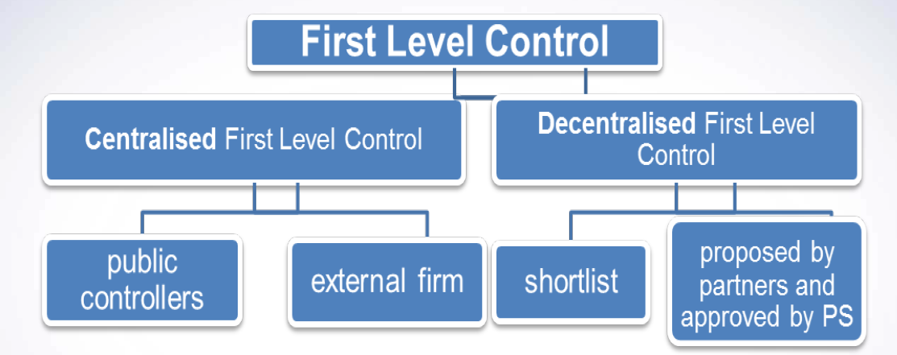
Appointment of FLCs
Art. 23 (4) of Regulation (EU) n. 1299/2013
It is responsibility of each Member State to set up a first level control system and designate the controllers responsible for verifying that the expenditures declared by beneficiaries from its territory complies with the applicable law and the Programme rules.
Control carried out by a controller proposed by the project partner and approved by a body designated at national/regional level
Control carried out at national level

Slide 19
Appointment of FLCs
Centralized System | Decentralized System
Croatia | Cyprus
Greece | France
Slovenia | Italy
UK (Gibraltar) | Malta
Albania | Spain **
Bosnia – Herzegovina | Portugal **
Montenegro
 | ** National validation must be obtained before submitting the payment claim. This must be taken into account in timetable for submitting claims.
Centralised system: A national central public body controls expenditures, the partner should contact the national body in charge of FLC;
Decentralised system: controller is selected by the partner, each project partner has to provide an approbation certificate delivered upon request by the approbation body designated by the Partner State, for the chosen first level controller

Slide 20
Audit trails
Partners must ensure that
all accounting documents linked to the project are available and filed separately and a separate accounting system and/or an adequate accounting code is in place.
there is a mechanism in place to avoid double funding
Original copies of documents to be kept by each partner until December 31st 2028, or longer if required by the Country's legislation.

Slide 21
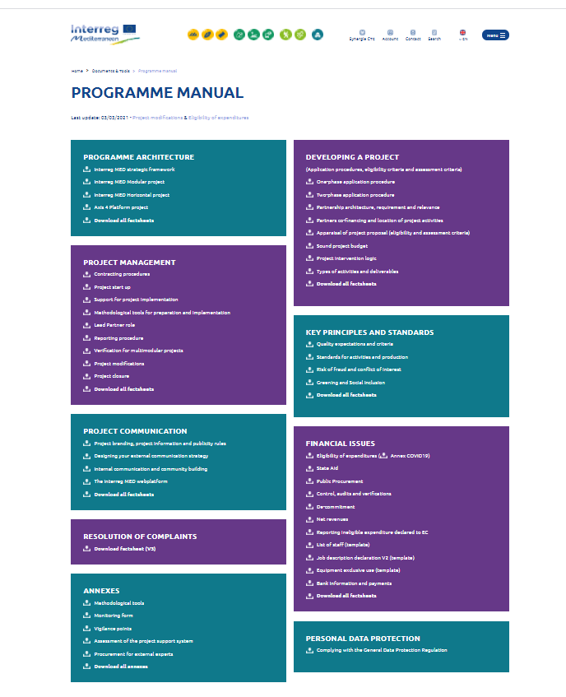
Reference documents
https://interreg-med.eu/
Programme Manual & other documents

Slide 22
Next steps
Methodology to carry out the needs analysis – by 06/08/21 - RAFVG
Identification of regional/local stakeholders (LWGs) – by 25/08/21 at the latest - RPs
Guidelines for the frontrunner analysis – by the beginning of September – CA Cluster
Transnational workshop - beginning of September – all PPs
World cafè and needs analysis – by 30/09/21 - RPs
Second online coordination meeting - ??? – all PPs

Slide 23
Thanks for your attention!

