Slide 1


ChIMERA PLUS
ChIMERA for Urban Sustainability
WP 3.3 Adaptation of ChIMERA methodology
(June 2021 - September 2021)
Kick-Off Meeting
26/07/2021

Slide 2

WP3.3 Overview
“…giver partners adapt ChIMERA methodology to receivers’ needs and support receiver partners in implementing ChIMERA process till the development of strategic action plans for their specific contexts”, AF p.3
GPs and RPs will carry out a Needs Analysis of receiver territories (support of CCI growth; potential of CCIs to foster sustainable urban development) → GPs will adapt ChIMERA methodology to RPs needs and will transfer it to RPs
RPs supported by GPs will identify stakeholders (policy makers, associations, CC subsectors, residents, etc.) dealing with CCIs potential for a sustainable urban development, involving them in working groups.
RPs supported by GPs will identify and analyze Frontrunner regions/cities on urban sustainability and role of CCIs for sustainability at European level

Slide 3
General overview of ChIMERA 3-step methodology
TWG & RWGs
State of the art & SWOT analysis
Frontrunners
(best practices)
Will allow the creation of recommendations to fill gaps and tune up the innovation supporting system for CCI sector

Slide 4
General overview of ChIMERA PLUS
3-step methodology
TWG & LWGs
3.3
Needs analysis and SWOT
3.3
Frontrunners
3.4
Development of a Strategic Action Plan to foster
the role of local CCIs in the transition process towards urban
sustainability and to support the development of regional/local CCI sector

Slide 5
Need Analysis of local CC sector
Giver Partners and Receivers Partners (with an external expert support) will carry out a Needs Analysis of receiver territories in terms of:
support of CCIs growth
potential of CCIs to foster a sustainable urban development (s.u.d.)
A bidirectional logic
what CCSs can do for the transition process towards urban sustainability |  | how the process towards urban sustainability can strengthen CCSs

Slide 6
Activation of local working groups (LWG)
Each partner will select CCI sub-sectors, present the project to main stakeholders and establishes a local working group (LWG).
LWGs should be created following the Quadruple Helix Model (Citizens; Government; University; Industry)
Maximum number of LWG members: 12 namely 3 persons for each QHM segment.
Selection Criteria for Regional Working Group
University | Partners should identify professors, researchers and students who work on CCI and urban sustainability field
Industry | Taking advantage of contacts’ list each partner should identify who are the main actors on the Industry segment related to urban planning and sustainability
Government | Main regional policy actors (Public Institutes, Regional Boards, Representatives of National Government in the Region, etc.) that have a significant regional role on CCI sector or with a decisive position on urban planning local policies and governance.
Citizens | The selection of citizens can be done through the use of regional media and social networks, by creating a call to attract the citizens for the purpose.

Slide 7
FRONTRUNNER ANALYSIS
RPs with external experts' support will carry out analysis of identified frontrunners regions/cities following adapted ChIMERA method:
DESK ANALYSIS
ONLINE INTERVIEWS to frontrunners on main aspects to promote urban sustainability and the role of CCI for sustainability (public policies, organization of systems/processes for a urban sustainable development, supporting services, models of interaction among key urban sustainability actors)

Slide 8
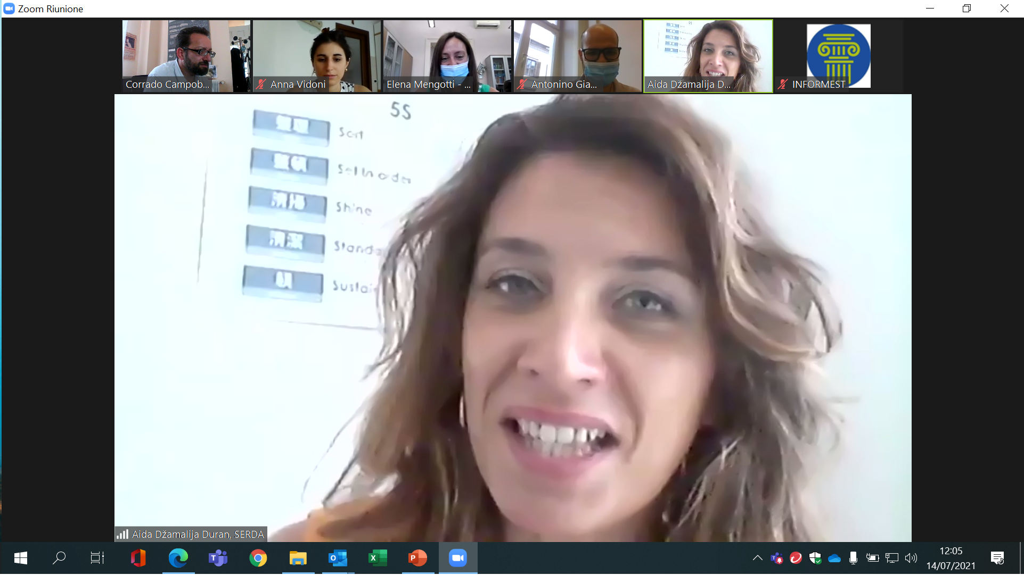
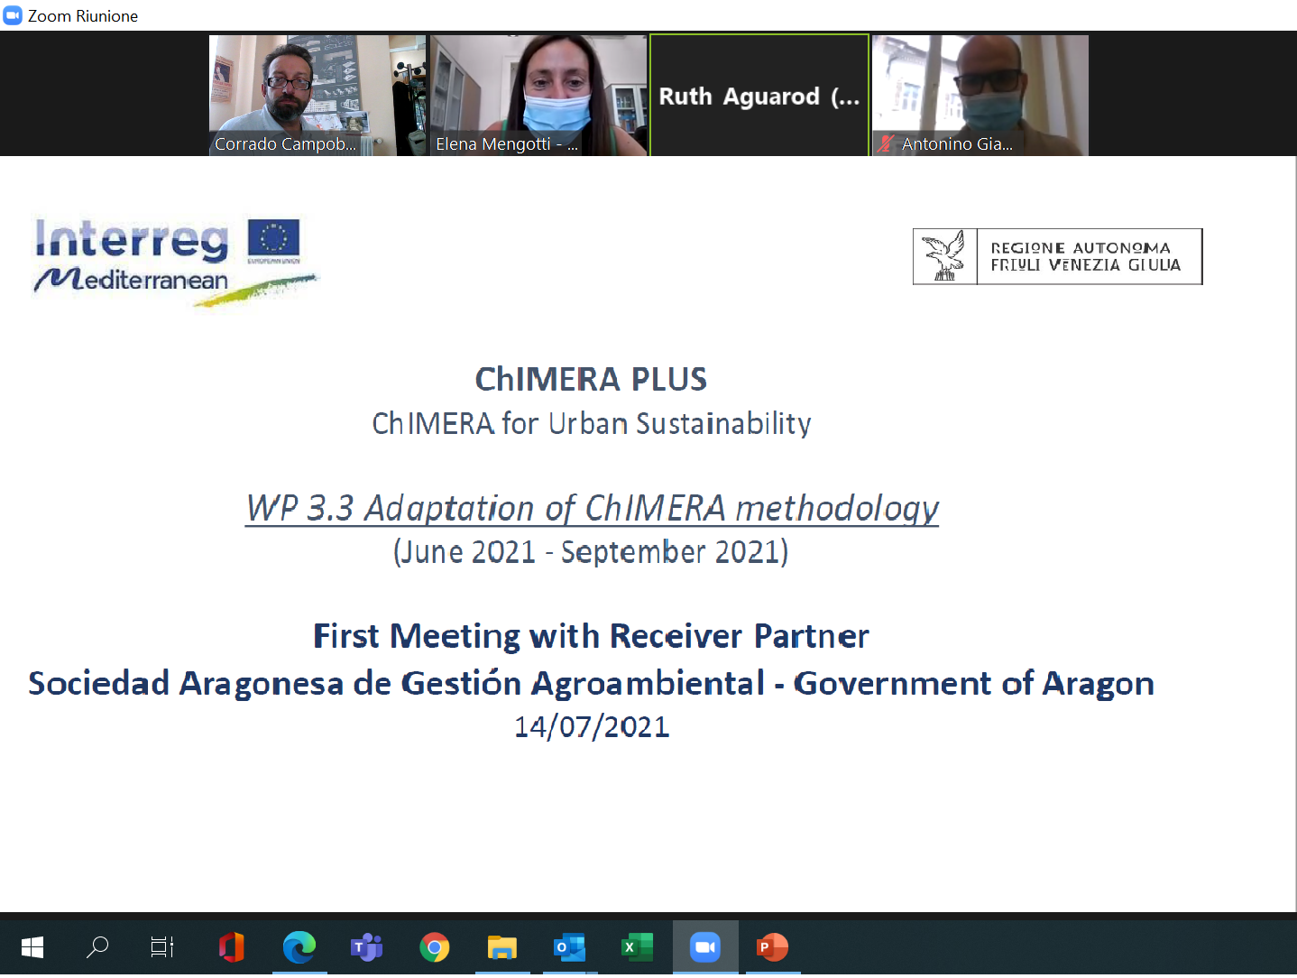
FVG Receiver Partners Meetings
FVG AR held three meetings with the Receiver Partners
09/07/21:Municipality of Nova Gorica
14/07/21: SERDA and SARGA

Slide 9
FVG Receiver Partners Meetings
The purpose of these first meetings with RPs was to collect information to calibrate the adaptation of the 3-steps ChIMERA methodology in a Urban Sustainable Development perspective
  “Receiver PPs (RPs) will share with givers PPs (GPs) main features of CCI sector of receiver territories”.
A number of points were addressed to collect Information and Feedbacks :
Urban Sustainability Objectives | Urban Sustainability Dimensions tackled
Previous experience of arts and culture in local planning practices | Stakeholders availability (policy makers, local and residents associations, CCS involved in s.u.d.)
Previous experience in citizen participation to local planning | CCIs suitable for participatory actions to identify creative solutions to urban sustainability

Slide 10

Urban Sustainability Objectives
    It is essential, as a first step, to identify the objective(s) of sustainable urban development (s.u.d.)
    The objective(s) constitutes the "guiding star" to identify the needed Resources, Skills and Stakeholders, both present and missing

Slide 11
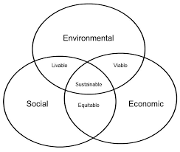
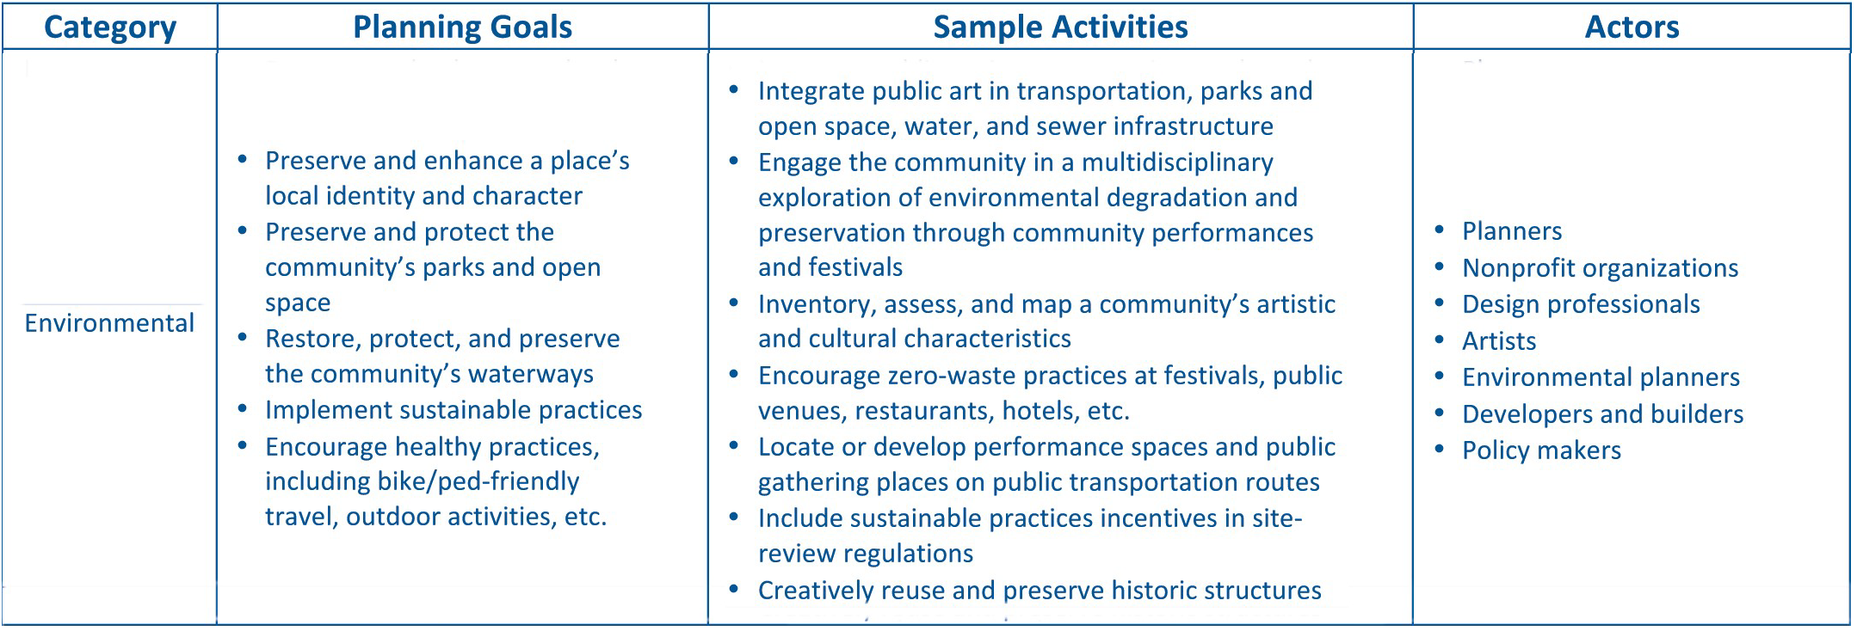
Urban Sustainability Dimensions tackled
The identification of the dimensions / categories (Social, Economic, Environmental, Community) affected by the objective constitute a second element of selection of the needed resources and actors

Slide 12
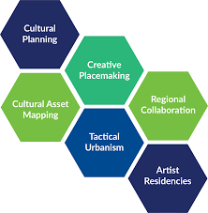
Previous experience of arts and culture involvement in local planning practices
These experiences are relevant to identify (or re-identify) communicative and operational practices allowing entities/ actors from the cultural and creative sectors to "team up" with local policy makers
These experiences are relevant to prevent and/or immediately identify possible obstacles (renitences; different perspectives, etc.) to LWGs activity
To assess the need for the intervention of professionals (animators) capable of mediating between the sphere of local politics and the cultural and creative one

Slide 13
Previous experience in citizen participation to local planning
The participatory approach is fundamental for the functioning of LWGs from a QHM perspective; previous experiences of participation of citizens/residents' associations in urban planning are relevant
Residents are carriers of significant requests and assessments that should be integrated into the SWOT analysis
In absence of experience in citizen participation to local planning → need to develop reflection/advocacy skills with respect to the urban sustainability issues at stake

Slide 14
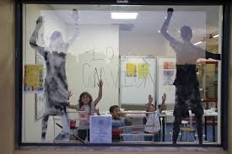
CCIs suitable for participatory actions for creative solutions to urban sustainability
A significant presence of the CCS (businesses and professionals) is important but not decisive: the most synergistic cultural and creative subsectors with respect to the specific actions to be developed must be identified
Existence of Spaces and Centers for Creativity to be involved and where to create debate (and community) around s.u.d. actions
Evaluate the possibility of launching a competition of ideas/hackathons with respect to the specific actions to be developed (Green spaces; Greenhouse gas Reduction; Public Transport; Transport Infrastructure; City Logistics ; Water/Air Quality; Waste/Reuse/Recycle; Housing)

