Slide 1
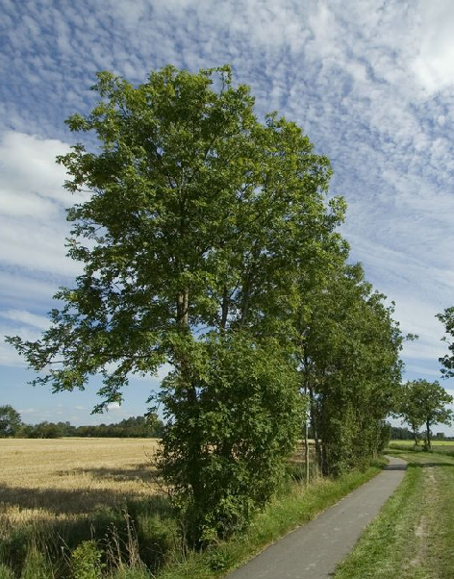
CHIMERA PLUS – ChIMERA for Urban Sustainability
KICK-OFF MEETING
26th July 2021

Slide 2
SARGA is a public company of the Government of Aragon that implements a wide range of projects and services addressed to improve the region
¿What is SARGA?
Our great expertise in agriculture and environment management is due to many years of experience and work implementing the agriculture and environment policies of the Aragon agriculture, livestock and environment department.

Slide 3
Significant figures
About 1.200 professionals.
3 headquarters (Zaragoza, Huesca and Teruel).
5 logistic centers.
Our stakeholders:
Farmers
Livestock farmers
Environment
Forestry

Slide 4
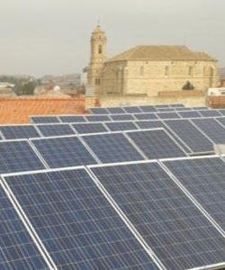
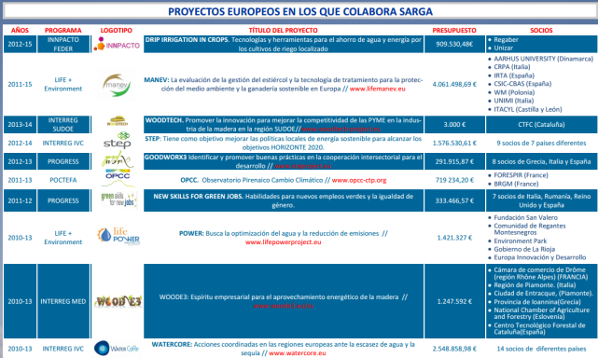
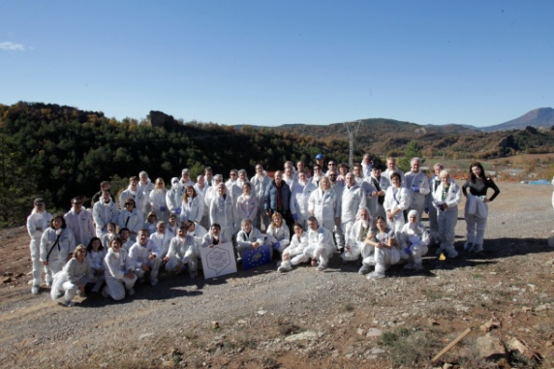
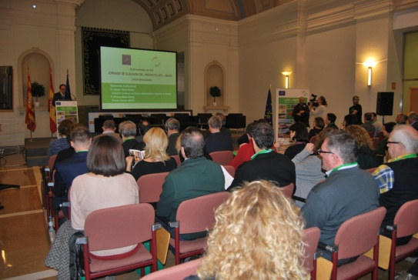
European Projects
About 30 European Projects:
5 LIFE
INTERREG MED, SUDOE, IVC, IIIA…
POCTEFA
H2020
ERASMUS+
PROGRESS
INNPACTO FEDER

Slide 5
Context of the region
Aragón is located in the north-eastern quadrant of the Iberian Peninsula and has a surface area of 47,720 square kilometres, with a population density of 28.23 inhabitants per km2.
Aragón is divided into 3 provinces: Zaragoza, Huesca and Teruel and has a total population of 1,300,000 people spread in 731 municipalities. Half of this population (almost 700,000) live in the capital, Zaragoza.
Zaragoza also generates 53.1% of the gross disposable income.

Slide 6
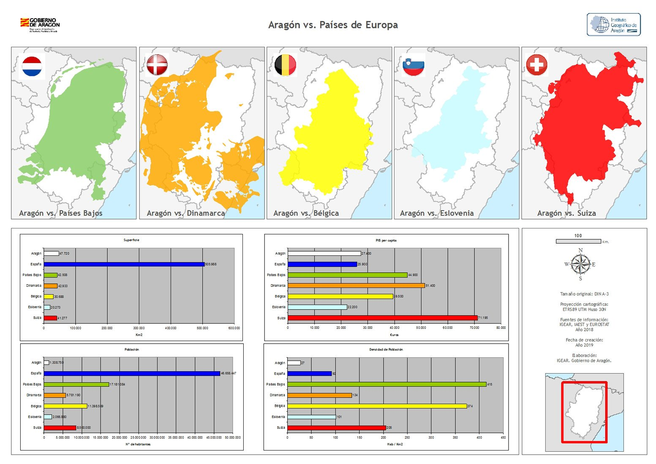
Aragón versus other EU countries in terms of length of the territory

Slide 7
Aragon, a very favourable environment for the 2030 Agenda.
Our region is committed to the SDGs. Quadruple helix players are involved in the 2030 Agenda.
We do have amazing natural resources and a rich cultural and monumental heritage, offering a large variety of touristic attractions and having a rich background of cultural and creative industries in terms of heritage, music, literature, visual arts, performing arts, handicrafts.
In 2008, Zaragoza hosted the World Expo on “Water and Sustainable Development”.

Slide 8
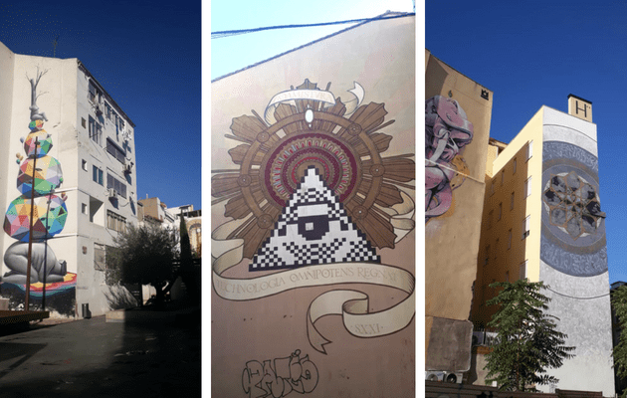
Examples of CCI initiatives related to urban sustainability in Zaragoza:
Festival Asalto: international urban art festival.

Slide 9
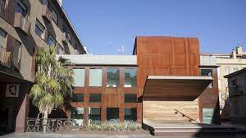
Examples of CCI initiatives related to urban sustainability in Zaragoza:
Espacio Las Armas: an initiative that aims to contribute to the commercial and social promotion of the area by attracting new visitors and promoting the visibility of entrepreneurial initiatives related to culture, design and creativity in the city.
This project tackled the regeneration of a large block in a degraded area of the city from a perspective that also incorporated social, cultural and economic revitalisation values, in a commitment to the so-called creative economy.

Slide 10
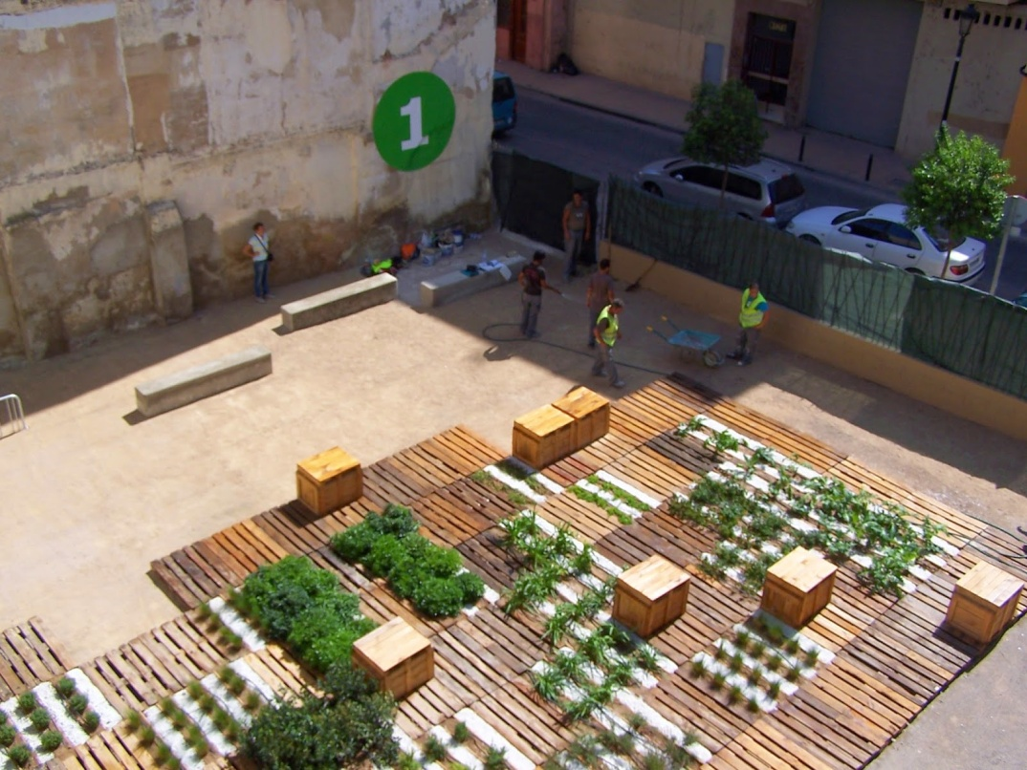
Examples of CCI initiatives related to urban sustainability in Zaragoza:
Esto no es un Solar: an initiative to use empty building sites in the historic centre of the city.
Citizen participation should be highlighted.

Slide 11
Examples of CCI initiatives related to urban sustainability in Zaragoza:
Made in Zaragoza: a network of creative entrepreneurs having an economic, social and/or cultural impact on the city.
Mercado de las Luces: an original flea market to give visibility to young local artists and creators.

Slide 12
But Aragón is not only Zaragoza:
The Centro de Arte y Naturaleza de Huesca (CDAN) has become a strategic partner of the New European Bauhaus initiative.
Through different actions it will try to break down the boundaries between the urban and the rural, the local and the global.

Slide 13
And that is why we would also like to explore CCI and rural sustainability within CHIMERA PLUS, if possible
on the axes formed between art-nature-landscape, climate change and the demographic challenge in rural areas.

Slide 14
THANK YOU VERY MUCH FOR YOUR ATTENTION

