Slide 1
Kick-off meeting
Chimera plus
26 July 2021
Programme co-financed by the European Regional Development Fund
Programme cofinancé par le Fonds européen de développement régional

Slide 2
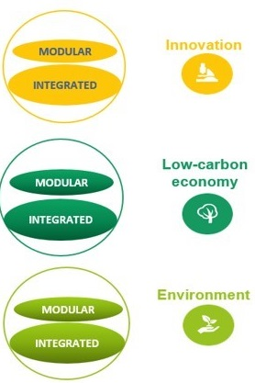
MED Architecture
PLATFORM and Strategic projects
Mediterranean shared vision on policies & actions
HORIZONTAL
projects
Thematic transnational
communities
MODULAR
projects
Local results
2
HP Green Growth
1
2/3
Facilitation
3
Axis 4 – Governance
HP Blue Growth
Results
1/2
1/2/3
Axis 1
Innovation
platform
PANORAMED
HP Social & Creative
Exchanges / Synergies
2
Strategic projects
Maritime & Coastal Tourism
Facilitation
1
2/3
HP Efficient Buildings
3
HP Urban Transport
Results
1/2
1/2/3
Axis 2
Low- carbon
economy
Strategic projects
Maritime Surveillance
Evidence-
based results
HP Renewable Energy
Exchanges / Synergies
2
Strategic projects
Innovation
HP Sustainable Tourism
Facilitation
1
2/3
3
HP Biodiversity Protection
Results
1/2
1/2/3
Axis 3
Natural
and cultural
Resources
Notes:
MED Architecture, components and interactions, situate the project;

Slide 3
Approved projects so far
Green Growth
Blue Growth
Social & Creative
20 projects
Urban transport
9projects
12 projects
Renewable Energies
11 projects
15 projects
Efficient buildings
17 projects
Biodiversity Protection
19 projects
Governance
7 projects
Sustainable tourism
30 projects
117 modular projects
8+8
Horizontal projects
2
Carbon foorprint projects
1
Platform project
6
Strategic projects
142 approved projects
82 finalised
44 ongoing
16 just approved
Notes:
In 11 calls for proposals between 2015 and 2021, we have approved 142 projects. The 1st started at the end of 2016.

Slide 4
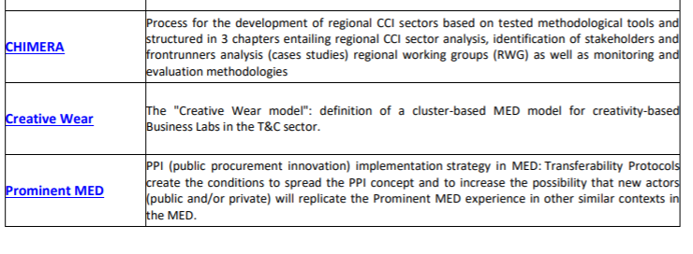
Transferring and Mainstreaming projects
Social & Creative

Slide 5
Transferring and Mainstreaming projects – key features
Restricted Call
Build upon concrete 2014-2020 Interreg MED projects’ achievements
Further capitalise on completed projects’ outputs
Very precise content, composed of 'transfer’ or 'mainstreaming’ activities
A mixed partnership between ‘givers’ and ‘receivers’

Slide 6
Challenges
Programme conditions: Jump Start, short implementation period, no extension
Covid-19 Impact
Transition period for EU programmes
Integration of new partners
Facilitating processes
Simplified Application Form
Simplified reporting process
Use of existing website and social medias
Work with HPs on transferring methodologies

