Slide 1
ChIMERA +
ChIMERA for Urban Sustainability
Kick off Meeting
26/07/2021
Elena Mengotti
Regional Department for culture and sports
Friuli Venezia Giulia Autonomous Region

Slide 2
CCIS IN FRIULI VENEZIA GIULIA
The cultural and creative production system in RAFVG represents 5.3% of the regional economy, with over 1.8 billion euros.
The sector involves over 31,000 workers, which represent 5.8% of the employed people in the Region.
FVG ranks at the top for the incidence of software and videogames sector on the total (with 14%).
Source: «Io sono cultura 2020», Symbola

Slide 3
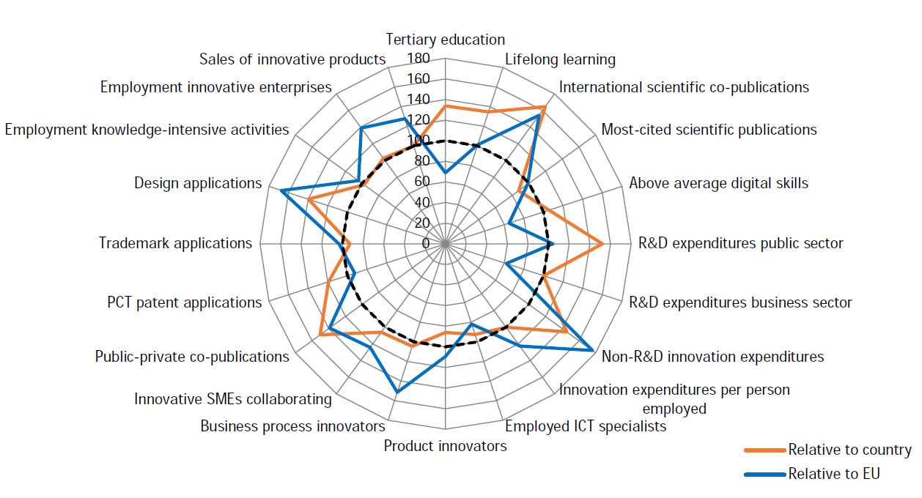
REGIONAL INNOVATION SCOREBOARD
Friuli-Venezia Giulia (ITH4) is a Strong Innovator: Innovation performance has increased over time (25.1%).
The radar graph shows relative strengths compared to Italy (orange line) and the EU (blue line), showing relative strengths (e.g. Non-R&D innovation expenditures) and weaknesses (e.g. R&D expenditures business sector).
Source: Regional Innovation Scoreboard 2021

Slide 4
WHAT WE DO
1
Protection and valorization regional cultural heritage;
2
Promotion of cultural activities;
Support to the starting-up and the development of Cultural and Creative Industries (ICCs);
4
Cultural heritage as the engine of the economy.
3

Slide 5
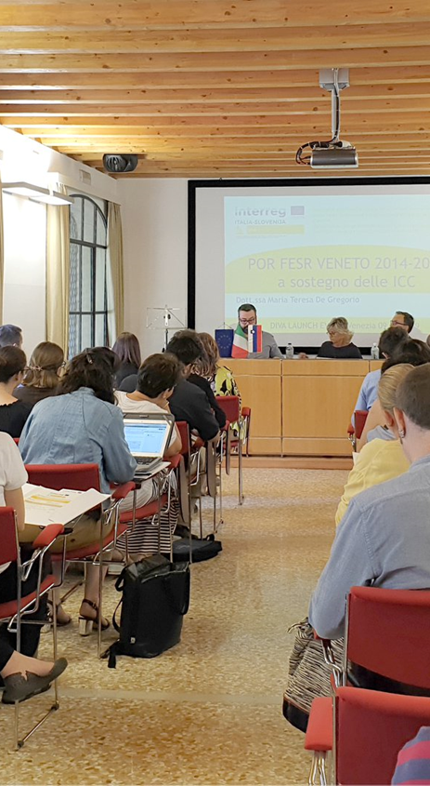
SEVERAL EU PROJECTS TO SUPPORT CULTURE AND CREATIVITY
Strengthen the role of cultural heritage, transforming it into SACHE: «Smart Accelerator of Creative Heritage Entrepreneurship».».
Strengthening cooperation between key ecosystem actors, in order to enhance the transfer of knowledge, introducing elements of disruptive innovation in the key sectors of the CCIs’ area.
Thanks to DIVA a 900,000 euro tender has financed 21 cross-border business ideas in the CC sectors.
Organization of the 1st regional fair of culture and creativity.
DURATION: 36 months
01.01.2019 - 31.12.2021
BUDGET: 2.062.753,85 €
DURATION: 40 months
01.03.2019 - 30.06.2022
BUDGET: 3.525.018,70 €

Slide 6
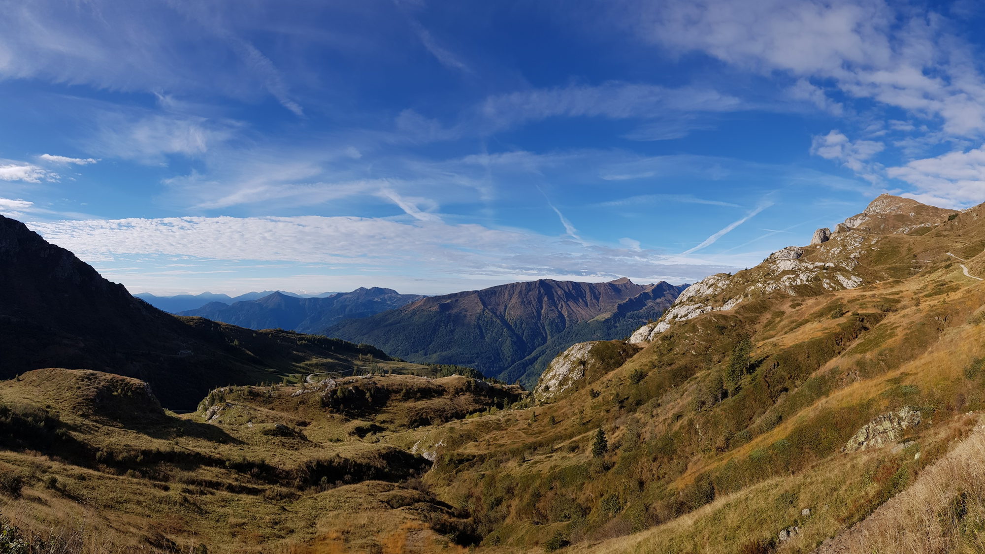
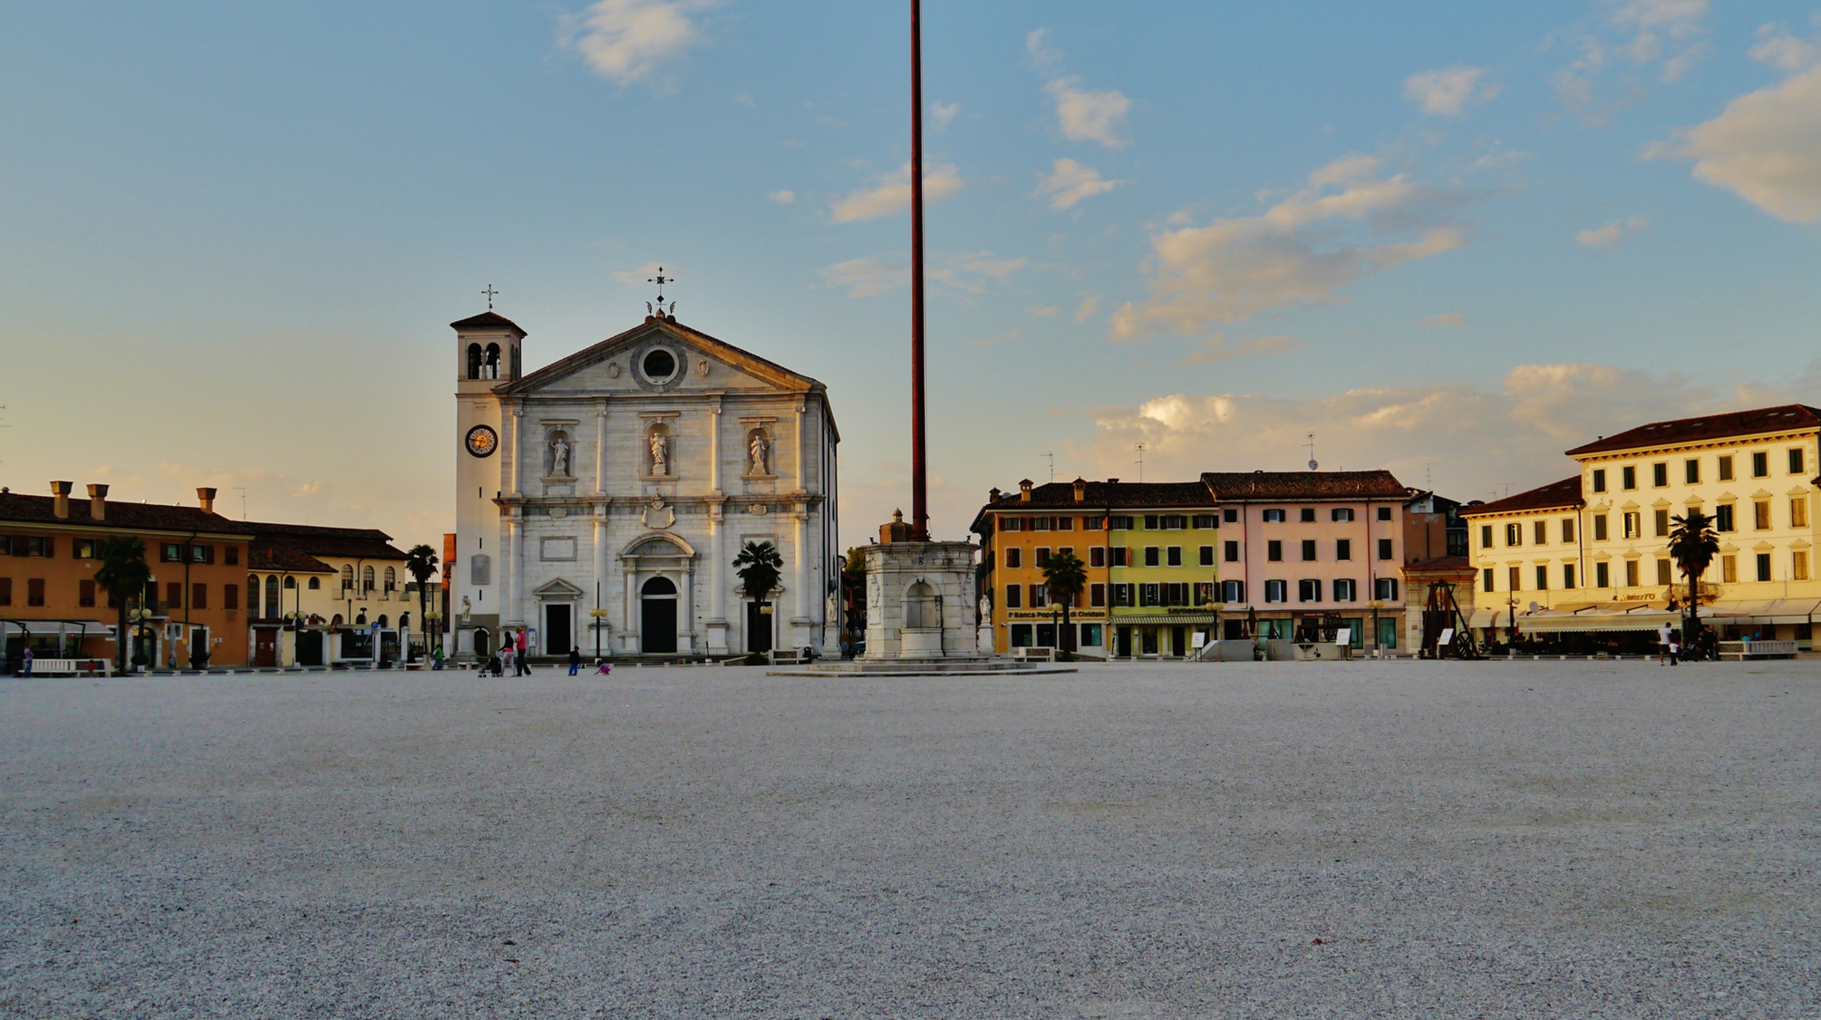
SEVERAL EU PROJECTS TO SUPPORT CULTURE AND CREATIVITY
CROSSINNO wants to promote:
an in-depth analysis on regional cross-fertilization between cultural heritage, CCIs and traditional SMEs;
two pilot actions to create synergies between CCIs and the cultural heritage, favoring innovation processes.
It aims to preserve the cultural heritage, promoting sustainable and experiential tourism, exploiting the potential of the CCIs.
The project foresees the realization of the permanent Assembly for Culture of the ADRION area.
DURATION: 30 months
BUDGET: 1.847.410,00 €
DURATION: 30 months
BUDGET: 659.235,00 €

Slide 7
REGIONAL CLUSTER FOR CULTURE AND CREATIVITY
Launched by a public tender in July 2019, the Cluster is managed by a Consortium of business incubators. The financial endowment for the period 2021-2023 is € 600,000.00.
The Cluster offers the following services:
Skills catalogue
Community building and networking
Promotion

Slide 8
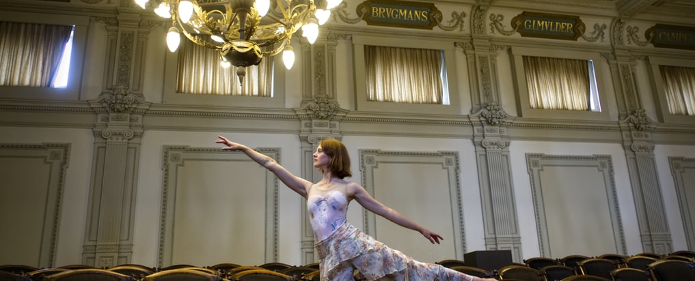
PROFESSIONAL TECHNICAL POLE OF THE CULTURAL AND CREATIVE SECTOR
The areas of activities are:
Conservation and enhancement of the historical and artistic heritage;
performing arts, visual arts and live entertainment;
creative industry related to the world of services;
activities related to the production of goods and services.
In 2019, FVG Region launched a call for tenders for the selection of the managing consortium for the Professional Technical Pole of the cultural and creative sector and for the implementation of coordination actions.
It is a new regional Center for high level professional training in the cultural and creative sector.

Slide 9
THANK YOU FOR THE ATTENTION!
Elena Mengotti
Regional Department for culture and sports
Friuli Venezia Giulia Autonomous Region

