Slide 1


CROSSINNO
Kick off meeting – Belluno 13/01/2020
Work Package Presentation
WP2 - Communication
Partner: PP3 – Friuli Venezia Giulia Autonomous Region – Department for Culture and Sports

Slide 2


WP aims
The WP aims at increasing the awareness on the project themes and at disseminating the results of the project to a wide range of stakeholders in the Programme area
The WP will implement a shared communication strategy defined at the beginning of the project and addressing different typologies of targets
The WP is led by PP3 – FVG AR
CROSSINNO ITAT1044 – Interreg ITAT 2014/2020

Slide 3
Regulatory framework
Regulation (EU) n. 1303/2013 (CPR – Annex XII in particular)
Commission Implementing Regulation (EU) n. 821/2014
Regulation (UE) n. 679/2016 (General Data Protection Regulation - GDPR)
IT-AT Programme Communication Strategy
CROSSINNO ITAT1044 – Interreg ITAT 2014/2020

Slide 4
Communication target groups
EXTERNAL COMMUNICATION
Citizens
National Authorities
Public and private entities working on the natural and cultural heritage sector
No profit organisations of the cultural sector
Cultural and Creative Industries
University and training institutions
Media: bloggers, journalists, TV, Radio, Press, On line media and social networks
INTERNAL COMMUNICATION
Partner Teams:
Project partner
External experts
Programme bodies:
JS (LP and WP2 Leader)
Managing Authorities (LP)
CROSSINNO ITAT1044 – Interreg ITAT 2014/2020

Slide 5
WP activities
2.1 – start-up activities
2.2 – definition of corporate identity
2.3 – realisation of communication materials
2.4 – organisation of communication events
CROSSINNO ITAT1044 – Interreg ITAT 2014/2020

Slide 6
2.1 – start-up activities
WP LEADER
Elaborates communication and dissemination strategy and prepares the related plan
OTHER PPs
LP contributes to the communication plan
PROPOSED TIMING: March 2020
CROSSINNO ITAT1044 – Interreg ITAT 2014/2020

Slide 7
2.2 – definition of corporate identity
WP LEADER
Defines the project infographic and the corporate identity and the layout of templates for communication materials
OTHER PPs
LP, PP1 and PP2 contributes to the definition of the project infographic
PROPOSED TIMING:
May 2020
CROSSINNO ITAT1044 – Interreg ITAT 2014/2020

Slide 8
2.3 – realisation of communication materials
WP LEADER
Produces the following communication materials:
roll-up
A3 poster
digital brochure on «best practices»
project video
story telling video
OTHER PPs
All PPs provide contents for brochure and video (to be agreed as not foreseen in AF)
PROPOSED TIMING
roll-up and A3 poster:
March 2020
PROPOSED TIMING promotional materials:
March 2022
CROSSINNO ITAT1044 – Interreg ITAT 2014/2020

Slide 9
2.4 – organisation of communication events
WP LEADER
Organises 1 local thematic workshop addressed to stakeholders and policy makers
Participates in 1 cross-border event and to the final conference
Publishes at least 1 press release
OTHER PPs
PP1 and PP2 organise 1 local thematic workshop in collaboration with LP
LP and PPs participate in 1 cross-border event and publish at least 1 press release each
PROPOSED TIMING:
March 2022
CROSSINNO ITAT1044 – Interreg ITAT 2014/2020

Slide 10
Reminder on communication rules
The WP leaders wishes to draw the attention of PPs on communication obligations (annex XII reg. (UE) 1303/2013):
A3 poster (see available Programme template)
use of the logo
project page on the PP institutional website
For further information, please check the Programme manual on communication activities available on the Programme website
CROSSINNO ITAT1044 – Interreg ITAT 2014/2020

Slide 11
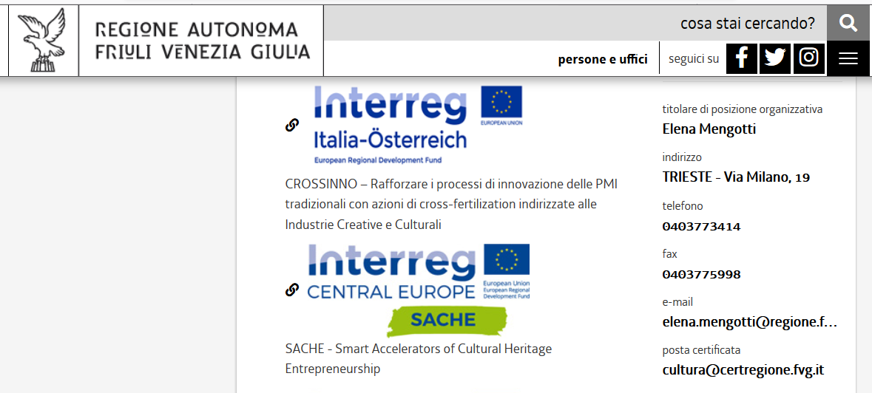
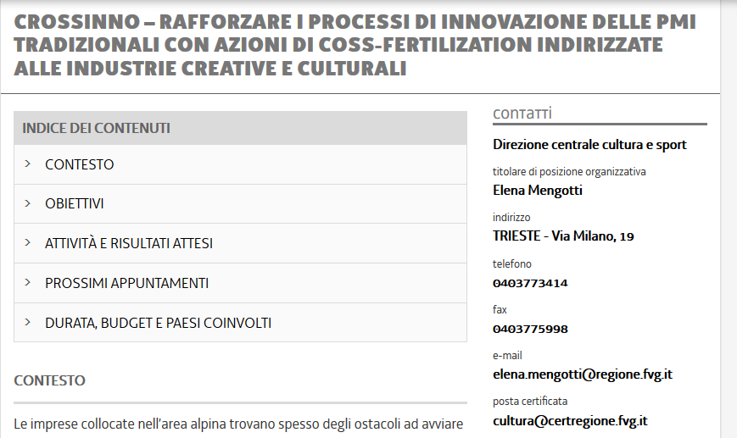
Website example
CROSSINNO ITAT1044 – Interreg ITAT 2014/2020

Slide 12
Issues to be discussed
the partnership needs to define the specific timing of all communication activities and date of delivery of milestones
budget constraints shall also be duly taken into consideration when planning and realising communication materials (12.000 Euro available for communication materials)
Clarification on quantification and contents of communication materials
CROSSINNO ITAT1044 – Interreg ITAT 2014/2020

Slide 13


Contacts
For any doubt or need in relation to WP2 activities, please contact:
elena.mengotti@regione.fvg.it +39 040 377 3414
irene.iurin@regione.fvg.it
project-crossinno@informest.it
CROSSINNO ITAT1044 – Interreg ITAT 2014/2020

Slide 14
Thank you for your attention!
WP2 – Communication
Partner PP3
Friuli Venezia Giulia Autontomous Region
Department for Culture and Sports
CROSSINNO ITAT1044 – Interreg ITAT 2014/2020

