Slide 1
Creatoures cultural routes in Slovenia from the content creators perspective
Presented by: Maša Klavora, Ustanova «Fundacija Poti miru v Posočju»
Prepared by: Boštjan Cotič, UIRS and
Maša Klavora and Tadej Koren, Ustanova «Fundacija Poti miru v Posočju» and
Natalija Lapajne, MAO

Slide 2
Creatoures cultural routes in Slovenia from the content creators perspective – the process
Preparation of the Local Action plan (LAP)
  A Pilot action – two new Creative cultural routes
The role of the Local Stakeholders group
  Participation in defining the objectives of the Local action plan
  Open call among Local Key stakeholders to present draft ideas for new routes (march and june 2021)
  3 applications:
    Tourism Ljubljana: Giants of cultural heritage in Ljubljana
    Museum of Architecture and Design: "Wherever the river flows, that's where I want to be" - Bridges and embankments of the Ljubljanica river.
    Walk of Peace Foundation: The story of a young soldier on the Soča river (Isonzo) WW1 front.
  2 selected based on the objectives of the Local Action plan (strong involvment of CCI, polycentric development of new routes, focus on younger tourists…)

Slide 3
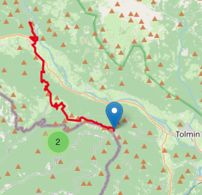
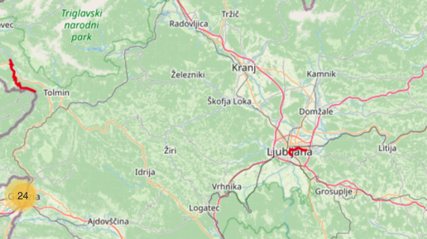
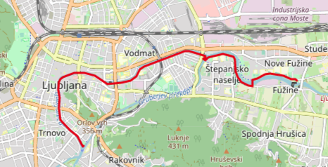
Locations ot the two new routes
Route no.2:"Wherever the river flows, that's where I want to be" - Bridges and embankments of the Ljubljanica river
Route no.1: The story of a young soldier on the Soča river (Isonzo) WW1 front
Source of photos: Creatoures project photos

Slide 4
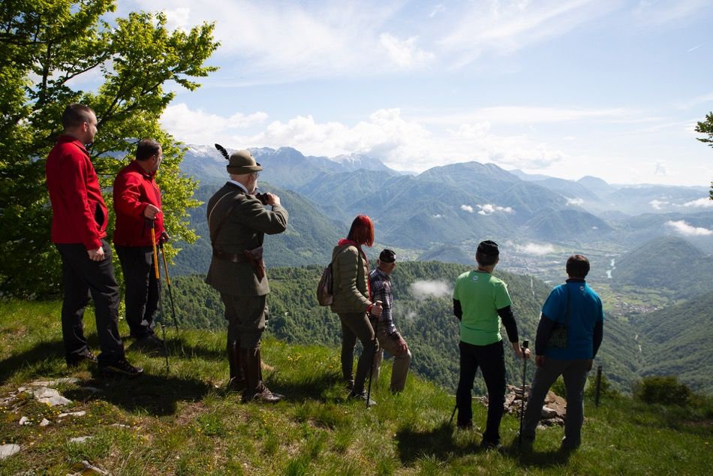
Route no.1: The story of a young soldier on the Soča river (Isonzo) WW1 front
The route is ideal for hikers as it passes by picturesque locations in Kobarid.
It is a bit shorter route, focused on the younger audience
The route connects the historical place of Kobarid, which was particularly marked by the First World War, with historical locations nearby.
The endpoint of the route is a Kolovrat open-air museum, which impresses visitors with its historical narrative and beautiful views from the Alps to the Adriatic.
Source of photos: Creatoures project photos

Slide 5
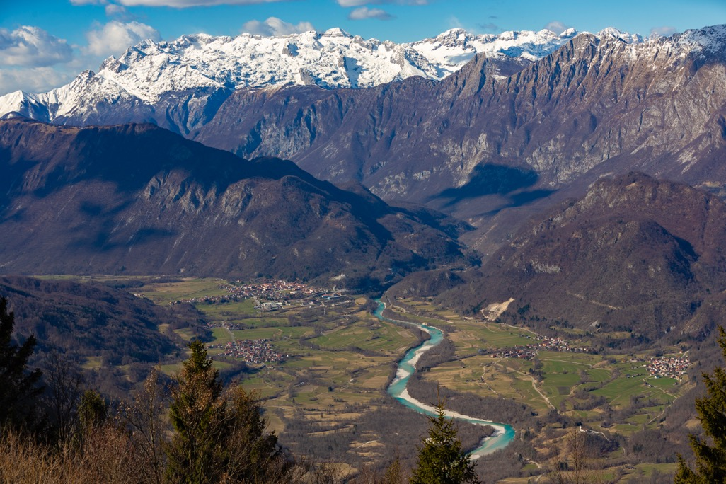
Route no.1: The story of a young soldier on the Soča river (Isonzo) WW1 front
The route is a great idea for a family trip through history and nature. Open-air museums and organized caverns offer children exciting exploration and time travel.
The path offers an opportunity to all those who were marked by the consequences of the WW1 in their ancestors, to come to terms with their sad fate.
Attractive programs are available for school and other organized groups, which offer interesting experiences under the guidance of experienced guides at selected locations.
Source of photos: Creatoures project photos

Slide 6
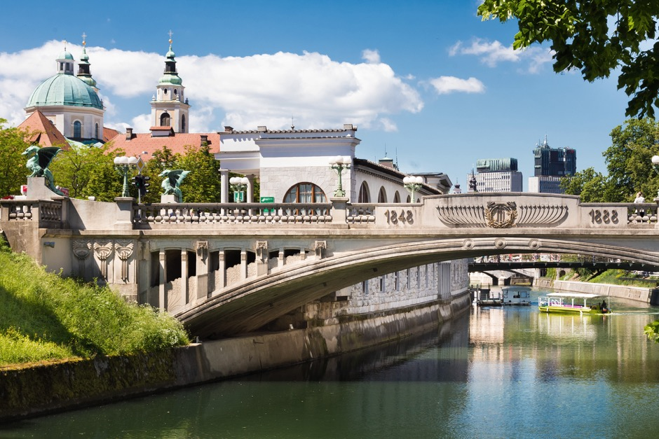
Route no.2: Wherever the river flows, that's where I want to be" - Bridges and embankments of the Ljubljanica river
The route offers an innovative tour of Bridges and embankments of the Ljubljanica river focused on the background of the design concepts of bridges and embarkments.
A great deal of effort was put into the research to gain some new info about the cultural heritage of the route. (archives search, interviews with architects, cultural heritage experts,…)
Children and young adults will interview authors (architects) or experts (for cultural heritage) in phase 2. they will also define questions (how it was done..)
The only possible methods to visit the route are by boat, by sup, by bike or walking. It is not possible to visit it by a car.
Source of photos: Creatoures project photos, archives

Slide 7
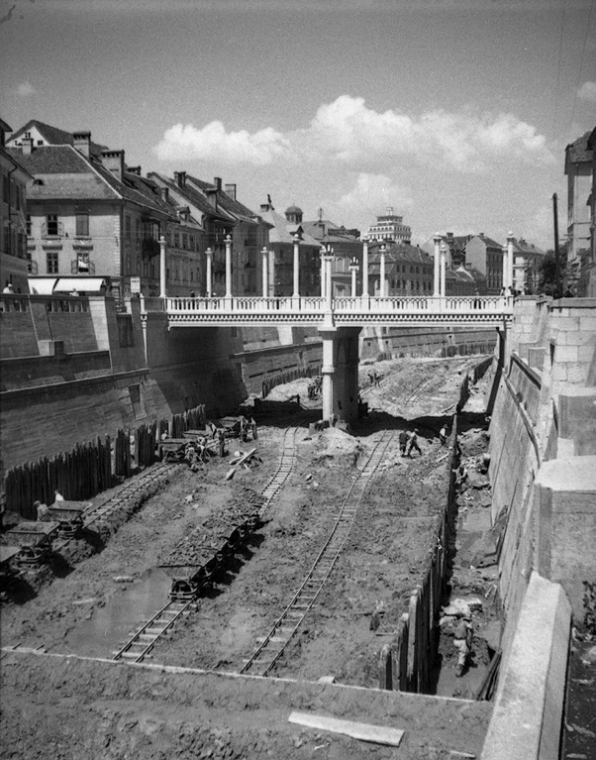
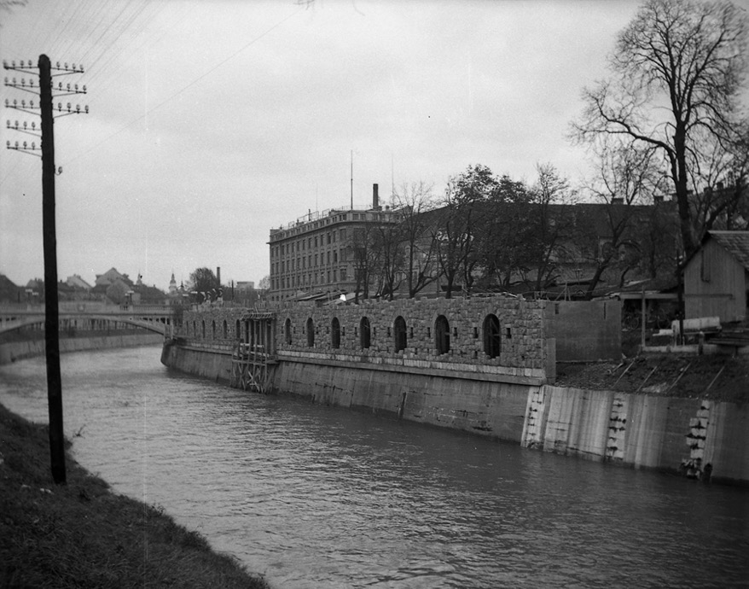
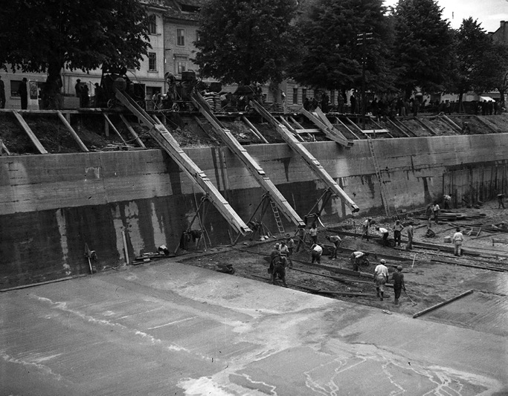
Route no.2: Wherever the river flows, that's where I want to be" - Bridges and embankments of the Ljubljanica river
Source of photos: archives SEM Peter Naglič

Slide 8
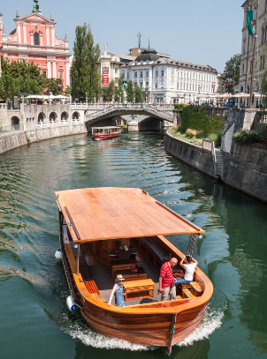
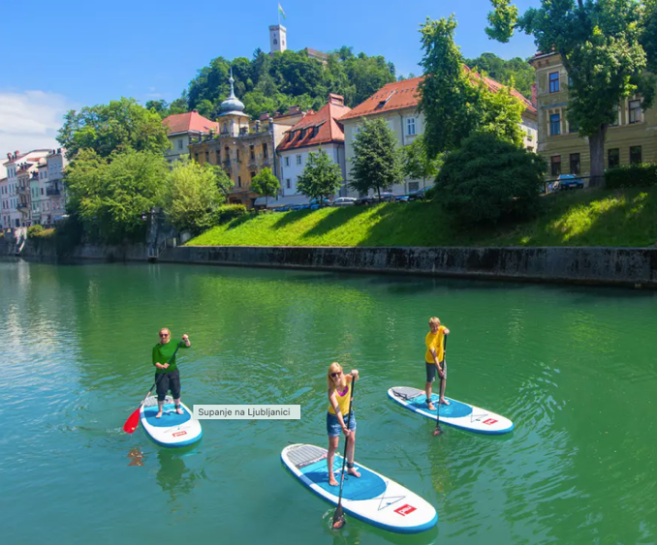
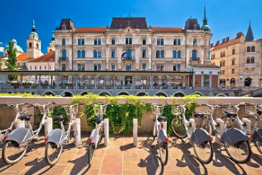
Route no.2 Explore the Bridges and embankments of the Ljubljanica river by boat, by sup, by bike or walking
Source of photos:
Creatoures project photos
www.barka-ljubljanica.si/
www.visitljubljana.com/
www.ljubljana.si/sl/aktualno

Slide 9
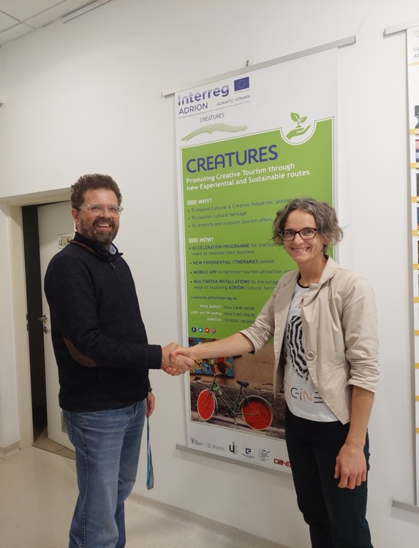
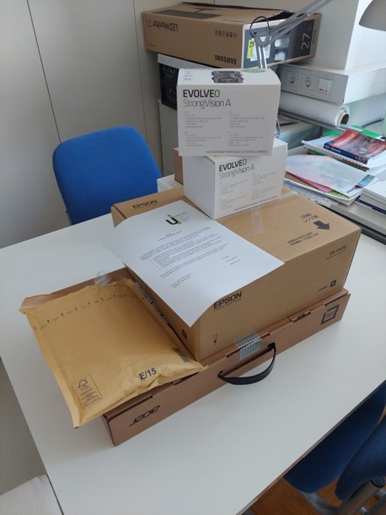
Project Creatures support in the developments of the routes:
Consultations for the development of the idea
Promotion and multimedia
Equipment for both locations
Press tour (t.b.d.)
Other actions
Source of photos: Creatoures project photos

