Slide 1




“Sustainable Creative Tourism - Perspectives from different territories”
The Region of Western Greece
Speaker: Danai Katsanta, Chamber of Achaia (GR), MSc Digital Art & Technology (EU Project Manager) , dkatsanta@e-a.gr
Partner: Patras Science Park / Chamber of Achaia (Associate partner)
Sustainable Tourism & Culture: Building new opportunities|Trieste| 21.10.2022

Slide 2
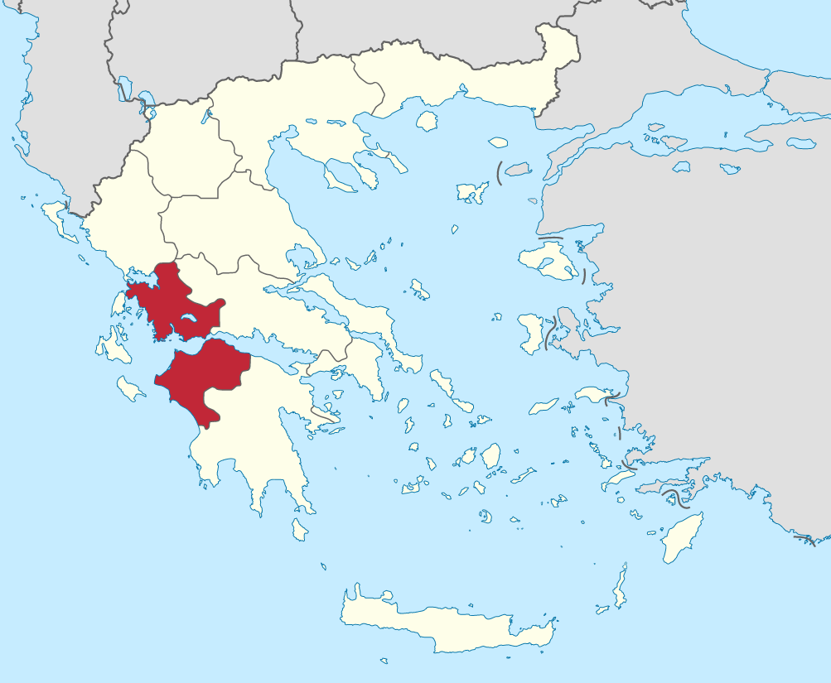
“Sustainable Creative Tourism - Perspectives from different territories”
The Region of Western Greece
Main Characteristics of Tourism in Western Greece
3 Prefectures: 1.Achaia, 2.Aitolia & Akarnania, 3.Ileia
Trying to rise both domestic and international-incoming tourism
Low flows of inbound travel traffic
“By-pass” region (weakness for our Region)
Tourism seasonality
2 cities acting as City Break + Culture & Shopping (Patras-Nafpaktos/Lepanto).
Creative Tourism: the sector that contributes to Regional Greek GDP growth and employment.
Notes:
Παράδοξο: πλούσια πολιτιστική κληρονομιά vs διερχόμενος τουρισμός που δεν μένει στην περιοχή

Slide 3
“Sustainable Creative Tourism - Perspectives from different territories”
The Region of Western Greece
Culture & Tourism in numbers
A rich history of 30 centuries
>460.000 visitors per year (Data 2019)
>400.000 visitors per year during Patras Carnival Period
2 UNESCO World Heritage Archaeological Sites
  The Archaeological site of Olympia-cradle of the Olympism (1989) &
  The Temple of Epicurious Apollo (1986)
>314 points of interest (museums, attractions, tours, etc) (TripAdvisor for the destination “Achaia, Aitolia & Akarnania, Ileia” )
Notes:
πλούσιο ιστορικό / θρησκευτικό απόθεμα (αρχαιολογικοί χώροι, πόλεις της Πάτρας, της Ναυπάκτου και του Μεσολογγίου με αρχιτεκτονικό / ιστορικό ενδιαφέρον, κάστρα, μουσεία, κ.α.) με σχετικά περιορισμένη αξιοποίηση και απήχηση, άυλο πολιτιστικό / λαογραφικό κεφάλαιο, σύγχρονη πολιτιστική παραγωγή και πολιτιστικές εκδηλώσεις και ιστορικό πλαίσιο κατάλληλο για τη δημιουργία αφηγηματικού περιεχομένου (βλέπετε επόμενες σελίδες)

Slide 4
“Sustainable Creative Tourism - Perspectives from different territories”
The Region of Western Greece
RoWG’s Strategic directions ½*
Main aspects & Sustainability indicators
1. Improvement of basic cultural infrastructure
2. Upgrade & promotion of tourist product
    Indicator: Cultural establishment of the destination
    Indicator:
    Volume of tourism demand
-Upgrading of additional infrastructure of museums & monuments
-Promotion & highlighting of cultural, historical & religious stock
-Design and build high-level experiences and activities
-Strengthening and upgrading the offered experience with other tourist products
-Digital upgrade & transformation
Notes:
186 page

Slide 5
“Sustainable Creative Tourism - Perspectives from different territories”
The Region of Western Greece
RoWG’s Strategic directions 2/2 *
Main aspects & Sustainability indicators
3. Skills enhancement & entrepreneurship development
4. Environmental protection & sustainability
    Indicator:
    Volume of tourism demand
    Employment generated by the service sector
    Indicator:
    a) Protection of valuable natural assets
-Providing incentives to Cultural & Religious Tourism businesses
-Promotion of cooperation between the public & private sectors with the aim of exploiting cultural resources
-Strengthening + upgrading the skills of industry professionals
-Sustainable management, protection and promotion of cultural heritage
-Protection and exploitation of the building stock / settlements of cultural interest
Notes:
186 page

Slide 6
“Sustainable Creative Tourism - Perspectives from different territories”
The Region of Western Greece
Indicative key socio-economic impacts of Creative Tourism
  Tourist product & tourist activity
    Quality upgrade, development of an integrated tourist product and distinct tourist identity to highlight the three poles of the Region / destination
    Strengthening the competitiveness of the destination at the national level
  Direct economic impact
    Increase in tourist revenue of inbound tourism
  Employment and training in the tourism and hospitality industry
    New jobs creation in the tourism sector
    Increasing the number of employed people and contributing to the reduction of unemployment
    Improving the quality of jobs
    Strengthening the skills and training of those employed in the tourism sector

Slide 7
“Sustainable Creative Tourism - Perspectives from different territories”
The Region of Western Greece
What’s next?
  It is observed that Creative tourism practices, make a shift towards new ideas and quality searches
  Tourism combined with culture & creativity can be-with the right ones adjustments- a driving force of the economy of Western Greece.
  It incentivizes creative industries which are expected to improve their production spaces by making them friendlier in communicating with the public and transferring knowledge
  Promotion of research on the interconnection of tourism with culture, including synergies with creative industry (eg ICT applications in museums and archaeological sites, spinoffs –startups, partnerships in living labs in destinations high traffic etc.)
  Further promotion and Development of Tourism product "AGRO, ECO, GASTRO, CARNIVAL, CULTURE, PERFORMING ARTS, LIFESTYLE, LUXURY, ACTIVITIES”

Slide 8
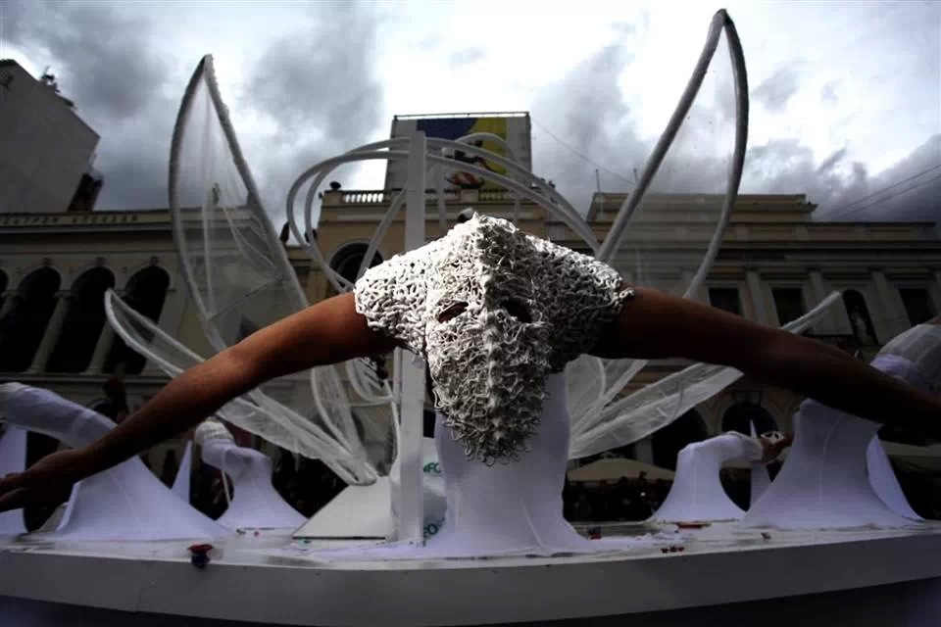
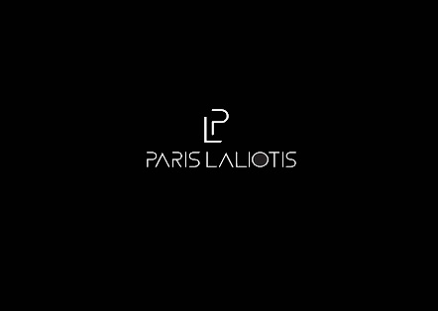
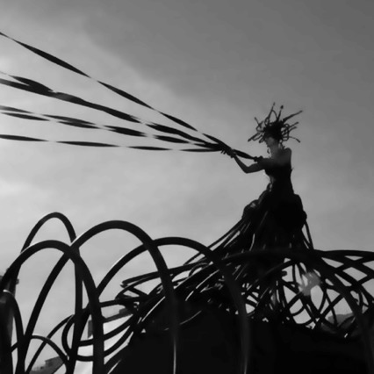
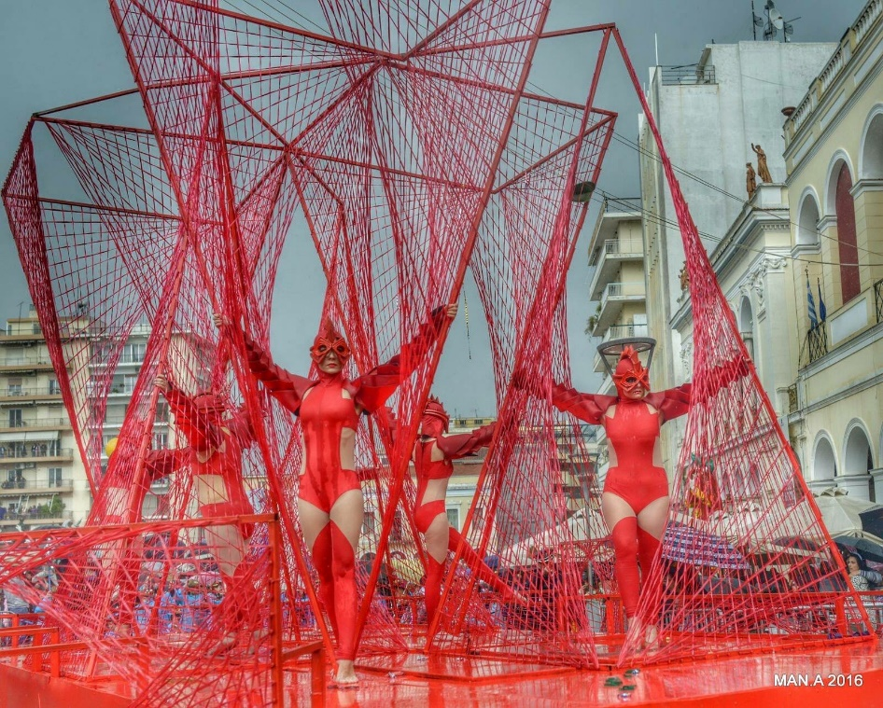
“Sustainable Creative Tourism - Perspectives from different territories”
Some good examples
  “PARIS LALIOTIS & G86”: Musician, Stage Designer, Visual Artist, Founder of Patras Carnival Group G86
  Created in 2011 to give new aesthetics to the carnival tradition, based on new forms, dramatic displays of acrobatics and kinesiology towards the creation of a theater stage.
  Offering a 4-day package, anyone would like to join the g86 street theater performance, will live the ultimate street theater experience. Become part of this unforgettable performance in the largest carnival parade of Greece and the Balkans.

Slide 9
“Sustainable Creative Tourism - Perspectives from different territories”
Some good examples
  “On the Spot”: a startup created by the need of Achaia Prefecture to attract cultural tourists, visiting our Region not only in the Patras Carnival Period but to search and find travel packets containing theatre performances, art exhibitions, gastronomy, carnival and religion tourism.

Slide 10
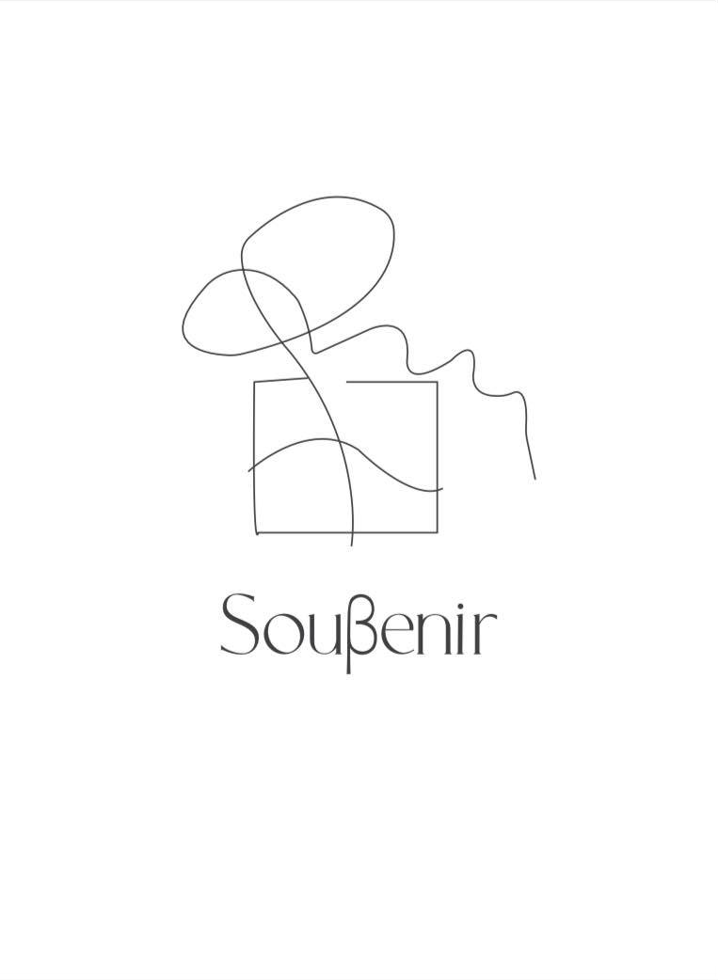
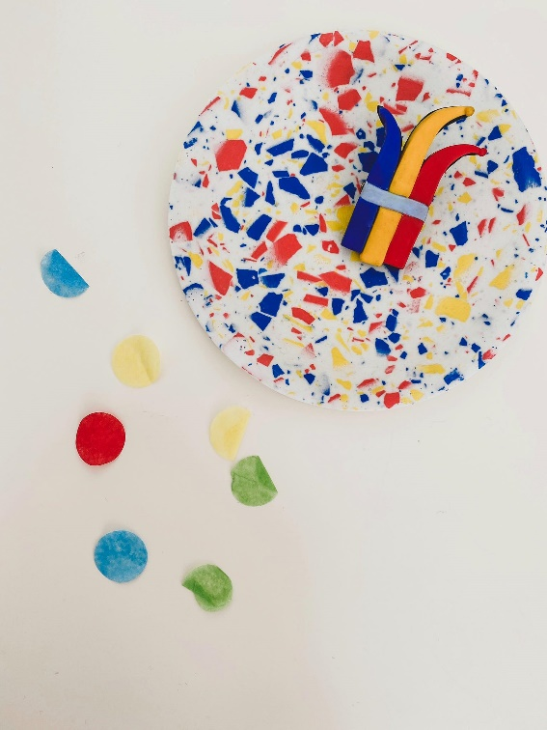
“Sustainable Creative Tourism - Perspectives from different territories”
Some good examples
  “Souvenir” : a startup funded by ENI CBC MED programme, created by the need to have personalized souvenirs when visiting Patras and Achaia prefecture, something to bring home when you leave the capital of Western Greece.

Slide 11
“Sustainable Creative Tourism - Perspectives from different territories”
Conclusion
  “An essential issue remains the safeguarding of the Sustainable Creative Tourism mechanisms. Those which will allow local communities, not only to participate in the decisions, but also to determine the nature, the dimensions, the necessary economic, cultural and ecological limitations”. Western Greece Region must keep trying!

Slide 12
THANK YOU!
Speaker:
Danai Katsanta, Chamber of Achaia (GR), MSc Digital Art & Technology (Project Manager) , dkatsanta@e-a.gr
Partner: Patras Science Park & Chamber of Achaia (Associate partner)
Final Conference | 22 – 23 April 2020

