Slide 1
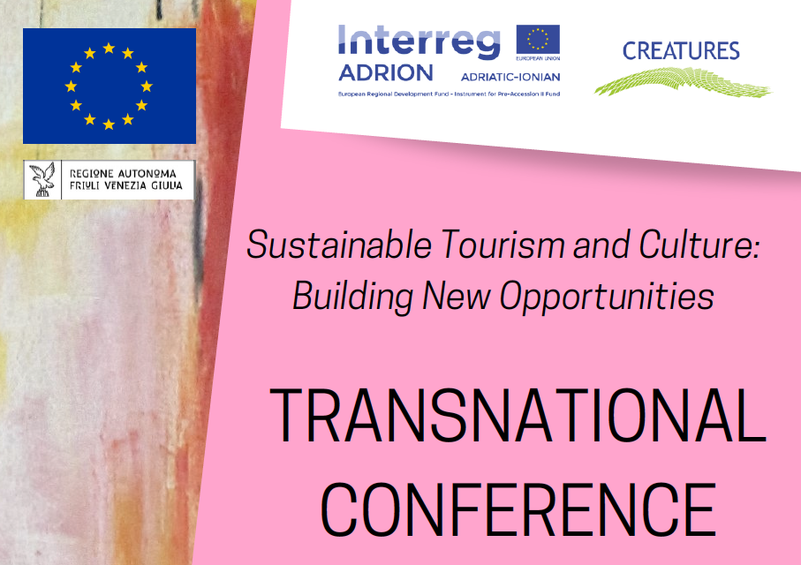

Slide 2

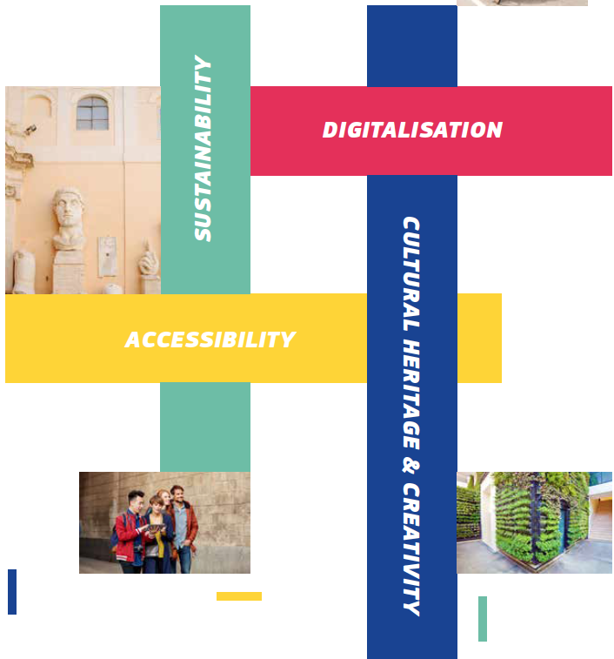
SMART TOURISM.

Slide 3
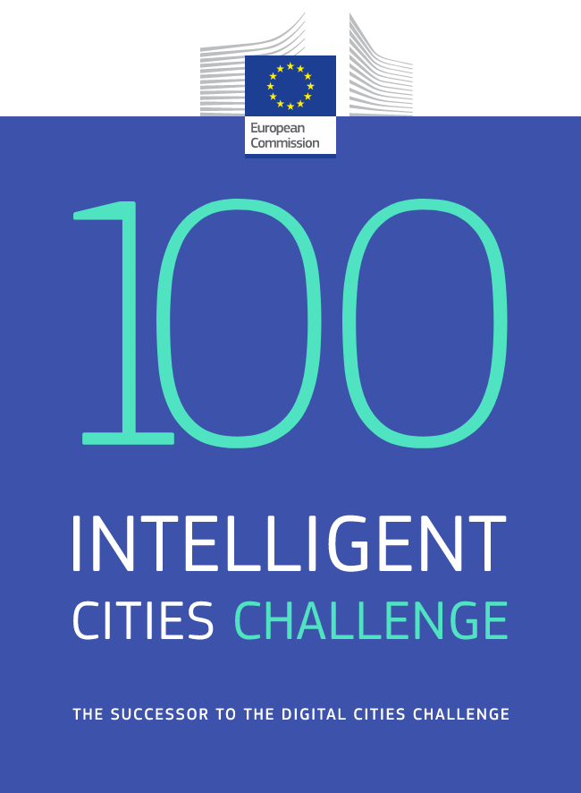
INTELLIGENT CITY.

Slide 4
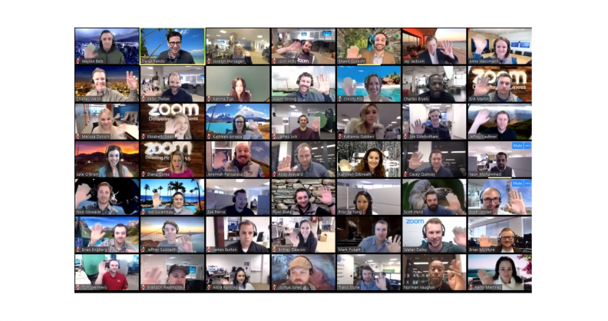
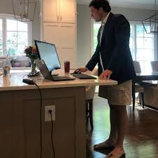
Mass adoption of technology and the new normal
NEW NORMAL.

Slide 5

2. Data are no longer reliable for algorithms.
DATA.

Slide 6
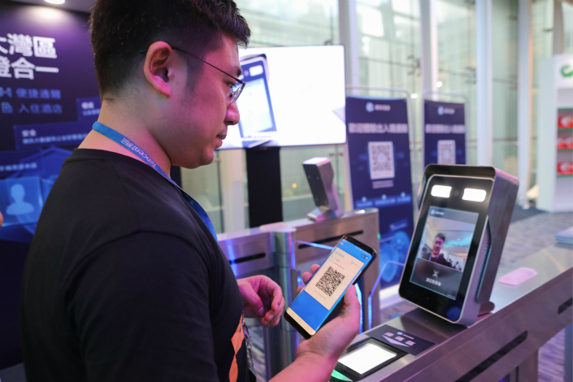
3. Digitalization and security
NEW NORMAL.

Slide 7

NEW NORMAL.

Slide 8
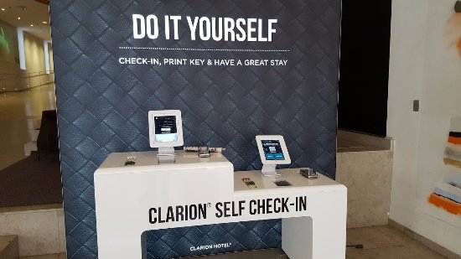
NEW NORMAL.

Slide 9
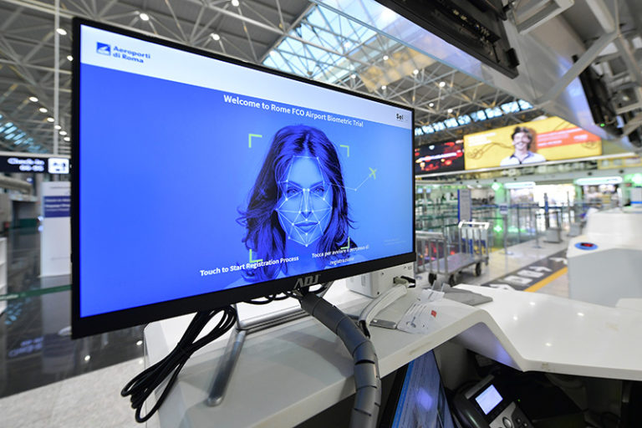
BIOMETRY.

Slide 10
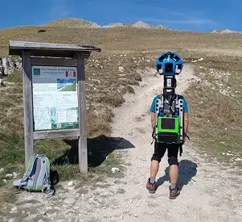
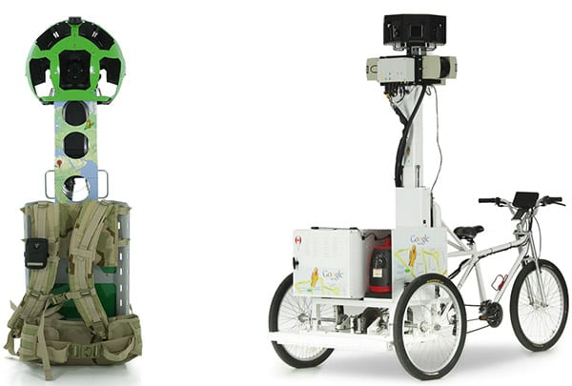
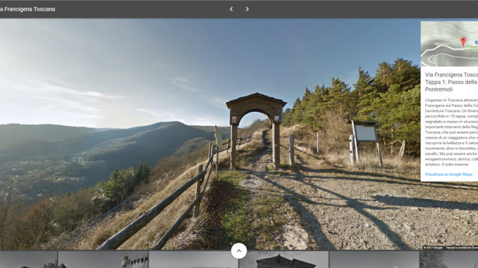

NATURE.

Slide 11
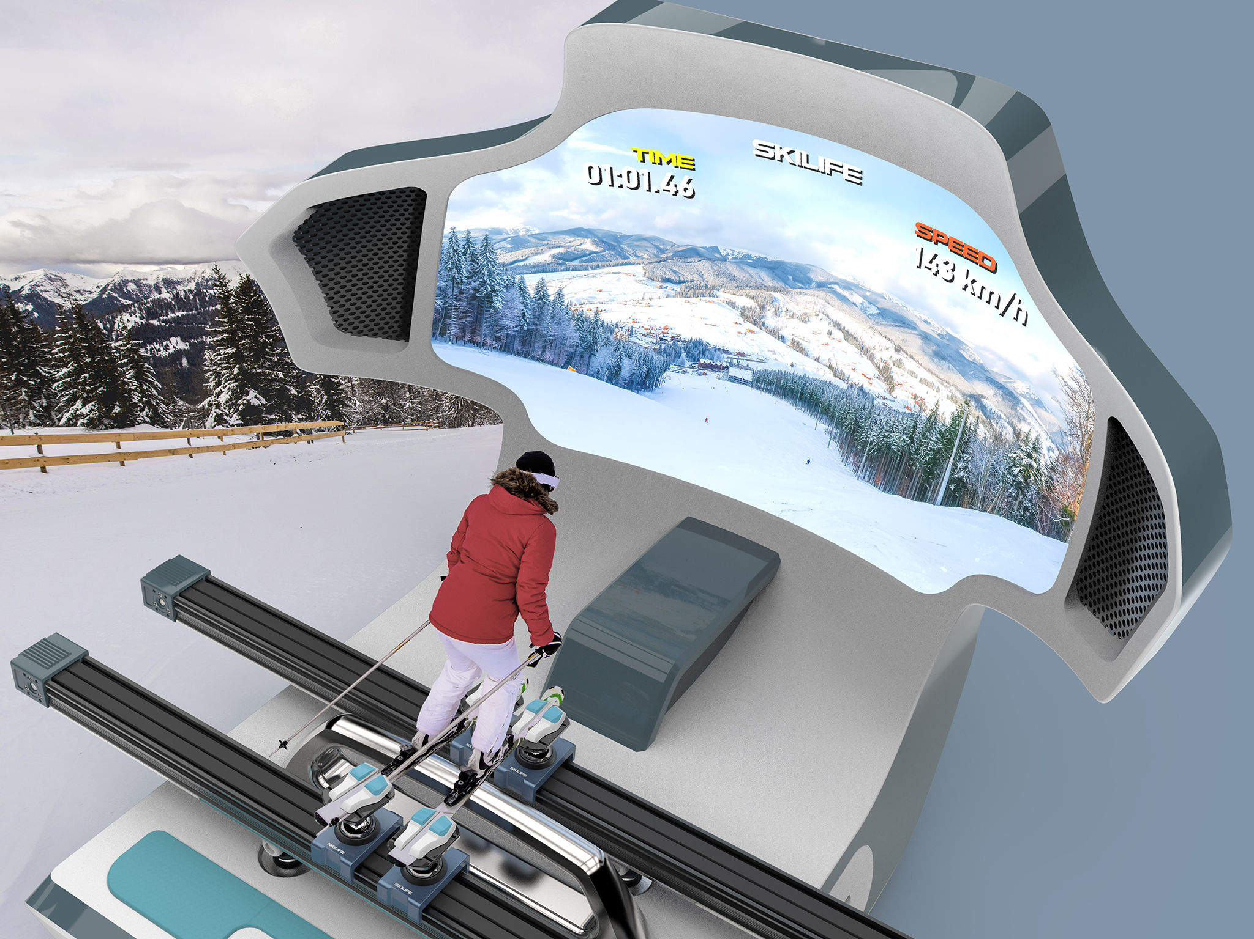
SPORT.

Slide 12

SPORT.

Slide 13

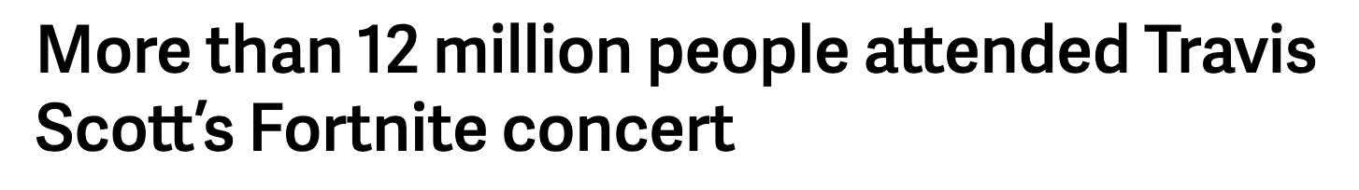
EVENTS.

Slide 14
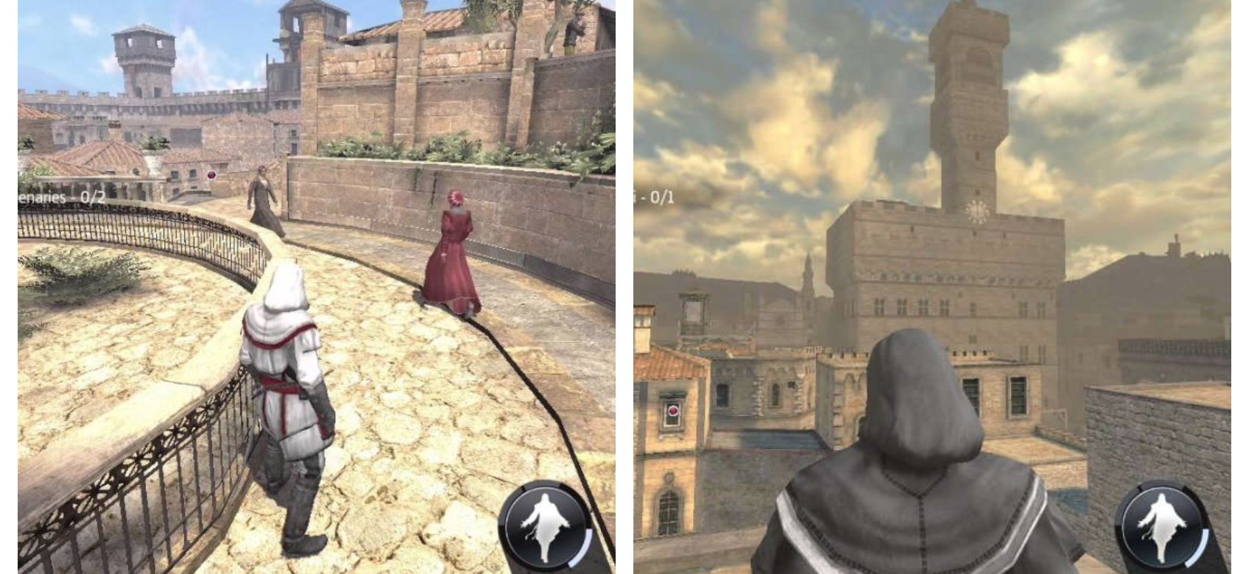
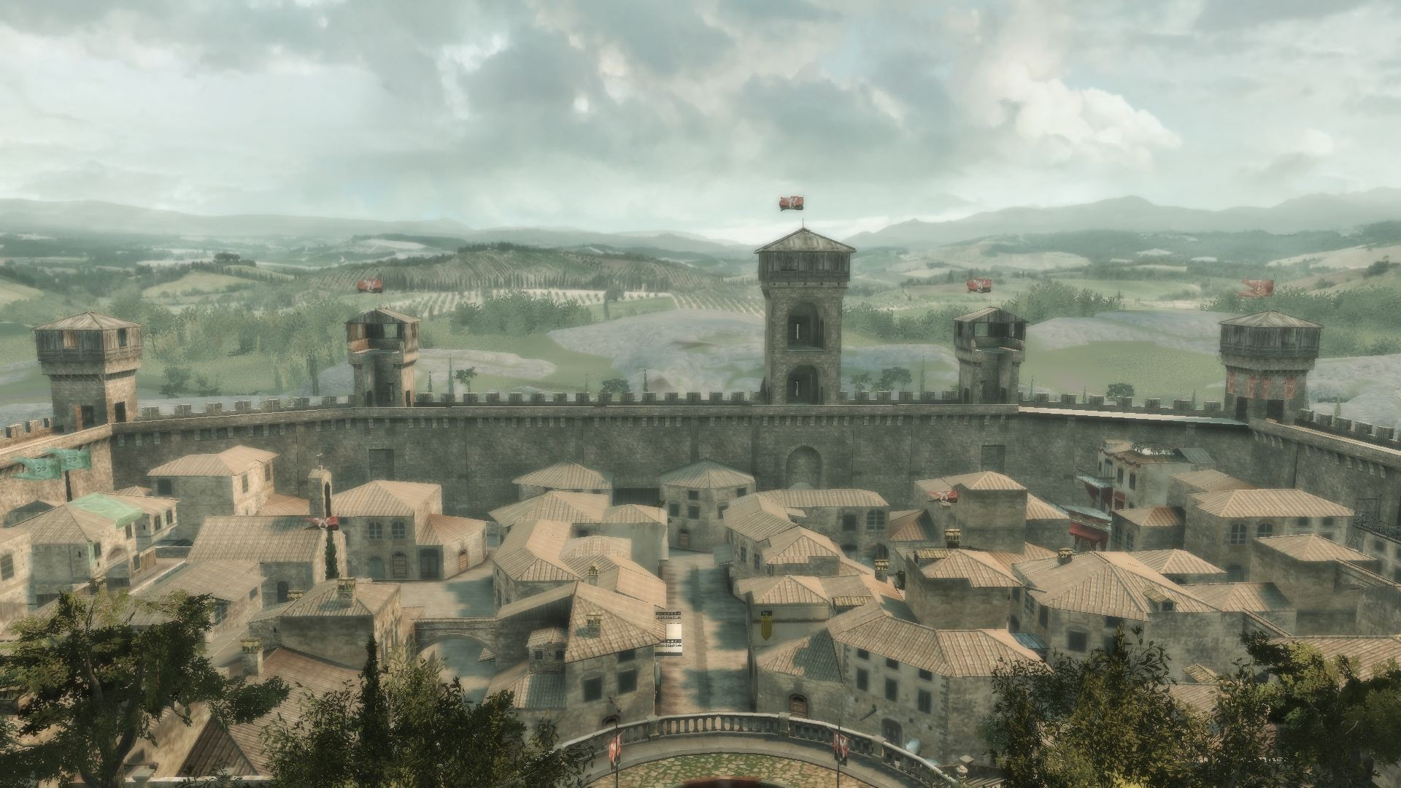
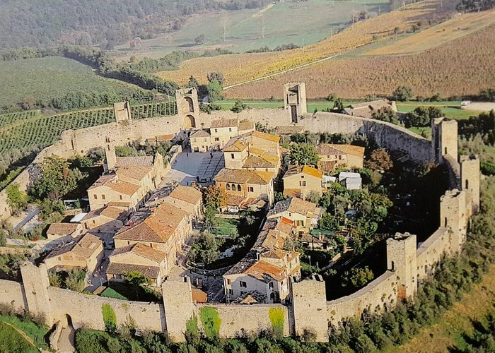
GAMES.

Slide 15
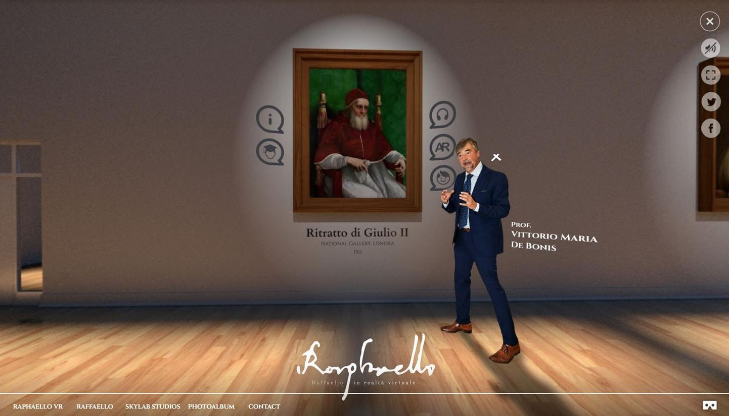
REINVENTING.

Slide 16
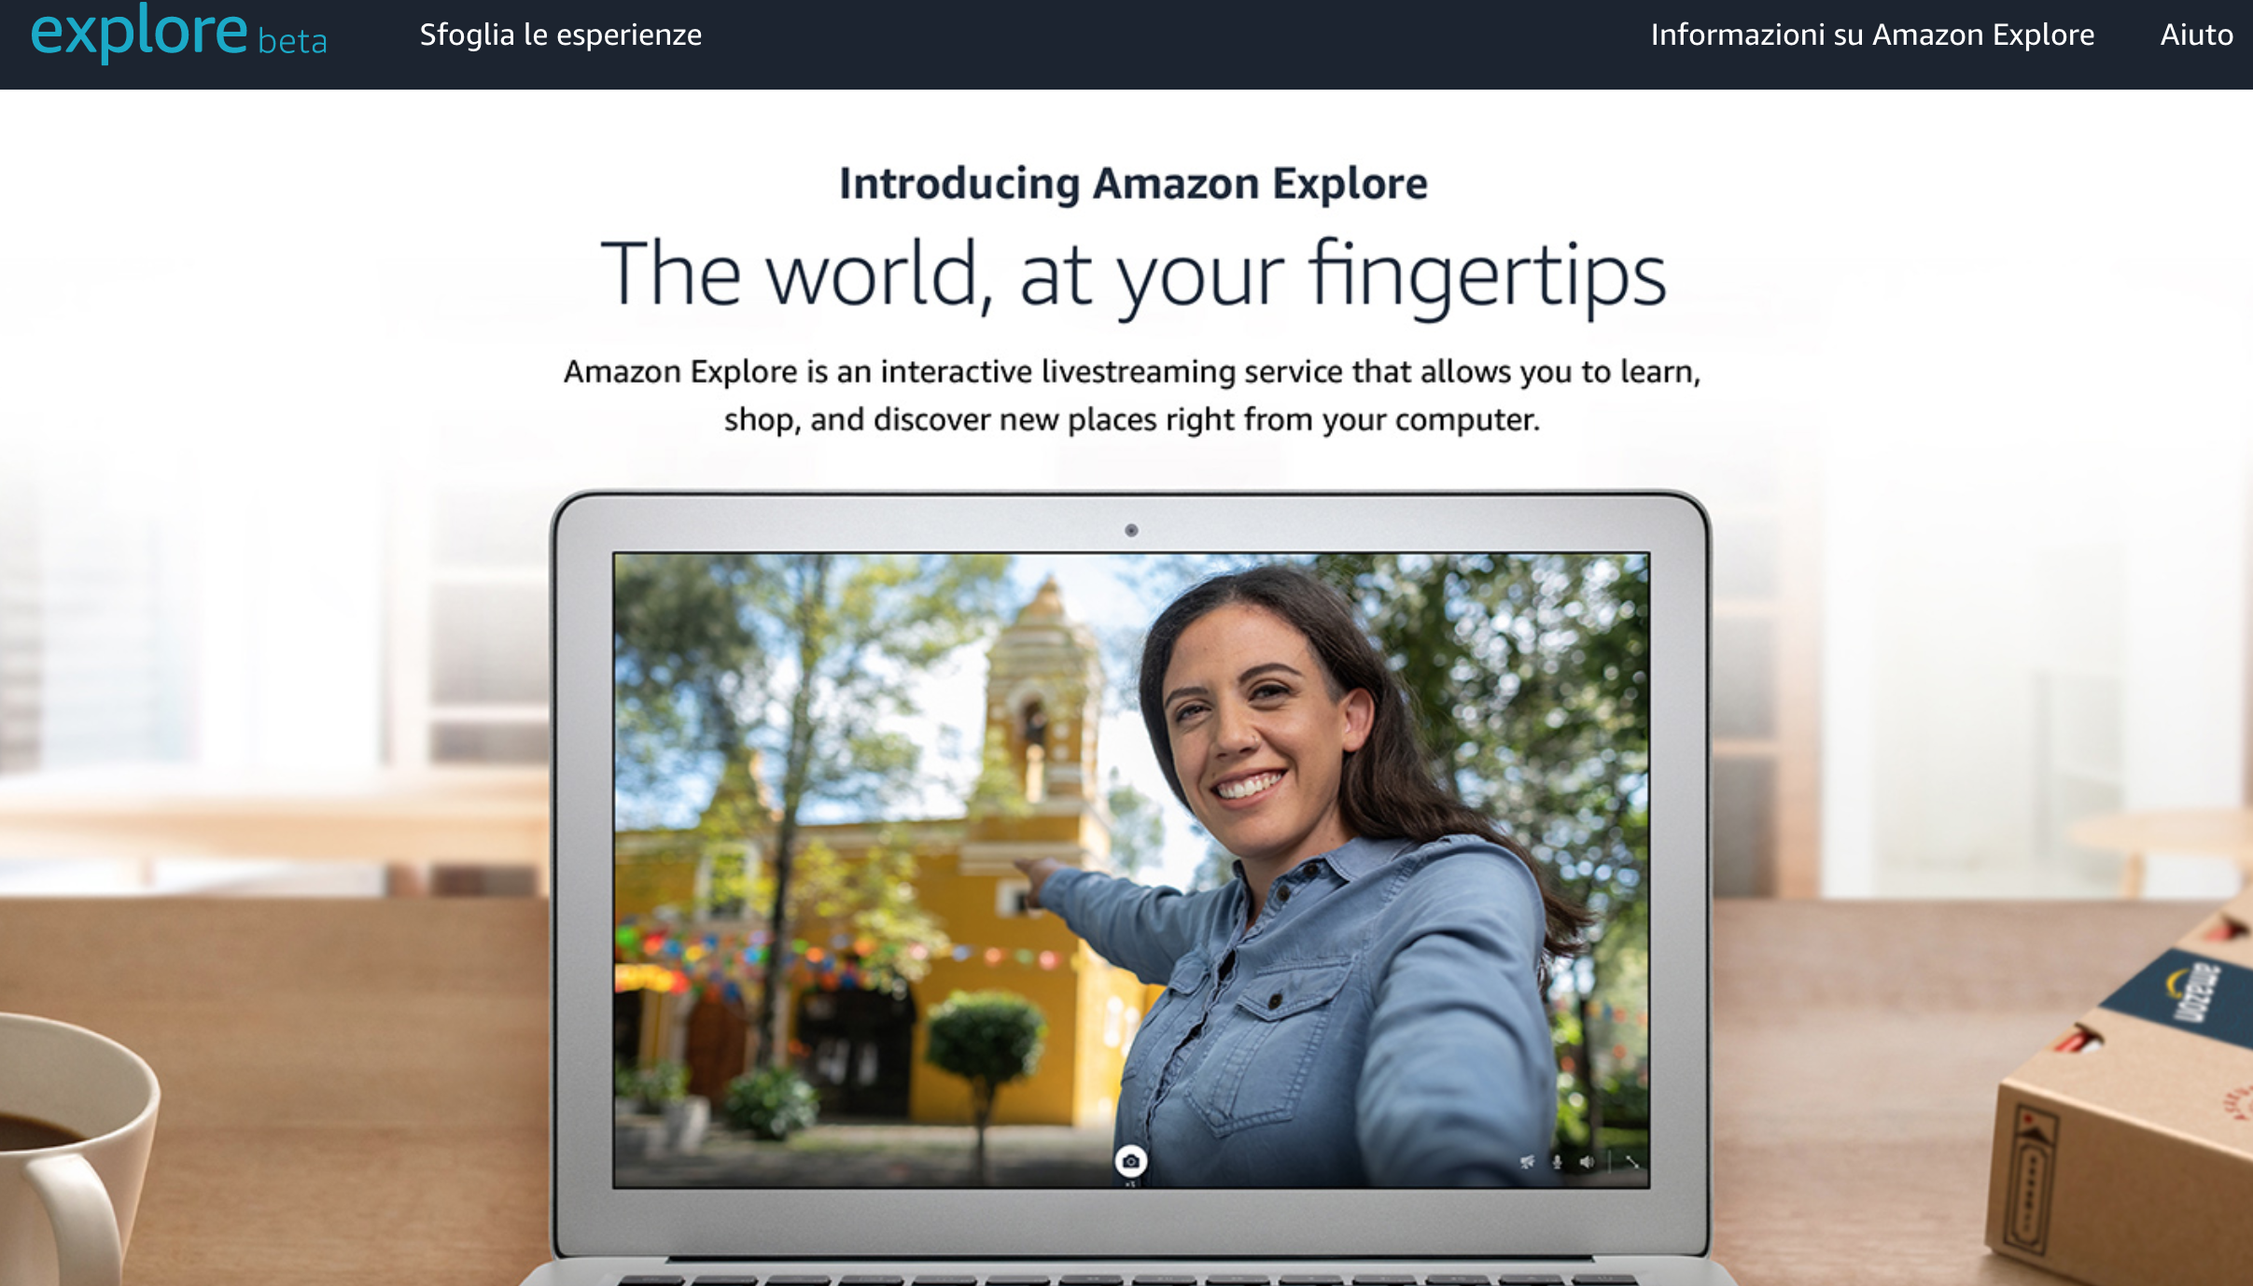
EXPERIENCES.

Slide 17
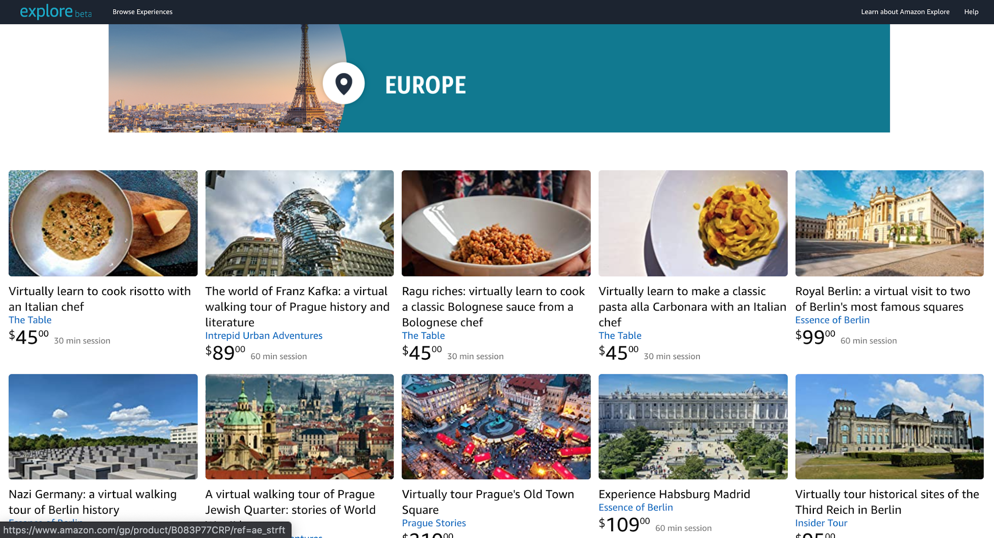
EXPERIENCES.

Slide 18

EXPERIENCES.

Slide 19

METAVERSE.

Slide 20
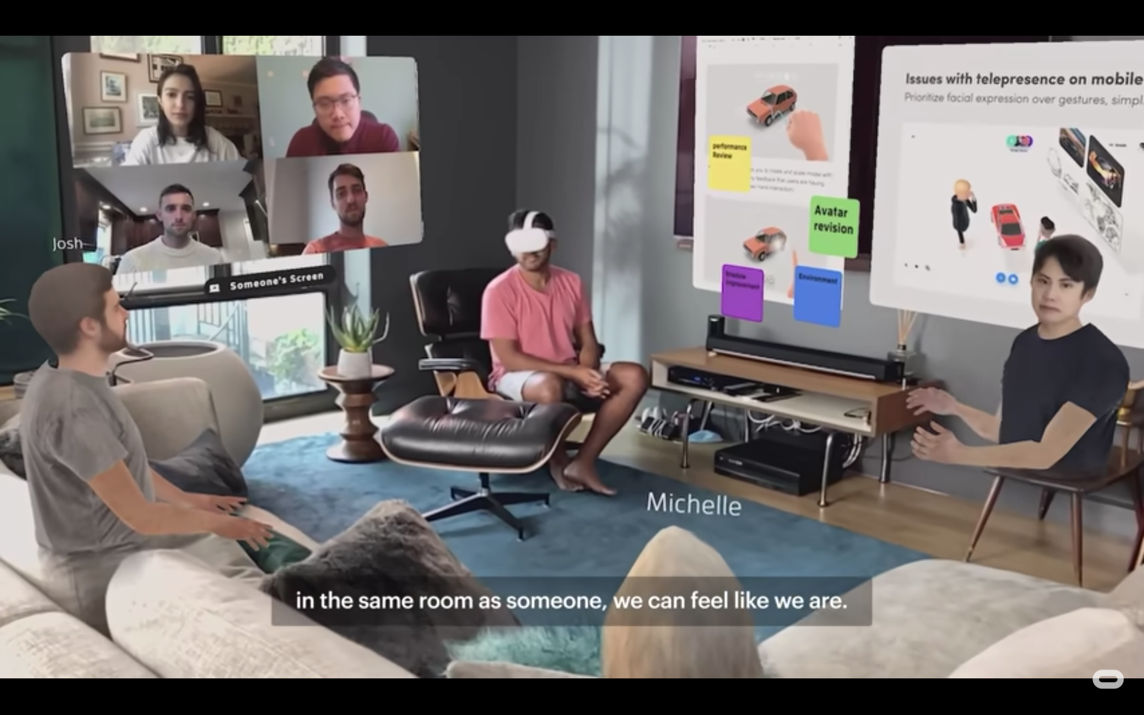
METAVERSE.

Slide 21
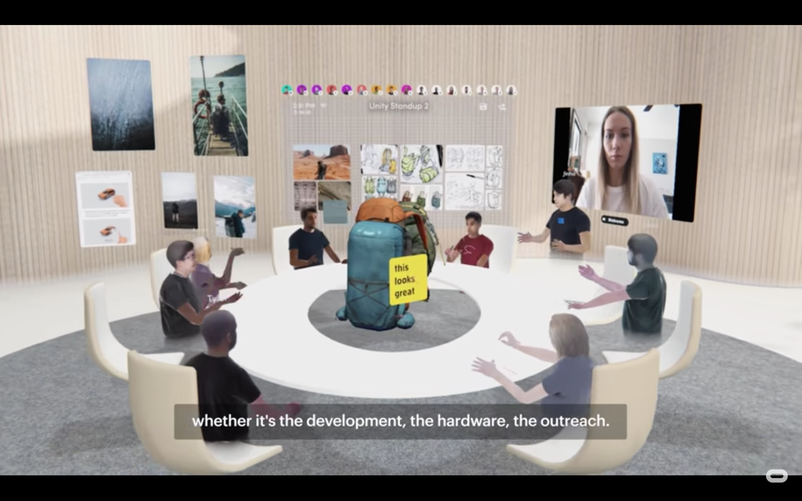
METAVERSE.

Slide 22
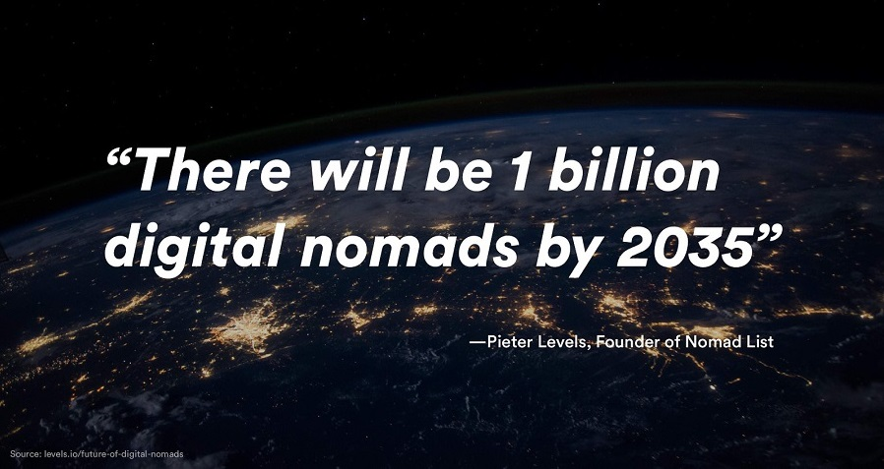
DIGITAL NOMADS.

Slide 23
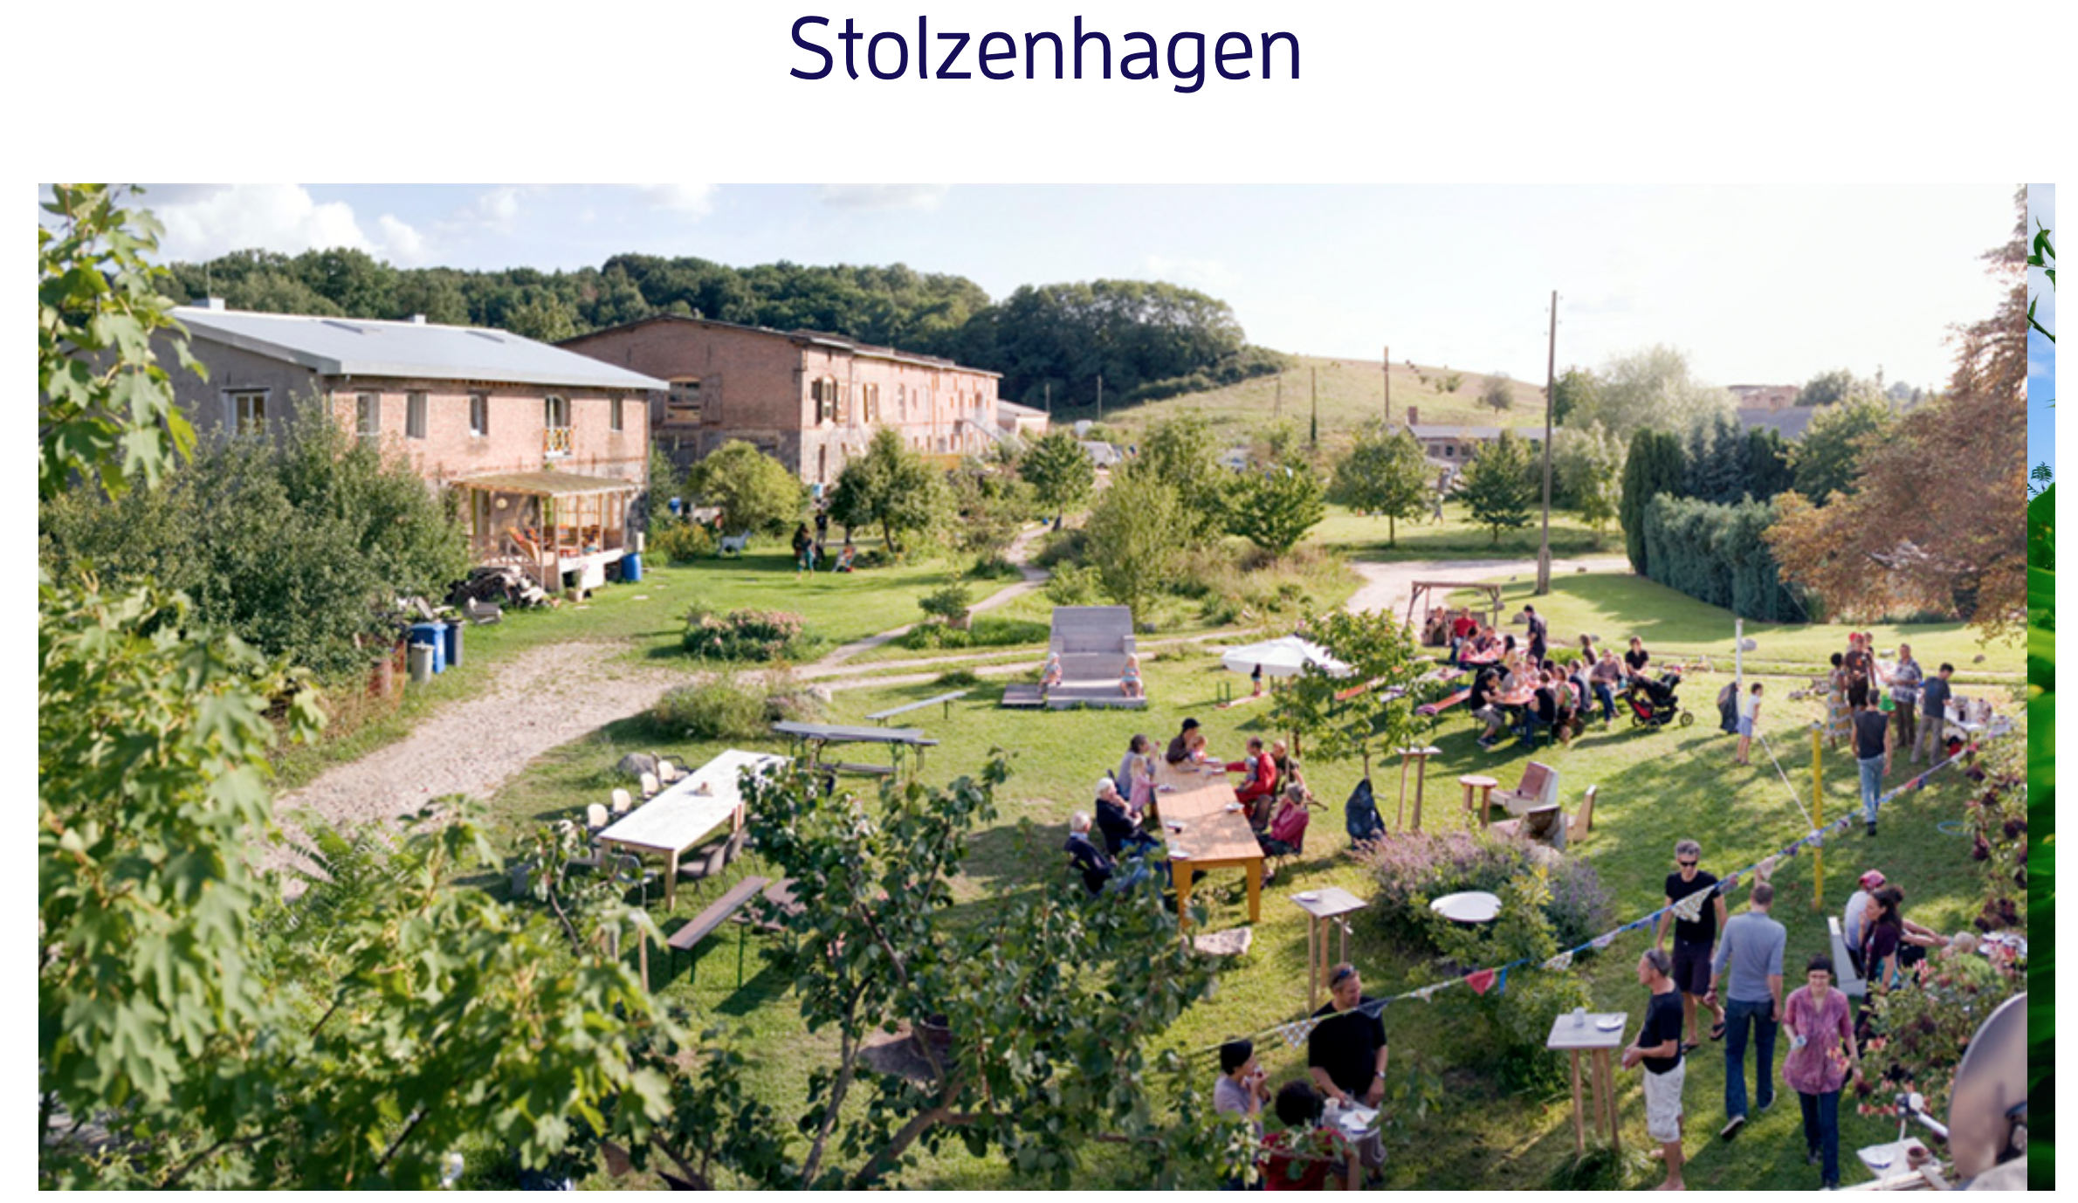
COLIVING.

Slide 24

COLIVING.

Slide 25
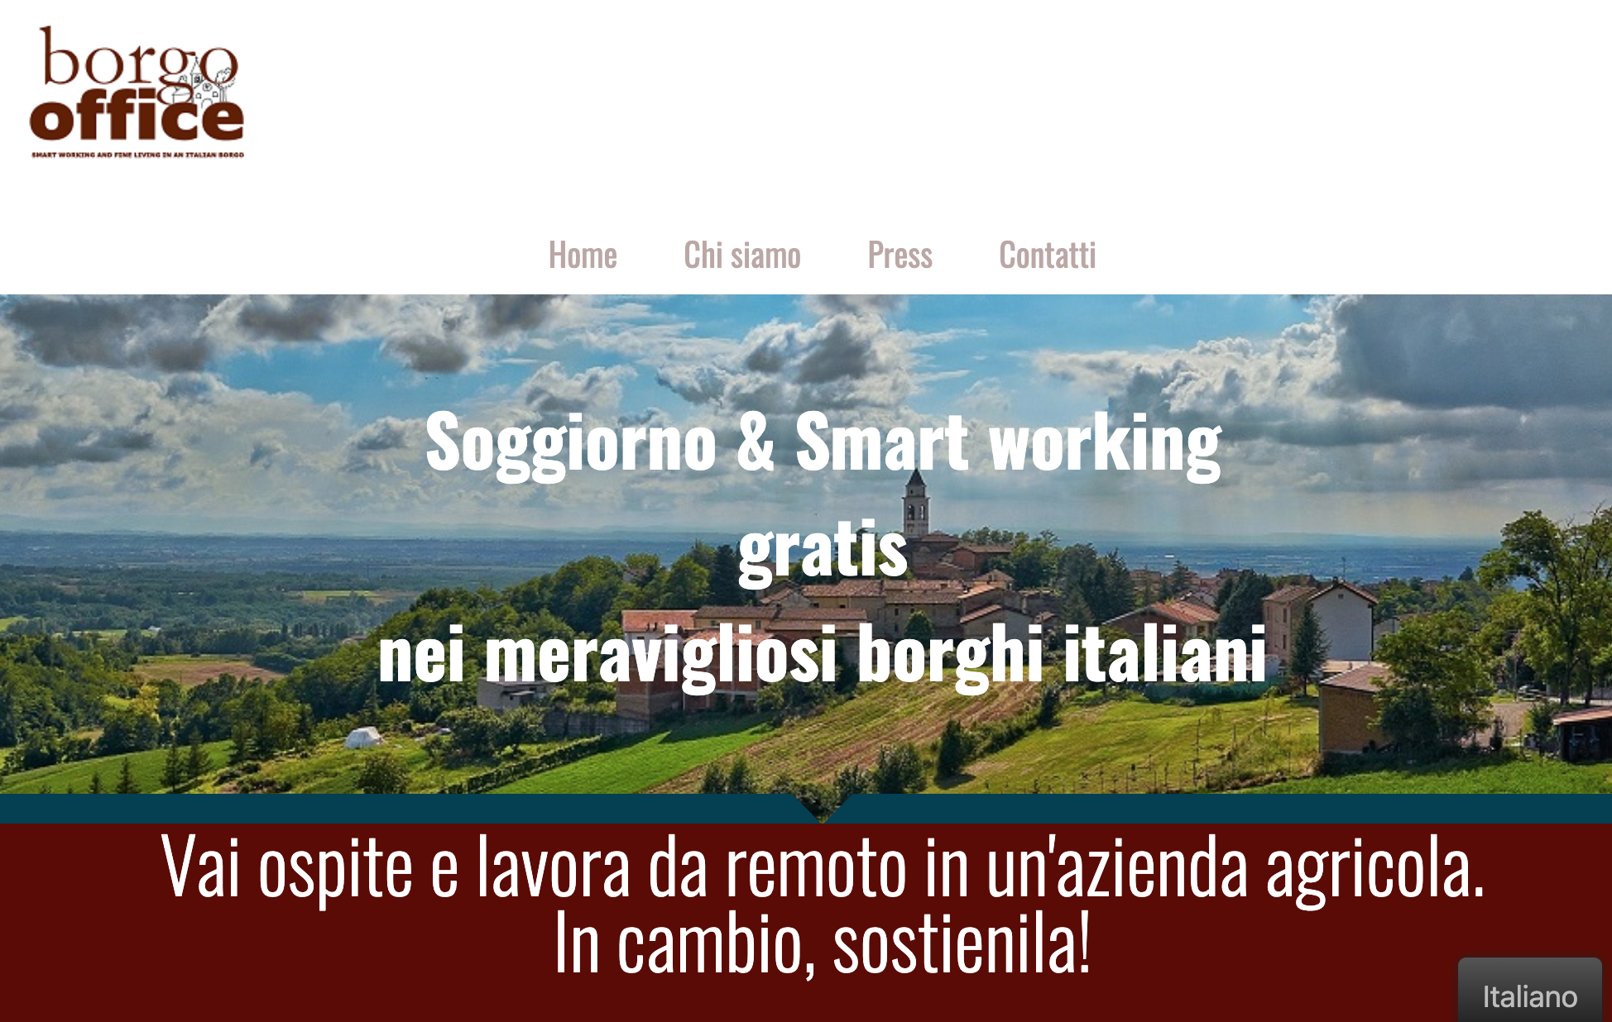
WORKATION.

Slide 26
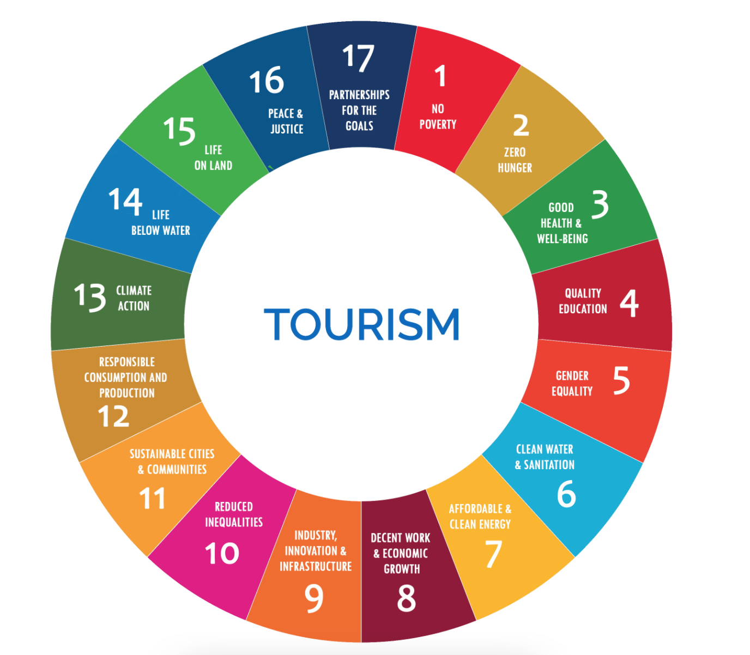
SDGS.

Slide 27
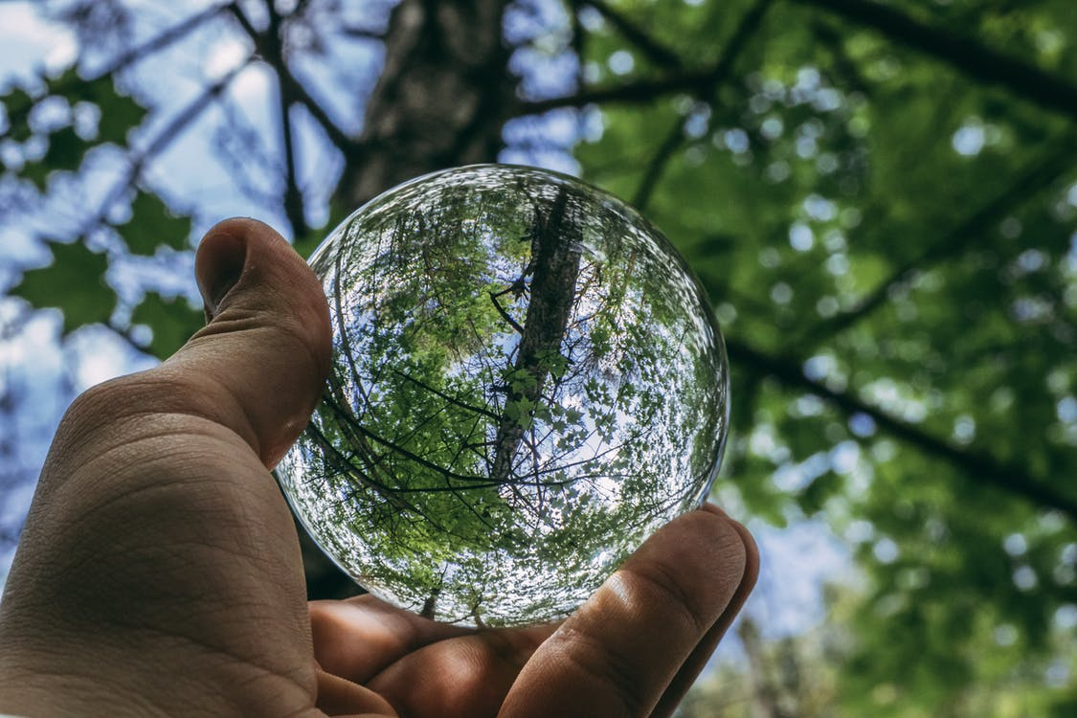
Preserve and enhance the environment while maintaining balanced economic and socio-cultural development
SOSTENIBILITY

Slide 28
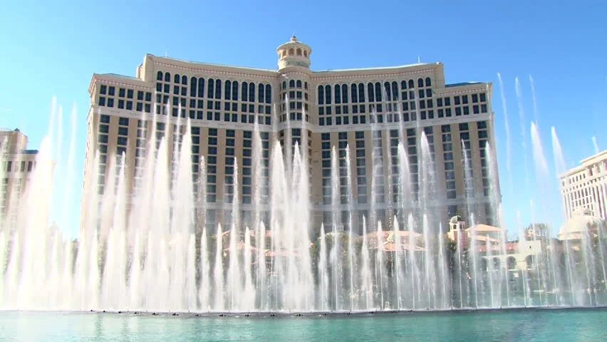
Managing natural resources better and developing innovative environmentally friendly measures
SOSTENIBILITY

Slide 29
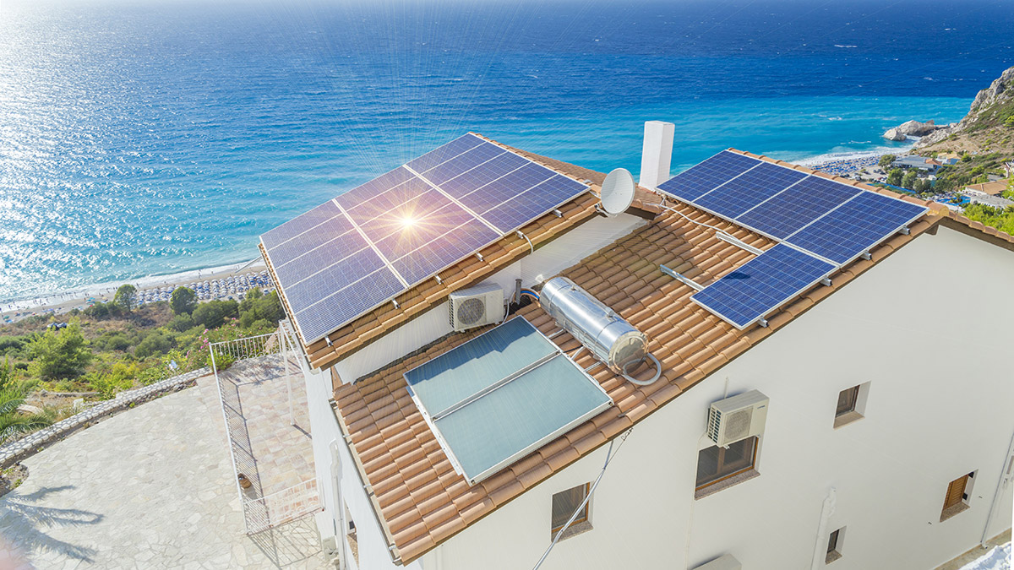
implement resource efficiency measures and actions to combat or adapt to climate change.
SOSTENIBILITY

Slide 30
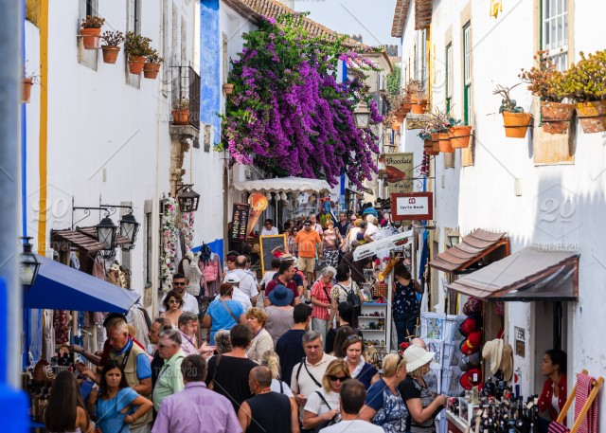
Reducing seasonality in tourism
SOSTENIBILITY

Slide 31
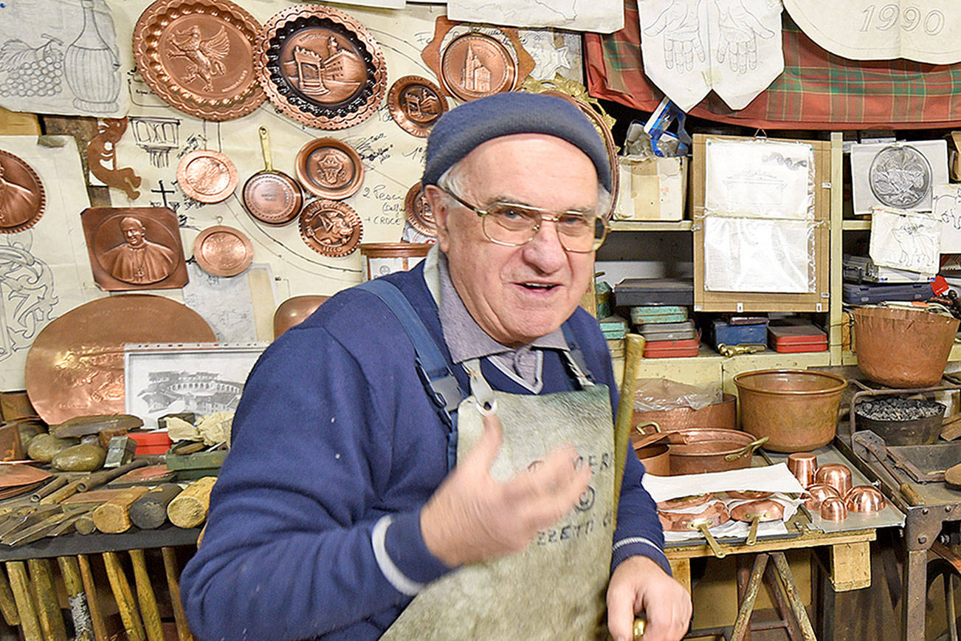
Sharing revenues with local communities and returning them to local development and businesses
SOSTENIBILITÀ

Slide 32


Slide 33
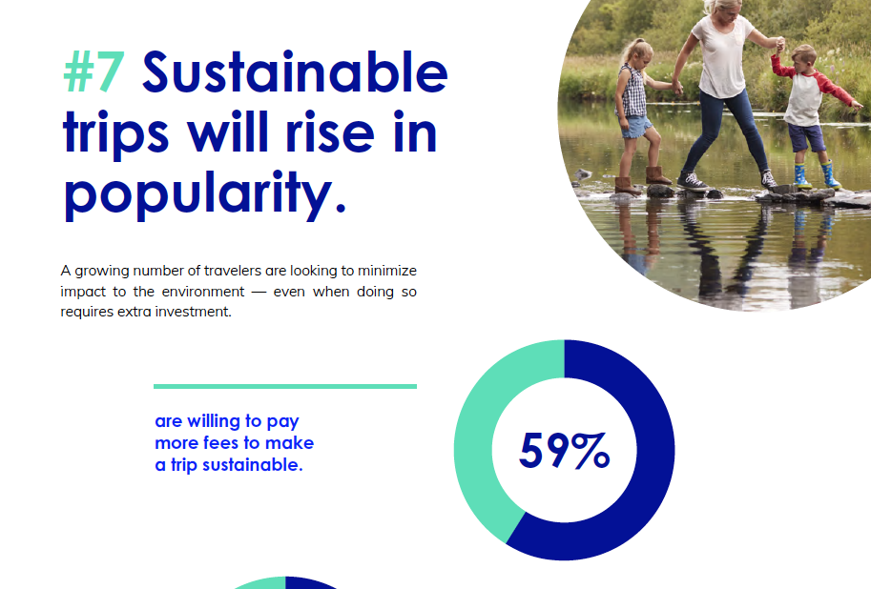

Slide 34
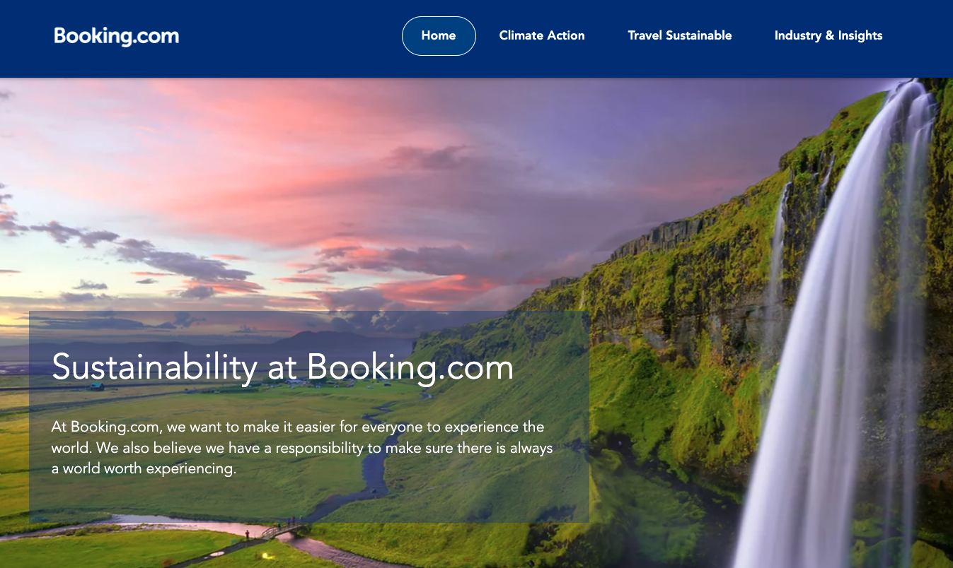
BOOKING

Slide 35
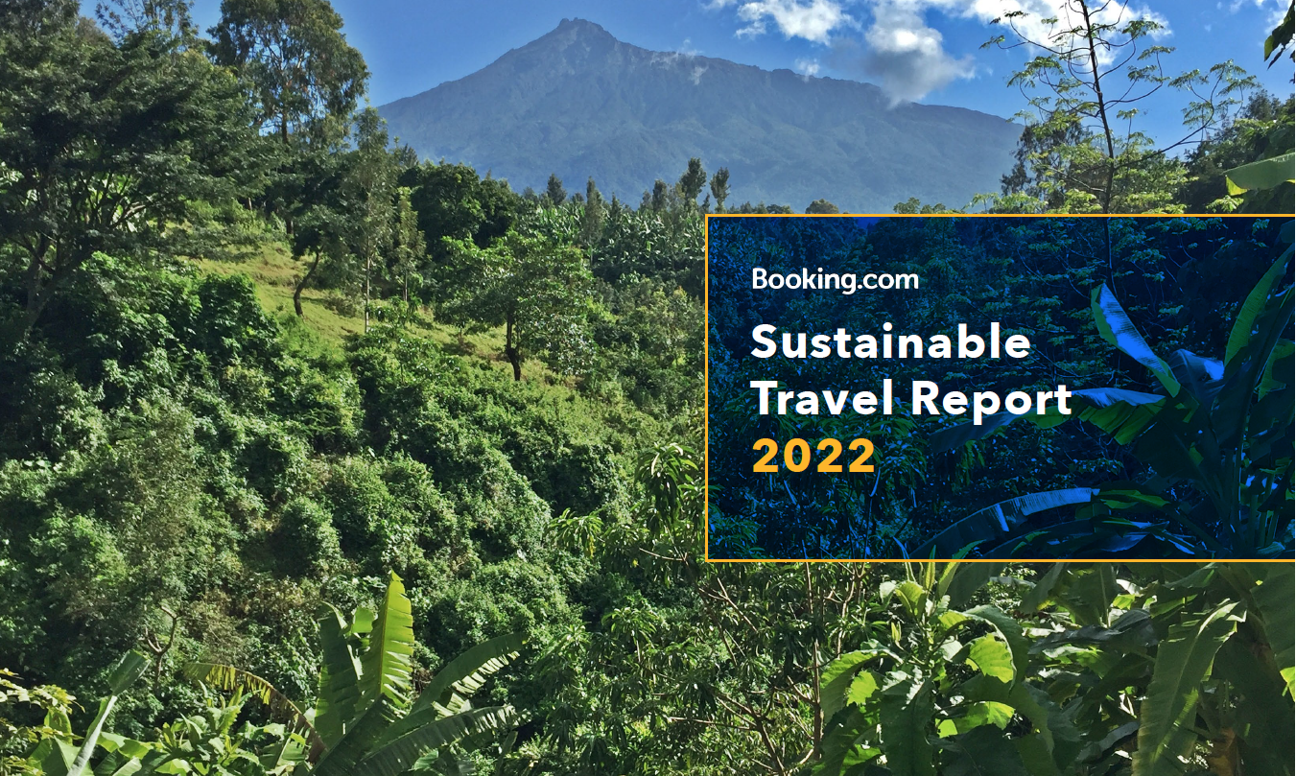
BOOKING

Slide 36
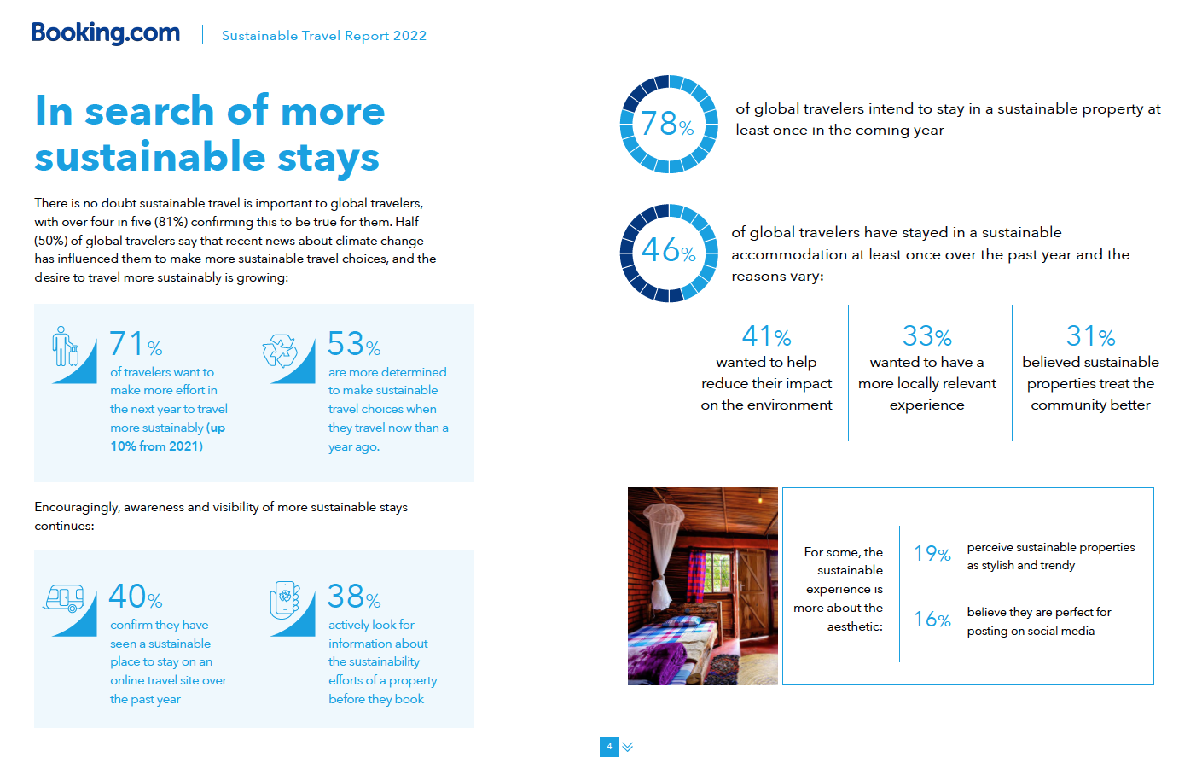
BOOKING

Slide 37
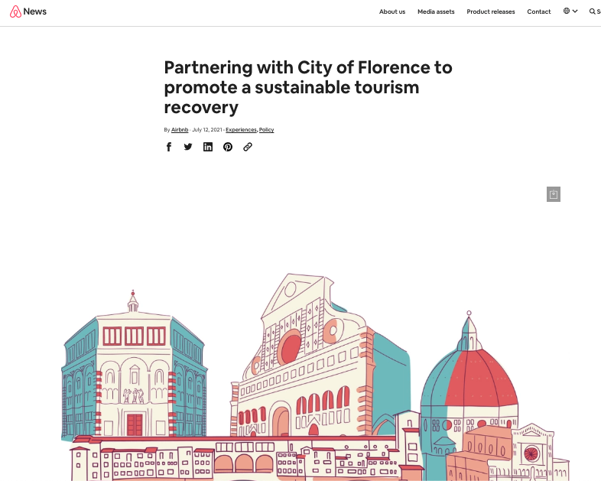
AIRBNB

Slide 38
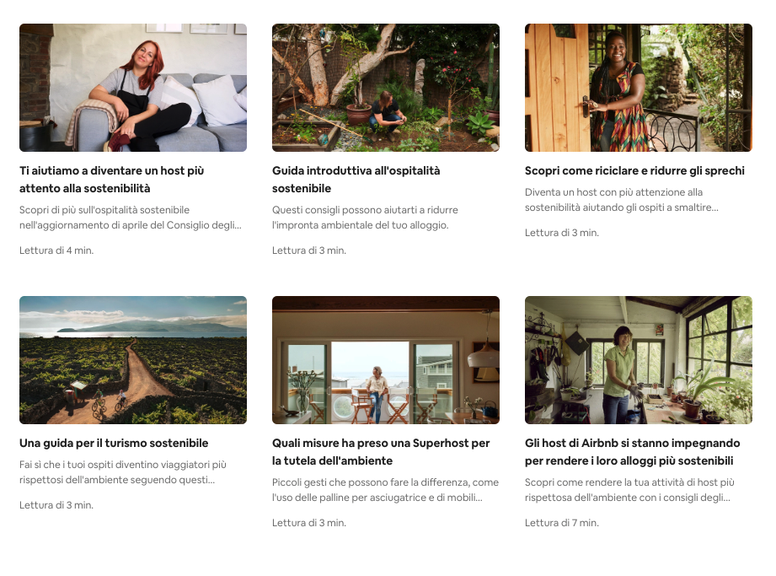
AIRBNB

Slide 39
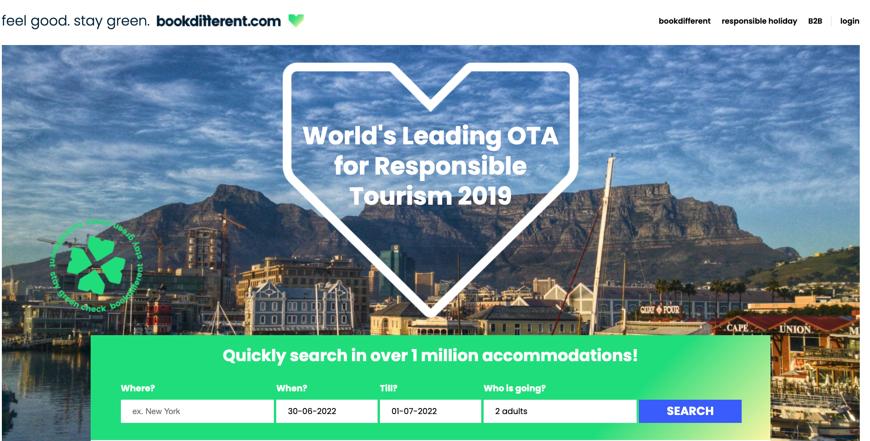
BOOK DIFFERENT

Slide 40
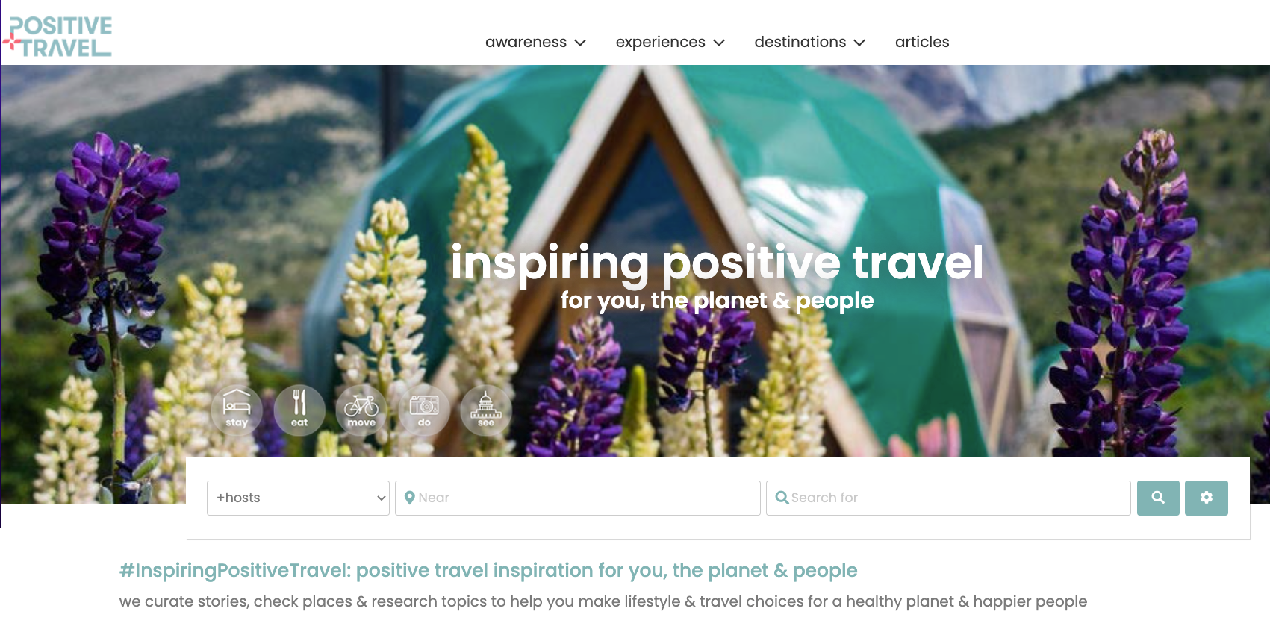
POSITIVE TRAVEL

Slide 41
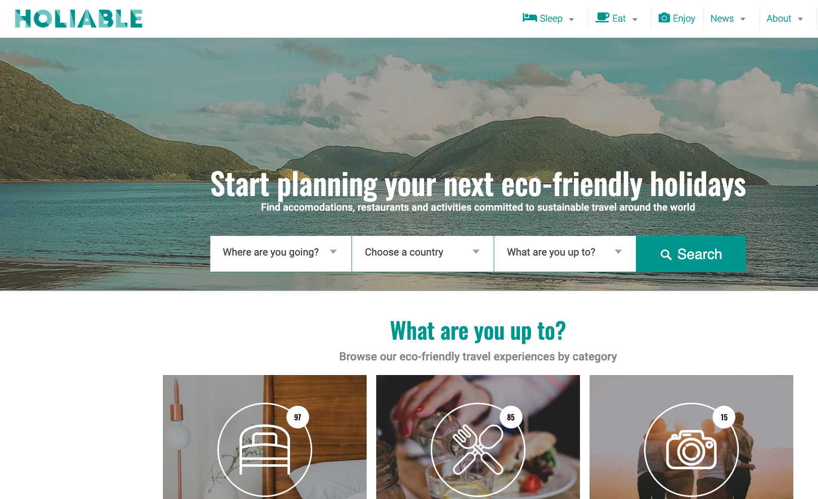
HOLIABLE

Slide 42
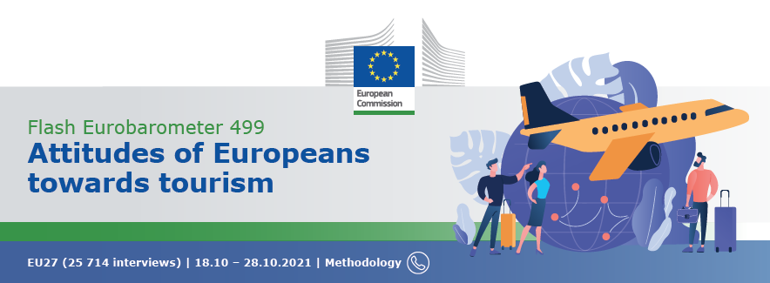
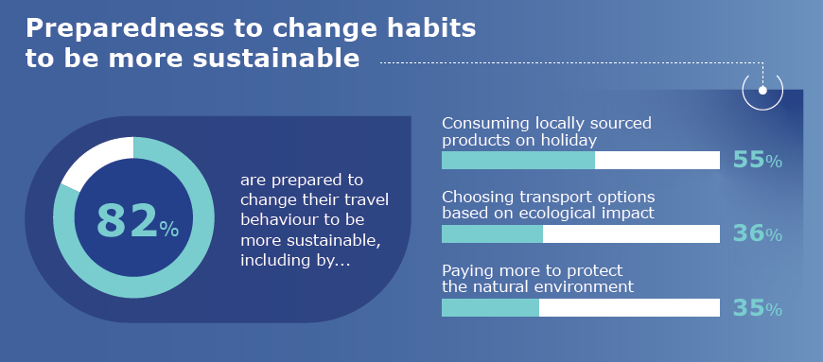

Slide 43
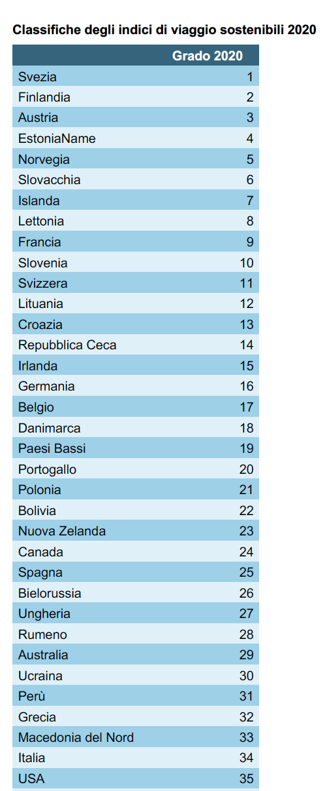
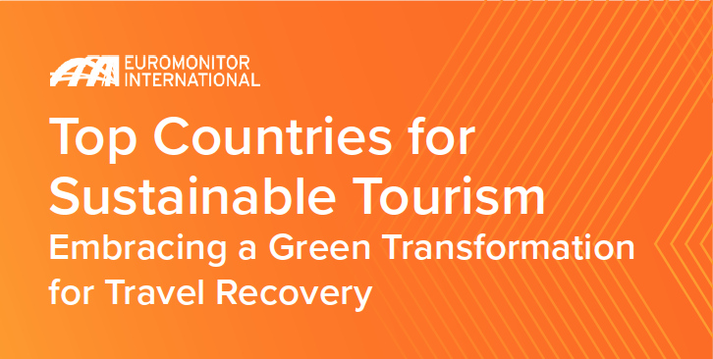

Slide 44
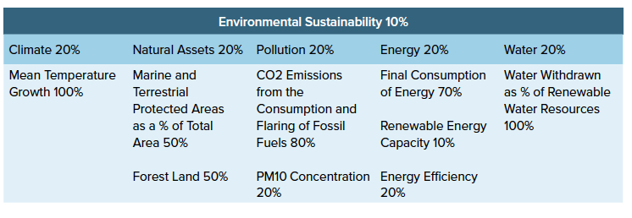
Pillar #1: Environmental Sustainability
Climate change
Pollution and carbon emissions
Policy measures taken to protect and maintain biodiversity and natural habitats
Use of natural resources
Dependency on fossil fuels
Adoption of renewable energy.

Slide 45
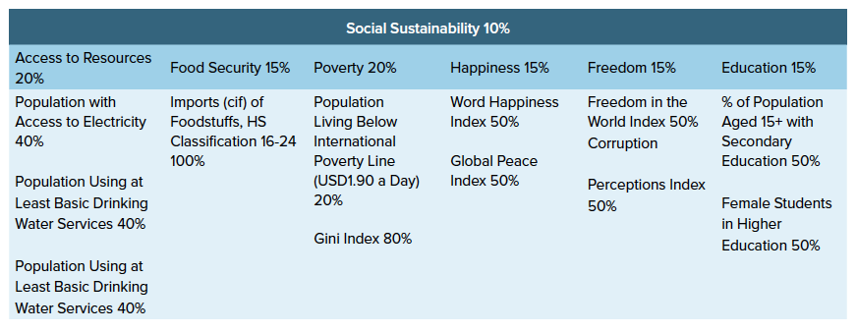
Pillar #2: Social Sustainability
Quality of life and wellbeing of population
Level of human rights
Access to basic food and shelter
Right to a decent wage
Equality and democratic freedoms provided through social policy.

Slide 46
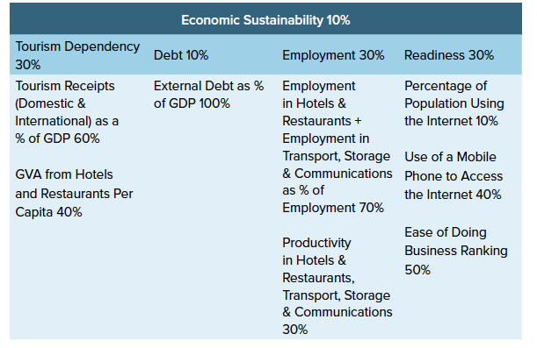
Pillar #3: economic sustainability
Economic growth
Responsible consumption and production
Ensuring decent work and employment
Poverty eradication
Democratising
technology
Creating a thriving
private sector.

Slide 47
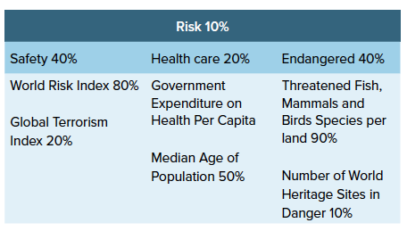
Pillar #4: Risk
Man-made risks like terrorism
Nature such as natural disasters and climate events,
Ability to care for the sick,
level of ageing of the population
Assets that travel and tourism businesses depend on.

Slide 48
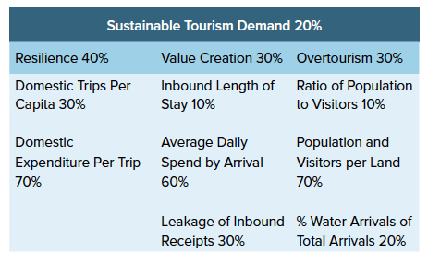
Pillar #5: Sustainable Tourism Demand
Ability to provide a balanced and resilient tourism
Creating a strong domestic tourism economy
Avoiding over-dependency over-tourism such as cruise
Striking the right balance between the residents and visitors

Slide 49
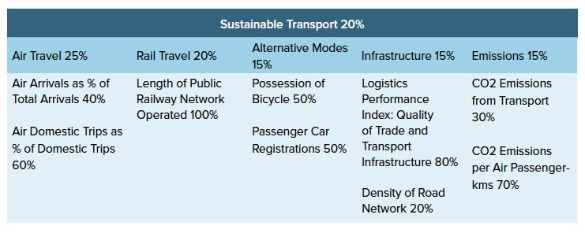
Pillar #6: Sustainable Transport
Quality and energy efficiency of transport infrastructure
Level of transport emissions
Availability of a diverse range of transport
Mobility options to ensure not an over-dependency on air travel.

Slide 50
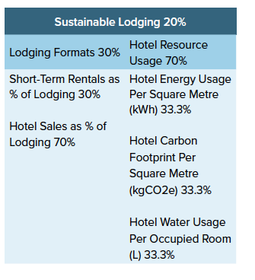
Pillar #7: Sustainable Lodging
Resource usage of full-service hotels
The diversity of lodging supply such as short term rentals, camping to ensure that there is not an over-dependency on hotels.

Slide 51

Grazie!
@edocolombo

