Slide 1

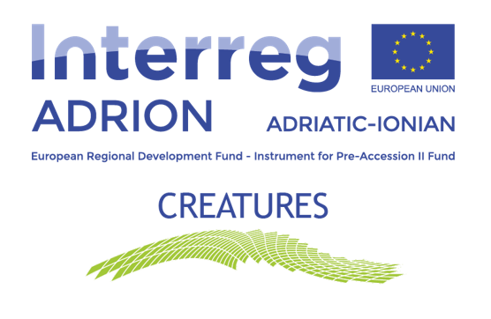

TRANSNATIONAL CONFERENCE
SUSTAINABILITY AND CULTURE
BUILDING NEW OPPORTUNITIES
REGIONAL DIRECTORATE OF CULTURAL HERITAGE &AULEDA-LOCAL ECONOMIC DEVELOPMENT AGENCY.
VLORE, ALBANIA
TRIESTE, 21OCTOBER 2022

Slide 2
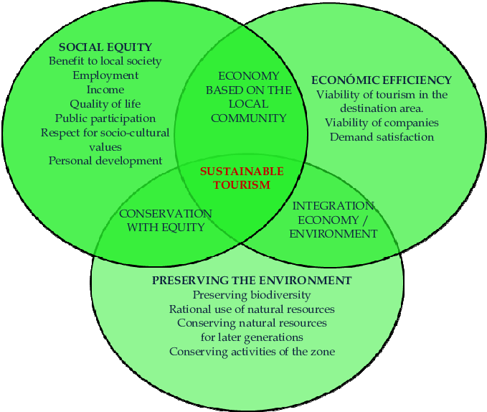
1. Make optimal use of environmental resources that constitute a key element in tourism development, maintaining essential ecological processes and helping to conserve natural heritage and biodiversity.
2. Respect the socio-cultural authenticity of host communities, conserve their built and living cultural heritage and traditional values, and contribute to inter-cultural understanding and tolerance.
3. Ensure viable, long-term economic operations, providing socio-economic benefits to all stakeholders that are distributed, including stable employment and income-earning opportunities and social services to host communities, and contributing to poverty alleviation.

Slide 3
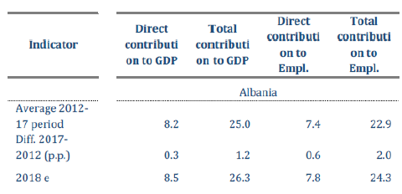

Slide 4
The main CCI subsectors of the Vlore Region (NUTS3)
Cultural tourism including museums, archaeological sites, churches etc.
Cultural activities (opera, theatre, cinema, festivals)
Handcraft activities
Other CCI subsectors include music, dance, photography, art galleries, interior design and textile mode.
CCI sector in Albania contributes with 2% of the GDP

Slide 5
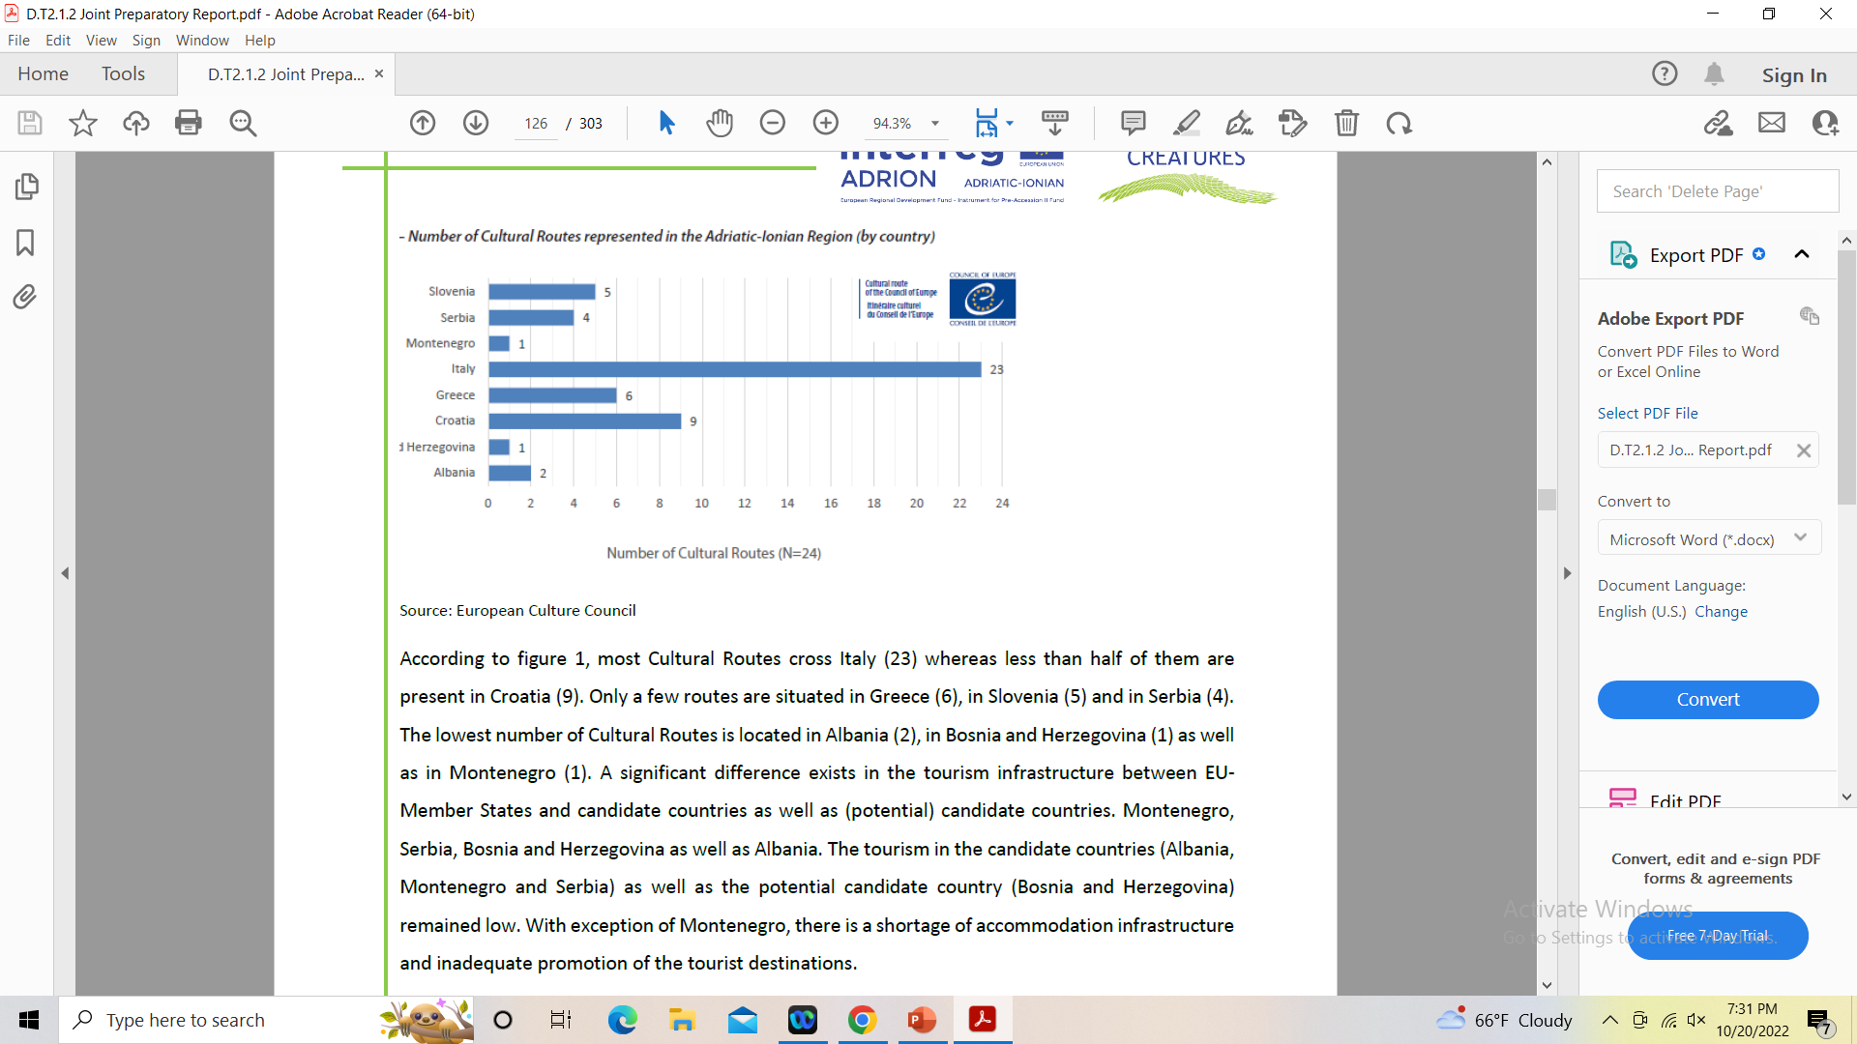
The potential of the cultural tourism lies in the development of new business models, relying on:
1. multidimensional heritage values and communication of these values
2. entrepreneurial development through diversification of products and smart specialization oriented to specific niche tourism (creative, culinary, eco-cultural) including meaningful, responsible and sustainable travel.

Slide 7
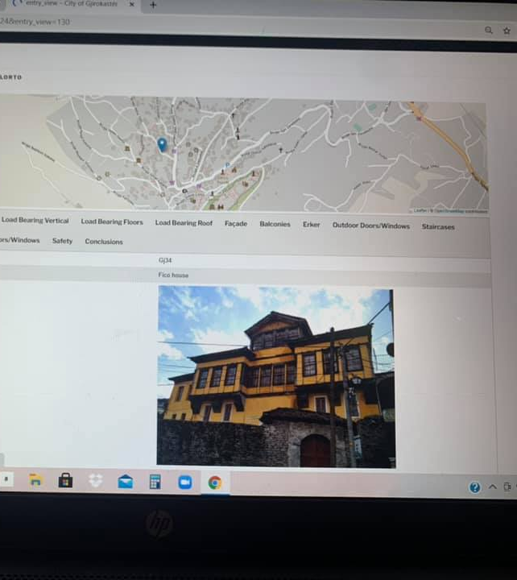
IRC – HERMES PROJECT – AULEDA, Local Economic Development Agency
Virtual tours and digitalization
The aim of this project is the development of a common strategic management platform for the building stock of settlements/regions in order to support the salvation, protection and presentation of their Cultural Heritage.
Heritage Management e System (HER.M.e.S) - winning the
prestigious European Prize for Cultural Heritage,
the Europa Nostra Award, in 2015.
64 historic buildings and monuments stock were assessed and digitized.
a decision-making tool (algorithm) will be applied in order to prioritize interventions and will produce common reports for the participating authorities.
Virtual tours realized accessible for foreign and domestic tourists
d. Cultural education platform for teachers and students

Slide 8
THANK YOU FOR YOUR ATTENTION!
Contact info: drtkvlore20@gmail.com

