Slide 1
Heritage in Virtual Reality
Prof. Dr. Selma Rizvic
DIGI.BA Association
Sarajevo Graphics Group, University of Sarajevo

Slide 2
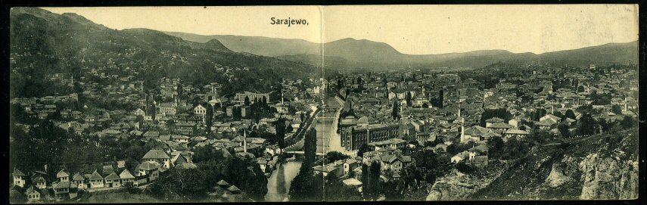
Motivation
cultural heritage enables us to understand the past
digital technologies enable us to understand cultural heritage
great potential in visualization of cultural monuments using 3D digitalization
additional quality could be obtained by adding stories
GOAL: to revive the forgotten cultural heritage in collective memory of people

Slide 3
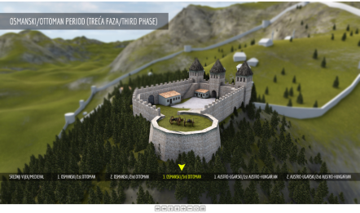
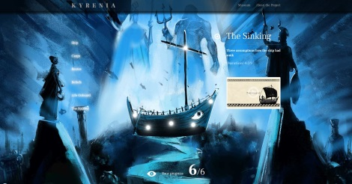
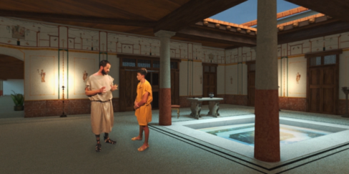
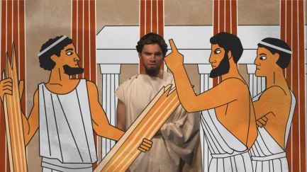
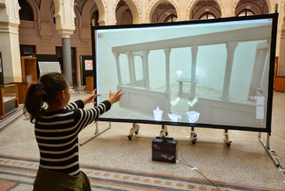
Sarajevo Graphics Group
founded in 2004 at the Faculty of Electrical Engineering, University of Sarajevo, Bosnia and Herzegovina
research areas: computer graphics, computer animation, visual arts, multimedia, interactive digital storytelling, virtual reality, augmented reality, mixed reality
members: computer scientists, artists, archaeologists, historians, writers, film and video professionals, musicians
In 2010 established as DIGI.BA Association
projects:
  cultural heritage virtual presentations
  virtual museums
  VR movies

Slide 4
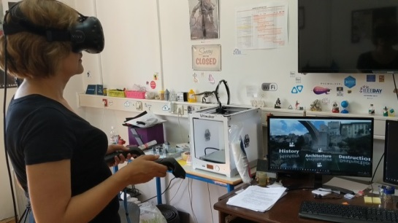
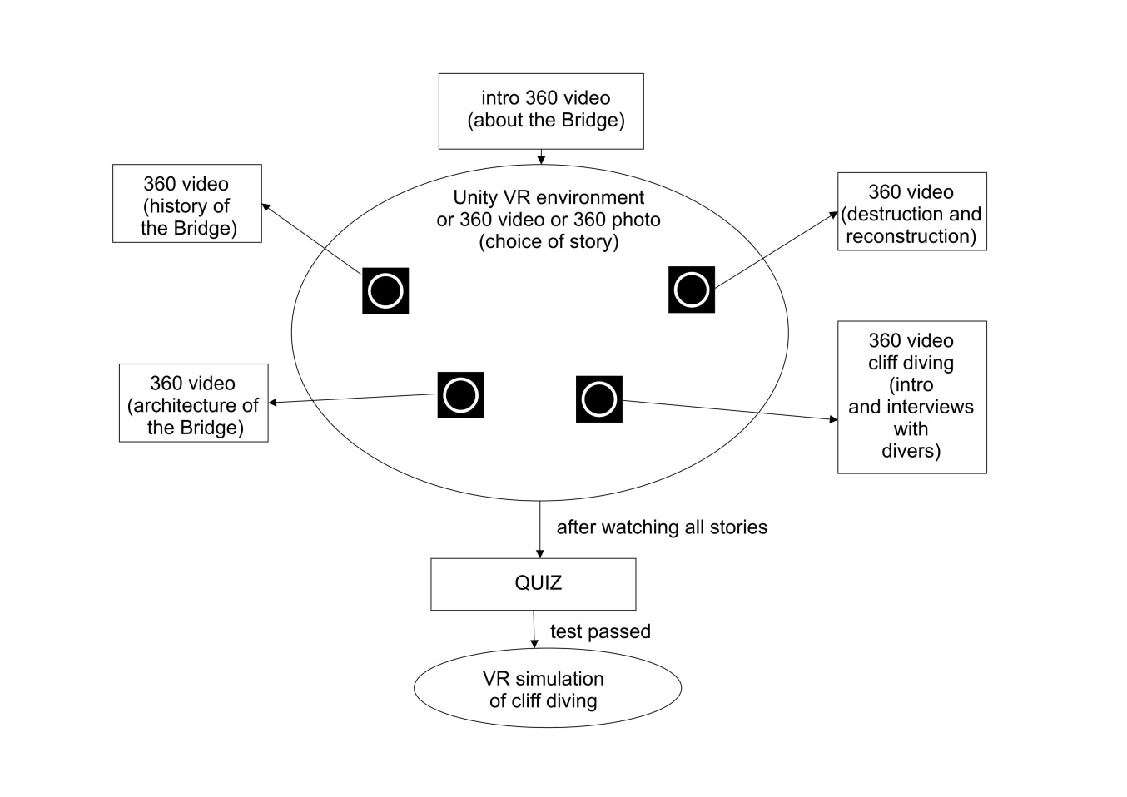
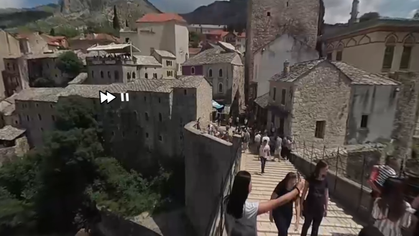
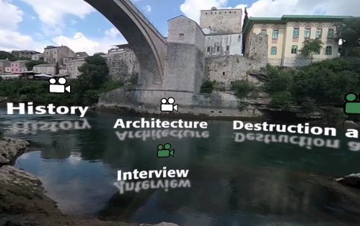
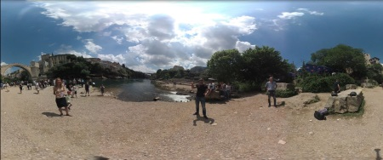
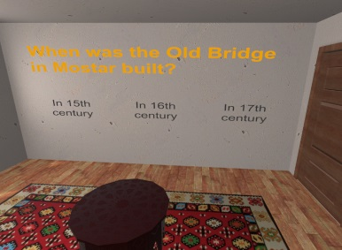
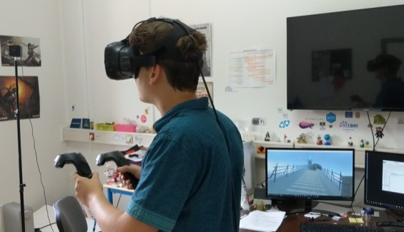
Mostar Bridge Diving VR
GOAL – edutainment
VR user interface
VR video stories
3D quiz
Cliff dive simulation

Slide 5
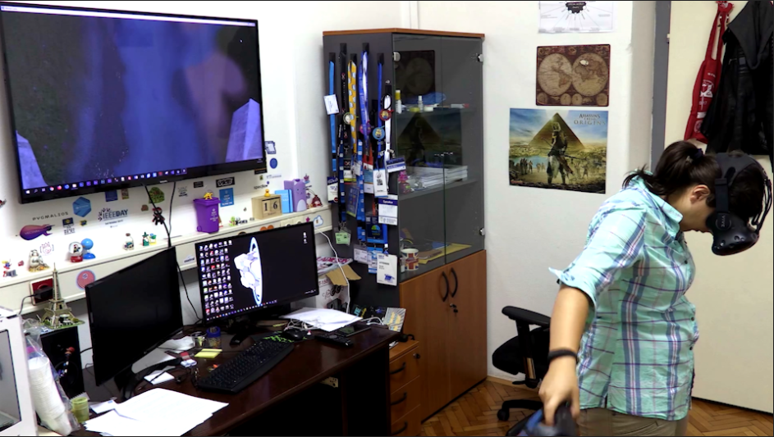
Mostar Bridge Diving VR - trailer

Slide 6
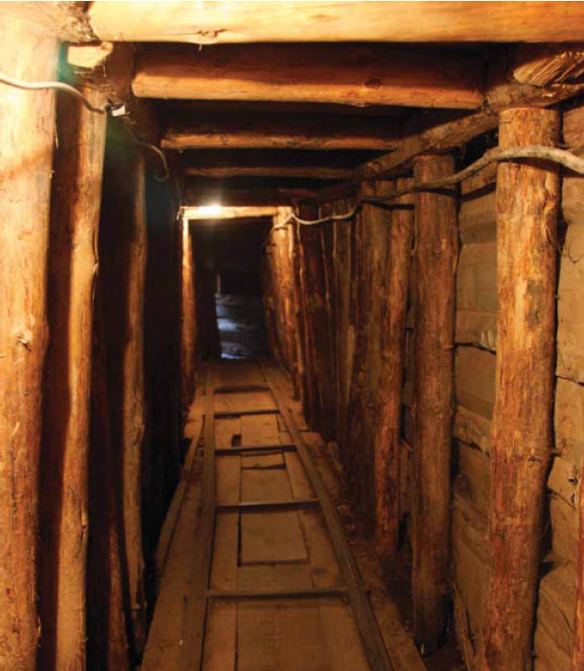
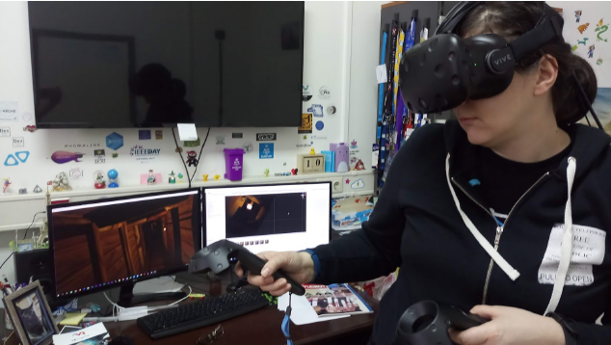
Sarajevo War Tunnel VR
Some cultural and historical heritage artifacts and monuments cannot be visited or explored anymore
Tunnel of hope enabled people to cross from the besieged city of Sarajevo to the free territory, bringing essential amounts of food, medical equipment, and weapons.
The Tunnel was crucial for the defense of the city during the war in the 1990s. Presently, it is only partially accessible to visitors.
The Sarajevo War Tunnel VR project aims to provide the users with the unique war experience of passing through the Sarajevo Tunnel of hope using immersive virtual reality

Slide 7
Sarajevo War Tunnel VR
After watching 4 digital stories the users are requested to take the quiz
If they pass they can enter in the Tunnel
After virtual crossing we offer more stories and movies
INTRO
RUNNING ACROSS RUNWAY
TUNNEL ENTRANCES
BULIDING TEH TUNNEL
THE MUSEUM
QUIZ
TUNNEL CROSSING SIMULATION
CURATOR STORIES
FILM ABOUT THE TUNNEL
OTHER ENTRANCES

Slide 8

Sarajevo War Tunnel VR - trailer

Slide 9
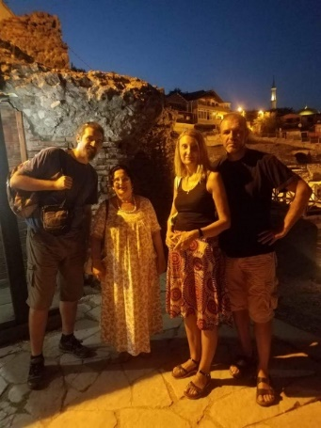
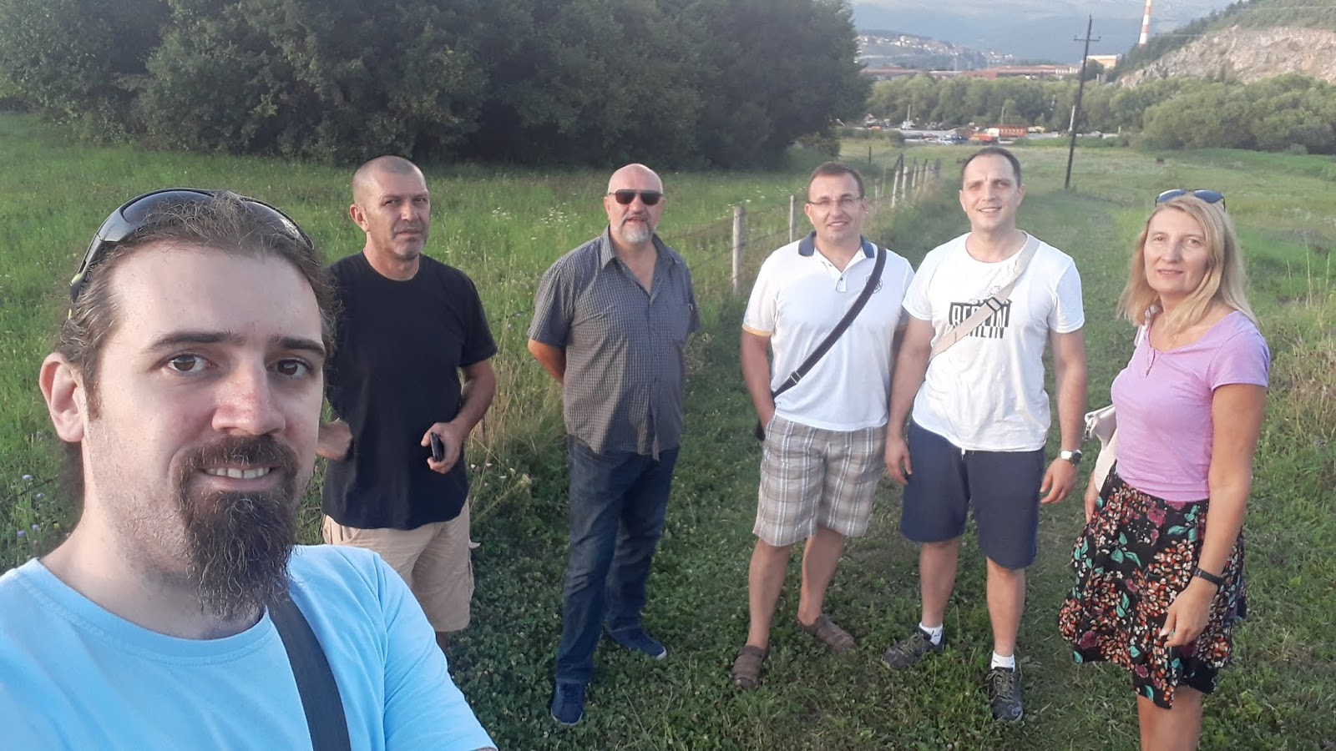
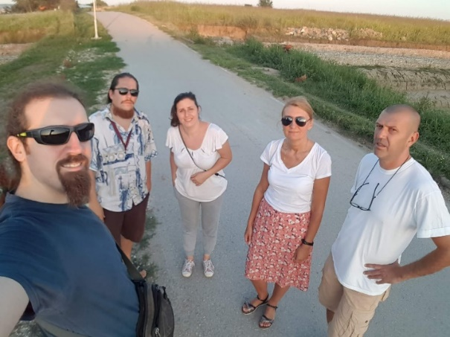
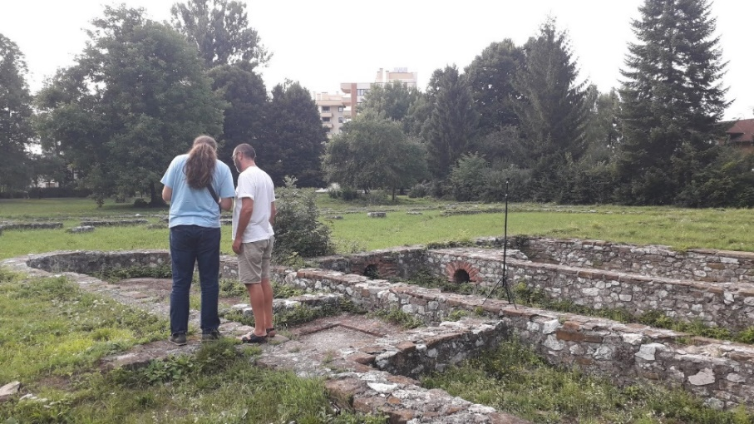
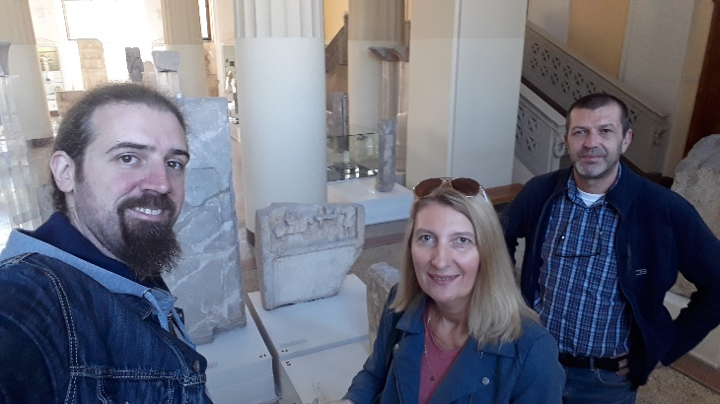
Roman Heritage in the Balkans
The goal of the Roman Heritage in the Balkans project is to create a virtual presentation of Roman cultural monuments in Bosnia and Herzegovina, Serbia, Montenegro and Albania showing that the whole area had common cultural heritage.
Selected sites:
  Roman villa and terme in Ilidza near Sarajevo,
  Roman military camp and city Viminacium near Pozarevac, Serbia,
  Municipium S. settlement near Pljevlja, Montenegro
  Durres amphitheater in Albania
presented through VR storytelling within an application is available online and installed in local museums, close to the selected archaeological sites
Project continues in 2020-21 with new 4 sites (lederata, Butrint, Mogorjelo and Doclea)

Slide 10
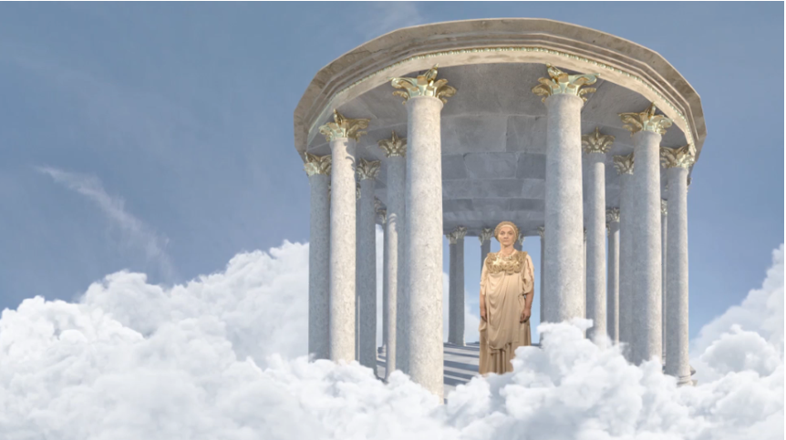
The trailer
Roman Heritage in the Balkans - trailer

Slide 11
Old crafts Virtual Museum
VR presentation of BH intangible heritage – crafts from Old town Sarajevo – Baščaršija
Through history 80 different crafts were performed in this place
Today, many of them are dying off
The Virtual Museum will preserve the crafts through digital technologies and protect them from extinction
In this version we present 3 last craftsmen of brush makers, haberdashers and boza makers.

Slide 12
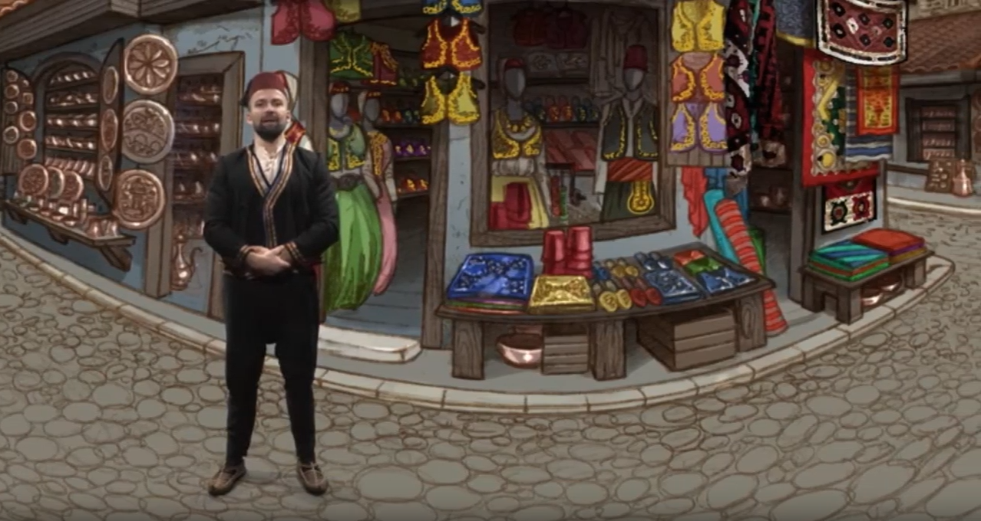
Old crafts Virtual Museum - trailer

Slide 13
Conclusion
Virtual Reality offers the users to EXPERIENCE cultural heritage
Time travel
Interactive digital storytelling
Edutainment
New form of media communication
Encouraging cultural tourism development

Slide 14

Thank you!
www.digi.ba

