Slide 1



Web kick-off meeting
WPC - COMMUNICATION PRESENTATION
Speaker: Silvia Comiati
Partner: PP2 – Friuli Venezia Giulia Autonomous Region
web kick-off meeting | 22 – 23 April 2020

Slide 2
WPC - main data
Duration: March 2020 – August 2022
WP Leader: PP2 – RAFVG
Partners involved: all PPs
General aims: to ensure clear and quality communication in all partner regions, to reach target audiences and convey the project message, to make the project known
Specific objectives: increase knowledge, raise awareness, influence attitude, change behaviours

Slide 3
Legal framework
EU regulations:
Art. 115-117 and Annex XII, section 2.2 of EC Regulation 1303/2013
Commission Implementing Regulation (EU) No 821/2014, lays out the rules for the EU flag, how to display the emblem and how to create permanent plaques /billboards
Commission Implementing Regulation (EU) No 447/2014, of 2 May 2014, especially Art 24, lays down obligations for visibility of projects funded under IPA
Programme documents regarding project communication:
the Implementation Manual of the ADRION Programme
the Project brand and visibility guidelines of the ADRION Programme

Slide 4
WPC - activities
C.1 – Start-up activities including communication strategy and website
C.2 – Publications
C.3 – Public Events
C.4 – Digital activities including social media and multimedia
C.5 – Promotional material

Slide 5
Activity C.1 – start-up activities
DELIVERABLES:
Communication Plan: drafted by WP Leader, to be commented by PPs
Project poster: to be provided in EN by WP Leader, all PPs have to display it in a location visible to the public
Project office templates: attached to Communication Plan
Project webpage on Interreg ADRION platform: to be set up and updated by WP Leader, all PPs contribute with news, events, pictures
Project webpages on partners’ websites: to be prepared by all PPs

Slide 6
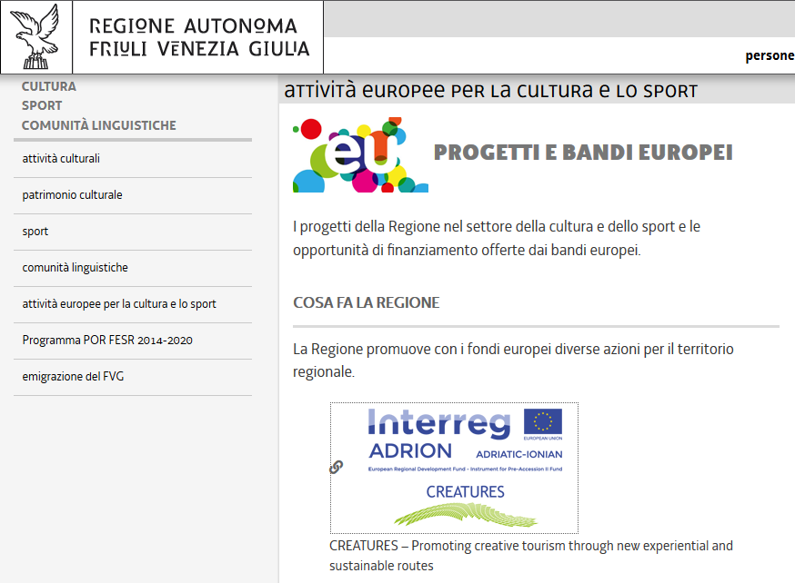
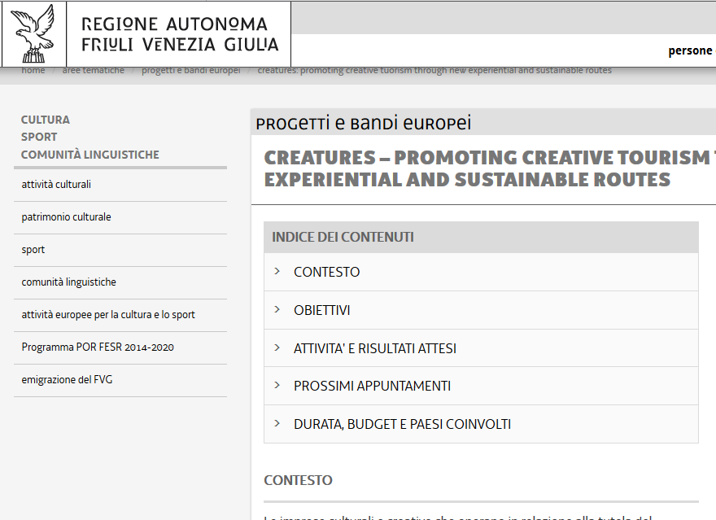
Project page - example
Project Logo
Link to the ADRION website
Short description including project aims and results

Slide 7
Activity C.2 - publications
DELIVERABLES:
Articles in local media: 3 articles per PP, national language
Articles in international media: 2 articles by WP Leader, EN
Press releases: 2 local press releases by each PP, national language
E-catalogue: collection of PPs’ good practices by PP8 (SEBS), graphic design by WP Leader
Final Report on CreaTourES Project: produced in paper-version by WP Leader, EN
TIMING TO BE RE-DEFINED?

Slide 8
Activity C.3 – public events
DELIVERABLES:
Dialogue on CreaTourES pathway: Mid-term project will be organized in 06/2021 in Vlore, organised by PP7 (RDNC)
CreaTourES Press tours: 1 press tour for each LAP produced
Local General States of Culture & Tourism - Final Local Dissemination Events: 1 local/regional to be organized by each PP (catchy format!)
ADRION General States of Culture & Tourism Transnational Final Conference: to be organised by WP Leader, one speaker and one/two stakeholders per each PP
Participation in external events: presentation of outputs and results

Slide 9




Activity C.4 - digital activities
DELIVERABLES:
Social media project accounts: set up and managed by WP Leader, all PPs contribute with posts, pictures, news, etc.
OPEN!!
OPEN!!
#CreaToures Key words: Cultural and Natural Heritage, CCIs, Tourism

Slide 10
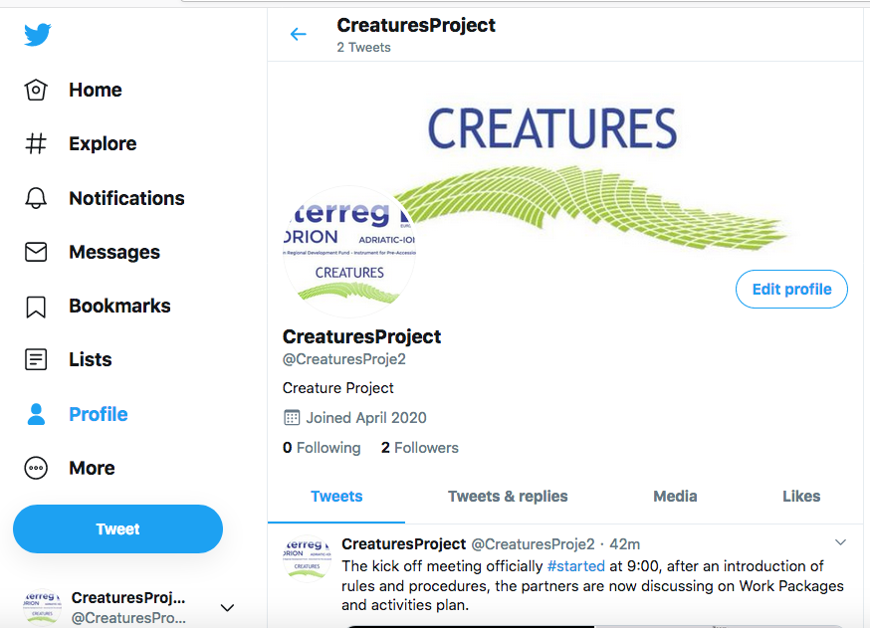
Activity C.4 - digital activities
DELIVERABLES:

Slide 11
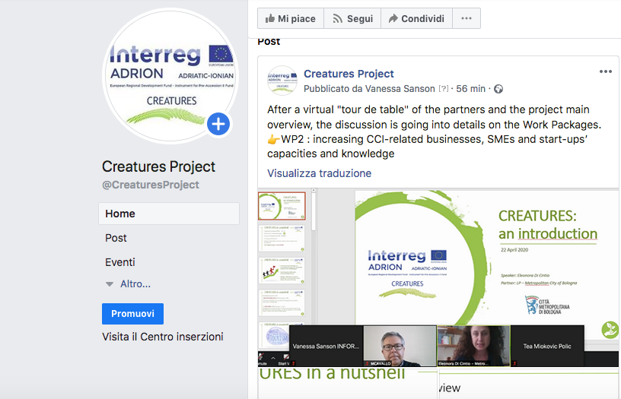
Activity C.4 - digital activities
DELIVERABLES:

Slide 12


Activity C.5 – promotional material
DELIVERABLES:
Project roll-up: graphic layout to be produced by WP Leader, all PPs will print one out
Communication and promotional materials: communication materials and branded promotional materials (pens, pencils, bags, USB sticks, notepads and other eligible material), all PPs

Slide 13
WPC – next steps
Activity | PPs | Timing
Create project web pages in PP institutional websites and send link to PP2 | All PPs | By mid- May
Connect/ subscribe to project social media | All PPs | By mid-May
Comment draft Communication Plan and provide list of local media and PP Communication Manager | All PPs | By end of April
Upload PP logo in the project repository | All PPs | By end of April
Provide PPs with poster and roll-up templates | PP2 | By end of May
Creates project web page in ADRION website | PP2 | According to ADRION timing
Share in project cloud the communication plan and the communication materials (manual, logos, visual identity) | PP2 | In the next days

Slide 14
THANK YOU!
Speaker: Silvia Comiati
Partner: RAFVG
Contact info:
elena.mengotti@regione.fvg.it
project-creatures@informest.it
web kick-off meeting | 22 – 23 April 2020

