Slide 1
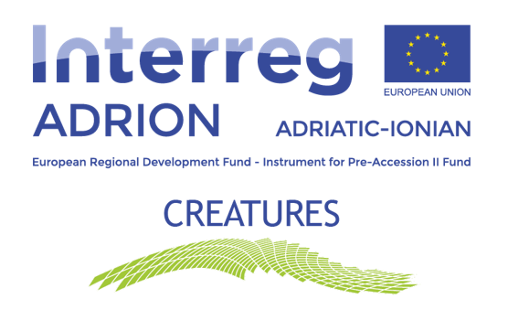
Web kick-off meeting
WP4 PRESENTATION
T3 - To develop CreaTourES mobile app and multimedia installations for CreaTourists
Speaker: Dr. Panagiotis KONSTANTINOPOULOS
Partner: PATRAS SCIENCE PARK S.A. (PSP)
web kick-off meeting | 22 – 23 April 2020

Slide 2
T3 - Contents
Presentation of concept
Partners Involved
Activities, timelines, Outputs, Deliverables
Work plan for FIRST 6 months
Discussion

Slide 3
T3 - Presentation of concept
T3 is related to the development of an innovative mobile app (MA) and multimedia installations (MI) promoted under the ADRION CreaTourES brand.
Mobile app (MA)
Preparatory phase: first technical studies and researches
Development phase: mobile app development
Final phase: mobile app will be tested for 8 months

Slide 4
Mobile app (MA) - Details
Building on the results of the pilot actions previously carried out (T2.4)
Selection and loading on the MA of at least 1 CreaTourES route per PP
The tourist-user will be able to select the ADRION city to visit (among the partners), the period of stay and the preferred CCI sectors (3-5) from the list offered: music, movies, fashion, visual arts, performing arts, design, marketing, architecture, handicraft etc.
The app (filtering) will identify and propose to the ‘CreaTourist’ the most suitable route(s) to satisfy his/her preferences, providing useful information about price, duration, venues (shown on a map), type of activities to be performed, contacts etc.
Interactive space reserved for the exchange of CreaTourists’ comments, opinions and suggestions will be available

Slide 5
Multimedia Installation (MI)
MI will be another original support tool for CreaTourists
Building on and deepening app's contents and the experiential-sustainable aspects characterising the selected route(s)
Official presentation: within the project Final Conference

Slide 6
T3 - Partners involved
PSP will coordinate T3, and will develop the app (MA) and the multimedia product (MI), supported by external experts
All PPs will contribute to define app & MIs' contents, providing translations and regular feedbacks to PSP throughout the development of the tools
All PPs will demonstrate Mi and MI in the selected areas (except for AUEB)
External experts/service providers will be sub-contracted, if needed
PSP will be responsible for the app also (at least) during the 3 years following the project end

Slide 7
T3 – Activities & Timeline

Slide 8
T3 - Outputs
* Both outputs related to the Programme Indicator:
COI_2 Increase in expected number of visits to supported sites of cultural and natural heritage and attractions
** Delivery date: 07.2022

Slide 9
Deliverables –T3.1

Slide 10
Deliverables –T3.2

Slide 11
Deliverables –T3.3

Slide 12
Deliverables –T3.4

Slide 13
Deliverables –T3.5

Slide 14
Deliverables –T3.6

Slide 15
Workplan – First 6 months
D3.1.1 | Market analysis | A market research on possible competitors and existing apps, similar to CreaTourES app idea (features, functions and objectives distinguishing CTES app) | 09.2020
D3.1.2 | Technical analysis | A technical analysis on the possible operating systems (Android, iOS, etc.) through which the app can be developed (or a multi-platform hybrid solution) | 09.2020

Slide 16
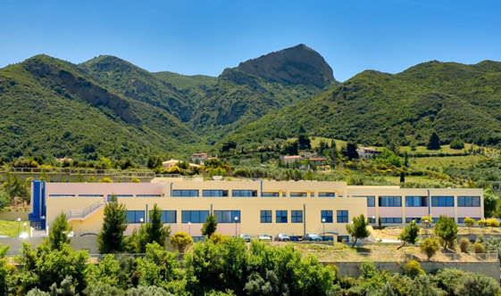
THANK YOU!
Speaker: Dr. Panagiotis KONSTANTINOPOULOS
Partner: PATRAS SCIENCE PARK S.A. (PSP)
Contact info: pkonst@psp.org.gr; info@psp.org.gr
URL: www.psp.org.gr
Tel.: +30 2610 911550, +30 6977 468431
web kick-off meeting | 22 – 23 April 2020

