Slide 1
Web kick-off meeting
WP PRESENTATION
Speaker: Olja Ljubišić
Partner: Regional Development Agency Dubrovnik Neretva County - DUNEA
web kick-off meeting | 22 – 23 April 2020

Slide 2
WORK PACKAGE 3 - T2 To increase decision makers’ competencies and tools related to CCIs

Slide 3
TIMEFRAME: 6/20 – 7/22
AIM
supporting local-regional, national & ADRION decision makers in developing more integrated CCI-related policies, regulations & practices, to better valorise their key-role and potential in supporting cultural heritage preservation and sustainable tourism.

Slide 4
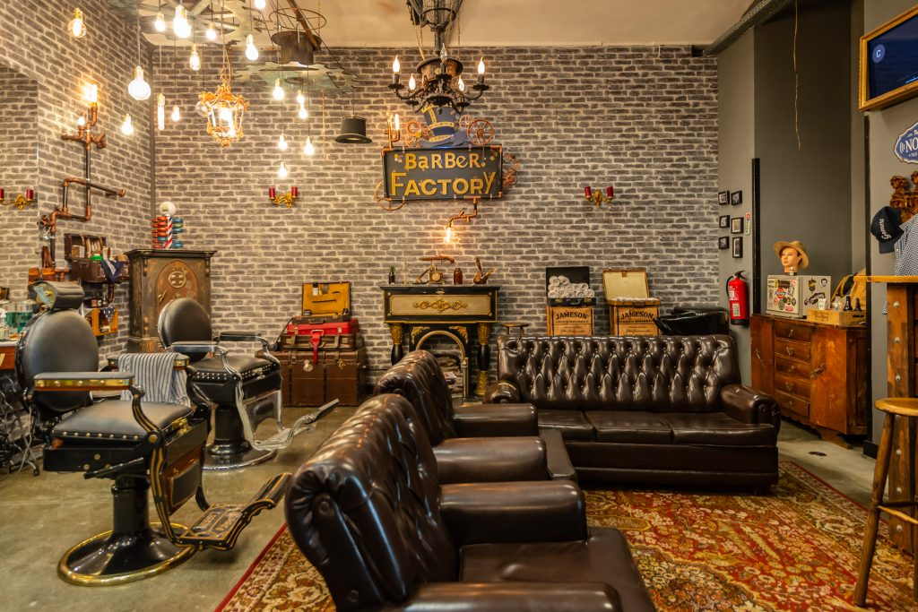
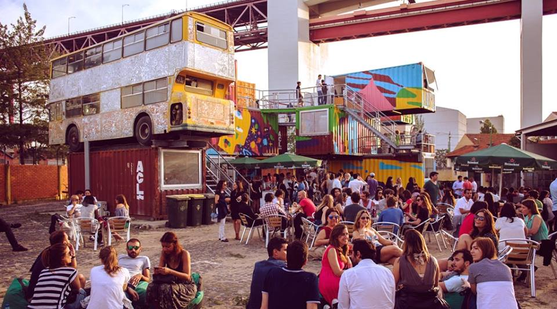
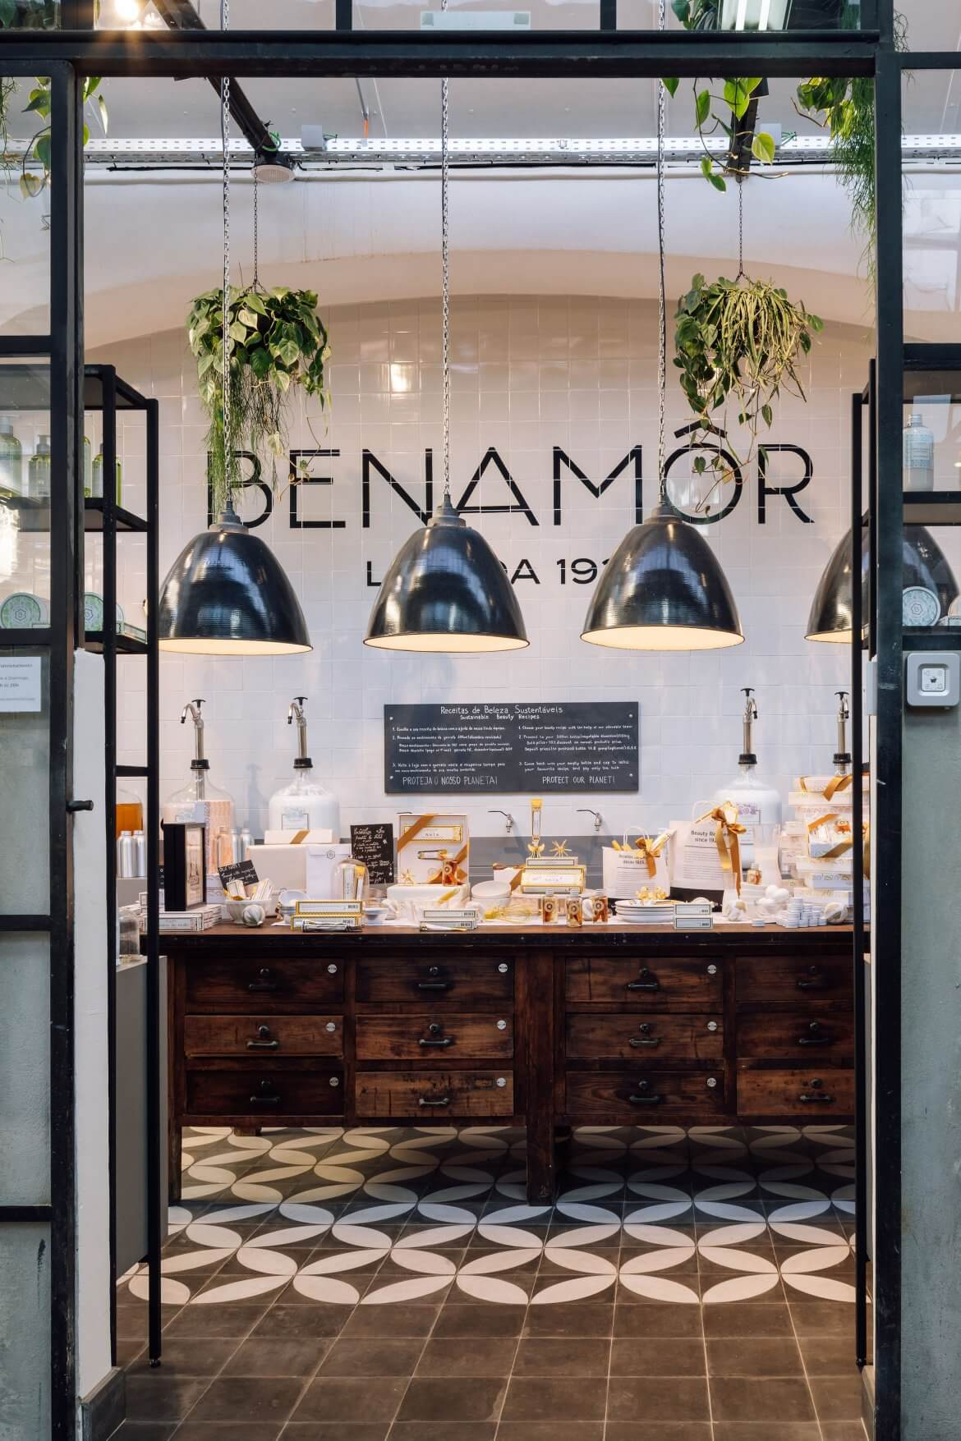
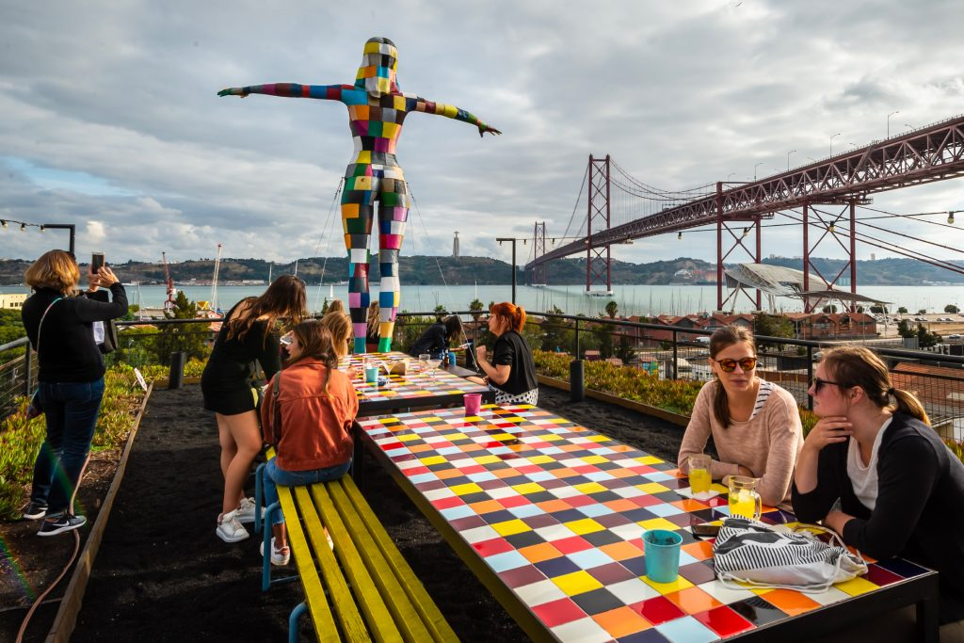
CREATIVE HUB

Slide 5
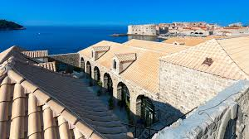
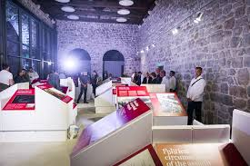
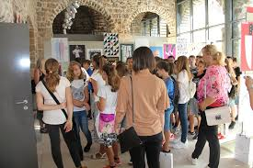
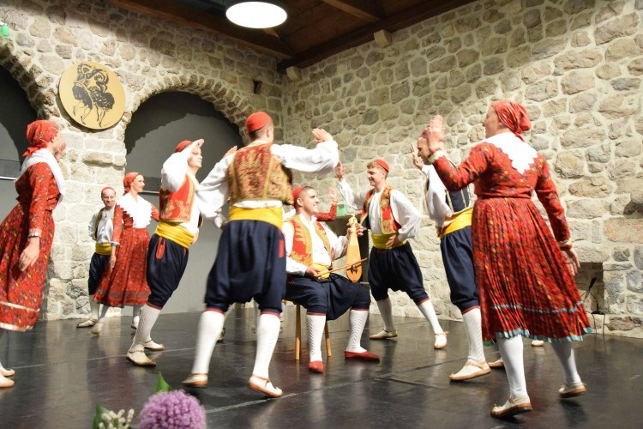
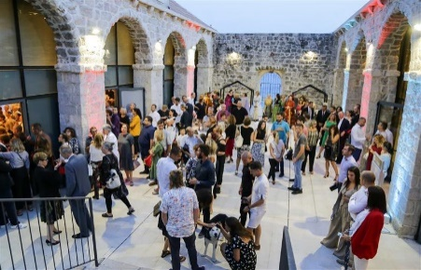
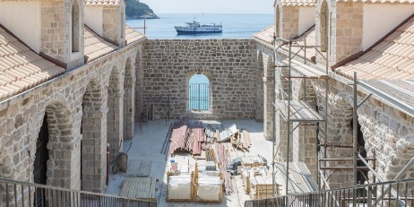
CREATIVE NEIGHBORHOOD

Slide 6
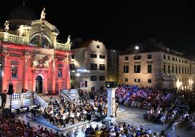
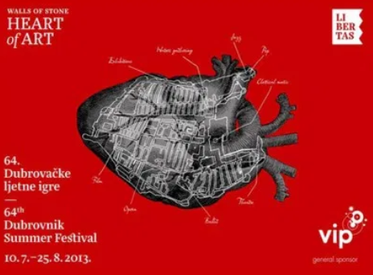
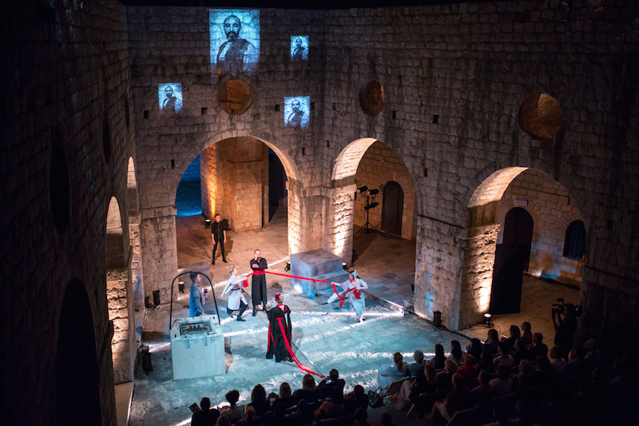
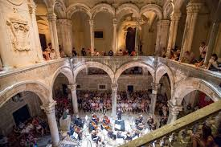
DUBROVNIK SUMMER FESTIVAL
St. Blaise church
Lovrijenac fortress
Rector’s palace

Slide 7
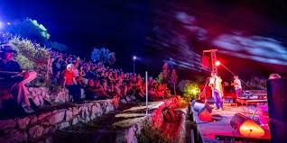
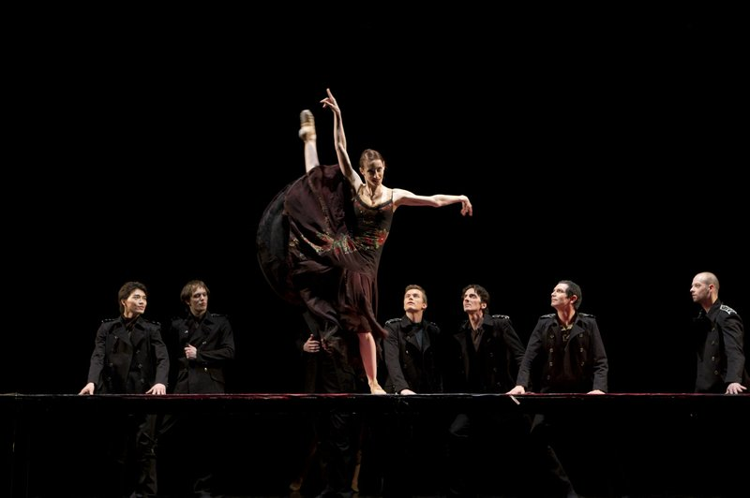
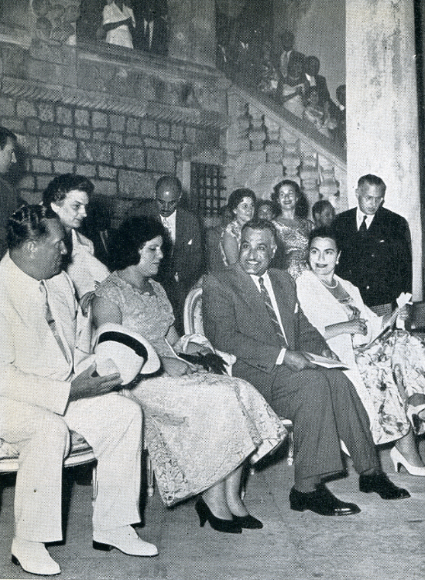
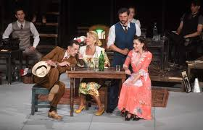

Slide 8
TARGET GROUPS
LOCAL, REGIONAL AND NATIONAL DECISION MAKERS
Comment and provide useful inputs on PR particularly useful for the transnational round tables and local/regional events organised by PPs, when PR will be presented and discussed.
Receive analysis, feedback and the LAPs produced.
CCI-RELATED EXPERTS
TOURISM PROFESSIONAL
CULTURAL HERITAGE PROFESSIONAL
R&I CENTRES
ECONOMIC DEVELOPMENT AGENCIES
BUSINESS SUPPORT ORGANISATIONS
CCI CLUSTERS
Involved in the development of LAPs and Pilot Actions providing technical support and know-how in order to ensure a more integrated approach and more effective results.

Slide 9
1 POLICY RECOMMENDATIONS
Integrated policy tools & measures for the long-term development and sustainability of ADRION CCIs, with a focus on heritage preservation and sustainable tourism. They will aim at policy integration, acting as policy driver above PPs’ national level.
7 LOCAL ACTION PLANS
LAPs will detail timing, activities, actors involved, available resources, expected results, related to the new "out of the box" creative tourism offers (e.g. multi-sensory experience), enhancing experimental sustainable aspects.
7 PILOT ACTIONS
Pilot action will test the effective attractiveness, ‘experientiality’ and sustainability of CreaTourES routes designed within the LAP. Tourists will be actively involved.

Slide 10
What will be done?
Project partners and other local stakeholders will gather lessons learnt during TMs and develop recommendations for policy makers.
Project partners and most developed CCI will choose and apply best examples of recommendations for their specific territory to design creative urban spaces for young tourists (2 routes per partner).

Slide 11
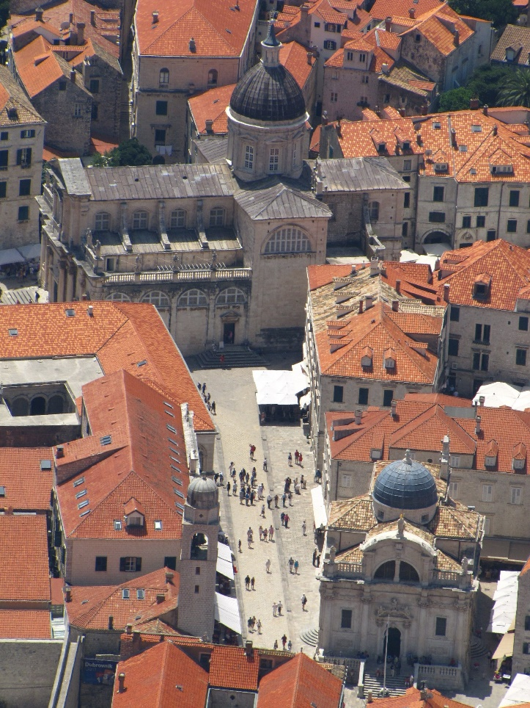
Responsabilities
ALL PP:
provide inputs for Policy Recommendations
being responsible for their own Local Action Plan and design of min. 2 routes
being responsible for their own Pilot Action
RDNC
- analysis of current legal, institutional and policy framework
DUNEA
monitoring methodology
legal recommendations
Policy Recommendations
UIRS
coordinate the production of Local Action Plans and Pilot Actions
AP
- Provide assistance to PPs

Slide 12
ACTIVITIES & DELIVERABLES

Slide 13
ANALYSIS OF CURRENT LEGAL, INSTITUTIONAL AND POLICY FRAMEWORK

Slide 14
ORGANIZE 7 LSG MEETINGS
All PPs will directly involve their relevant local stakeholders to identify and analyse the existing strategies and policies, analysing the main legal-institutional aspects related to CCI at local, regional and national level (particularly focusing on S3, Regional Development Plans, legal measures, subsidies, incentives, social status, etc.), also highlighting the link with EU framework.
COLLECT & ANALIZE DATA
In carrying out the analysis, PPs will focus on the aspects of CCI more directly connected to cultural heritage preservation-valorisation and sustainable tourism promotion.
Data and information collection will be coordinated by RDNC, responsible for re-elaborating and integrating the different specific results provided by PPs in a preparatory repot to be used for producing the final PRs.
The report (in English language) will be shared (via e-mail) by RDNC with PPs, APs and LSs within 09/2020.

Slide 15
TIMEFRAME: 4 months 6/2020 – 9/2020
RESPONSIBLE: RDNC
6&7/2020
ALL PP:
1 meeting with local stakeholders
DELIVERABLE T2.1.1: 7 Local Stakeholder Groups’ meetings 7/20
8/2020
ALL PP:
Identify the existing strategies and policies and prepare data and info for Joint Preparatory Report and deliver to RDNC
9/2020
RDNC:
Analyse the main legal-institutional aspects related to CCI – at local, regional and national level, also highlighting the link with EU framework.
DELIVERABLE T2.1.2: Joint Preparatory Report

Slide 16
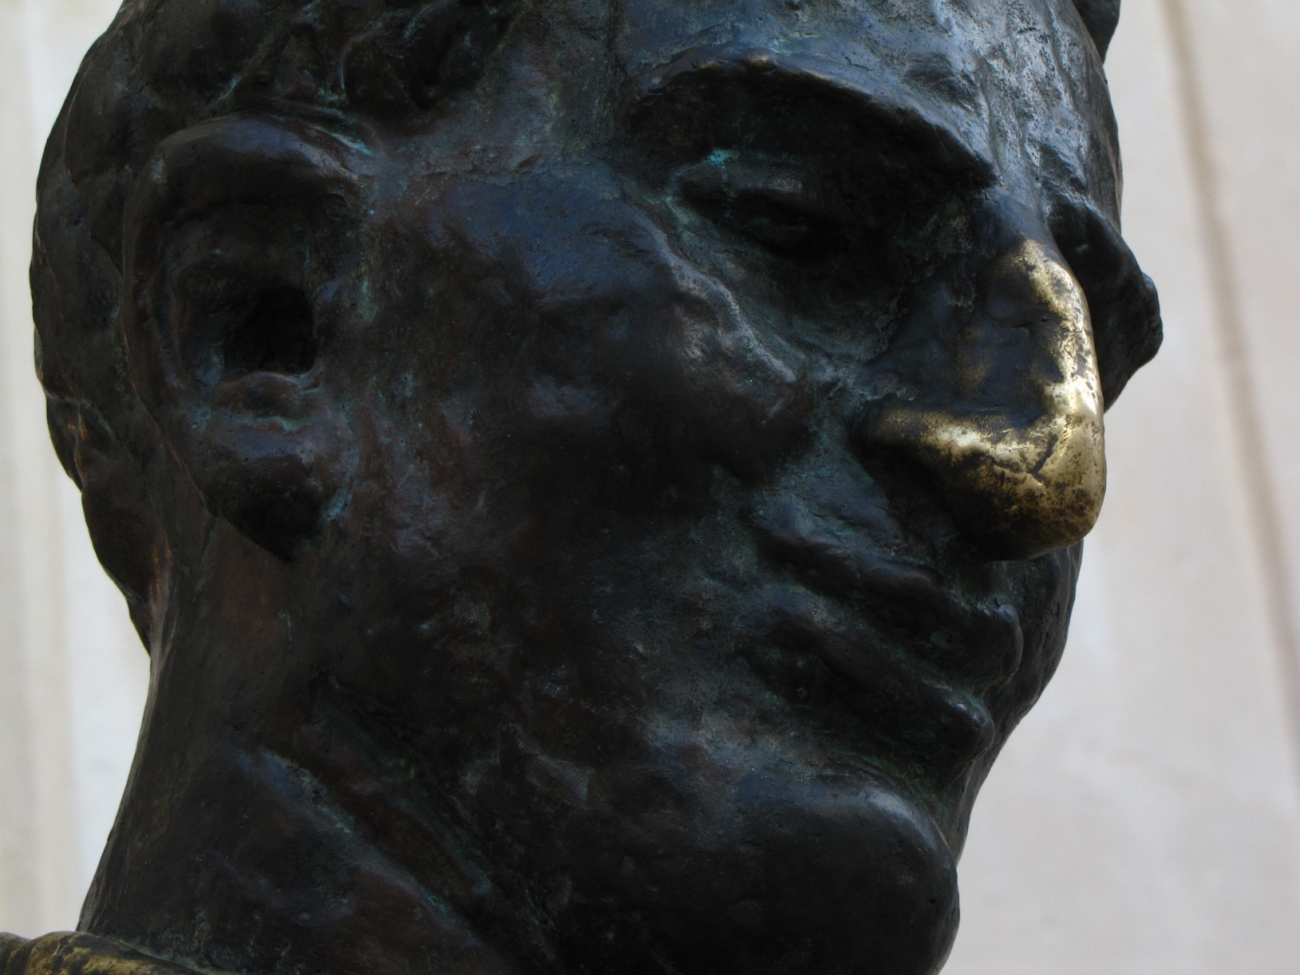
DEVELOPMENT OF POLICY RECOMMENDATIONS TO SUPPORT ADRION CCI (co-production)

Slide 17
POLICY RECOMMENDATION
to better support CCI in the ADRION Region
to promote the importance to create a “European space of creativity”, where especially CCI-related SMEs & start-ups can play a key-role in preserving-valorising cultural heritage and supporting sustainable tourism
to act as policy drivers & governance innovator above the national level
to support PPs in the production of effective LAPs

Slide 18
MONITORING SYSTEM FOR CCI
DUNEA will develop innovative and shared indicators, methods and tools for measuring impact of CCI on cultural heritage preservation and promotion of sustainable-experiential tourism.
LEGAL RECOMMENATIONS FOR CCI
DUNEA will develop legal recommendations aimed at strengthening the inter-sectoral and multi-level cooperation between CCI (with a focus on CCI-related SMEs and start-ups), cultural heritage & tourism sectors (to be included in the final PRs).

Slide 19
MID-TERM PROJECT MEETING 06/2021 (Vlore)
All PPs, APs and LSGs will discuss the final aspects of Policy Recommendations, before their finalization within 07/2021.
POLICY RECOMMENDATION REPORT
DUNEA will set up a participatory methodology involving partners and stakeholders, to point out joint policy recommendations to support ADRION CCI (particularly CC-related SMEs and start-ups), focusing on post-2020 RIS3, regional development & territorial cohesion policies. The co-production process will be summed up into a short report.
LANGUAGE: in English and PPs’ national language
PROFFESIONAL SUPPORT: APs with specific know-how on CCI (e.g. ClustER CCI)
PRESENTATION: at project Final Conference

Slide 20
TIMEFRAME: 10 months 10/2020 – 7/2021
RESPONSIBLE: DUNEA
10/2020
AUEB-RC:
define methodology for PR
2-6/2021
DUNEA:
set up a participatory methodology involving partners and stakeholders
ALL PP:
involve partners and stakeholders and point out joint policy recommendations to support ADRION CCI (particularly CC-related SMEs and start-ups), focusing on post-2020 RIS3, regional development & territorial cohesion policies
6/2021
MID TERM PROJECT MEETING
(organization RDNC, attending ALL PP)
(DELIVERABLE: T2.2.3)
7/2021
ALL PP:
provide input for short report
DUNEA:
short report with summed up co-production process
(DELIVERABLE T2.2..4)
10/2020-1/2021
DUNEA:
develop innovative and shared indicators, methods and tools for measuring impact of CCI weight in cultural heritage preservation and promotion of sustainable-experiential tourism (DELIVERABLE T2.2.1)
prepare legal recommendations for supporting cooperation between CCI and sectors of cultural heritage & sustainable tourism (DELIVERABLE T2.2.2)

Slide 21
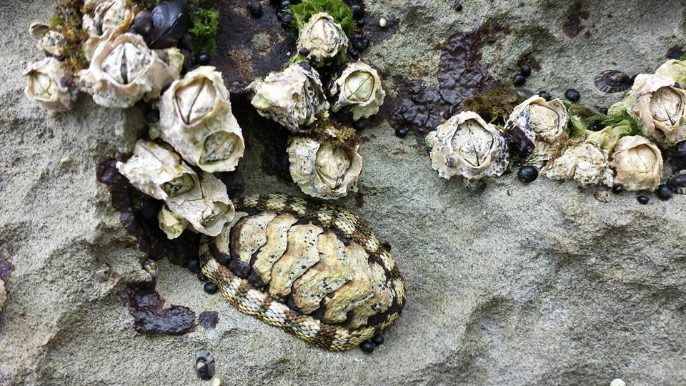
PRODUCTION OF LOCAL ACTION PLANS

Slide 22
LOCAL ACTION PLANS
to strengthen the link between local CCI-SMEs & start-ups and the interconnected sectors of cultural heritage preservation and sustainable tourism
to design new creative, experiential, sustainable tourism routes valorising local cultural heritage and responding to the new tastes-needs of tourists (especially the youngest)
Structured document: includes activities description, timeframe, budget and task allocations

Slide 23
APs
APs with experience in social, economic, cultural & environmental development (ClustER CCI, AULEDA, SERDA, ACC, MCRS, FWSV) will support PPs to increase their territorial attractiveness, competitiveness and sustainability.

Slide 24
Each PP will organize at least 1 LSG MEETING in order to directly and effectively involve all relevant LSs in the production of LAP, also discussing with them on the development of other project activities (JAP implementation and PRs production).
Determine at least 2 CreaTourES routes
SECTORAL ANALYSIS will be carried out by PPs, supported by their LSGs’ members (according to their respective areas of action), to design more competitive, attractive and ‘profitable’ tourism offers, also considering territorial strengths & weaknesses
FEASIBILITY STUDIES will be carried by PPs, supported by their LSGs, as systematic assessments of characteristics, costs and possible results of their LAPs (including cost-benefit analysis and economic-financial sustainability analysis)

Slide 25
UIRS will define a common methodology and template to collect data & feedback from PPs during testing of new routes.
Within 7 LOCAL ACTION PLANS PPs will test at least 2 new CreaTourES routes. Tourists will be directly and actively involved.
1st REPORT ON LAP (PRODUCTION PHASE) - LAPs produced by PPs will be integrated and summarized in a joint report, highlighting common elements and differences between LAPs, and laying the foundations for the next implementation phase and pilot actions by UIRS.

Slide 26
TIMEFRAME: 1/2021 – 8/2021
RESPONSIBLE: UIRS
3/2021
ALL PP:
7 LSG meetings
(DELIVERABLE T.2.3.1)
Determine at least 2 CreaTourES routes
4/2021
ALL PP:
7 sectoral analysis
(DELIVERABLE T.2.3.2)
5/2021
ALL PP:
7 feasibility studies
(DELIVERABLE T.2.3.3)
5/2021
UIRS:
define a common methodology and template to collect data & feedback from PPs in the process of testing new routes
6/21
ALL PP:
Test new routes. Tourists need to be directly and actively involved. Finalize Local Action Plans
DELIVERABLE T.2.3.4: 7 Local Action Plans preparation
8/2021
UIRS:
1 REPORT on LAPs (production phase)
(DELIVERABLE T.2.3.5)

Slide 27
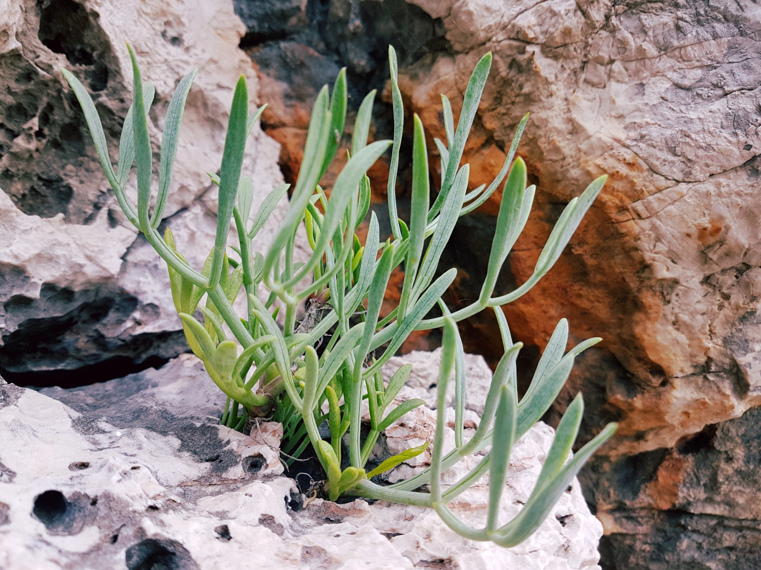
PILOT IMPLEMENTATION OF LOCAL ACTION PLANS AND CREATURES ROUTES

Slide 28
PILOT ACTION
EXPERIMENTAL PHASE OF LAP
Testing-evaluating action directly involving tourists, especially the younger ones (18-35 years) considers monitoring a period of almost 1 year in order to detect the real feasibility, attractiveness, effectiveness and replicability of the creative-experiential tourism routes designed, also in a transnational perspective.
Pilot action will promote a ‘design-thinking’ method based on a user-centric approach and aimed to produce more effective, lasting and transferrable results.
Data and feedback collected will be used for improvement of mobile app.

Slide 29
TRANSNATIONAL MEETING 11/2021 Dubrovnik
Within each PILOT ACTION, PPs will test at least 2 new CreaTourES routes designed and included in the LAP. Tourists will be directly and actively involved. All data & feedback will be collected and processed by PPs before being provided to UIRS.
2nd REPORT ON LAPs (IMPLEMENTATION PHASE) - All PPs’ data & feedbacks on the CreaTourES routes tested by tourists will be collected and elaborated in a joint final report by UIRS, highlighting the transnational perspective of the new sustainable and creative tourism model(s) produced by PPs through the project (for the refinement of the mobile app).

Slide 30
TIMEFRAME: 8/2021 – 7/2022
RESPONSIBLE: UIRS
11/2021
TRANSNATIONAL MEETING
11/21 (organization DUNEA; attending ALL PP)
(DELIVERABLE T.2.4.1)
1 year
ALL PP:
7 Pilot Actions for testing new routes. Tourists will be directly and actively involved. Collect and process dana. Send feedback to UIRS
(DELIVERABLE T.2.4.2)
7/2022
UIRS:
2nd REPORT on LAPs (implementation phase)
(DELIVERABLE T.2.4.3)

Slide 31
BUDGET
 | MCBO | FVGAR | UIRS | PSP | AUEB-RC | DUNEA | RDNC | SEBS | TOTAL
STAFF | 37,000.00 | 26,500.00 | 32,500.00 | 31,500.00 | 22,500.00 | 37,000.00 | 27,500.00 | 27,500.00 | 242,000.00
OFFICE | 3,700.00 | 2,650.00 | 3,250.00 | 3,150.00 | 2,250.00 | 3,700.00 | 2,750.00 | 2,750.00 | 24,200.00
TRAVEL | 5,800.00 | 4,400.00 | 6,000.00 | 5,400.00 | 6,400.00 | 4,500.00 | 4,500.00 | 6,000.00 | 43,000.00
EXTERNAL | 31,000.00 | 33,000.00 | 28,000.00 | 28,000.00 | 11,350.00 | 44,000.00 | 30,500.00 | 26,000.00 | 231,850.00
TOTAL | 77,500.00 | 66,550.00 | 69,750.00 | 68,050.00 | 42,500.00 | 89,200.00 | 65,250.00 | 62,250.00 | 541,050.00

Slide 32
BUDGET - STAFF
 | P1 | P2 | P3 | P4 | P5 | TOTAL
MCBO | 1,000.00 | 9,000.00 | 8,000.00 | 8,000.00 | 11,000.00 | 37,000.00 | 242,000.00
FVGAR | 3,000.00 | 6,000.00 | 5,500.00 | 5,500.00 | 6,500.00 | 26,500.00
UIRS | 1,000.00 | 8,000.00 | 8,000.00 | 8,000.00 | 7,500.00 | 32,500.00
PSP | 2,000.00 | 8,000.00 | 8,500.00 | 8,000.00 | 5,000.00 | 31,500.00
AUEB-RC | 1,000.00 | 3,500.00 | 7,000.00 | 6,000.00 | 5,000.00 | 22,500.00
DUNEA | 2,000.00 | 12,000.00 | 8,000.00 | 8,000.00 | 7,000.00 | 37,000.00
RDNC | 1,000.00 | 7,000.00 | 6,500.00 | 6,000.00 | 7,000.00 | 27,500.00
SEBS | 1,000.00 | 4,000.00 | 5,500.00 | 8,000.00 | 9,000.00 | 27,500.00

Slide 33
BUDGET - TRAVEL
 |  | P1 | P2 | P3 | P4 | P5 | TOTAL
MCBO | 2 pax to Vlore |  |  | 1,500.00 |  |  | 1,500.00 | 43,000.00
 | 2 pax to Dbk |  |  |  | 1,400.00 |  | 1,400.00
 | 2 pax to Athens |  |  |  |  | 1,450.00 | 1,450.00
 | 2 pax to Trieste |  |  |  |  | 1,450.00 | 1,450.00
FVGAR | 2 pax to Vlore |  |  | 1,500.00 |  |  | 1,500.00
 | 2 pax to Dbk |  |  |  | 1,400.00 |  | 1,400.00
 | 2 pax to Athens |  |  |  |  | 1,500.00 | 1,500.00
UIRS | 2 pax to Vlore |  |  | 1,500.00 |  |  | 1,500.00
 | 2 pax to Dbk |  |  |  | 1,500.00 |  | 1,500.00
 | 2 pax to Athens |  |  |  |  | 1,500.00 | 1,500.00
 | 2 pax to Trieste |  |  |  |  | 1,500.00 | 1,500.00
PSP | 2 pax to Vlore |  |  | 1,500.00 |  |  | 1,500.00
 | 2 pax to Dbk |  |  |  | 1,500.00 |  | 1,500.00
 | 2 pax to Athens |  |  |  |  | 1,200.00 | 1,200.00
 | 2 pax to Trieste |  |  |  |  | 1,200.00 | 1,200.00
AUEB-RC | 2 pax to Vlore |  |  | 1,800.00 |  |  | 1,800.00
 | 2 pax to Dbk |  |  |  | 2,000.00 |  | 2,000.00
 | 2 pax to Trieste |  |  |  |  | 2,000.00 | 2,000.00
 | 2 pax to LSG meetings to Patras |  | 200.00 | 200.00 | 200.00 |  | 600.00
DUNEA | 2 pax to Vlore |  |  | 1,500.00 |  |  | 1,500.00
 | 2 pax to Athens |  |  |  |  | 1,500.00 | 1,500.00
 | 2 pax to Trieste |  |  |  |  | 1,500.00 | 1,500.00
RDNC | 2 pax to Vlore |  |  | 1,500.00 |  |  | 1,500.00
 | 2 pax to Dbk |  |  |  |  | 1,500.00 | 1,500.00
 | 2 pax to Trieste |  |  |  |  | 1,500.00 | 1,500.00
SEBS | 2 pax to Vlore |  |  | 1,500.00 |  |  | 1,500.00
 | 2 pax to Dbk |  |  |  | 1,500.00 |  | 1,500.00
 | 2 pax to Athens |  |  |  |  | 1,500.00 | 1,500.00
 | 2 pax to Trieste |  |  |  |  | 1,500.00 | 1,500.00

Slide 34
BUDGET - EXTERNAL
 |  | P1 | P2 | P3 | P4 | P5 | TOTAL
MCBO | LSG meeting |  | 500.00 | 500.00 | 500.00 |  | 1,500.00 | 231,850.00
 | 2 pax to Vlore |  |  | 1,500.00 |  |  | 1,500.00
 | pilot management |  |  |  | 16,000.00 | 12,000.00 | 28,000.00
FVGAR | LSG meeting |  | 500.00 | 500.00 | 500.00 |  | 1,500.00
 | 2 pax to Vlore |  |  | 1,500.00 |  |  | 1,500.00
 | pilot management |  |  |  | 18,000.00 | 12,000.00 | 30,000.00
UIRS | LSG meeting |  | 500.00 | 500.00 | 500.00 |  | 1,500.00
 | 2 pax to Vlore |  |  | 1,500.00 |  |  | 1,500.00
 | pilot management |  |  |  | 15,000.00 | 10,000.00 | 25,000.00
PSP | LSG meeting |  | 500.00 | 500.00 | 500.00 |  | 1,500.00
 | 2 pax to Vlore |  |  | 1,500.00 |  |  | 1,500.00
 | pilot management |  |  |  | 15,000.00 | 10,000.00 | 25,000.00
AUEB-RC | Support DUNEA in developing working methodology to produce Policy Recommendations |  |  | 4,700.00 |  |  | 4,700.00
 | Production of PRs (methodological support to DUNEA) |  |  |  | 4,200.00 |  | 4,200.00
 | Organization of meeting in Athens |  |  |  |  | 2,450.00 | 2,450.00
DUNEA | External expertise in support to coordination activities (T2.1 &T2.2) | 8,000.00 | 5,000.00 |  |  |  | 13,000.00
 | LSG meeting |  | 500.00 | 500.00 | 500.00 |  | 1,500.00
 | Organization of the meeting in DBk |  |  |  | 4,000.00 |  | 4,000.00
 | 2 pax to Vlore |  |  | 1,500.00 |  |  | 1,500.00
 | Costs for the pilot running |  |  |  | 14,000.00 | 10,000.00 | 24,000.00
RDNC | LSG meeting |  | 500.00 | 500.00 | 500.00 |  | 1,500.00
 | organization of the meeting in Vlore and LSG meetings |  |  | 5,000.00 |  |  | 5,000.00
 | Costs for the pilot running |  |  |  | 15,000.00 | 9,000.00 | 24,000.00
SEBS | LSG meeting |  | 500.00 | 500.00 | 500.00 |  | 1,500.00
 | 2 pax to Vlore |  |  | 1,500.00 |  |  | 1,500.00
 | Costs for the pilot running |  |  |  | 15,000.00 | 8,000.00 | 23,000.00

Slide 35
THANK YOU!
Speaker: Olja Ljubišić
Partner: Regional Development Agency Dubrovnik Neretva County - DUNEA
Contact info: oljubisic@dunea.hr
+385 99 5206110 (Viber/Whatsapp)
olja_ljubisic (Skype)
web kick-off meeting | 22 – 23 April 2020

