Slide 1
Web kick-off meeting
The PROJECT REPORTING
Speaker: Eleonora Di Cintio
Partner: Metropolitan City of Bologna
web kick-off meeting | 22 – 23 April 2020

Slide 2
FINANCIAL MANAGEMENT
Basic principles:
Use all the money
Be accountable
Be cooperative

Slide 3
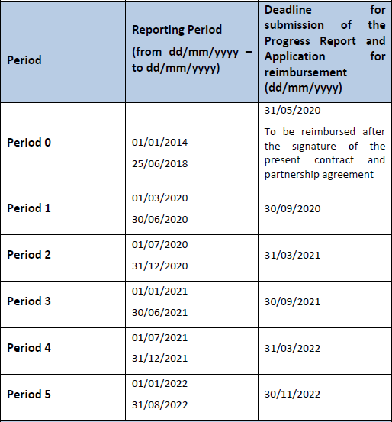
6 Reporting periods
Quick info:
LP - Submission via eMS to the MA within 3 months from the end of the Reporting Period
PP - Submission via eMS to the FLC within 10 calendar days from the end date of the Reporting Period
NOTE: The Period 1 ends at the end of June 2020.

Slide 4
The PROJECT PARTNER REPORT
Activity description
Describe your contribution in the semester!
+
€
€
€
…Upload all expenditures and invoices on the eMS platform paying attention to the budget line and the Work packages!
Financial information

Slide 5
RECOMMENDATIONS
related to the Project Partner Report
Timely submission is essential: submit your Partner Project report to the national controller according to set deadlines: in 10 calendar days after the end date of the reporting period
Check eligibility of costs
Provision of information must be accurate, reliable and duly supported
Be realistic
A great writing
Get in touch with your national controller (through NCP), ask for the required format, timing and set-up communication for co-operation
If in your country/region, FLC organizes a workshop about preparation of FLC report, it is recommended to attend
…in English!

Slide 6
…eMS PLATFORM: first duties&info!
The electronic Monitoring System (eMS) is the virtual place where you will upload all documentation
All PPs must become eMS users through registration (soon!)
Usernames are to be communicated to the LP
LP and PPs must consider password and login as confidential data
Only the LP can have access to all PPs and project reports

Slide 7
REPORTING and PAYMENT PROCESS…
05
MA/JS:
Payment to the Lead Partner
06
Lead Partner:
Payment to the project partners
04
Ma/JS:
verification
FINISH
03
Lead partner
Produces and submits the project progress report
and request for payment
START
01
Project partners:
Submit their partner reports on eMS to
their controllers
02
Controllers
Checks reports submitted and
Revise
Reject
Not verify
Validate

Slide 8
NATIONAL CONTROLLERS - First Level Controller (FLC) The independent body/person in charge of the verification of Project Partner Reports.
The identification of the National controller depends on the national control systems set in place by the ADRION Partner State: centralized or decentralized.
€€
CENTRALIZED
DECENTRALIZED
In Croatia and Italy, the costs of control are charged to beneficiaries.
→ Choose the right budget line!
The Partner State appoints the body/institution and can also decide whether the service is free of charge or not.
It is up to the Project partner to identify the FLC. It can be external (procurement rules) or internal (for public bodies only) and must be validated by the national ad hoc Committee.
Albania, Bosnia and Herzegovina, Croatia, Greece, Montenegro, Serbia, Slovenia
Italy

Slide 9
…VALIDATION OF EXPENDITURE
01
The Lead Partner submits the Project Progress Report and the request of payment.
02
The MA/JS can accept ot not the documentation received. If everything goes well (!!!), the MA/JS will pay the LP within 90 days from the date of submission.
€
03
The Lead Partner pays all Partners.

Slide 10
ELIGIBILITY OF EXPENDITURE
Project budget lines:
Staff costs;
Office and administrative expenditure;
Travel and accommodation costs;
External expertise and services costs;
Equipment expenditure.
NOTE: always check eligible and not eligible expenditure!

Slide 11
QUICK&USEFUL REMINDERS
Pre-financing (for IPA partners only)
Albania, Bosnia and Herzegovina
Advance payment is up to 10% per IPA PP and it will be deducted from its first 2 request of payments
Period 0: 1° DEADLINE!
CREATURES preparation costs: 11.100€ in the External expertise budget line. Deadline to apply: 31.05.2020
Modification in operations
Of major and minor relevance; some require the prior approval by the JS/MA. Always inform the LP without delay

Slide 12
BUDGET FLEXIBILITY
a minor change from the AF
Budget flexibility allows projects to reallocate amounts up to 20% or € 40.000,00 in total
Among budget lines or work packages.
The PPs must inform the LP about the need of minor changes without delay.
Avoid extremely limited amount (e.g.: EUR 500/1.000).
A communication must be sent to the JS via eMS.
Other requirements are listed in the Implementation manual.
EX. 1
NOTE: Budget flexibility cannot apply in the first six months of project implementation.
EX. 2

Slide 13
MAJOR CHANGES
from the AF
01 Changes in the partnership
02 Changes in project budget (exceeding budget flexibility)
03 Changes in the work plan
04 Prolongation of the project duration
All major changes have to be prior communicated to MA/JS and further approved by the Monitoring Committee. If necessary, the MA/JS can ask for support to the NCPs.
All major changes require an amendment of the subsidy contract and of the partnership agreement.
NOTE: No project modification in the first six months of project implementation (unless they are vital).

Slide 14
USEFUL DOCUMENTS
Implementation manual
Subsidy contract
Partnership agreement
Application Form
On
Metrocloud!
CONTACT
Valeria Stacchini, financial manager
valeria.stacchini@cittametropolitana.bo.it

Slide 15
THANK YOU!
Speaker: Eleonora Di Cintio
Partner: Metropolitan City of Bologna
Contact info: eleonora.dicintio@cittametropolitana.bo.it
web kick-off meeting | 22 – 23 April 2020

