Slide 1
Kick Off meeting ADRION1050 CREATURES
ADRION JS
KOM - 22 April 2020

Slide 2
Communication requirements

Slide 3
Communication: Essential for the project success
key part of the project implementation;
Communication ensures higher visibility to the project activities, outputs and results;
It is aimed to reach the project goal/s informing about the project achievements;

Slide 4
ADRION project web site
Your project web site will be hosted on the ADRION website;
The web site must be updated every 2 months (monitoring requirements);
The hosted pages shall have a pre-defined structure and/or contain a minimum quality and content requirements set by the programme.

Slide 5
Integrated project logo

Slide 6
During the implementation:
Reference to the co-financing source (ERDF and IPA II) in ALL communication activities
Integrated project logo that consist in : Programme name; EU emblem; reference to the co-financing source (ERDF and IPAII) and project acronym. It will be provided by the programme to all the projects.
Providing on partner’s institutional website a short description of the project including its aims and results, and highlighting the financial support from the Union (ERDF/IPAII);
Poster A3 format displayed at a location readily visible by the public (in each partner premises) making clear reference to the co-financing source, amount of ERDF and IPAII budget;
Project web site.

Slide 7
LEGAL requirements

Slide 8
ADRION legal framework
Obligations between MA and LP
Subsidy contract
Declaration on absence of double funding
Obligations between LP and PPs
Partnership Agreement

Slide 9
Subsidy Contract
Obligations between MA and LP
Subsidy contract
Declaration on absence of double funding
Obligations between LP and PPs
Partnership Agreement

Slide 10
ADRION legal framework - subsidy contract
Defines the obligations between the LP on behalf of the entire partnership and the Managing Authority (lead partner principle);
Content cannot be modified;
Signed between MA and the LP legal representative reported in the Application Form;
Signed at the end of the negotiation process;
Signed by LR Declaration on absence of double funding at the time of SC signature must be attached to the subsidy contract along with payment form!
Two copies to be signed.
The LP signs first and the MA signs last;
No changes in text of the subsidy contract possible (offer);

Slide 11
ADRION legal framework - subsidy contract main topics
Overall framework
Reference legal framework;
Amount of subsidy (ERDF and IPA funds) and project duration;
Reporting and requests for payments;
Project and financing management (including validation of expenditure);
Publicity, communication and branding;
Amendment of the subsidy contract and project changes;
Financing control and audits;
Withdrawal or recovery of unduly paid out funds;
Decommitment of project budget;
Durability of operation, ownership and use of outputs and contribution to programme results;
Project management
Termination and repayment;
Revenues;
Advance payment;
Force majeure and litigation.
Other conditions
Notes:
You must be ready in implementing the project (e.g.: having all the necessary permissions , licences etc in relation to the activities to be implemented
Obligations of the LP (representative of the entire partnership

Slide 12
Partnership Agreement
Obligations between MA and LP
Subsidy contract
Declaration on absence of double funding
Partnership Agreement
Obligations between LP and PPs

Slide 13
ADRION legal framework - partnership agreement
Defines obligations between the LP and the Project Partners;
Mirrors content of subsidy contract;
Possibility of personalize the agreement in accordance to specific partnership needs to ensure sound project management (e.g.: deadline for submission of documentation for further requests for payment);
Signed within two months from the signature of the subsidy contract;
One PA signed between LP and all PPS or several PA signed by LP and each PP;
Information on the signature by all partners to be provided (no compulsory provision of signed document);
Model of partnership agreement offered by ADRION.
Overall structure (mirroring obligations of the LP) cannot be changed;
The MA reserves the right to check the truthfulness of the document, whether it has been signed by the LP and all PPs and if it is compliant with the minimum requirements.
Notes:
Obligations of the PP, obligations of the LP towards the PP
Steering committee

Slide 14
Compliance with legal requirements and financial flow
Subsidy contract
Partnership agreement
Paper copy to be returned duly signed
MA signs last
LP must sign within 1 month from the receipt
Signature by all PPs within 2 months from the subsidy contract signature
Information via eMS (Supplementary information)
Provision of 10% advance payment (for IPA PPs) and reimbursement of preparation costs to partners: only if a) the subsidy contract is signed by the parties (LP and MA), b) the affected partner has signed the partnership agreement
LACK OF SIGNATURE OF LEGAL DOCUMENTS
NO MONEY FOR THE AFFECTED PARTNER
Notes:
Adavnce payment of 10% of partner budegt is atuomatically disbursed by the CA to the LP , which will then pay the IPA partners on conditions that legal requiremenst (signature of the SC and of the PA) are fulfilled.
Preparation cost are claimed by the Lead partner via project report 0 in which ceri

Slide 15
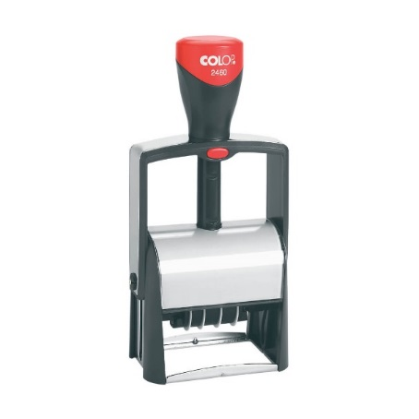
Project stamp
In order to avoid double funding, each project partner must annul invoices with the project stamp
The project stamp must contain the following information:
The expenditure has been co-funded by the INTERREG ADRION Programme;
The number and the acronym of the project;
The amount claimed in the project;
The date of payment.
In case of electronic invoices (or other documents with probative value), the minimum information to be incorporated are the same as above, except for:
Date when the service/equipment has been provided.

Slide 16
For ITALIAN Partners only
CUP – Codice Unico di Progetto - must be request by EACH Italian Partner (LP/PP), as follows:
PUBLIC bodies: directly requesting CUP to the following address http://cupweb.tesoro.it/CUPWeb/ ;
PRIVATE bodies: requesting CUP to the ADRION Managing Authority.
In consideration of the Italian decentralized system of First Level Control:
Each Italian partner must refer to the Italian NCP, in order to comply with the requested procedure for the validation of the selected FLC (internal or external) ASAP!
adrionIT@regione.marche.it
www.regione.marche.it/adrion
Notes:
No CUP a livello di progetto

Slide 17
Supplementary information to be provided in the eMS
To be filled in by the LP within 2 months from the signature of the Subsidy Contract
“Project Management” - Information on the Lead Partner project management team (project, financial and communication manager);
“Bank Information” - Bank information of the LP;
“Documents” – Information on the location of the official documents at the LP and each PP premises;
“FLC” - National controllers for LP and each PPs;
“Partnership Agreement” - Date of signature of the Partnership Agreement by all the PPs and upload of the PA;
“User assignment” – assignment of specific user(s) to all the partners.

Slide 18
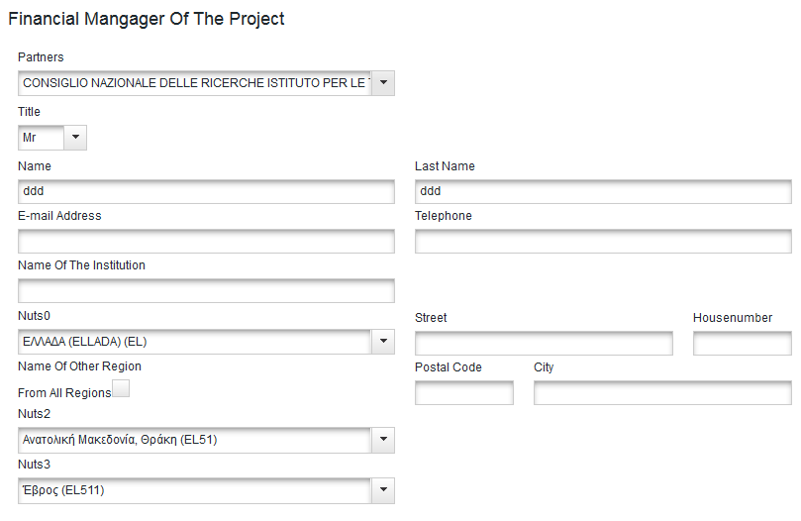
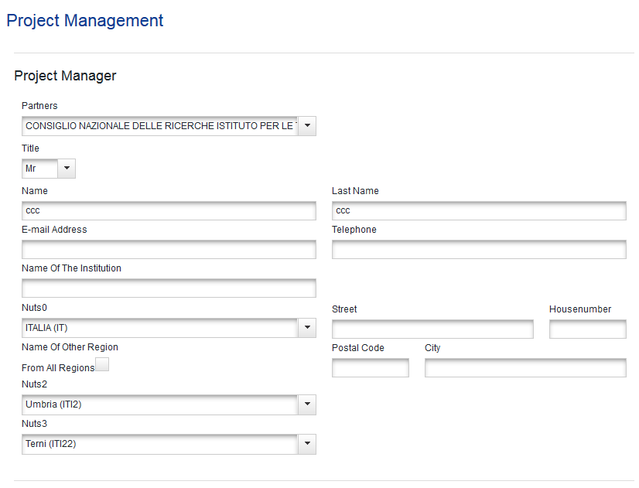
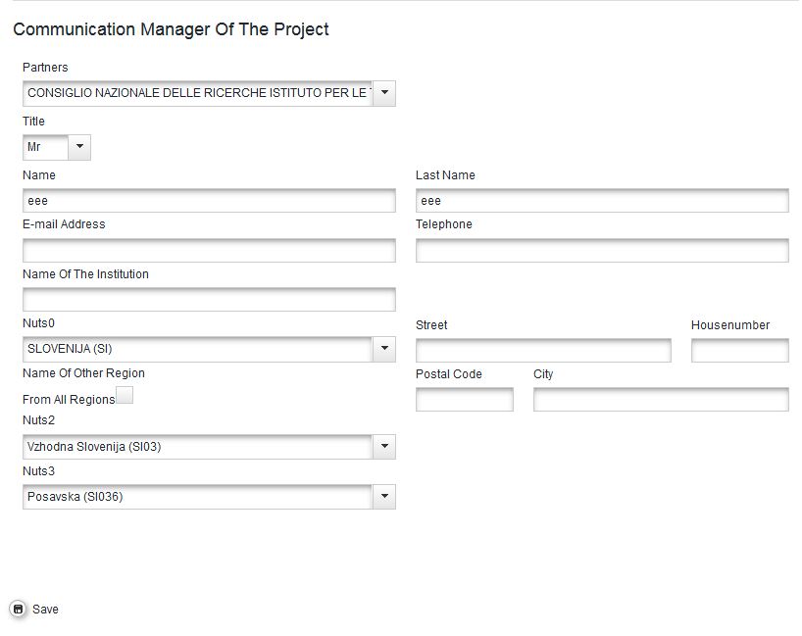
Project Management
In this section information on the project management team is required. Please provide names and contact data of the project manager, finance manager and communication manager.

Slide 19
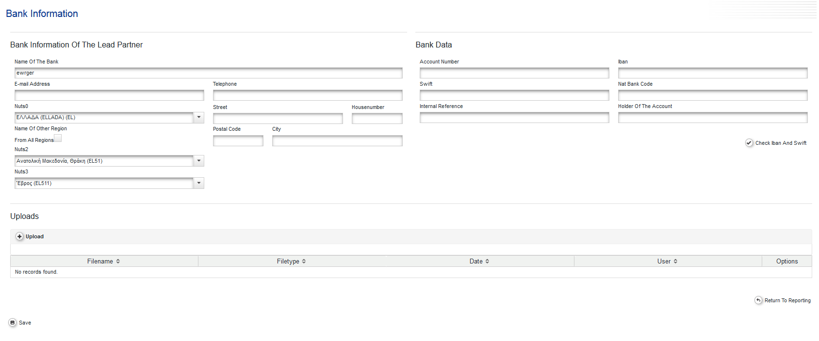
Bank Information
In this section details on the bank account of the Lead Partner are required for the reimbursement of the ERDF and IPA amounts, which must be in line with information provided in the signed payment form.
In case of changes of bank data during project implementation, please inform immediately the JS.

Slide 20
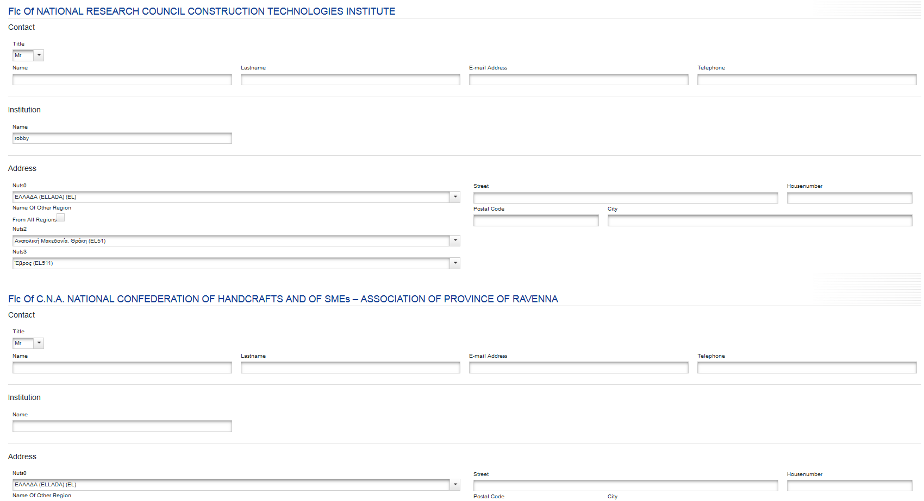
FLC - First Level Control
For each project partner the name and contact data of the national controller must be included.
Please note, that for partners from Italy, where a decentralized control system has been adopted, a procedure for receiving the validation of the selected FLC by the national control body (Commissione Mista) must be fulfilled.
As for PPs from all the other ADRION countries please get in touch with your National Contact point to receive information.

Slide 21
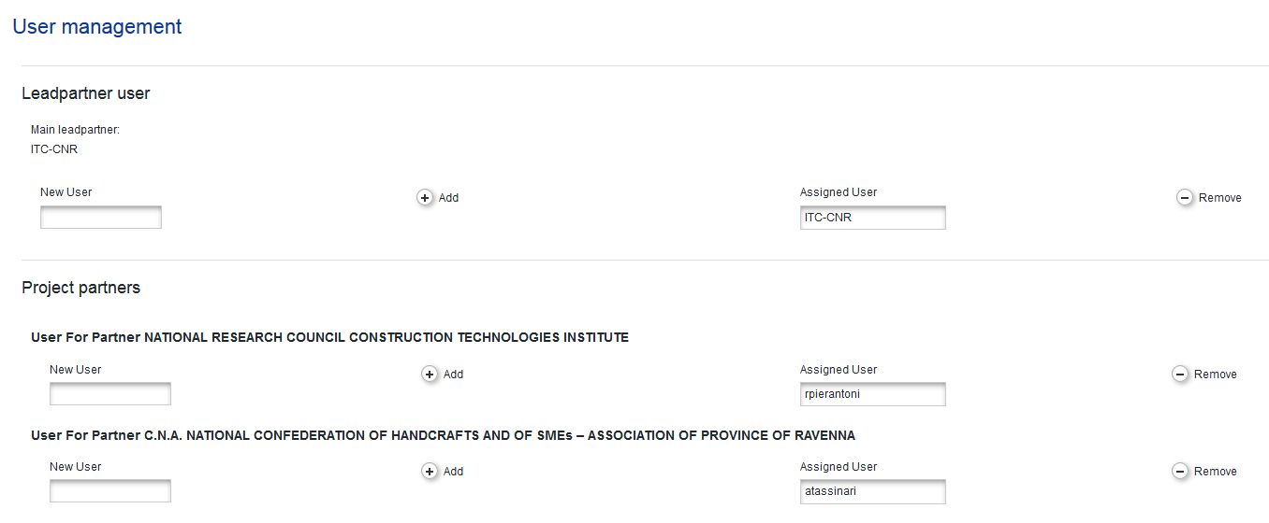
User Assignment
Lead Partner must assign project partner role to each PP.
How?
By entering PP username in the field “New User”;
Then by clicking on “+Add” button.
As a precondition, each PP must register in eMS and provide the received username to
the Lead Partner
Role of Project Partner allows to:
- have read access to the application form;
- Have write access to PP partner report.
If necessary, users can be removed/changed by lead partner

Slide 22
Documents
In this section information on the location of project documents must be provided by all project partners.

Slide 23
Partnership Agreement
In this section information on signature of the Partnership Agreement by all project partners has to be provided.

Slide 24
How to start off the right foot
Activities calendar
At PP level
Public Procurements
Separate accounting system
Internal procedures and team
Controllers
Bank account(s)
Project Start up
Audit trail
Tracking all processes
Supervisory structure
Kick off meeting
Steering board rules of procedure
Notes:
Here some specific step to be undertaken

Slide 25
The audit trail
The audit trail is the procedure/s allowing tracking all the financial documents and additional necessary documents supporting the financial flow within a project.
It includes all documents related to the project from the subsidy contract/partnership agreement to the reports, proofs of payments and reporting closure, including eventual amendments or revisions of the Application Form.
The audit trail must be kept both at level of single partner (including lead partner) and project level.

Slide 26
The audit trail – an example
Type of document | Specifications
Subsidy contract | All versions; Latest updated application form annexed to the subsidy
Partnership agreement | All versions;
Reporting forms | All submitted documentation
PP reporting forms (if any) | All accepted documentation
First level control reports and certificate | All reports
For each expenditure | Information on the selection process - procurement procedure Received invoices Proof of payment Documentation submitted to the first level controller
Further supporting document related to other budget lines | Time sheets; contracts; reports.
Outputs and deliverables produced | Adequate and relevant related documentation produced during the project lifetime

Slide 27
Adequate archive and a separate accounting system
A physical and/or electronic archive must be put in place allowing data storing, records and documents concerning the physical and financial implementation of the project;
A separate accounting system or an adequate accounting code must be put in place for the project.
Supporting documents composing the audit trail must remain available at the premises of each beneficiary at least for a period of three years. This period starts from 31 December following the submission of the payment claim to the EC by the MA that contains the last expenditure of the project following its completion.

Slide 28
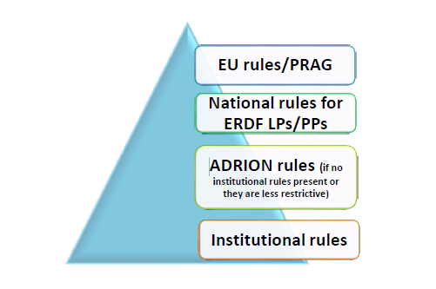
Public procurement rules
Public procurement rules

Slide 29
Public procurement rules – ERDF Partners
contracts equal or greater than the thresholds defined by Directive 2014/24/EU and its amendment
EU Directives
contracts below the EU thresholds
National rules
THRESHOLD
PP rules
contracts below national thresholds
If PP does not have own rule: ADRION rule
Contracts higher EUR 5.000 (VAT excluded) up to national thresholds: three requests for offers to be sent
Transparency rules must apply

Slide 30
Public procurement rules
Public procurement rules – IPA Partners
SERVICE CONTRACTS | ≥ EUR 300 000 International restricted or open tender procedure | < EUR 999 999 Framework contract SIEA 2018 Or < EUR 300 000 - Framework contracts (SIEA 2018, Audit, Commission, …) - Simplified procedure |  | ≤ EUR 20 000 but > EUR 2 500 Single tender A payment may be made against invoice without prior acceptance of a tender if the expenditure is ≤ EUR 2 500
SUPPLY CONTRACTS | ≥ EUR 300 000 International restrected or open tender procedure | < EUR 300 000 but ≥ EUR 100 000 Local open tender procedure | < EUR 100 000 but > EUR 20 000 Simplified procedure

Slide 31
Financial aspects and reporting

Slide 32
Eligibility of expenditure
It has occurred in the eligible period related to the duration of the project (with the exception of preparation costs and project closure costs);
It refers to costs occurred for the implementation of the project and in accordance with the approved AF;
It is essential for the implementation of the project and it would not be incurred if the project is not carried out;
It relates to a product or service foreseen in the approved project proposal and that has been delivered and complies with publicity and information requirements;
It is borne directly by the beneficiary and supported by accounting documents justifying incurred expenses/payments (invoices, pay rolls…) except for costs calculated as flat rates and lump sums;
It relates to an activity which has not benefitted from financial support by another public source (no double funding);
It complies with the principle of sound financial management (efficiency, effectiveness and economy);
It complies, if required, to the public procurement rules applicable in the respective Partner State;
It is registered in the beneficiary’s accounts through a separate accounting system or an adequate accounting code set in place specifically for the project;
It is not in contradiction with specific Programme rules;
It has been validated by an authorized national controller.

Slide 33
Not eligible expenditure
In kind contributions (in the form of provision of works, goods, services, land and real estate for which no cash payment supported by invoices, or documents of equivalent probative value, has been made);
Interest on debt;
Purchase of land;
Recoverable value added tax (VAT), except where it is not recoverable under national VAT legislation;
Fines, financial penalties and expenditure on legal disputes and litigation;
Costs for gifts, except those not exceeding EUR 50 per gift where related to promotion, communication, publicity or information;
Costs related to fluctuation of foreign exchange rate;
Charges for national financial transactions.
Programme also considers as not eligible the following expenditure:
Under travel and accommodation budget line, the cost of taxis shall not be reimbursed, except when (i) it can be demonstrated that no public transport was available at the time and place needed or (ii) local transportation is covered with a daily allowance provided for by the internal rules of the concerned partner;
Costs for alcoholic beverages;
Costs for the creation of a project web site, as ADRION will offer in its web site space for all funded projects in order to guarantee a coordinated visibility, unless duly justified;
Heavy investments, infrastructures and works, as described by the Directive 2014/24/EU (annex II);
Basic courses (e.g. language, accounting, use of MS Office);
Orchestras and shows unless clearly described in the AF and further approved;
NO shared costs.

Slide 34
Reporting – validation of expenditure
Lead Partner
Validation documentation with Certificate
Validation documentation with Certificate
Validation documentation with Certificate
Controller validation
Controller validation
Controller validation
Upload on eMS
Upload on eMS
Upload on eMS
PP 1 report documentation
PP 2 report documentation
PP X report documentation

Slide 35
Request for payment
Reporting
Payment
MA/JS
Submits the project progress report and request for payment
After the necessary verifications pays the Lead partner the ERDF/IPA amounts requested
Lead partner
Submit their progress reports and all the documentation related to the incurred expenditure to the LP
After having received the payment, proceeds to the payment of the project partners without delay
National controller
Project partners
Send their incurred proof of expenditure to the national controllers for validation

Slide 36
Reporting periods
Period of activities | Submission of the partner report to FLC | Submission of the project report
0) January 2014 – February 2019 | After signature of Partnership Agreement | 31 May 2020
1) March-June 2020 | 10 July 2020 | 30 September 2020
2) July-December 2020 | 10 January 2021 | 31 March 2021
3) January-June 2021 | 10 July 2021 | 30 September 2021
4) July-December 2021 | 10 January 2022 | 31 March 2022
5) January-August 2022 | 10 September 2022 | 30 November 2022
Additional reports may be asked in case of de-commitment risk

Slide 37
Report 0
To be presented after the signature of the Subsidy Contract and Partnership Agreement;
Lump-sum;
No need to present invoices or other supporting documents;
Correct budget lines as in the Application Form (no Equipment);
Reports must be certified by FLC.

Slide 38
Advance payment for IPA partners
Automatically, after the signature of the Partnership Agreement;
Only to IPA partners;
10% of the IPA II contribution;
To be compensated in equal shares with the first two payments requested by the IPA partners.

Slide 39
Reporting and request for payment
Content (including communication) and finance reporting :
Content part of the report
Finance part of the report
Feeding indicators
Overall finance performance
Inform on the state of advancement
PP/LP partner performance
Inform on deliverables
Finance performance at ERDF and IPA level (not based on total project budget)
Eventual problems encountered
To be submitted within three months after the end of the periods as foreseen in the AF.
Pre-filled forms (based on the approved Application Form and further achievements) and additional template on description of activities.
Paperless reporting.

Slide 40
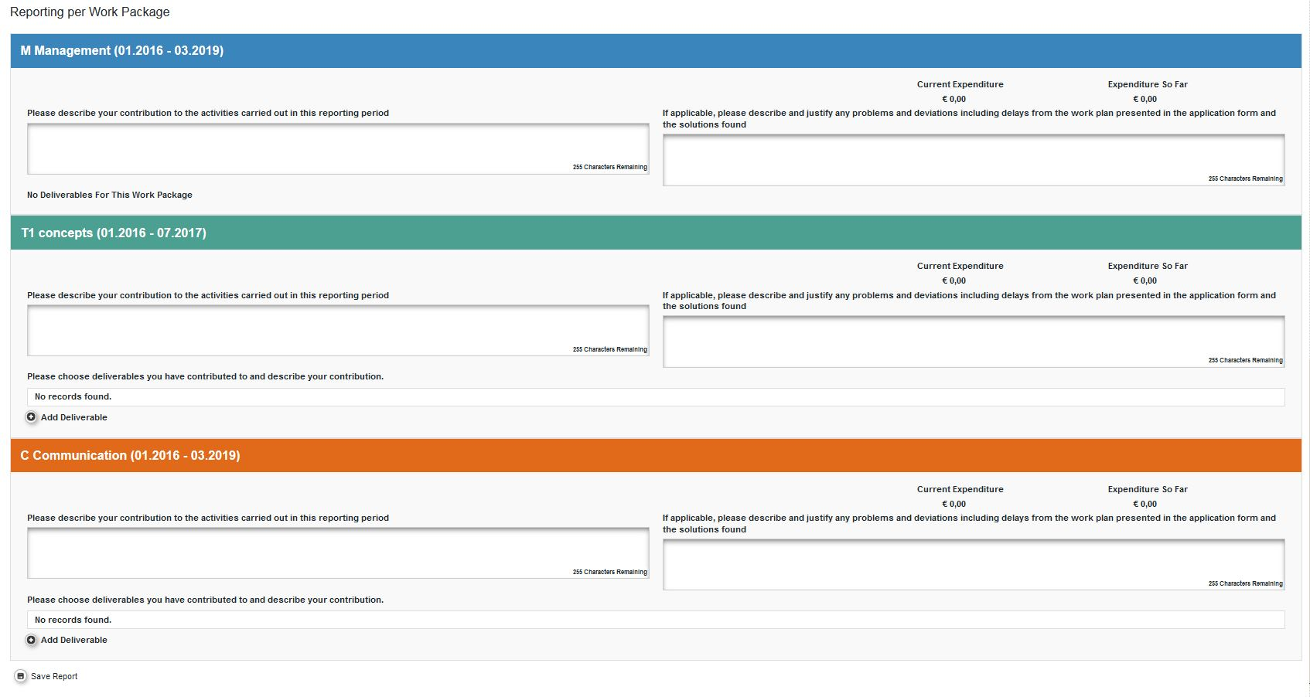
Reporting – content (extract from eMS)

Slide 41
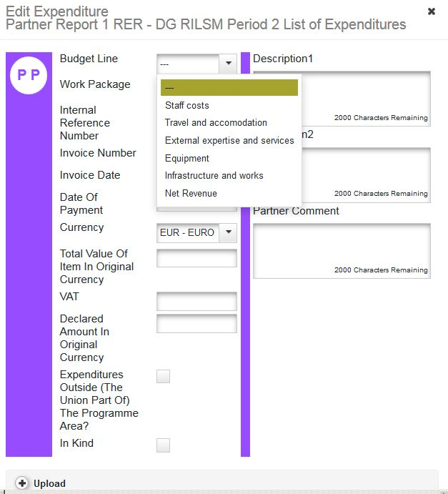
Reporting – expenditure inserting (extract from eMS)

Slide 42
Pay attention on reporting!
Complete information. No empty reports;
FLC Certificates properly filled, signed, dated;
Importance of indicators and aggregated indicators (e.g.: Target groups);
Horizontal principles;
Costs in the correct BL and WPs;
Verify capacity of BL and WPs for each partner.

