Slide 1





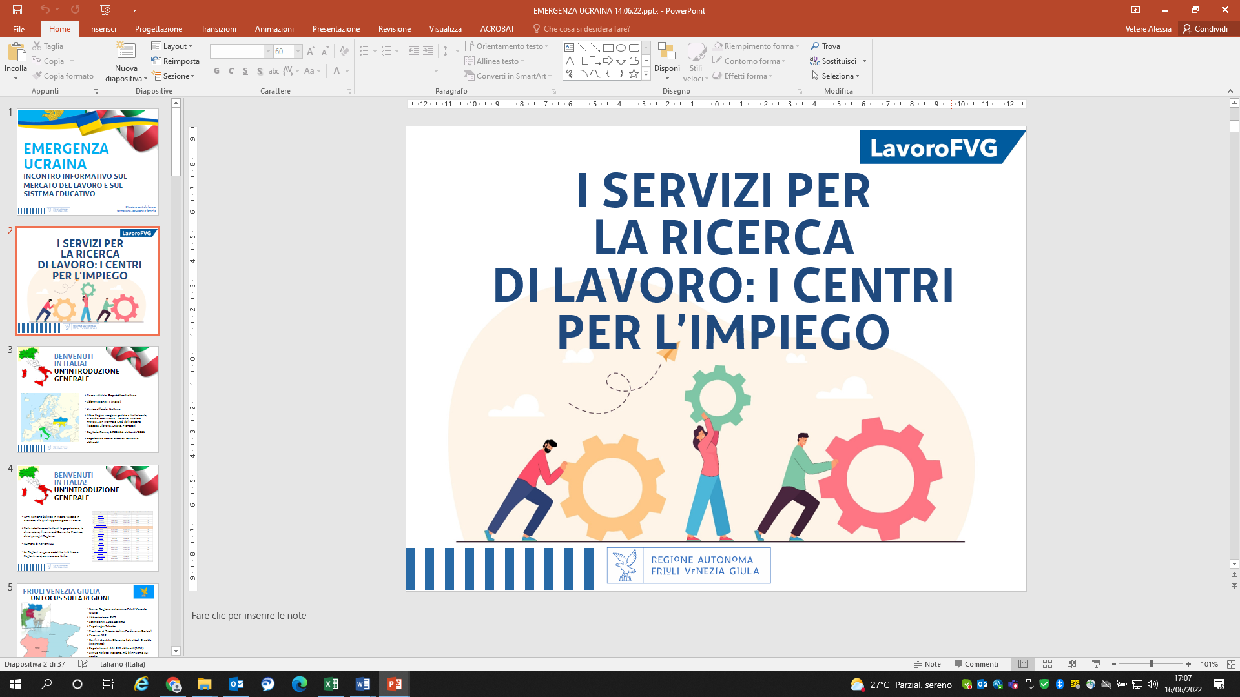

Direzione centrale lavoro, formazione, istruzione e famiglia
UKRAINIAN
EMERGENCY
informative workshops
on regional labour market and education systems
Direzione centrale lavoro,
formazione, istruzione e famiglia

Slide 2

THE SERVICES FOR JOB SEARCH: THE EMPLOYMENT CENTRES

Slide 3
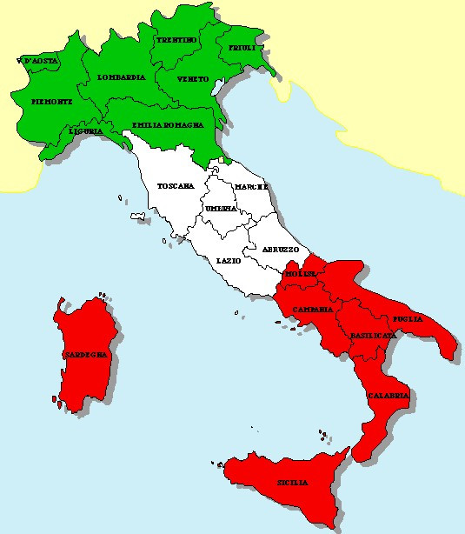
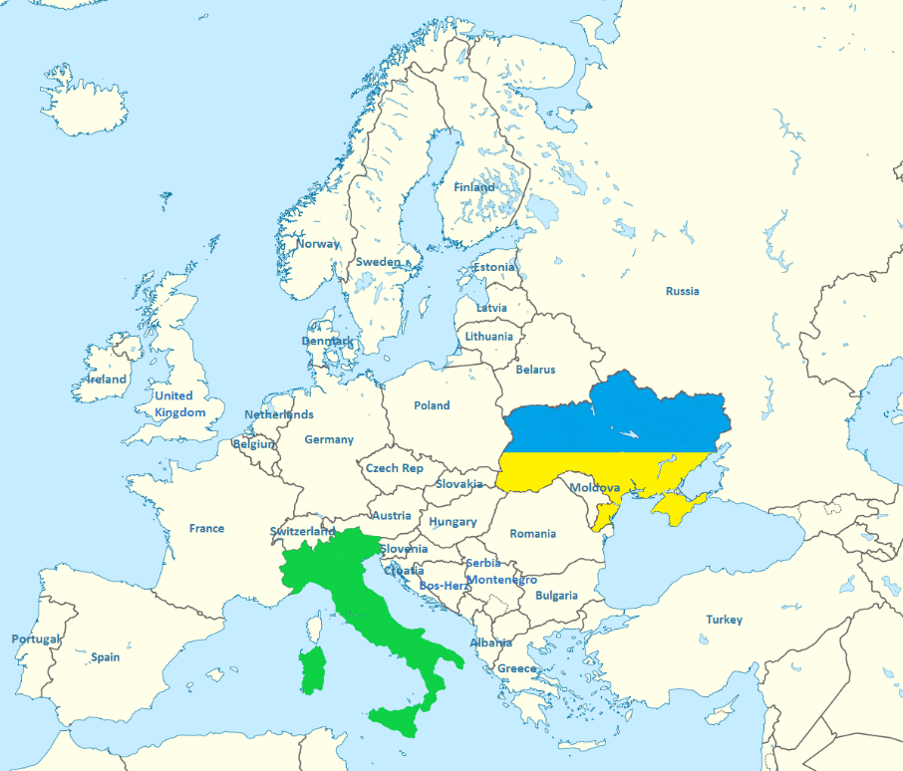
WELCOME TO ITALY!
GENERAL COUNTRY OVERVIEW
Complete and official name: Italian Republic (Repubblica Italiana)
Abbreviation: IT (Italy-Italia)
Official language: Italian (Italiano)
Other languages are speaked at regional or local level, close to the borders with Austria, Slovenia, Switzerland, France, San Marino and Vatican City (German, Slovenian, Croatian, French)
Capital city: Rome (Roma, 2.763.804 inh./2021)
Total population: about 60 million inhabitants

Slide 4
WELCOME TO ITALY!
GENERAL COUNTRY OVERVIEW
Number of Regions: 20
The regions belong to 3 macro-regions:
North, Centre and South Italy (as the map shows)
Each region has its own Provinces, as macro-areas whose the Municipalities belong to.
In the table below, the population distribution and the area for each region, the number of Provinces and Municipalities.
 | Regions | Population (residents, year 2021) | Area (km²) | Municipalities | Provinces
1. | Abruzzo | 1.281.012 | 10.831,50 | 305 | 4
2. | Basilicata | 545.130 | 10.073,11 | 131 | 2
3. | Calabria | 1.860.601 | 15.221,61 | 404 | 5
4. | Campania | 5.624.260 | 13.670,60 | 550 | 5
5. | Emilia-Romagna | 4.438.937 | 22.444,54 | 330 | 9
6. | Friuli Venezia Giulia | 1.201.510 | 7.932,48 | 215 | 4
7. | Lazio | 5.730.399 | 17.231,72 | 378 | 5
8. | Liguria | 1.518.495 | 5.416,15 | 234 | 4
9. | Lombardia | 9.981.554 | 23.863,10 | 1.506 | 12
10. | Marche | 1.498.236 | 9.401,18 | 225 | 5
11. | Molise | 294.294 | 4.460,44 | 136 | 2
12. | Piemonte | 4.274.945 | 25.386,70 | 1.181 | 8
13. | Puglia | 3.933.777 | 19.540,52 | 257 | 6
14. | Sardegna | 1.590.044 | 24.099,45 | 377 | 5
15. | Sicilia | 4.833.705 | 25.832,55 | 391 | 9
16. | Toscana | 3.692.865 | 22.987,44 | 273 | 10
17. | Trentino-Alto Adige | 1.077.078 | 13.604,72 | 282 | 2
18. | Umbria | 865.452 | 8.464,22 | 92 | 2
19. | Valle d'Aosta | 124.089 | 3.260,85 | 74 | 1
20. | Veneto | 4.869.830 | 18.345,37 | 563 | 7
Total |  | 59.236.213 | 302.068,26 | 7.904 | 107

Slide 5

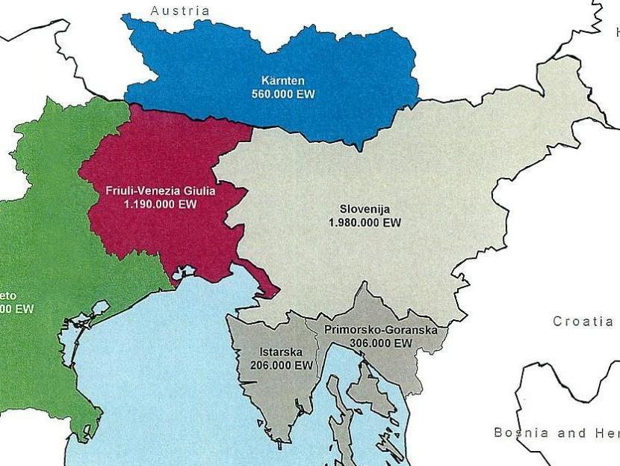
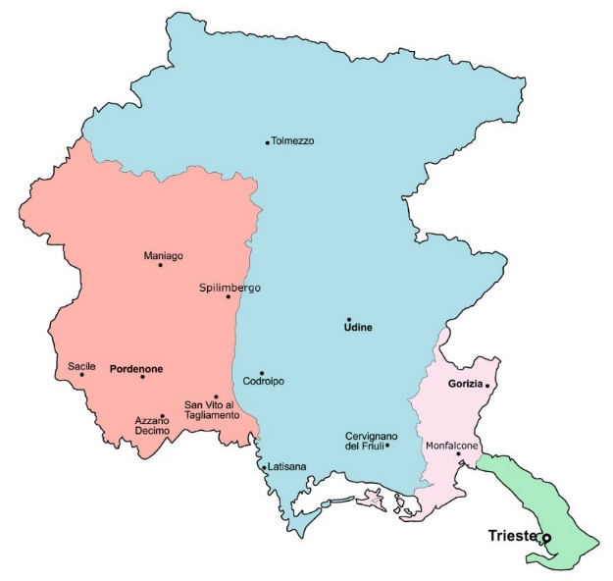
FRIULI VENEZIA GIULIA
A FOCUS ON THE REGION
Full name: Regione autonoma Friuli Venezia Giulia
Abbreviation: FVG
Total area (km2): 7.932,48 km2
Regional capital: Trieste
Territories: 4 (Trieste, Udine, Pordenone, Gorizia)
Municipalities: 215
Regional borders: Austria, Slovenia (direct), Croatia (indirect)
Regional population: 1.201.510 inh. (2021)
Main languages: Italian, plus bilingualism in the areas close to the borders
Employed people: 511.000
Active Companies/businesses: 92.000

Slide 6
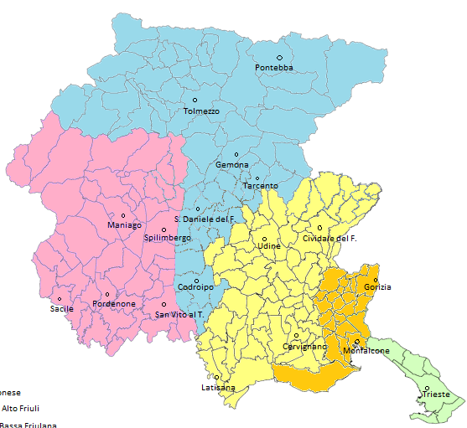
THE EMPLOYMENT CENTRES
IN FRIULI VENEZIA GIULIA
5 Hub
Giuliano
Isontino
Pordenonese
Udine e Bassa Friulana
Medio e Alto Friuli
18 Employment Centres
Trieste
Udine
Cividale del Friuli
Cervignano del Friuli
Latisana
Tolmezzo
Pontebba
Gemona del Friuli
Codroipo
2 local points
Lignano Sabbiadoro
Grado
San Daniele del Friuli
Tarcento
Pordenone
Maniago
Sacile
San Vito al Tagliamento
Spilimbergo
Gorizia
Monfalcone

Slide 7

Access to the labour market and to the active labour market policies
an overview on the permits of stay
  ENTRY WITHOUT VISA
  Duration: 90 days
  YOU CAN:
  Access to health services
  Access to education
  YOU CAN NOT:
  Sign an employment contract or start a business
  Register to an Employment Centre
PERMIT FOR FAMILY REASONS
or FAMILY COHESION
(PERMESSO PER MOTIVI FAMILIARI o COESIONE FAMILIARE): (must be required within 8 days of entering Italy)
Duration: equal to the one of the requesting foreign family member, renewable
YOU CAN:
Sign an employment contract or start a business
Register to an Employment Centre
Access to health services
Access to education
You have a tax code (codice fiscale)

Slide 8
Access to the labour market and to the active labour market policies
an overview on the permits of stay
Ordinary ASYLUM REQUEST-WORK ACTIVITY
(RICHIESTA ASILO POLITICO – ATTIVITA’ LAVORATIVA):
Duration: 6 months, renewable
(while waiting for the international protection)
  YOU CAN:
  Access to health services
  Access to education
  Access to work after 60 days from the request
  You have a tax code
POLITICAL ASYLUM (ASILO POLITICO)
Duration: 5 years, automatic renewal
YOU CAN:
access to work (can be converted into a work permit, but entails the loss of refugee status)
access to health an to education
SUBSIDIARY PROTECTION (PROTEZIONE SUSSIDIARIA)
Duration: 5 years, renewal after the evalutation of the Commission for refugees
YOU CAN:
access to work (can be converted into a work permit, but entails the loss of refugee status)
access to health an to education
"SPECIAL CASES" PERMIT (ex humanitarian reasons)
Duration: 2 years
YOU CAN:
access to work (can be converted into a work permit, within 2 years)
access to health
access to education

Slide 9
Access to the labour market and to the active labour market policies: the Temporary protection (so called «Protezione speciale, PROT. TEMPORANEA ART. 20 TUI EMERG. UCRAINA»)
Can a person entitled with a residence permit for temporary protection work in Italy? And who is waiting for the permit?
Yes, Article 2 of the Prime Ministerial Decree of 28 March 2022 expressly allows the beneficiary of temporary protection access to the labor market. This article refers to the provisions of the civil protection ordinance no. 872 of March 4, 2022, according to which "the work both in a subordinate, even seasonal, and autonomous form is allowed to people coming from Ukraine following the crisis in progress, on the basis of the request for a residence permit presented only to the competent Police Headquarters (Questura)".
It is therefore possible to start working with the receipt of the presentation of the application for temporary protection, even if the residence permit has not yet been issued. This is a possibility already generally provided for in Article 5, paragraph 9 bis, of the Consolidated Immigration Act and expressly referred to in the civil protection order to which the Prime Minister's Decree refers.
There are, therefore, no impediments to the immediate recruitment by an Italian employer of a citizen from Ukraine in possession of the receipt of the request for a residence permit for temporary protection.

Slide 10
The Italian labour market: general overview
on contract types
Permanent contract (contratto a tempo indeterminato)
Fixed-term contract (contratto a tempo determinato)
Seasonal work (Lavoro stagionale) - targeting specific sectors (as e.g. agriculture or tourism) and more in general applied for those activities taking place in a specific period of the year, so without character of continuity
Apprenticeship contract (Contratto di apprendistato)
Intermittent work contract (Contratto di lavoro intermittente)
Staff leasing contract (Contratto di somministrazione)
Domestic work contracts (Contratti di lavoro domestico: domestic help/maid, babysitter, personal care/assistance)
SUBORDINATE
(private or public sectors)
The self-employed or independent worker is the person who undertakes to carry out, in return for payment, a work or a service mainly on his own account and without being subordinate.
Self-employed workers are: entrepreneurs, farmers, traders, artisans and professionals.
AUTONOMOUS
(self-employment)

Slide 11
The Italian labour market:
THE TRAINEESHIP
It is NOT an employment contract, but there is a written agreement.
The trainee, the Host Company and the Promoter sign a Traineeship Agreement and a Traineeship Individual Programme
It is on-the-job experience, either in an already known profession or to learn a new profession.
Can last from a minimum of 3 MONTHS to a maximum of 12 MONTHS
Working hours could be part-time or full-time
The trainee receives a monthly allowance for the activity carried out (in our region, minimum 500.00 euros for 40 hours per week)
There are 2 insurances: against accidents in the workplace and a third party liability
The trainee signs an attendance register every day
THE EXTRACURRICULAR TRAINEESHIP

Slide 12

The Italian labour market
what is meant
by “Job contract”
The employment contract is a written agreement signed between the employee and the employer.
An employment contract is meant to describe in detail the specificities of the working relationship of both parties involved (employer and employee), including:
The data of the employer, The data of the employee, The job title/profession, The salary, The responsibilities, The duties, The sick pay, The holidays, The maternity leaves and other special permits, The notice periods.
In Italy, there are different types of employment contracts that vary according to the sector of employment according to the legal provisions of the national collective labour agreement (CCNL- Contratto Collettivo Nazionale del Lavoro).
The general conditions of the CCNL are agreed between organisations representing workers, trade unions and their employers, represented by their employers' associations.
As for e.g.: Trade, Tertiary and Services (Commercio Terziario e Servizi), Metalworking Industry (Metalmeccanico Industria), Multiservices (Multiservizi), Foodstuffs (Alimentari)

Slide 13

WHY GO TO THE EMPLOYMENT CENTRE?
TO RECEIVE INFORMATION ON THE LABOUR MARKET
TO ACCESS TRAINING FOR FREE
TO FIND A SUITABLE JOB
TO ASK FOR DOCUMENTS useful to the future employer to be hired

Slide 14

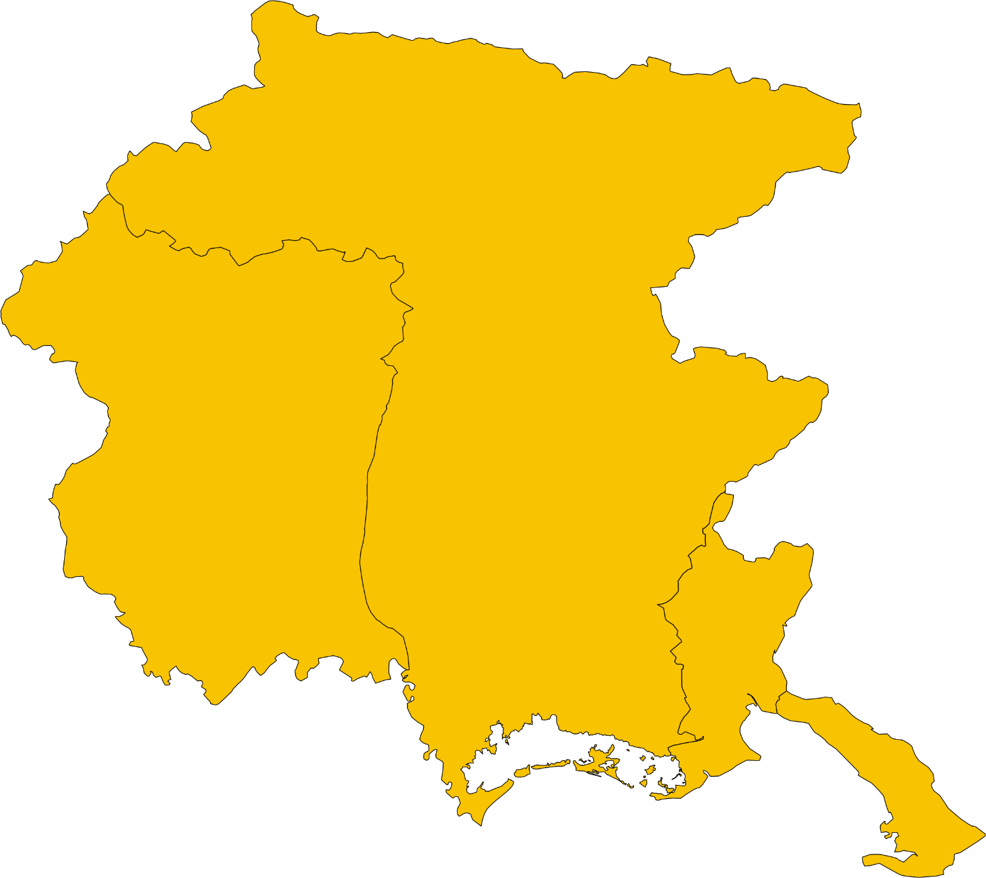






WHY GO TO THE EMPLOYMENT CENTRE?
TO RECEIVE INFORMATION ON THE LABOUR MARKET
TOURISM
PERSONAL CARE/ASSISTANCE
AGRI-FOOD
BUILDING & CONSTRUCTION
METALWORK
TECHNOLOGICAL CLUSTERS
SHIPBUILDING
INDUSTRY

Slide 15
WHY GO TO THE EMPLOYMENT CENTRE?
TO RECEIVE INFORMATION ON THE LABOUR MARKET
TO ACCESS TRAINING FOR FREE
TO FIND A SUITABLE JOB
TO ASK FOR DOCUMENTS useful to the future employer to be hired

Slide 16

WHY GO TO THE EMPLOYMENT CENTRE?
TO ACCESS TRAINING FOR FREE
If you want to learn Italian:
Courses for levels A1 - A2 - B1 - SAFETY
If you already speak Italian:
Courses to learn a job
(e.g. secretarial, cooking, industry)
These are longer courses (up to 1000 hours)
Italian A2 level is required
Traineeships
TRAINING experience
Direct experience in a COMPANY
Duration 3 to 6 months.
Monthly expense reimbursement of 500 euros for full time

Slide 17
WHY GO TO THE EMPLOYMENT CENTRE?
TO RECEIVE INFORMATION ON THE LABOUR MARKET
TO ACCESS TRAINING FOR FREE
TO FIND A SUITABLE JOB
TO ASK FOR DOCUMENTS useful to the future employer to be hired

Slide 18


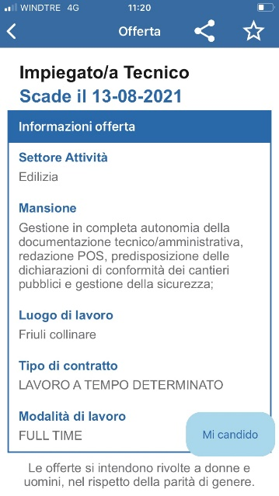

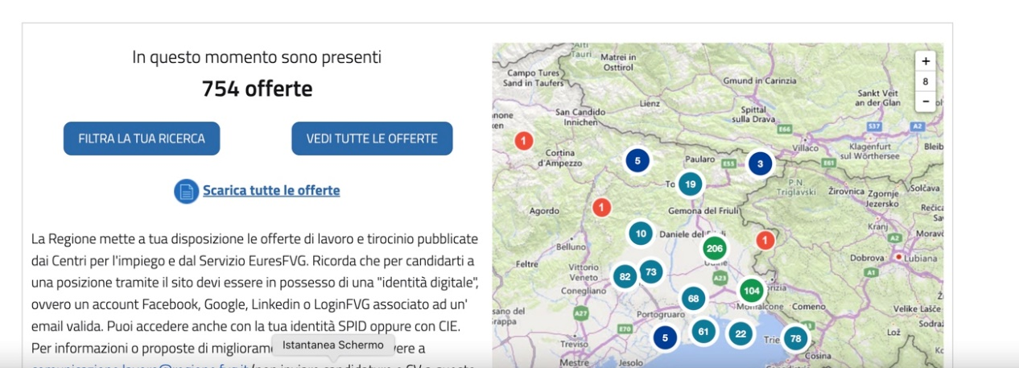
WHY GO TO THE EMPLOYMENT CENTRE?
TO FIND A SUITABLE JOB
http://offertelavoro.regione.fvg.it

Slide 19

WHY GO TO THE EMPLOYMENT CENTRE?
TO FIND A SUITABLE JOB
DOMESTIC WORK
SI.CON.TE is a public service which offers a specialised service to match supply and demand in the field of domestic work, such as domestic helper, babysitter or family assistant
FAMILY ASSISTANTS
Direct assistance to partially or non-self-sufficient persons
BABYSITTER
Managing and supervising children or infants, taking care of hygiene and clothing
DOMESTIC HELPER/MAID
Activities related to housekeeping and laundry tasks
Simple hygiene and health services
Activities related to the needs for food and cleaning of the home where the assisted persons live
Organisation of play and recreational activities, support with homework, support with daily activities
Activities related to the meal preparation and to the cleaning needs of the home where the children live
Activities related to meal preparation
Activities related to the maintenance of green areas and pet management

Slide 20
ASK FOR A MEETING
WITH US!
Trieste
Scala Cappuccini, 1
040 3772899
siconte.trieste@regione.fvg.it
Gorizia
Corso Italia, 55
0481 386666
siconte.gorizia@regione.fvg.it
Monfalcone
Piazzale Salvo D'Acquisto, 3
0481 386650
siconte.monfalcone@regione.fvg.it
Udine
Viale Duodo, 3
0432 207881 siconte.udine@regione.fvg.it
Codroipo
Via Balilla, 4
0432 207881 siconte.udine@regione.fvg.it
Tolmezzo
Via Matteotti 19
0432.207816 siconte.tolmezzo@regione.fvg.it
Pordenone
Largo San Giorgio, 12
0434 529399 siconte.pordenone@regione.fvg.it
SI.CON.TE provides its services through 7 desks on the regional territory opened from Monday to Friday from 9 to 13
Unique number for the family
It’s possible to contact the Service via telephone + 39 040 3775252, or by email at siconte.info@regione.fvg.it from Monday to Friday from 10 to 13
Branch offices (open once a week): Muggia, Duina Aurisina, San Vito al Tagliamento, Gemona del Friuli

Slide 21
WHY GO TO THE EMPLOYMENT CENTRE?
TO RECEIVE INFORMATION ON THE LABOUR MARKET
TO ACCESS TRAINING FOR FREE
TO FIND A SUITABLE JOB
TO ASK FOR DOCUMENTS useful to the future employer to be hired

Slide 22
ASK FOR A MEETING
WITH US!
emergenzaucrainacpi@regione.fvg.it
Phone nr.:
Cpi di Udine +39 (0)432 207701
Cpi di Trieste +39 (0)40 3772877
Cpi di Pordenone +39 (0)434 529292
Cpi di Gorizia +39 (0)481 386600
During the interview, we will speak about your previous experiences, your competencies and about your job expectations.
Then, we will evaluate all the opportunities offered by our services, to support you in finding a job in Friuli Venezia Giulia as soon as possible.

Slide 23
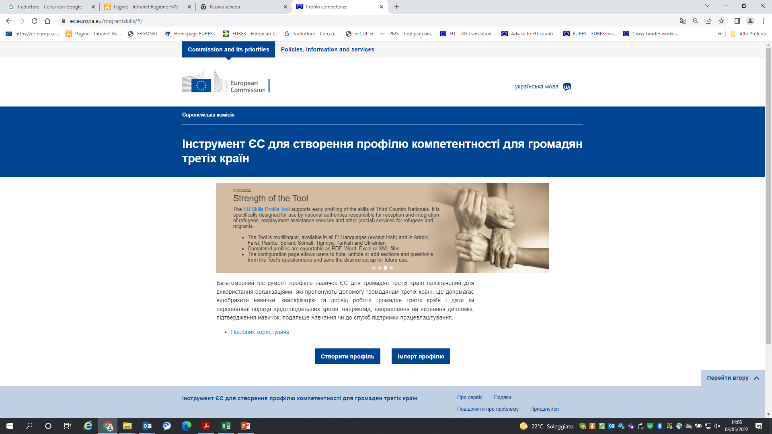
FILL OUT YOUR CV WITH US
the EU SKILLS PROFILE TOOL (1)
Access the web page https://ec.europa.eu/migrantskills/#/
2) Set your LANGUAGE
3) Decide if you want to:
CREATE E NEW PROFILE
IMPORT AN EXISTING ONE (once dowloaded/exported, the Profile can be updated at any time, by you or by the Employment Centres operators)

Slide 24
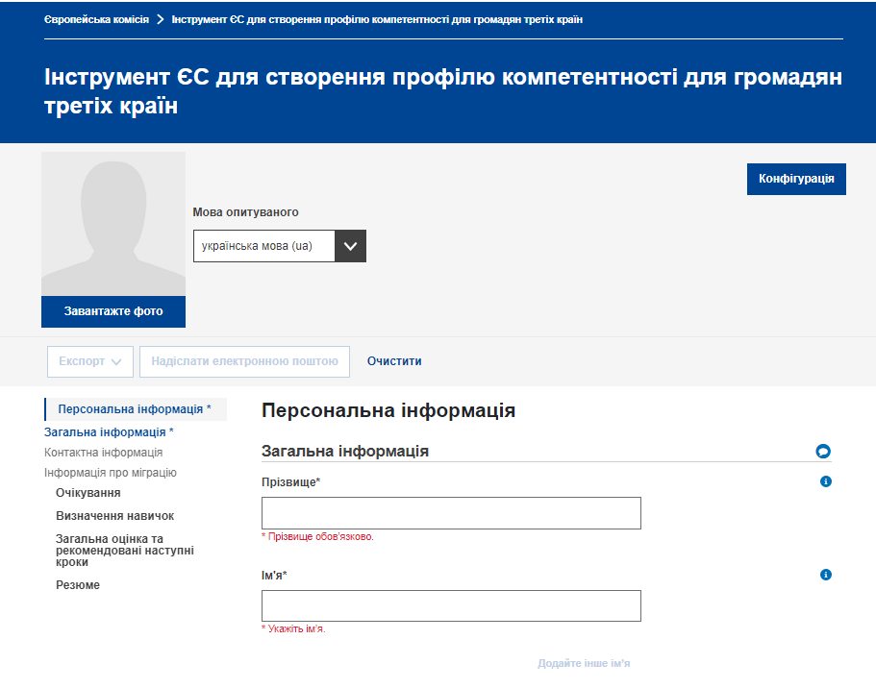
FILL OUT YOUR CV WITH US
the EU SKILLS PROFILE TOOL (2)
4) Start to fill in the information
5) Don’t forget to:
DOWNLOAD AN SAVE YOUR PROFILE
SEND IT BY EMAIL
IMPORTANT!
If you already started to create a Profile, and already have an appointment with the Employment Centre or you are planning to make it, please send your Profile also to emergenzaucrainacpi@regione.fvg.it
The Employment Centres operators will be able to recover it and complete the information during the individual assessment/interview

Slide 25
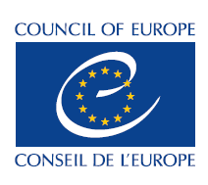
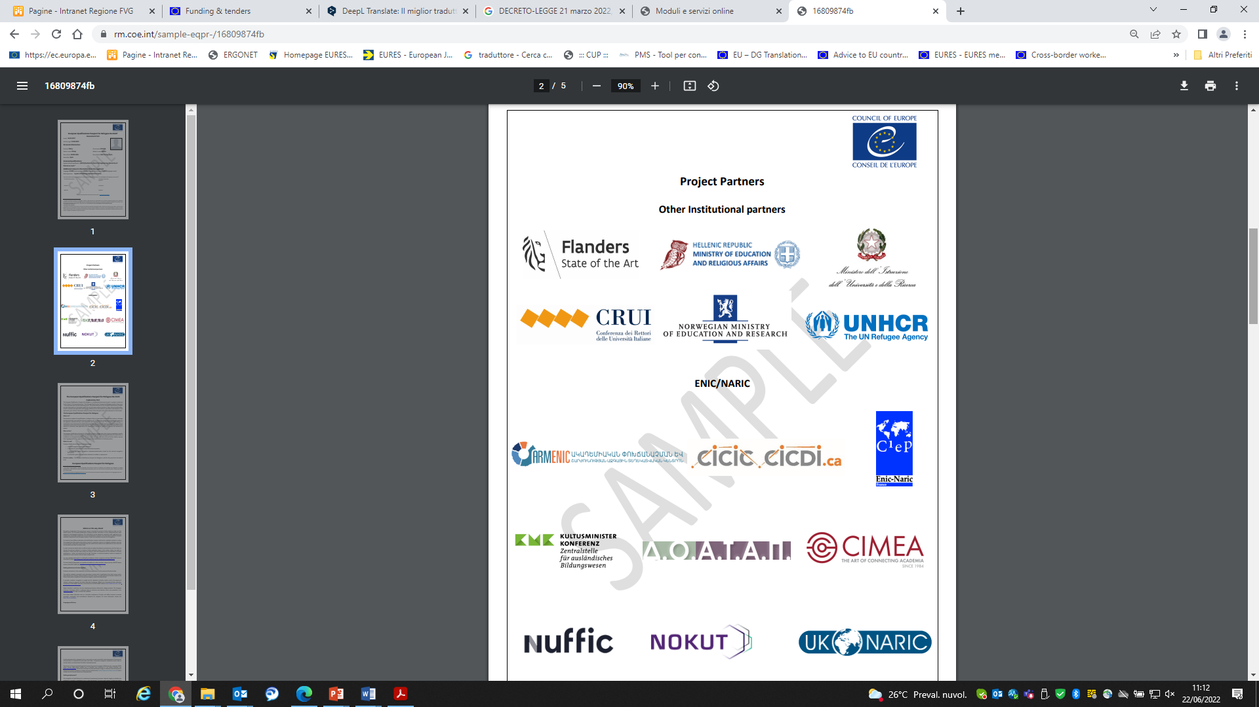



THE HEALTH AND MEDICAL PROFESSIONS:
EQPR
European Qualifications Passport for Refugees
ENIC/NARIC
Direzione centrale lavoro,
formazione, istruzione e famiglia

Slide 26
FOCUS - THE HEALTH AND MEDICAL PROFESSIONS:
European Qualifications Passport for Refugees(EQPR)
until 4 March 2023, the temporary exercise of health professional qualifications and the qualification of socio-health professional is allowed to Ukrainian professional citizens residing in Ukraine before 24 February 2022 intending to practice in the territory, in public or private health or socio-health care centres
the healthcare structures shall provide the names of the Ukrainian professionals recruited to the Region and to the professional Order responsible for the territory
WHAT THE LAW SAYS
(LAW DECREE 21 march 2022, n. 21, art.34,
Derogation from the rules on recognition of health professional qualifications for Ukrainian doctors)
DOCTOR
NURSE
SOCIO-SANITARY OPERATOR
MEDICAL LABORATORY TECHNICIAN
VETERINARY
EDUCATOR
WHICH PROFESSIONS (some examples)
DENTIST
PHYSIOTHERAPIST
HEALTHCARE ASSISTANT
RADIOLOGIST
ORTHOTOTECHIST
Other health professions
Direzione centrale lavoro,
formazione, istruzione e famiglia

Slide 27
FOCUS - THE HEALTH AND MEDICAL PROFESSIONS: :
European Qualifications Passport for Refugees(EQPR)
per lavorare è necessario essere il possesso del Passaporto Europeo delle Qualifiche per i Rifugiati (EQPR-European Qualification Passport for Refugees)
l’EQPR è uno strumento che facilita il riconoscimento delle qualifiche dei rifugiati in assenza di una completa documentazione
l’EQPR è un documento che elenca le qualifiche in termini di istruzione superiore, esperienze di lavoro e conoscenze linguistiche di un rifugiato
l’EQPR è utilizzato quando si desiderano avviare ulteriori studi o cercare un impiego
THE EQPR TOOL
to create it, you need to access the EQPR IT Platform (https://wallet.diplo-me.eu/coe/#/auth/login)
STEP 1: fill in the online questionnaire
STEP 2: you meet a team of evaluators for an interview (about 45 min.) during which your qualifications are assessed. The evaluators are experts in study qualifications. They have experience with foreign qualifications and knowledge of the education system in their home countries. The interview takes place in the mother tongue or language of instruction.
STEP 3: after the interview, a decision is made whether or not to issue the EQPR
HOW TO
For more information and to download the leaflet on how to start the procedure (UKR, IT, ENG), you can access this page:
https://www.coe.int/en/web/education/recognition-of-refugees-qualifications
Direzione centrale lavoro,
formazione, istruzione e famiglia

Slide 28
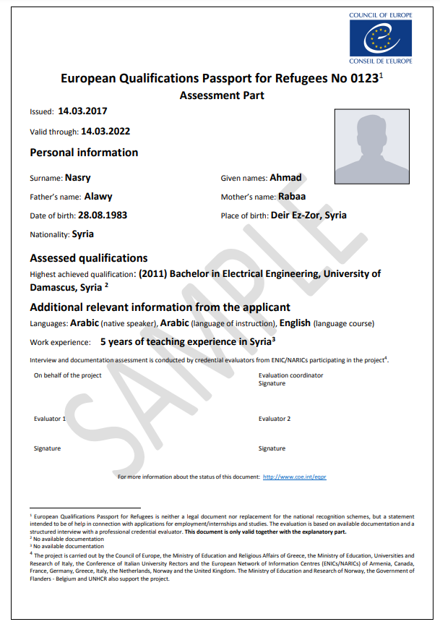
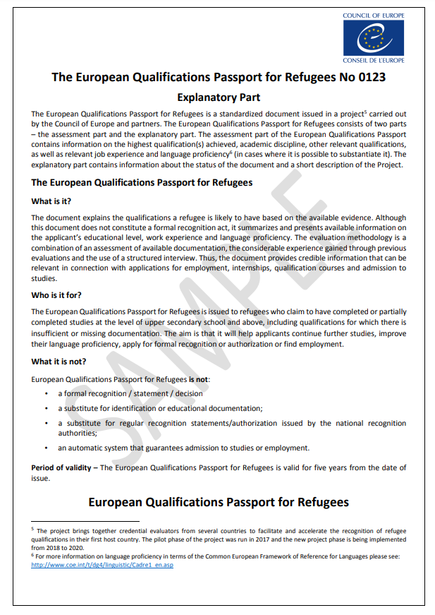
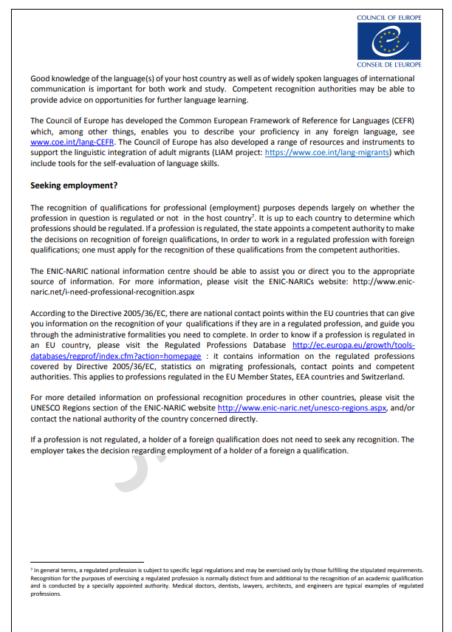
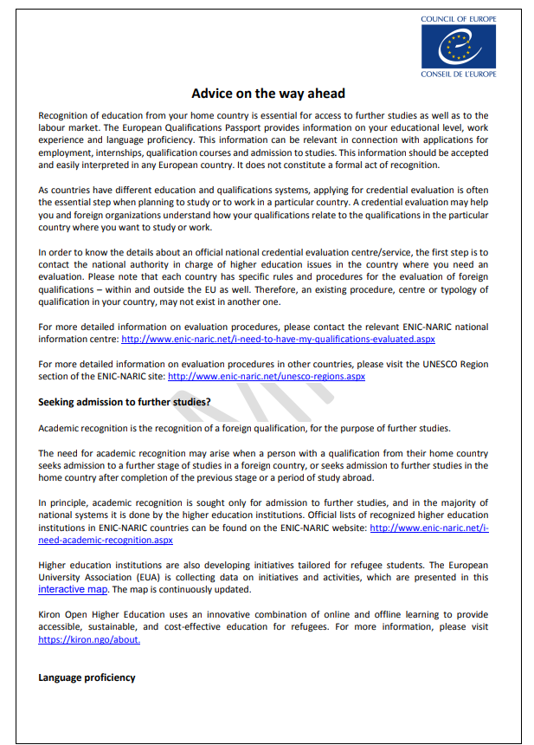
FOCUS - THE HEALTH AND MEDICAL PROFESSIONS: :
European Qualifications Passport for Refugees(EQPR) – an example
Direzione centrale lavoro,
formazione, istruzione e famiglia

Slide 29

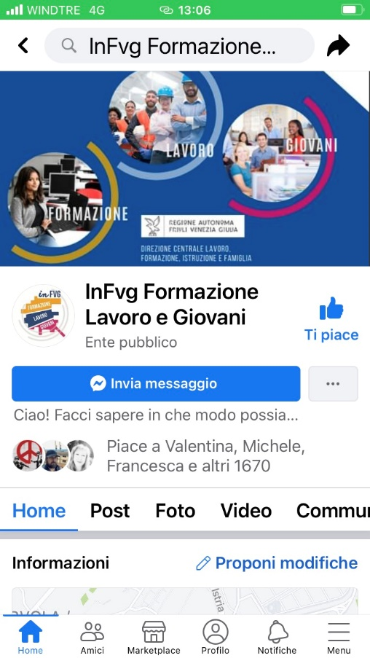


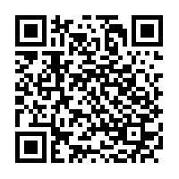
ALWAYS STAY
UPDATE!
WEB
offertelavoro.regione.fvg.it
www.pipol.fvg.it
www.regione.fvg.it > job and training
SOCIAL
@inFvg
@lavoro_FVG
Subscribe to the S.I.L.O. Newsletter - Labour and Employment Information Service
http://bit.ly/iscrizione_Silo

Slide 30
OTHER INITIATIVES AND USEFUL INFORMATION
A Platform to apply
for subsistence allowance”
Through this platform you can apply for a subsistence contribution for yourself, for your children, and for the minors you have legal guardianship of.
The contribution aims to offer you a first economic support in Italy and it is:
• for people having an independent accommodation or being hosted by relatives, friends or host families
• recognized for a maximum of three months starting from the date indicated on the receipt of the application for a residence permit for temporary protection
The platform is available in ITA, ENG, UKR.
https://contributo-emergenzaucraina.protezionecivile.gov.it/#/

Slide 31
OTHER INITIATIVES AND USEFUL INFORMATION
DRIVING LICENCE
Annex II
I. EQUIVALENCE TABLE
for the conversion of driving licenses issued in Ukraine into Italian documents
UNTIL 12 MONTHS: non-EU licence holders may drive in Italy with their document of origin for up to one year after taking up residence in Italy.
AFTER 12 MONTHS: according to the reciprocity agreement between Italy and Ukraine, Ukrainian citizens will have to convert their original driving licence into an Italian one. The conversion of the Ukrainian driving licence into an Italian one will NOT require additional examinations, for all Ukrainian citizens who have been resident in Italy for less than 4 years at the time of the application for conversion.
The mutual recognition of Ukrainian and Italian driving licences for the purpose of conversion has been in force since 24 January 2022 and will remain so for five years, until 24 January 2027, unless extended or modified by law.
(*) category A can be issued if the driver is 24 years old
(**) category C can be issued if the driver is 21 years old, or from the age of 18 for the CQC(Carta di Qualificazione Conducenti) holder
(***) category D can be issued if the driver is 24 years old, or from the age of 21 for the CQC(Carta di Qualificazione Conducenti) holder
(****) category D1 can be issued if the driver is 21 years old

Slide 32


Meeting with
Regional Orientation Center
Patrizia Piani, Daniela Patriarca
Stable structure to support educational guidance (Friuli area)
Research service, lifelong learning and the European Social Fund
Friuli Venezia Giulia Region

Slide 33
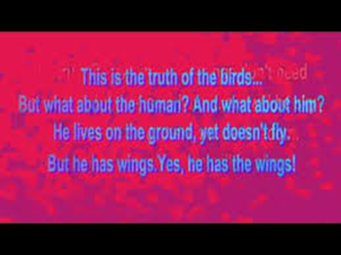
Le ali
E’ vero, agli alati il suolo non serve.
Non c’è terra, ci sarà la volta celeste.
Non c’è un campo, ci sarà la libertà.
Non c’è una coppia, ci saranno le nubi.
In questo è la verità dell’uccello.
E per l’uomo? Com’è per l’uomo?
Vive sulla terra. Non sa volare.
Ma ha le ali. Ma ha le ali!
E sono ali non di penne e piume,
Ma di verità, di onore, di fede.
Chi le ha come fedeltà in amore.
Chi come eterna aspirazione.
Chi come onestà nel lavoro.
Chi come generosità e premura.
Chi come canti o speranza.
O come poesia, o come sogni.
L’uomo non sa volare…
Ma ha le ali. Ma ha le ali!
Lina Kostenko (nata 19 marzo 1930, Rzhyshchiv)

Slide 34


I centri di orientamento regionali (COR)
Regional Orientation Center
How can we help you
Understanding your needs
Understand what you can do to feel satisfied
Know your interests
Understanding what you would like to do '' when you grow up ''

Slide 35




THE GUIDANCE SERVICES OF THE FVG REGION
Informations
Hospitality
Counseling
Network activity
opportunities for studying, training and working, information materials (guides, databases, etc.)
Understanding the needs, supporting the choice process, facilitating the orientation and reorientation path in the academic / training path
To clarify ideas about the educational / professional future, overcome any issues that hinder the decision, explore new study / work opportunities
In collaboration with Institutions to share good educational guidance practices and increase the quality of the services offered

Slide 36
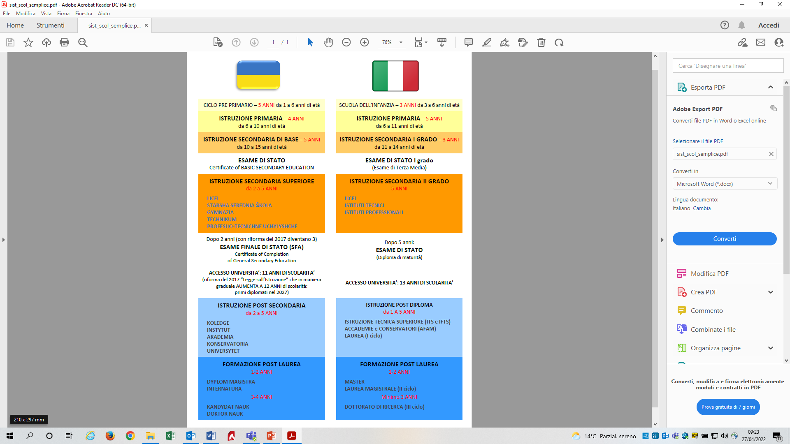

SCHOOL SYSTEMS

Slide 37


School systems in comparison
Pre primary cycle
Primary education 4
Basic secondary education 5
Upper secondary education 2 / 3-5
Post secondary education
2- 5
Post graduate training1-2 / 3-4
STATUS EXAM
STATUS EXAM
Kindergarten3
Primary education 5
1st grade secondary education
3
2nd grade
secondary
education
5
Post diploma education
1-5
Post graduate training1-2
STATUS EXAM
STATUS EXAM

Slide 38


Ukrainian professional training
Professional training Italy
Duration: 2-5 years
Junior Qualified Worker
Duration: 3 years
EQF (European Qualifications Framework)
level 3
professional operator qualification
1st (initial) level of vocational training
EQF (European Qualifications Framework) level 2
2nd (initial) level of vocational training
EQF (European Qualifications Framework) level 3
3rd (higher) level of vocational training
EQF (European Qualifications Framework) level 4-5
Possible 4° year
EQF (European Qualifications Framework)
level 4
professional diploma

Slide 39
THE APPRENTICESHIP
APPRENTICESHIP FOR VOCATIONAL QUALIFICATION AND DIPLOMA | The apprenticeship for the vocational qualification and diploma (first level apprenticeship) is intended for young people aged between 15 and 25, which can potentially be activated in all sectors of work. Young people hired with this type of contract will continue to attend school to obtain a regional certificate of vocational qualification or diploma corresponding to Level 3 and 4 of EQF. http://www.regione.fvg.it/rafvg/cms/RAFVG/formazione-lavoro/tirocini-apprendistato/FOGLIA1/ | Is it an employment contract? YES
VOCATIONAL APPRENTICESHIP | Aimed at young people aged between 18 and 29 years old to obtain a vocational qualification through training carried out mainly in companies. http://www.regione.fvg.it/rafvg/cms/RAFVG/formazione-lavoro/tirocini-apprendistato/FOGLIA2/ | Is it an employment contract? YES
HIGHER EDUCATION AND RESEARCH APPRENTICESHIP | Intended for young people aged between 18 and 29, for the achievement of university degrees and higher education, including PhDs, for research activities, as well as for the apprenticeship for access to the regulated professions. http://www.regione.fvg.it/rafvg/cms/RAFVG/formazione-lavoro/tirocini-apprendistato/FOGLIA3/ | Is it an employment contract? YES

Slide 40

OTHER INITIATIVES AND USEFUL INFORMATION
“ACCESS TO EDUCATION”
We would like to remind you that the enrolment of foreign minors in Italian schools of all levels can be requested at any time during the school year. may be requested at any time during the school year.
Foreign minors who do not have any personal documentation, or who have irregular or incomplete documentation, are enrolled with reservation, without prejudice to the achievement of their final qualifications. The certificate is issued to the person concerned with the identification data acquired at the time of enrolment.
Foreign minors subject to compulsory education, including Ukrainian refugees, are enrolled in the class corresponding to their age, unless the teachers' board decides to enrol the child in a different class.

Slide 41
CONTACTS
Trieste
Scala dei Cappuccini 1,
Tel. 040-3772855
e-mail: cent.r.o.ts@regione.fvg.it
Gorizia
Corso Italia 55
Tel. 0481-386420
e-mail: cent.r.o.go@regione.fvg.it
Udine
Viale Ungheria 43
Tel. 0432-555409
e-mail: cent.r.o.ud@regione.fvg.it
Pordenone
Piazza Ospedale Vecchio 11/a Tel. 0434-529033
e-mail: cent.r.o.pn@regione.fvg.it
THE SERVICE IS PUBLIC
AND FREE

Slide 42

QUESTIONS ?

