Slide 1
TALIA Horizontal Project Territorial Appropriation of Leading-edge Innovation Actions Social&Creative Community
Venice, 15 June 2018
SMATH Kick-Off Meeting
Francesco Molinari, mail@francescomolinari.it
[& Marianna Cavone, m.cavone@innova.puglia.it]

Slide 2
Background

Slide 3
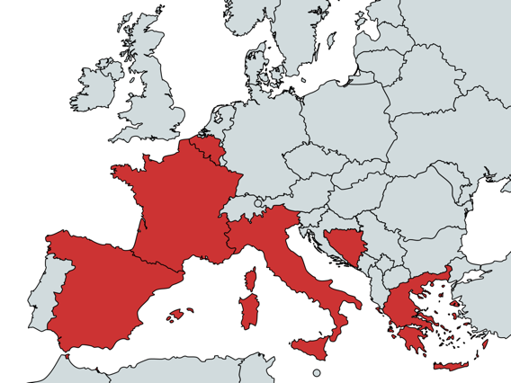
Partnership
with support of
UHCC

Slide 4
Aim
To build and develop the Social & Creative community of InterregMED Programme by orchestrating the progress and results of individual modular projects in the Cultural and Creative Industries and Social Innovation, particularly through:
Empowering the public and private actors engaged in innovation policy and practice towards Creativity Based Innovation
Reinforcing transnational cooperation between actors of the quadruple helix (research, businesses, public sector, civil society) through capacity building
Promoting triple-loop policy learning based on the on-going results of modular projects dealing with cultural, creative and social innovation
Assembling an online community of communities of Social and Creative Innovation gathering institutions, project participants as well as emergent clusters and networks.
be aware
share lessons learned
act and practice

Slide 5
Approach
TALIA
Local & Regional Project partner communities
Regional & National S3's, OP's, MED Axis 4
National, EU, Global ENoLL, CoR, World Bank, UNESCO, etc.
TALIA operates top-down and bottom-up to convey the results of participating projects towards effective policy impact

Slide 6
Focus areas
Discovery and Communication
Virtual spaces and face-to-face events for interaction and dissemination
Engagement and support
Liaison with on-going projects and their local and transnational networks
Capitalisation and impact
Briefings and tools to extend results across the MED space and policy agendas

Slide 7
Activities
MED Innovation Vision
Communication strategy
Semantic framework
Platform integration
Events organisation & attendance
Thematic domain mapping
Engagement and interaction
Input and feedback collection
Interoperability and services
Capitalisation Strategy
Indicator mapping
Evidence aggregation
Services to Vertical Projects
Axis 4 interaction
Community building
capitalization
discovery
engagement

Slide 8
Target groups
Sectoral agency | Cultural and innovation agencies may be involved in TALIA activities through participation in local and on-line communities and drawn in through TALIA networks. | 15
Other | One of the main targets of TALIA are the relevant vertical projects who will be direct targets for the activities of WP3 but also the indirect beneficiaries of the activities of WPs 2 and 4. We are starting to deal with 6 projects with 77 partners | 77
Business support organisation | Business support organisations are likely to be partners in local and on-line communities, and drawn in through TALIA networks, e.g. Insuleur. | 50
Education / training centre and school | Education and training centres are likely to be partners in local and on-line communities and also are drawn in through TALIA networks. For instance, this type of target is often the host of a Living Lab. | 50
Enterprise, except SME | We expect enterprises to be more the indirect beneficiaries of activities for TALIA, ie through Open Data or PCP policies, design, etc. | 25
General public | The general public will be a final target for WP2, in addition to the TALIA communities. TALIA will attempt to shape public opinion and perceptions on the role and relevance of C&SI in the MED space. The figure would refer to yearly website visits. | 5000
Interest groups including NGOs | TALIA expects interest groups and NGOs to play a large part in local and on-line communities, including local innovation hubs, associations and networks, etc. | 250
Higher education and research | Universities play an important role in research and innovation, particularly for culture and open data, and often play a leading role in Living Labs. | 50
Infrastructure and (public) service provider | Service providers are likely to play an important role for Open Data policies on the one hand and in PCP and innovation policy programmes on the other, and these will both be issues addressed by TALIA | 25
International organisation, EEIG | TALIA may intercept the World Bank (through previous work in eg Open Data) as well as EEIGs in the social and cultural sectors. | 5
Local public authority | Local public authorities will likely play a role in hosting local innovation clusters and initiatives (cultural hubs, co-working spaces, open data communities, etc.) through participation in local innovation communities. | 50
National public authority | TALIA capitalisation and policy work will target national authorities to promote C&SI innovation policies building on lessons learned from its vertical projects, primarily through policy briefs. | 10
SME | SMEs are an important target for TALIA, as key beneficiaries of the innovation potentials developed and explored by vertical projects, in areas ranging from cultural heritage to social enterprises. | 250
Regional public authority | Regional public authorities are the main policy level targeted by all TALIA actions, in particular through WP4. | 20

Slide 9
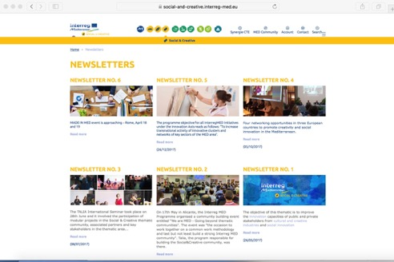
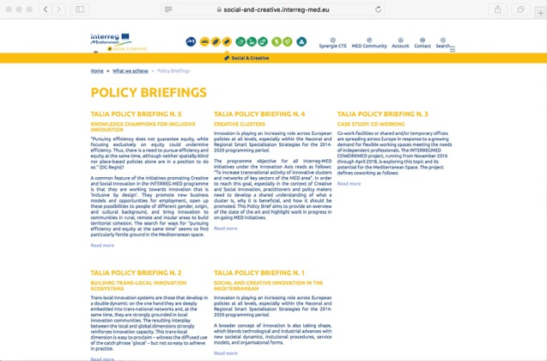
https://social-and-creative.interreg-med.eu/
Knowledge Diffusion

Slide 10
Semantic Framework
TALIA Learning Ontology
Normative implications of the MED model (Vision)
Regional policy priorities (Capitalisation)
Engaged MED stakeholders (Google Map)

Slide 11
MED Projects/Pilots Capitalisation
Scaling Up
Consolidation of results
Scaling Out
Geographical extension of results
Policy Learning
What goes through
Policy Impact
What is (will be) used to transform policies
Consolidation of results and their adoption at regional/national level as a follow up to project activities
Geographical extension of results to other contexts, via replication, transfer, adaptation, networked learning, etc.
Actual uptake of a project result or recommendation on the part of the relevant target policy makers
Possible transformative effects on higher-level policy frameworks and in general the practice of policy making

Slide 12
Interaction with SMATH
SOCIAL & CREATIVE Modular Projects
M1
M1+2
M2
M2+3
CoWorkMed
OpenDoors
ChIMERA
ProminentMED
CreativeWear
Co-Create
Chebec
HP TALIA
SMATH
ODEON
+ 2 Integrated Territorial Projects:
MD.NET
+Resilient

Slide 13
Joint organisation of events

Slide 14
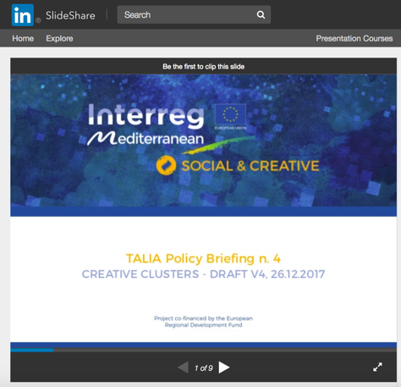
Dedicated focus on CCI

Slide 15
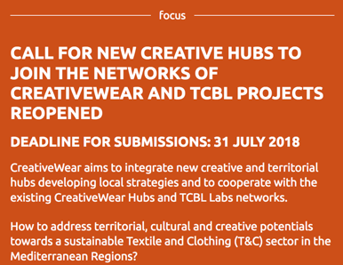
Connection with CreativeWear Hubs
https://creativewear.interreg-med.eu/

Slide 16
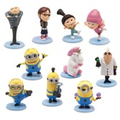
Joint monitoring / evaluation

Slide 17
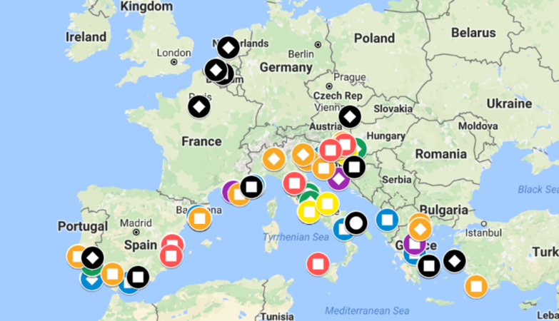
Community Mapping

Slide 18
Info request to all SMATH partners
Online: https://docs.google.com/spreadsheets/d/1AcUnPBppuQwgbWowuN8SixAy9pTVDIzPruxriCILSz4/edit#gid=653207613
or https://tinyurl.com/yagp6ral

Slide 19
Contacts
infotalia@regione.puglia.it
https://social-and-creative.interreg-med.eu
@MEDSocialcreat
Social & Creative MED

Slide 20
Thank you Francesco Molinari, mail@francescomolinari.it

