Slide 2
SMATH Smart atmospheres of social and financial innovation for innovative clustering of creative industries in MED area
Smart Atmospheres
wealth of heritage traditions
start-up and the development of SME
publicly oriented domain of culture
business oriented domain of creativity
access to finance

Slide 3
WP 3 – TESTING OVERALL APPROACH AND ROADMAP

Slide 4
Wp3 - MAIN DATA
Coordinator | University of Venice
Duration | 03/2018-07/2020
Budget | 1.147.337,50 (about 60% of the total budget)
Tasks | 3.1(UNIVE); 3.2(UNIVE); 3.3(ICUB); 3.4(Pole ICP); 3.5(PRIMI?); 3.6(BA); 3.7(Technopolis); 3.8(BA)
Deliverables | 3.1(3); 3.2(5); 3.3(3); 3.4(4); 3.5(4); 3.6(3); 3.7(3); 3.8(3) Totally 28 deliverables to be produced
Outputs | 3(3.1; 3.2; 3.3)

Slide 5
Piloting Areas
1 | Veneto Region (Italy) | LP+UNIVE
2 | Friuli Venezia Giulia Region (Italy) | FVG
3 | Zagreb Metropolitan Area (Croatia) | RAZA
4 | Maribor (Slovenia) | ATM
5 | Barcelona Metropolitan Area (Spain) | BA+ICUB
6 | Athens Metropolitan Area (Greece) | TECHNOPOLIS
7 | PACA Region (Provence-Alpes-Cote d’Azur) | PoleICP+PRIMI

Slide 6
WP3 – results
1 | SMATH platform to host materials, market-place, EU-Alert, crowdsourcing platform, etc | D.3.2.1; D.
2 | 7 NESTS established (Spain 1; France 1, Italy 2, Slovenia 1, Greece 1, Croatia 1) with a set of services | Task 3.3
3 | MED Creative (Industries) Cluster | D.3.7.1
4 | 3 transnational working groups established (social cohesion, soustainable tourism; urban regeneration) | Task 3.7
5 | 300 SMEs (Creative Industries, High-Tech SMEs, Cultural operators, etc) assisted to strengthen managerial capacities and attract public/private investors for their projects | Task 3.4; task 3.5; task 3.6
6 | 70 projects developed with the assistance provided and proposed to public and private investors (EU Funds; Private investors; crowdfunding) | D.3.5.1; D3.6.1; D.3.6.2; D.3.6.3

Slide 7
The «structure» to be established with SMATH project
MED Creative Industries Cluster
NEST 1 (Italy)
NEST 2 (Italy)
NEST 3 (France)
NEST 4 (Spain)
NEST 5 (Slovenia)
NEST 6 (Greece)
NEST 7 (Croatia)
To strengthen the internationalisation, the joint cooperation and the exchange of knowledge and training contents, SMEs and operators crom Cis and Cultural «engines» will be involved with the activities of the MED Cis cluster. The cluster, supported by the local action of NESTs, will assure the necessary critical mass to approach new markets, create cooperation opportunities and exchange knowledge and contents.
The MED Cis Cluster will be organized with 3 working groups(strategic sectors): responsible tourism, urban regeneretion and sustainable tourism
NESTS are local service providers able to meet Creative and Cultural operators’ needs and expectations and exploit their potential in terms of economic growth and social innovation
SMATH online platform
SMATH Platform: online platform able to store contents, materials and tools(EU-Alert system; crowdsourcing system, etc) SMATH toolkit, to support both the capacity building activities and the activities carried out by the 7 NESTS.

Slide 8
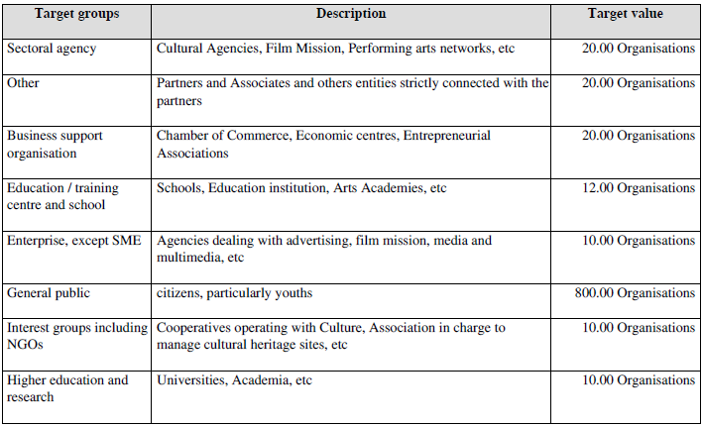
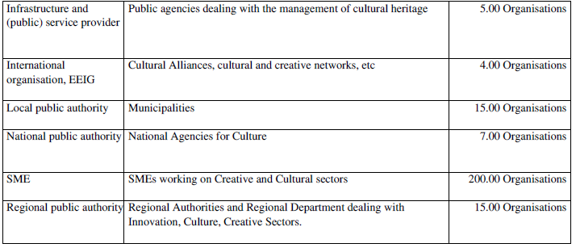
Users addressed by WP3 activities
Creative Industreis and practitioners
Cultural «Engines»
High-tech SMEs
Intermediaries
Academia
Policy makers
Financial Operators

Slide 9
How to involve Creative Industries and Cultural Operators in SMATH Project
COOPERATION
Events with Cis and financial operators
New project/ideas connected with social innovation
COMPETENCE
Managerial capabilities
Coaching to develop projects
OPPORTUNITIES
Study tour offered
Transnational event in Arles
Business plans development
Market Place with other SMEs, etc
Pitching events with financial operators
Crowdfunding
EU Alert System for Creatives and Cultural operators
Joint cooperation at transnational level (3 groups)
Crowdsourcing platform

Slide 10
WP3 logical frame
Preparatory phase
Methodology
Fine-tuning of the toolkit
Implementing the Structure
Setting-up the Nests
Portfolio of services
Testing the toolkit
Strenghtening the cooperation between Cis and Cultural operators
Promoting Internationsalition
Mapping of the actors
Developing projects and cooperation opportunities
Increasing competence and marketing attitude
Increase financial opportunities
MED Creative Industries Clusters
Clustering ideas and project into 3 strategic groups
Crowdsourcing
Scientific committee involvement
Evaluation
Final Evaluation report
SMATH platform

Slide 11
WP3 - tasks
task | Title | Resp. | Starting
3.1 | Coordination of the testing phase | UNIVE | 03/2018
3.2 | Fine-tuning of tools for the generation of «smart athmosphere» as ecosystem to support Creative Industries | UNIVE | 03/2018
3.3 | Mapping providers of resources with a view to enhance the visibility and attractiveness of creative industries | ICUB | 09/2018
3.4 | Strengthening Creative Industries’ networking and cooperation attitude | Pole ICP | 12/2018
3.5 | Enhancing managerial capabilities of cultural engines | PRIMI? | 03/2019
3.6 | Support in financial and Funding Opportunities | BA | 03/2019
3.7 | Promotion of Cooperation to enhance internationalisation | Technopolis | 11/2019
3.8 | Evaluation of Pilot Activities | BA | 05/2018

Slide 12
…next steps
 |  | Resp | PPs involved | Deadline
3.1 | Harmonization of data in the AF | LP+UNIVE | Task leaders | 16/07/2018
3.1 | Development of the pilot action methodology (D.3.1.1) | UNIVE | All PPs | 16/07/2018
3.1 | Skype conference with task leaders | UNIVE | Task leaders | Tbd (as soon as possible)
3.1 | Mehodology for the Scientific Committee | UNIVE | All PPs | 31/07/2018
3.1 | Identification of the members for the Scientific Committee | UNIVE | All PPs | 14/09/2018
3.1 | Training course addressed for PPs, Observers, etc etc | UNIVE | All PPs | By 30/09/2018??
3.2 | Analysis of existing tools/projects to be capitalised (D.3.2.1) – Section 3.5 | UNIVE | All PPs | 31/07/2018

Slide 13
….it is an adventure….

