Slide 2
WP2 Communication WP and tasks presentation
SMATH Kick-off Meeting Mestre, 14-15 June 2018
Technopolis SA

Slide 3
Contents
WP objectives and overview of activities
Upcoming tasks and implementation plan

Slide 4
WP2 Objective
Support and increase capabilities of the the Creative Clusters, cultural industries and Creative networks
raise awareness of the eco system of culture, creativity and innovation

Slide 5
How?
“traditional” and social/digital tools
dedicated actions for the Creative Clusters, cultural industries and Creative networks
general information addressed to the eco system of culture, creativity and innovation that will support the project (Academia, Local Regional Authorities, Association, Citizens)
coordination with the other EU transnational initiatives, horizontal projects and with MED programme

Slide 6
WP2 Activities
2.2 Setting-up common methodologies for actions (strategy, plan)
2.3 Project Communication Tools
(poster, templates, flyers, videos etc)
2.4 Open Days and final Conference (Exchanging information)
2.5 Coordination with Horizontal project - TALIA
2.6 Coordination with MED Programme
2.7 Participation in External Events

Slide 7
Act 2.2 - Setting-up common methodologies for actions
D.2.2.1. 1 Joint Communication Strategy Plan | Plan | 1 Communication Plan | The Guide will define and describe the principles & guidelines of the project's communication strategy (objectives, partners' roles, target groups, toolkit, channels, activities, timeplan, outputs) which will be evaluated by concrete criteria set.
Del Leader: TECHNOPOLIS Partners Participating: UNIVE, ATM, BARCELONA ACTIVA, FVG, Pole ICP
D.2.2.2 - 1 workshop on innovative means of communication | Plan | 1 training course | Considering the project topic and the need to define an appropriate and shared communication model, a 2-day workshop addressed to Partners, particularly those in charge for the communciation activities, will be organized at the beginning of the project to have a common understanding and a common set of instruments for the communication
Del Leader: Veneto Region Partners Participating: all
D.2.2.3 - 1 communication plan for the social network actions | Plan | 1 Social Network plan | As an outcome of the training workshop, a detailed SOCIAL MEDIA STRATEGY will be elaborated, together with the information on existing portals, platforms, networks to be included in the flow of social communications
Del Leader: TECHNOPOLIS Partners Participating: all

Slide 8
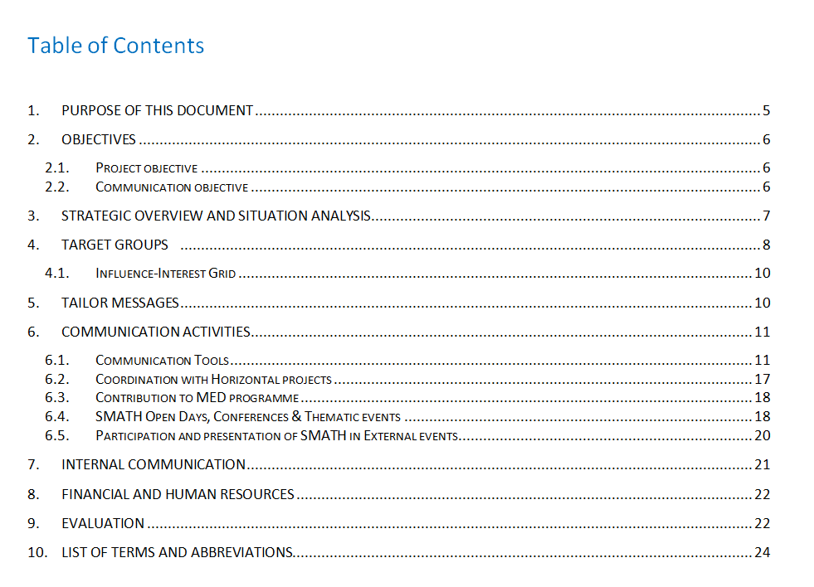
Act 2.2 - Setting-up common methodologies for actions
Joint Communication Strategy Plan

Slide 9
Act 2.3 - Project Communication Tools (Delivering information) 1/2
D.2.3.1. Project's corporate image | Digital or written communication | posters, folders, templates | Design of the project's common templates to be used for the deliverables, events' &meetings' presentations. Design & development of corporate image including 1 project poster.
Del Leader: TECHNOPOLIS Partners Participating: Veneto Region
D.2.3.2. Project leaflets | Digital or written communication | Flyers | Elaboration of 2 flyers. The first one will present the project in general; the second one will be linked to the promotion of the Nests established at local level.
Del Leader: TECHNOPOLIS Partners Participating: ATM, RAZA, BARCELONA ACTIVA, FVG, PRIMI
D.2.3.3. Newsletters | Digital or written communication | 5 Newsletters | The project will develop 5 Newsletters and will be distributed to key stakeholders that will constitutes the main target groups of the project (Policy Makers, Providers of Open Data, SMEs, Intermediary organizations, Innovation & Knowledge providers, researchers etc).
Del Leader: TECHNOPOLIS Partners Participating: All

Slide 10
Act 2.3 - Project Communication Tools (Delivering information) 1/2
D.2.3.4. SMATH video | Digital or written communication | 1 video | SMATH video will present the project's progress, milestones and major results and will constitute an effective story telling tool of dissemination addressed to the main target groups.
Del Leader: PRIMI Partners Participating: TECHNOPOLIS, UNIVE
D.2.3.5.SMATH storytelling | Digital or written communication | 5 story telling | As a result of the piloting phase, paying attention to the transnational events organized, 5 story telling (in form of videos) will be prepared to support trasferring actions and the follow-up of the SMATH platform
Del Leader: PRIMI Partners Participating: All
D.2.3.6.Press Releases | Digital or written communication | 20 Press releases | Each partner will be responsible of promoting the projects progress through dedicated press and internet releases linked to relevant events and activities and publications in the internet. 2 per PP totally (total 20) until the end of the project.
Del Leader: TECHNOPOLIS Partners Participating: All

Slide 11
Act 2.4 - Open Days and final Conference
D.2.4.1. Regional Open Days and awareness raising Events | Public/ Political event | 8 Open Days proceedings | Each Nest will organize one Open Day event after the middle of the Testing phase to communicate the project's progress and results to all interested
Del Leader: TECHNOPOLIS Partners Participating: Veneto Region, ATM, RAZA, BARCELONA ACTIVA, FVG, PRIMI
D.2.4.2. MED congress on Creative industries and the cooperation with "cultural engines" to promote innovation and growth. | Public Event | 1 Conference Report | The Event, organized in Arles by POLE ICP aims at promoting the model of cooperation between Creative Industries and cultural "engines" tested with SMATH project. It will strengthen the impact of the testing phase and prepare the transferring
Del Leader: Pole ICP Partners Participating: all
D.2.4.3 MED-Conference to promote the contribute of Cis to Social Innovation | Public Event | 1 Conference Report | The event, organized by BA will promote the link between CIs with Social Innovation and will prepare the setting up of 3 working groups according to the 3 SMATH main entries of Social Innovation(Social Cohesion-Urban regeneration-Responsible Tourism)
Del Leader: BARCELONA ACTIVA Partners Participating: Veneto Region, UNIVE, ATM, RAZA, TECHNOPOLIS, FVG, Pole ICP, PRIMI
D.2.4.4. 1 MED Conference Proceedings’ Report | Public/ Political event | 1 Final Conference report | SMATH Conference will be hosted by Veneto Region and will deliver a proceedings report incorporating the articles/presentations of the conference, list of participants, outcomes, strategic directions, to be distributed to all relevant target groups
Del Leader: Veneto Region Partners Participating: UNIVE, ATM, RAZA, TECHNOPOLIS, BARCELONA ACTIVA, FVG, Pole ICP, PRIMI

Slide 12
Act 2.5 - 2.7 Coordination with TALIA, MED Programme, external events
Activity 2.5: Coordination with Horizontal project
Synergies, activities, participation in events and reporting
Del Leader: TECHNOPOLIS
Partners Participating: all
Activity 2.6: Coordination with MED Programme
Participation in events and reporting
Del Leader: TECHNOPOLIS
Partners Participating: all
Activity 2.7: Participation and presentation of SMATH in External events, Participation in events and reporting
Del Leader: TECHNOPOLIS
Partners Participating: all

Slide 13
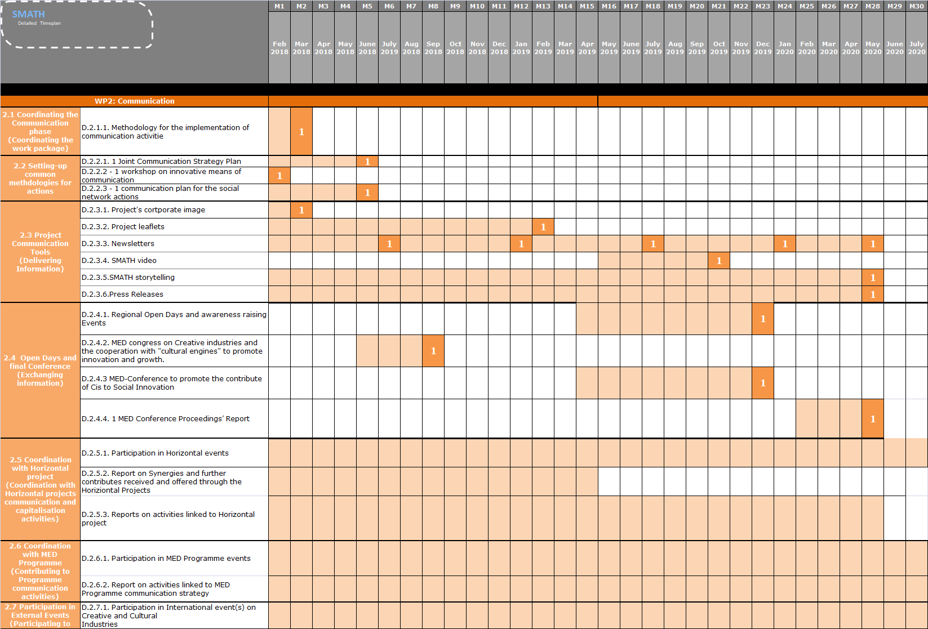
Timeplan (AF)
Notes:
Replan is necessary!

Slide 14
Upcoming tasks and implementation plan (next 6 months)
D2.1.1 | Draft of the methodology for the implementation of communication activities | TECHNOPOLIS | 30/06/2018
D.2.1.1 | Finalization of the methodology and related annexes | After LP comments - TECHNOPOLIS | 15/07/2018
D.2.2.1 | Backbone of the Joint Communication Strategy | TECHNOPOLIS | 15/07/2018
D.2.2.1 | Approved backbone by the Partners | TECHNOPOLIS+All | 31/07/2018
D.2.2.1 | Finalisation of the Joint Communication Strategy | TECHNOPOLIS | 20/09/2018
D.2.2.2 | Workshop on innovative means of communication | Veneto Region | ?
D.2.2.2 | Proposal of Agenda for the workshop | Veneto Region | ?
D.2.2.3 | 1 communication plan for the social network actions | TECHNOPOLIS | 15 days after the workshop
D.2.3.1 | Project Corporate Image (PPT, poster, deliverable etc) | TECHNOPOLIS | 10/08/2018
D.2.3.3 | Newsletter structure and proposal for 1st newsletter info | TECHNOPOLIS | 30/08/2018

Slide 15
Upcoming tasks and implementation plan (next 6 months)
All Partners’ activities which foreseen workshops, meetings and events, additional than those scheduled into WP2, will have to organize, promote and report them following the guidelines of this document and
in close connection with Communication Manager and the Project Coordinator.

Slide 16
Thank you
Contact details
Konstantina Zachari,
k.zachari@innovathens.gr
T. (+30) 213 0109300 (int. 117)

