Slide 1
SMART ATHMOSPHERES Creating new and better connections between culture and creativity
Fabrizio Panozzo
Ca’ Foscari University
Laboratory for the Management of
Arts and Culture (maclab)
Mestre, June 15, 2018

Slide 2
SMART ATHMOSPHERES
Why Atmospheres ?
The inventor of the notion of “district” or “cluster” explains its success with “the widespread knowledge and information that are in the air”
or
“the special atmosphere that gives the various advantages to the firms gathered together in a particular area”
(A. Marshall, 1873/79)

Slide 3
SMART ATHMOSPHERES
Smart ?
“When widespread knowledge and information generate various advantages”
Being smart implies not only having information and knowledge but also making sure that they produces actual result.
SMATH applies these basic ideas to Cultural and Creative economy

Slide 4
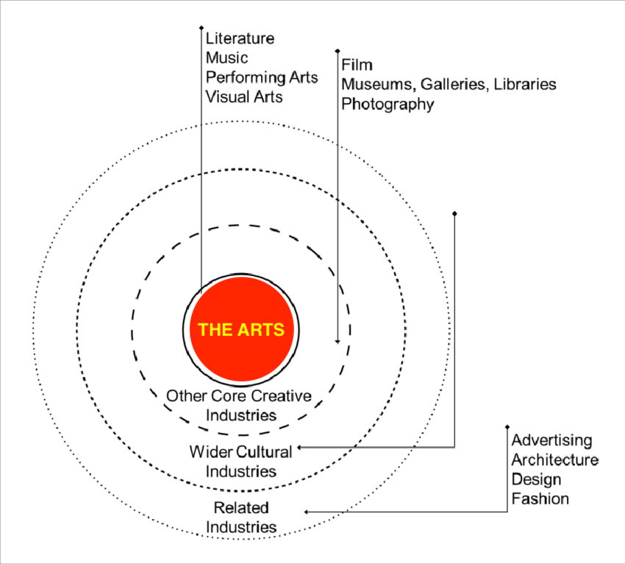

Slide 5
CULTURE OR CREATIVITY ?
Culture/art and creativity may sound close in theory but in practice they are not
SMATH capitalizes on this to generate a new, specific spirit of collaboration between culture and creativity
Social innovation is seen as the trigger : we need to develop innovative social ties between “artists” and “industries”

Slide 6
HOW ?
Expanded and intensified mutual knowledge and cross-fertilization
Highly focused development of practice-based models and tools.
Richer collaboration between two aggregates of “cultural engines” and “value enhancing services”
The “Creative Nest” as the physical and symbolic spaces in which Smart Atmosphere generate positive spill overs

