Slide 1
International Conference
« Culture and creativity »:
paving the way to the future of EU policies.
ChIMERA Final Event
Venue : Trieste
date 2019, September the 26th
Speaker Name: VALENTINA TIRLONI
Title: Final results of ChIMERA MED European Project for UNS
Institution: Université Nice Sophia Antipolis UNS
E-mail: valentina.tirloni@univ-cotedazur.fr
Logo partner

Slide 2
Main results for UNS and its environment
A tighter relationship between University and local actors in CCI sector (public and private)
A sustainable economic model for University programes in creative writing sector (Storytelling Institute and new programes with INA)
A dedicated Cluster should not be the best means to federate all the actors
Participation in the organization of activities within the three Festivals

Slide 3
Festival CanneSeries April from the 8th to the 11th, in Cannes

Slide 4
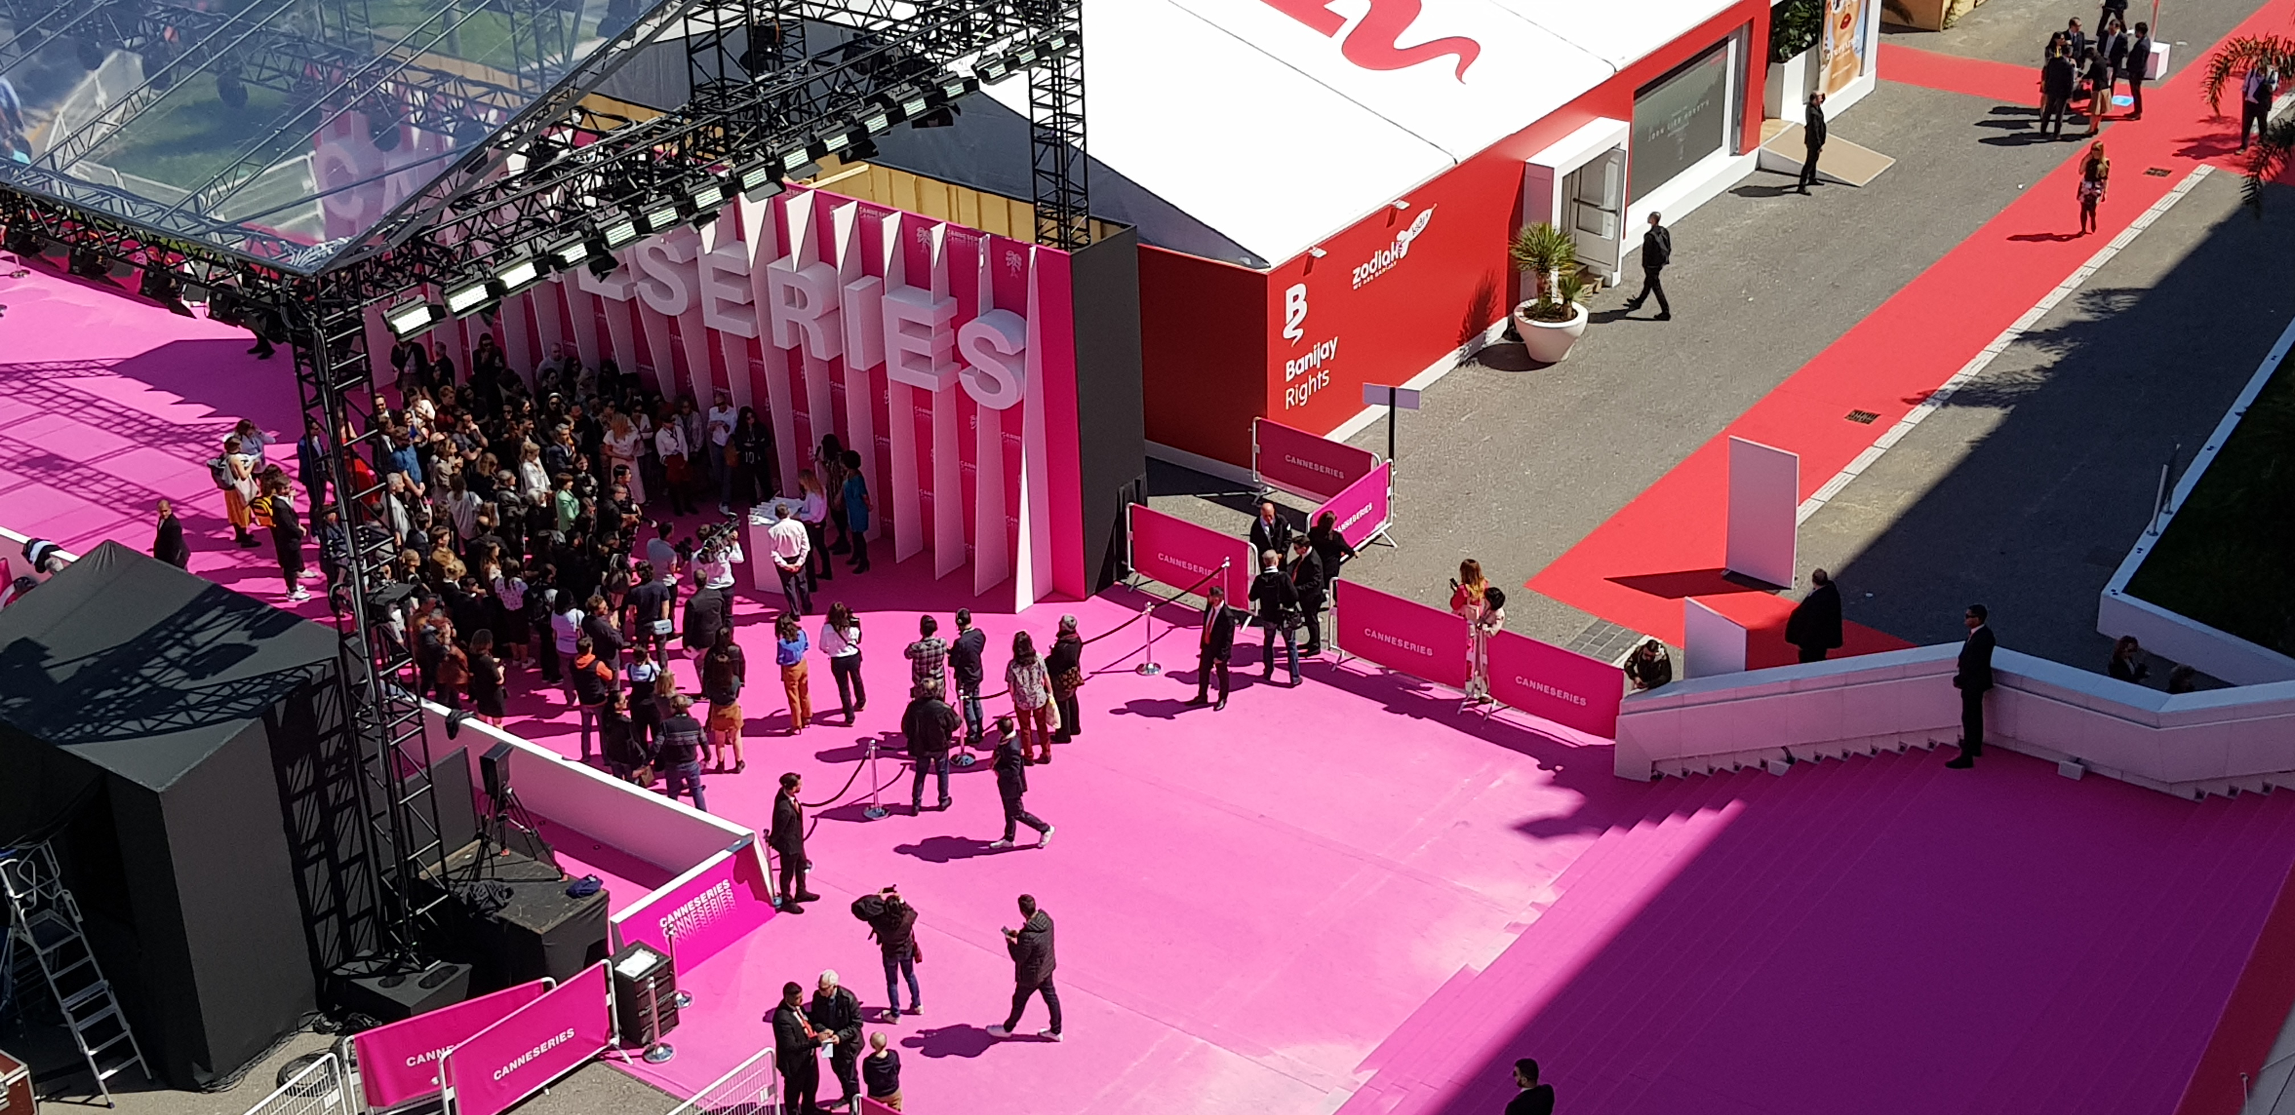
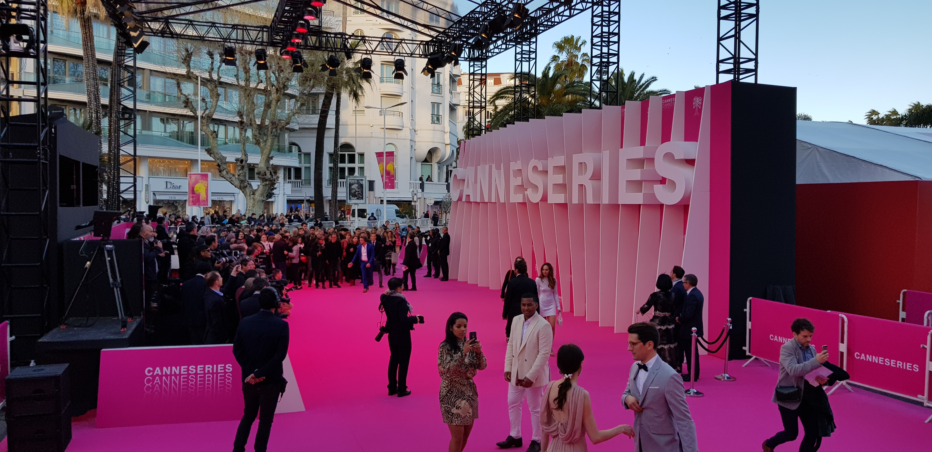

Slide 5
Old and new programmes for creative writing and showrunner
RESIDENCES ET PRODUCTIONS ARTISTIQUES (CHAIRE ET ECOLES D’ART)
Ecritures et scénarisation Séries TV Canneseries Institute :
Chaire Mairie de Cannes - Université Côte d’Azur – Vivendi Canal Plus – DFFB (février-mars)
Ecritures et scénarisation Storytelling Institute - Chaire Mairie de Cannes - UCA – Vivendi Canal+ – UCLA Theater Film and Television School (avril-mai)
FORMATIONS COURTES (NIVEAU GRADUATE, EUR CREATES)
Summer School UCA – INA : Design d’expériences numériques : réalité virtuelle et réalité
augmentée (ouverture 2019)
Summer School UCA – INA : Formation au métier de showrunner directeur artistique de
séries TV (ouverture 2019)

Slide 7
A very rich sector for audiovisual

Slide 8
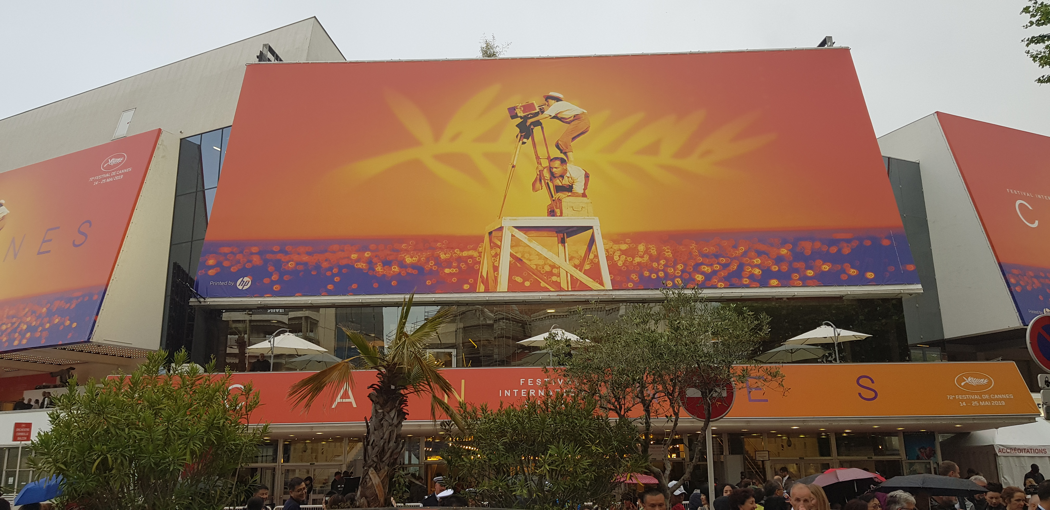
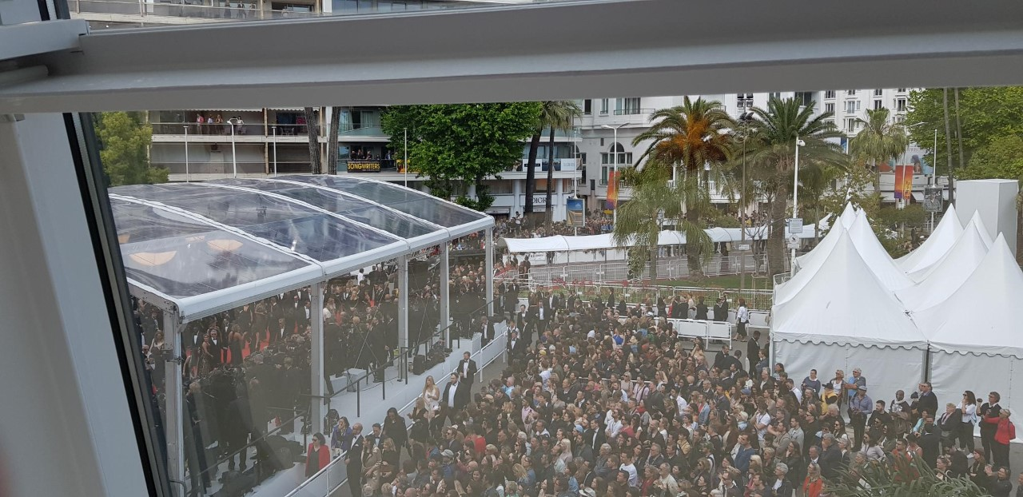
Cannes Film Festival Mai, from the 14th to the 25th

Slide 9
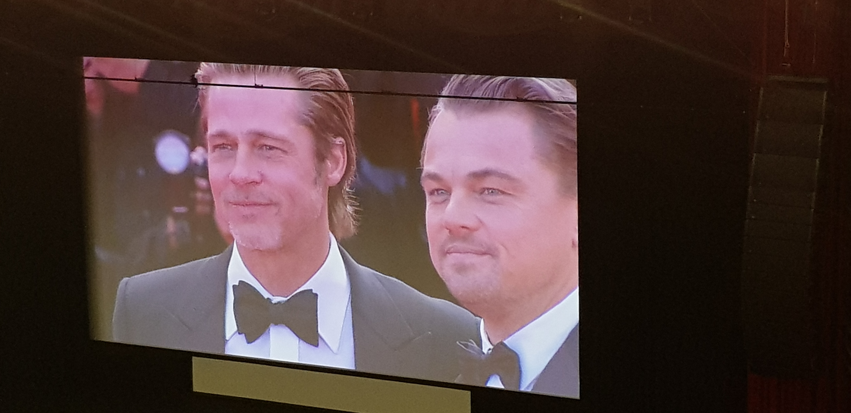
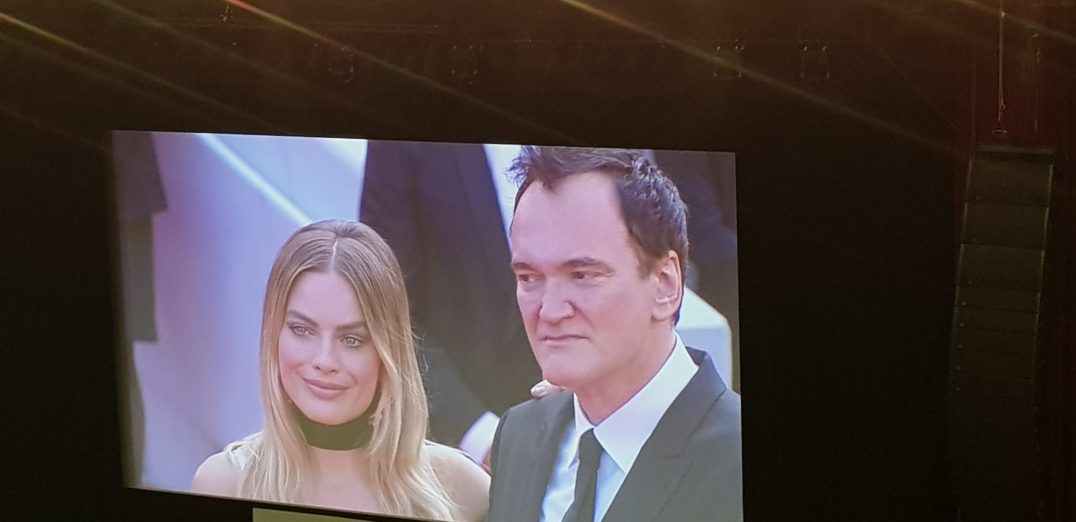

Slide 10
Nice Short Film Festival, October 11th-18th

Slide 11
International Conference
« Culture and creativity »:
paving the way to the future of EU policies.
ChIMERA Final Event
THANK YOU
Venue : Trieste
date 2019, September the 26th
Speaker Name: VALENTINA TIRLONI
Title: Final results of ChIMERA MED European Project for UNS
Institution: Université Nice Sophia Antipolis UNS
E-mail: valentina.tirloni@univ-cotedazur.fr
Logo partner

