Slide 1
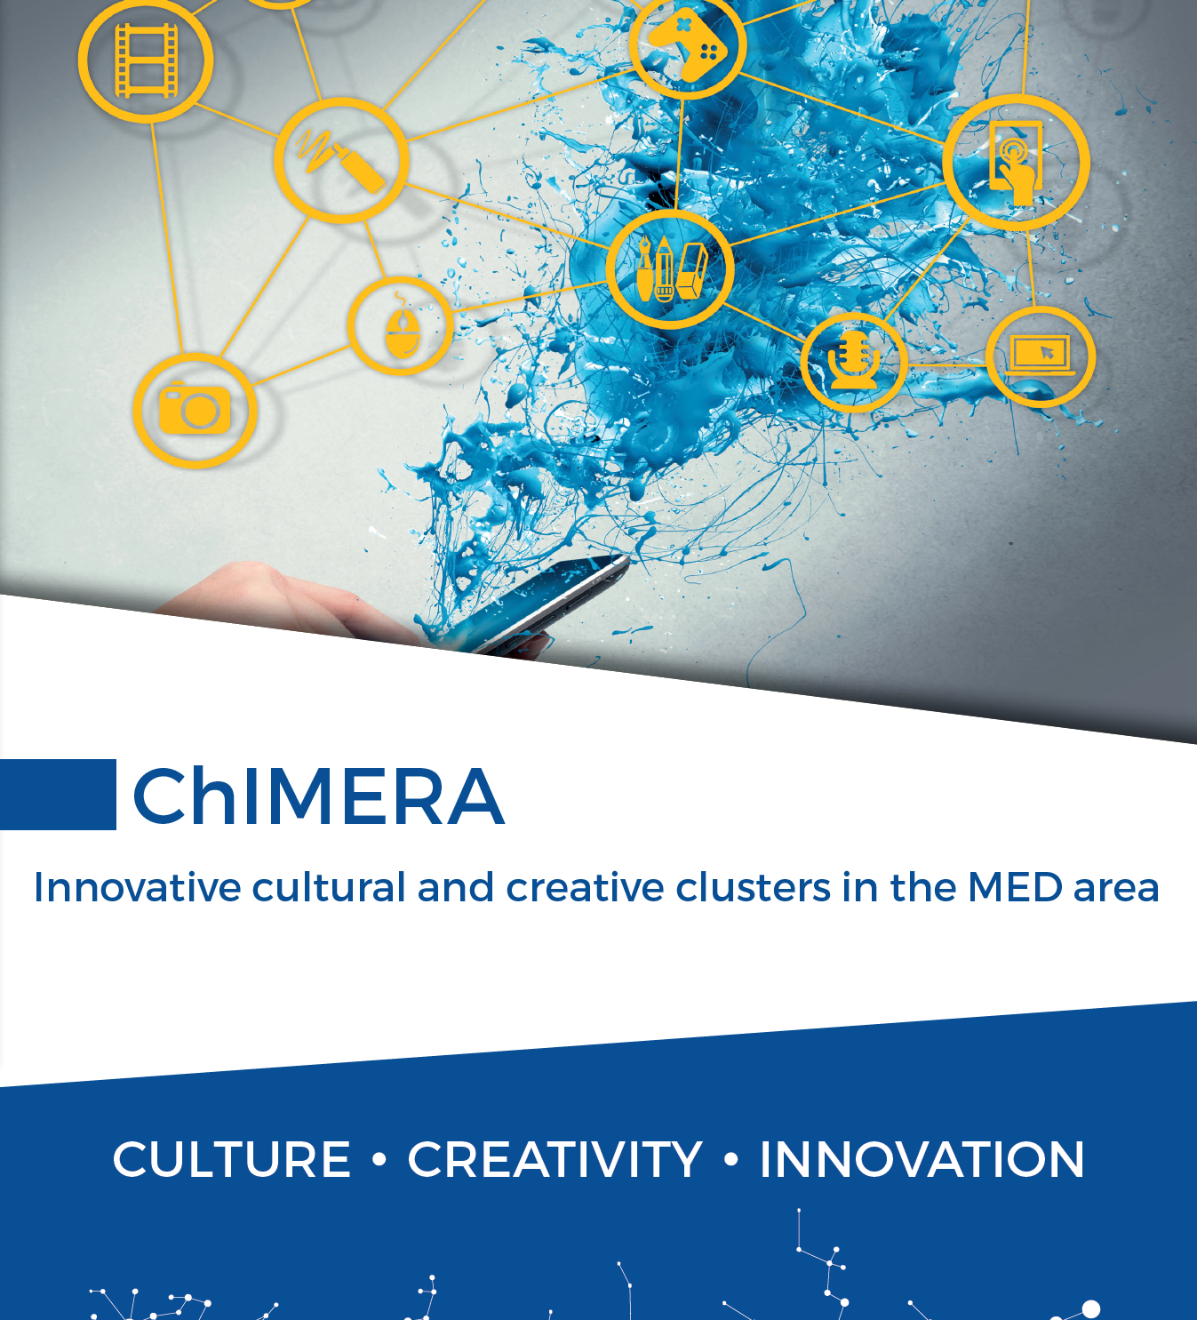




International Conference
Final Event
Trieste
26/09/2019
Antonio Bernardo
ERDF Managing Authority
Partner Regione Basilicata

Slide 2

CHIMERA FRAMEWORK
Regional innovation strategies for smart specialisation (RIS3)
The Regional Strategy includes Cultural and Creative Industries as one of the five priorities of the Smart Specialization Strategy of the Basilicata Region which focused on three main CCI sectors:
creative industry for tourism;
creative industry and design;
creative industry at the service of the productive sectors.
The priority investment areas are:
development and application of technologies for the management, protection and use of cultural heritage;
support for the adoption of technologies for the creative industry and design

Slide 3
WHY BASILICATA REGION JOINED CHIMERA
Involvement in the project for the establishment of a transnational cooperation in the CCI sector in order to improve the innovation capability of the CCI public and private actors, strengthen the cooperation among companies, research bodies, public authorities, and civil society both at territorial level and at transnational level favoring the creation of networks and clusters able to promote a cross-fertilization in the sector and unlock the potential of cultural and creative industries

Slide 4
RESULTS IN BASILICATA
At project level:
CCI State of the Art Analysis
Strategic Action Plan
(Organization of the) Training for Cluster Managers (n. 23 Managers/Facilitators)
Living Lab (3 workshops - n.100 participants)
Cluster Business Plan
Innovation project
At territorial level:
Establishment of the CCI cluster ‘Basilicata Creativa’ (48 companies + UNIIBAS and ‘CNR’)
Public Notice for the support of entrepreneurial activities aimed at enhancing the cultural and natural attractors of the regional territory with a special focus on the CCI sector: creative, cultural, artistic activities, publishing, music, cinema, game production, design, fashion, communication, marketing and digital

Slide 5
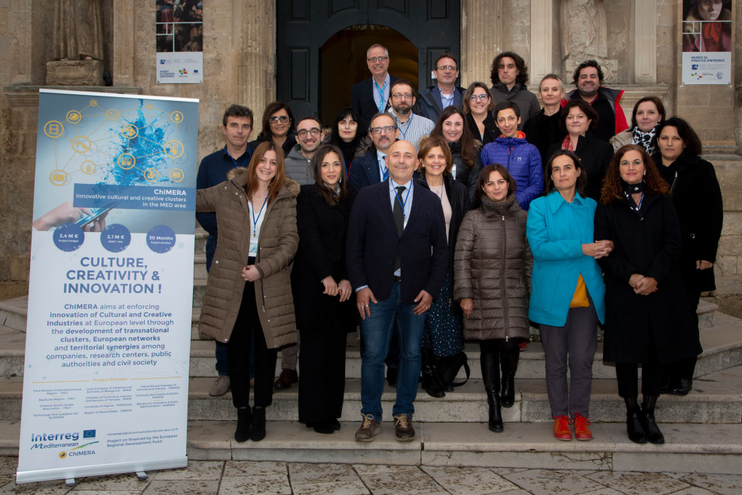
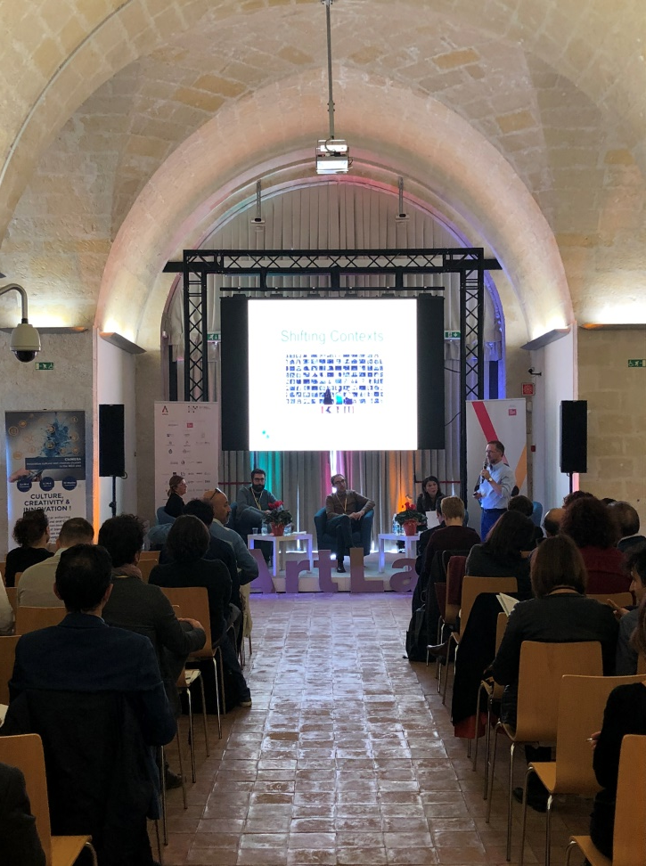
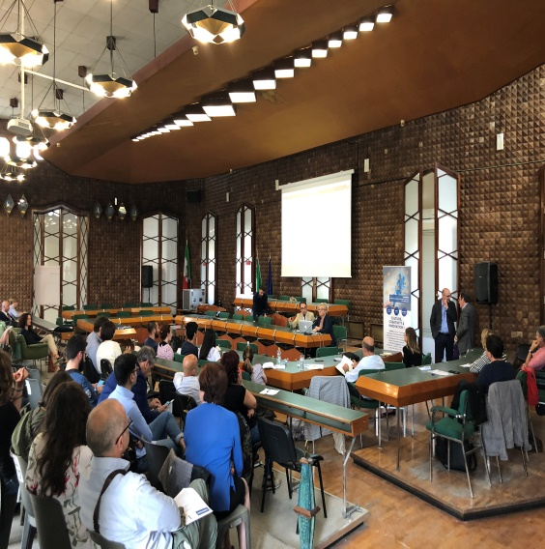
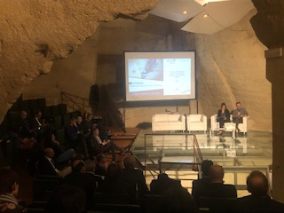
SOME PICTURES

Slide 6
THANK YOU
FOR YOUR ATTENTION

