Slide 1
TALIA Horizontal Project Territorial Appropriation of Leading-edge Innovation Actions International Seminar
Gaetano Grasso – InnovaPuglia SpA
Ljubljana 2017, 4th October

Slide 2
0. Project infodata
November 2016 – October 2019
1.499.040 €
6 partners from 6 European countries

Slide 3
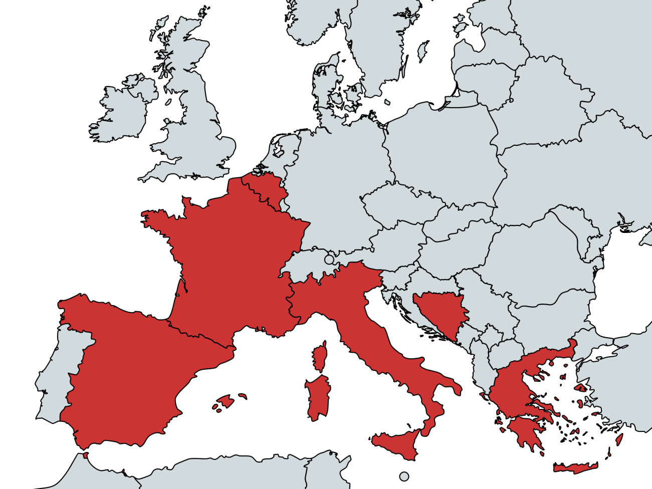
1. TALIA Project Partner
with support of
UCC
Notes:
Lead Partner
Strongly interested in leading this journey in the fields of culture, creative and social industries according to our regional priorities remarked in the Regional Smart Specialization Strategy
Project Partners
From Bosnia and Herzegovina, Spain, France, Greece, Belgium

Slide 4
4. TALIA Objective
Engagement and support
Liaison with on-going projects and their local and transnational networks.
Communication
Virtual spaces and face-to-face events for interaction and dissemination
Capitalisation and impact
Briefings and tools to extend results across the MED space and policy agendas

Slide 5
5. TALIA Common Framework
A Single Message
TALIA synthesizes project activities and results as a single message, projecting a coherent ‘Mediterranean model’ of innovation
Dissemination and Communication
TALIA leverages partner innovation networks and communities to extend the reach and impact of project results
Policy Evidence
TALIA services support evidence based policy making and the three learning loops of projects, programmes and policies.

Slide 6
6. TALIA Expected Impact
TALIA
Local and regional Project partner communities
Regional and National RIS3, National OPs, MED Axis 4
National, EU, Global ENoLL, FLL, CoR, World Bank, UNESCO, etc.
TALIA operates top-down and bottom-up to convey the results of participating projects towards effective policy impact.

Slide 7
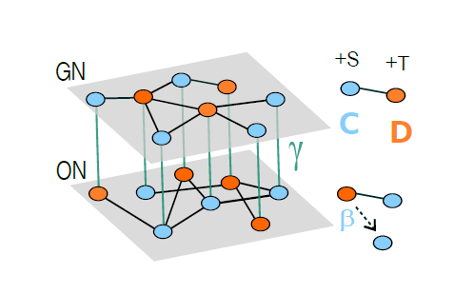
7. Multiplex Networks
Social influence and game dynamics take place in different domains, which we model as different layers of a multiplex network. The coupling between these dynamical processes can lead to cooperation in scenarios where the pure game dynamics predicts defection. In addition, furthermore the structure of the network layers and the relation between them can further increase cooperation.

Slide 8
8. Activities
Communication Strategy
MED Innovation Vision
Semantic framework
Platform integration
Events organisation & attendance
Thematic domain mapping
Engagement and interaction
Input and feedback collection
Interoperability and services
Community
Capitalisation Strategy
Indicator mapping
Evidence aggregation
Services to Vertical Projects
Axis 4 interaction

Slide 9
9. Community
“Performing arts “
“Advertising Design based manufacturing
Services and tourism”
“Open data”
“Social entrepreneurship”
“Public sector innovation”
….
Cultural and Creative Industries
Social Innovation
Project | Keywords
ChIMERA | CCI Innovation system/strategy; Innovative tools&services; Innovative financial instruments; Services for internationalization and innovation;Innovation business plan
Co-Create | Cross-innovation; innovative tools&services; Innovative financial instruments; IPR instruments; Creative camps tools; Innovation processes and products
CoWorkMED | Coworking/HuBs; Innovative ideas; Open innovation; Innovative tools&services ; Micro-factories; Social and urban innovation
CreativeWear | Cross-innovation;Coworking /HUBs;Creativity-based business model innovation
Open Doors | Sharing Economy; Coworking/HuBs; Innovative tools&services ; Innovative financial instruments/Crowding
ProminentMED | PublicProcurement of Innovation (PPI); Innovative financial instruments; Innovative ideas; Innovative products
Studyng
Testing
Capitalization
S
T
C

Slide 10
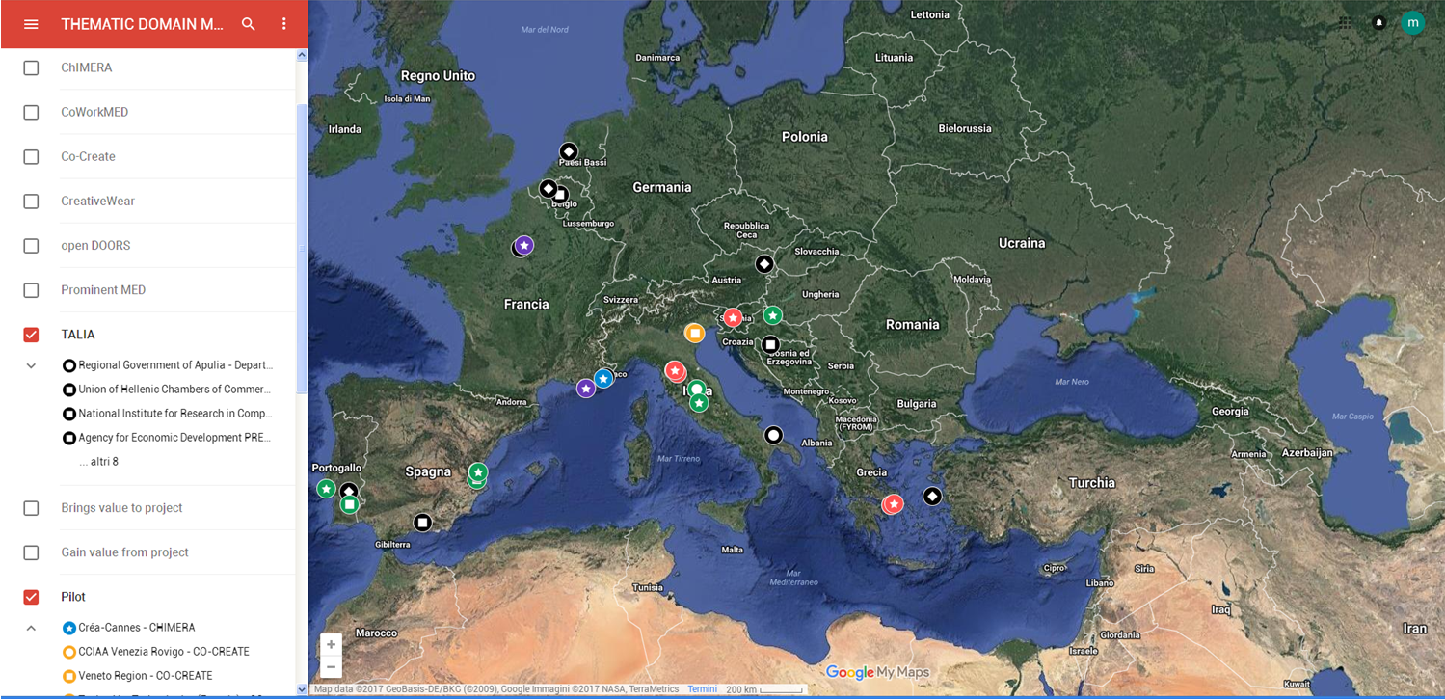
10. Tematic Mapping
Notes:
State of the art, since the beginning of the projects shows a MED community distribution where we can have evidence of TALIA actors, MODULAR PROJECT partners and STAKEHOLDERS linked to Modula Project partners interest in bringing value to projects or gain values from them. This is a first map we are working on in order to extract also thematic relationship and mutual interests among community agents

Slide 11
11. Capitalization
Scaling Up Consolidation of results | Scaling Out Geographical extension of results
Policy Learning What goes through | Policy Impact What is (will be) used to transform policies

Slide 12
12. Contact info
Adriana Agrimi [a.agrimi@regione.puglia.it]
Marianna Cavone [m.cavone@innova.puglia.it]
Marco Di Ciano [m.diciano@innova.puglia.it]
http://talia.guadalinfo.es/
@MEDSocialcreat
Social & Creative MED

Slide 13
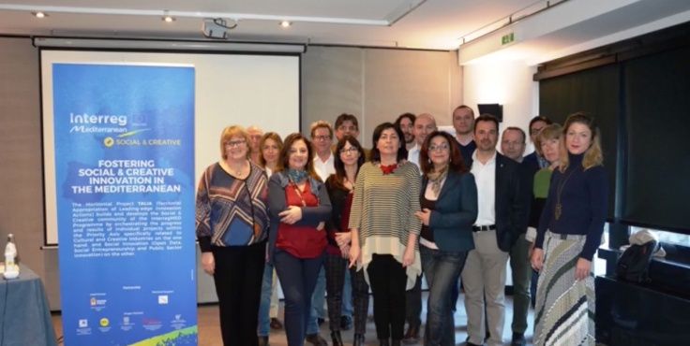
Thank you
TALIA Horizontal Project Team

