Slide 1
October 2017
Fabrizio Rovatti – Managing Director, Innovation Factory

Slide 2



Slide 3
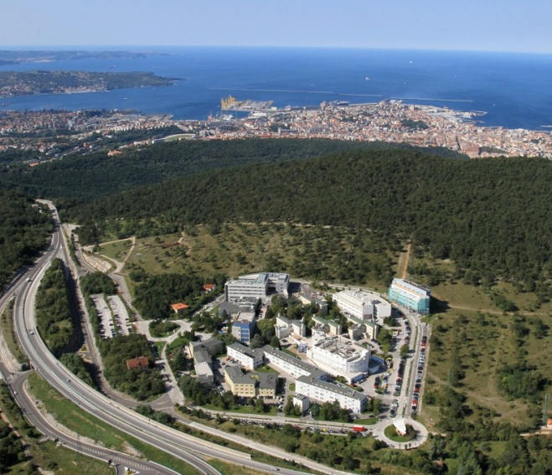
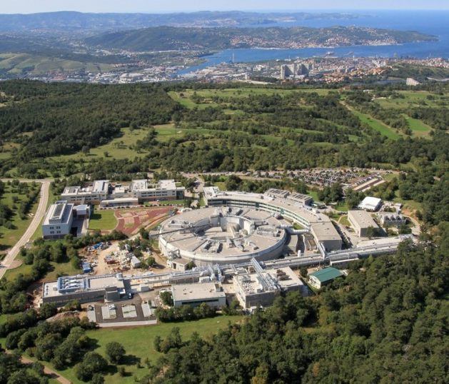
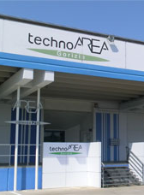
AREA SCIENCE PARK TODAY: 3 CAMPUSES
Basovizza Campus
TechnoAREA Gorizia
Padriciano Campus

Slide 4

AREA SCIENCE PARK:
A DRIVER OF PUBLIC/PRIVATE PARTNERSHIPS
R&D
RISORSES TO
CREATE KNOWLEDGE
KNOWLEDGE TO
DRIVE DEVELOPMENT
PUBLIC LEVER
PRIVATE LEVER

Slide 5







AREA SCIENCE PARK: KEY FACTS
Since 1978 the leading Italian science and technology park.
Public Research Body, under the control of MIUR
Hosts 87 High-Tech R&D Centers, helping them to grow.
79 private companies
8 public research bodies
Creation and development of high tech start-ups thanks to the certified incubator Innovation Factory
> 9 m€/year
from competitive projects
122 direct staff
2.600 employed
in the 3 campuses
3 campus - 94.000 sqm for R&D activities

Slide 6





EVOLUTION STRATEGY: 4 LINES OF ACTIVITY

Slide 7
AREA SCIENCE PARK: AN INNOVATION ECOSYSTEM WITH 4 LINES OF ACTIVITY
Development and management
of the Science and Technology Park.
Pre-incubation, incubation and acceleration for the creation and development of high-tech startup.
National and international projects to promote innovation and high-tech research (exploitation of research and technology transfer). Co-ordination of the regional public research bodies.
Development of services and public-private partnership to enable companies exploitation of the existing expertise and technology public facilities (Synchrotron and CBM).

Slide 8

INNOVATION FACTORY – ABOUT US
CERTIFIED INCUBATOR @ AREA Science Park
Innovation Factory is an in-house company of AREA Science Park. We are one of the most relevant players in the Italian startup ecosystem and support startups from the pre-seed and seed stage
FROM THE IDEA TO THE MARKET:
We help existing and prospective companies to bring innovative ideas to the market and create a sustainable and scalable business growth. Our expertise allow us to provide advice and support in any stage of the value chain.
RESEARCH
COMPANY
PRODUCT
sottotitolo presentazione
IDEA
DEVELOPMENT
MARKET

Slide 10
INNOVATION FACTORY – how we operate
Start up risk
REDUCING RISKS
INCREASING THE VALUE
Start up value
Pre-seed
Seed
Start up
Expansion
Idea
Validation
R&D
Patents
Prototypes
First product
First sales
Market established
Trade
Sale
IPO
TEAM DEVELOPMENT
PRODUCT DEVELOPMENT
MARKET DEVELOPMENT

Slide 11





INNOVATION FACTORY – VALUE PROP
technical education and entrepreneurial training
financial support
networking, financial and industrial partners
dedicated services, mentoring and coaching
equipped laboratories and first-class facilities

Slide 12



SERVICES FOR STARTUPS
BUSINESS MODEL DEFINITION &
BUSINESS PLAN VALIDATION
BUSINESS & TECHNOLOGY INTELLIGENCE
market & technology scenarios
INNOVATION PLAN DESIGN
technical & economic feasibility
IP STRATEGY
patent assessment & prior art analysis
DECISION MAKING STRATEGIC SUPPORT
TRAINING COURSES & COACHING
MARKETING & COMMUNICATION
NETWORKING
for research, development, industrial & commercial partner
FINANCIAL PLANNING
FUND RAISING
networking for banks, VC’s and investors

Slide 13









INNOVATION FACTORY – METHODOLOGY
A PROVEN MODEL FOR SUPPORTING ENTREPRENEURSHIP
We developed over years a proprietary and validated approach for supporting the birth and growth of new innovative businesses ; thanks to our methodology we are able to successfully manage every single step from ideas and projects selection, pre-incubation, incubation and company acceleration.
VALUE PROPOSITION
STRATEGY
MARKETING
NETWORKING
Idea Scouting
Evaluation and selection
Pre-incubazione
Startup
Market
Growth
Exit
BUSINESS IDEA
BUSINESS MODEL
BUSINESS PLAN
FUND RAISING
ORGANIZATIONAL
CONSOLIDATION
1. Structured and formal process designed with the aim to support innovative ideas.
2. Field validation of the technical, economic and market feasibility.
3. Definition and implementation of the project plan, the strategy, and the business model.

Slide 14
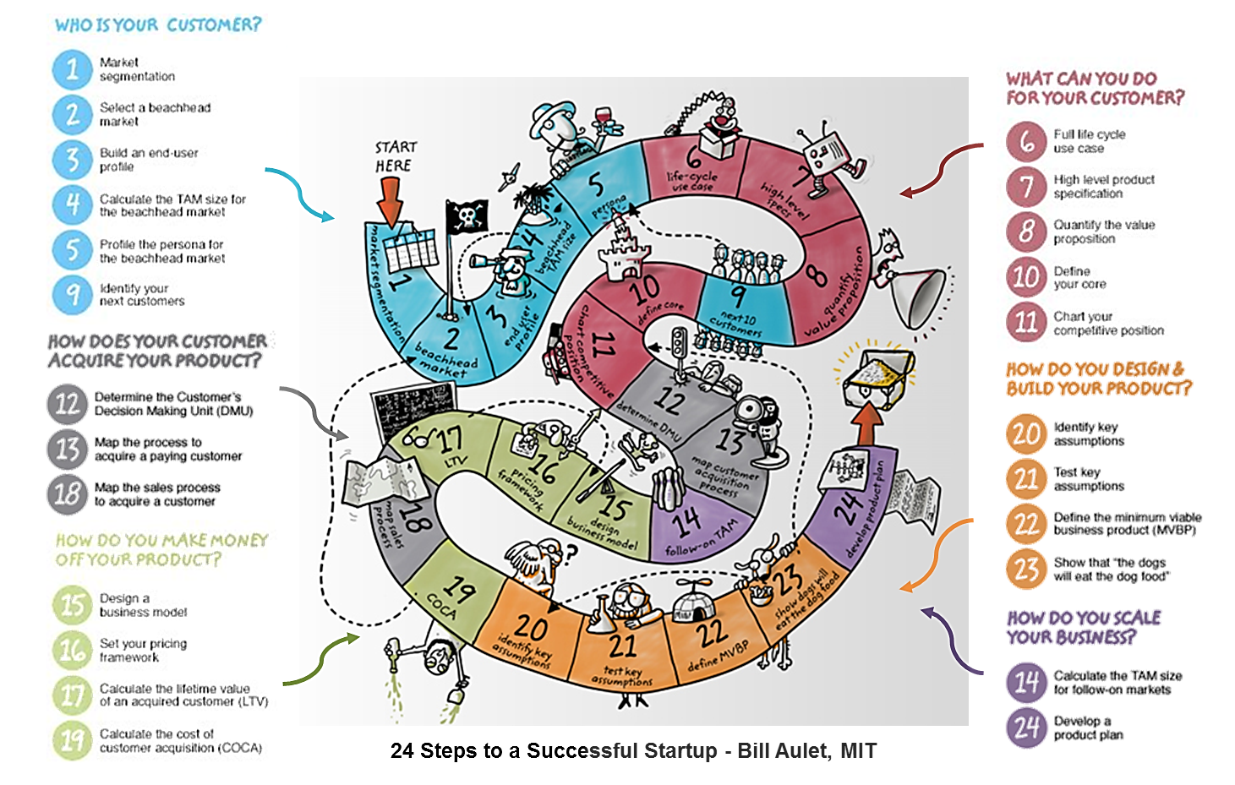
INNOVATION FACTORY – APPROACH
DISCIPLINED ENTREPRENEURSHIP
Notes:
The 24 Steps are discrete and can be grouped into six themes. Each step should be done in numerical order with the understanding that in each step you will learn things that will prompt you to revise the work you have done in earlier steps. These themes present a general outline of how the 24 Steps will help you create a sustainable, innovation-based business.

Slide 15
RECENT PROGRAMS
IMPRENDERÒ 4.0__Project aimed at the spread of entrepreneurial culture, seen as an indispensable precondition for launching virtuous paths of socio-economic development, promoted and funded by the FVG Region with ESF funds.
Projects supported: 49 ⇨ Startups: 1
CAMPUS DI IMPRESA__Project aimed at the creation of innovative companies funded with ESF funds from the FVG Region.
Projects supported: 36 ⇨ Startups: 4
SpinAREA__Integrated program for the creation and development of tech/knowledge-intensive enterprises, co-funded by Italian Ministry of Economic Development and AREA Science Park.
Projects supported: 47 ⇨ Startups: 12
IFChallenge__IF program designed to accelerate the development of entrepreneurial projects, encouraging the creation / growth of innovative businesses, and to identify better startups in which to invest our own resources.
Projects supported: 12 ⇨ Startups: 3

Slide 16


RESULTS (UP TO NOW)
1700+
285
50
7+
PROJECT
IDEAS EVALUATED
ENTREPRENEURIAL PROJECTS SUPPORTED
START UP SUPPORTED
INVESTMENTS public and private from industrial partner and VC (M€)

Slide 18




CURRENT INITIATIVES
Business acceleration and consolidation programs, aimed at the entrepreneurial development of projects of cultural value, addressed to cultural, creative and touristic companies
  The Friuli Venezia Giulia Region and AREA Science Park have signed a collaboration agreement to contribute to the socio-economic development of the regional production context, promoting the creation of new businesses through the development of business incubation activities.
  Focus on FVG's CCI, to be supported through incubation services.
  AREA Science Park is the coordinator of the activities, involves 4 regional certified incubators.
  The programs are funded under the Community Programming POR FESR FVG 2014-2020. Calls issued directly by the Region:
    I° Call for creative cultural enterprises Action Line 2.1.b.2 (acceleration and consolidation) opened from October 2017

Slide 19


Slide 20





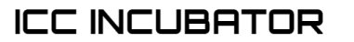


FUTURE DEVELOPMENTS & OPPORTUNITIES
FVG Cultural Incubator
A possible development is the launch of the FVG Cultural Incubator,
an initiative of FVG Region together with AREA Science Park.
The initiative would convey activities and resources focused on ICCs and
It would increase awareness of GDP growth thanks to the close connection between traditional companies and ICCs

Slide 21

FUTURE DEVELOPMENTS & OPPORTUNITIES
Transform innovative projects into the cultural field in industrial applications (products and services) by generating economic value and fostering technology transfer and the creation of new entrepreneurship with high intensity knowledge and high growth potential.
  providing appropriate tools, enhancing the ability to experiment, innovate and create businesses and facilitate access to funding and an appropriate range of tech/business skills;
  promoting business culture in the CCI sectors through new tools to fund new entrepreneurial ideas.
Support technological and market development of businesses, improving their competitiveness and boosting their growth in terms of turnover, employment and profitability.
  to help cultural and creative industries develop in their local and regional environment, as a platform for launching a stronger global presence;
  moving to a creative economy by catalyzing the repercussions of cultural and creative industries on a whole range of economic and social contexts.

Slide 22

Fabrizio Rovatti
Managing Director – Innovation Factory srl
AREA di Ricerca Scientifica e Tecnologica – AREA Science Park
Padriciano, 99 – 34149 Trieste – Italia/Italy
www.innovationfactory.it
www.areasciencepark.it

Slide 23

STARTUP INCUBATOR

