Slide 1


www.mao.si I www.bio.si I www.futurearchitectureplatform.org
Notes:
Hello again! As said I am happy to say this event is just the announcements of official public kick off of newly established - Centre for creativity of Slovenia → a 6 year national project - run by MAO - to be held in from 16-18 November this year.

Slide 2

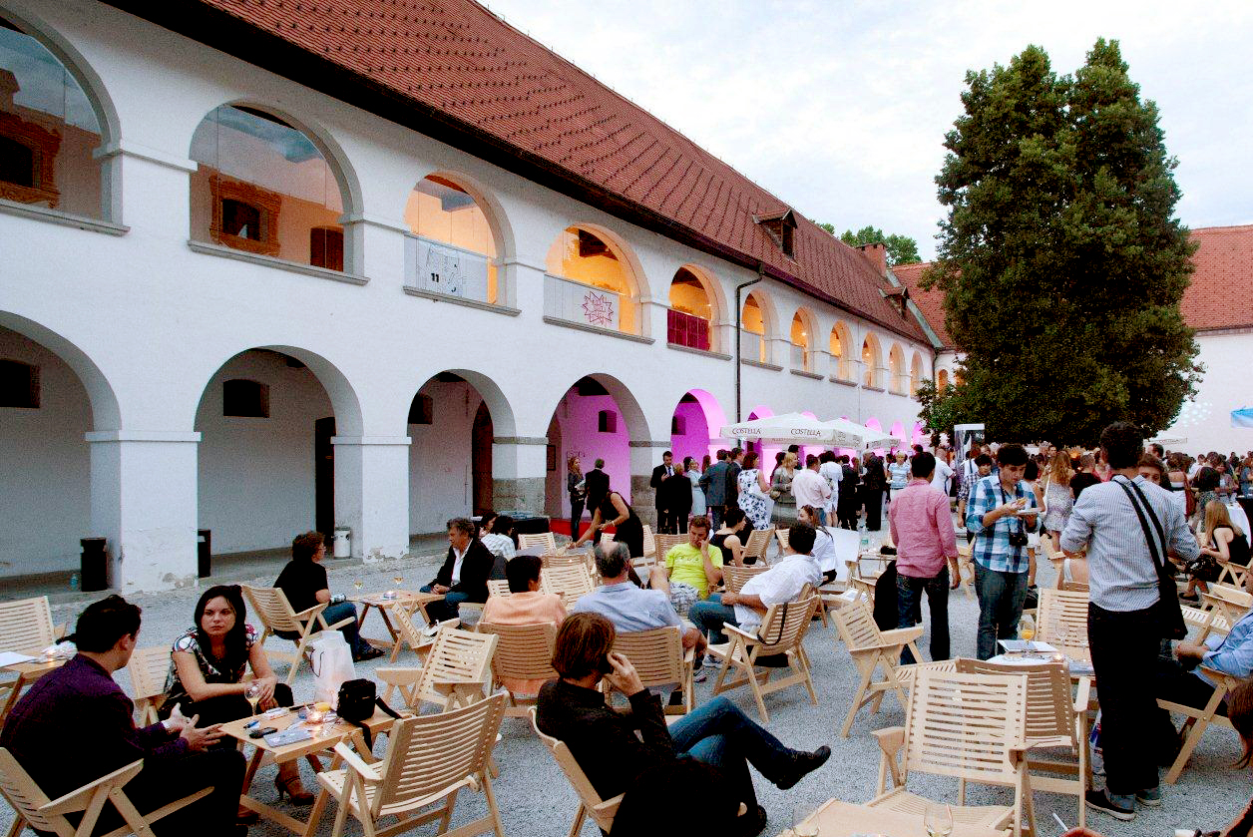
Notes:
But because this is not an official launch and some of you might wonder what has a museum to do with contemporary Centre for creativity - I will today just shortly present the main activities of the centre and how this idea developed under our museum.

Slide 3
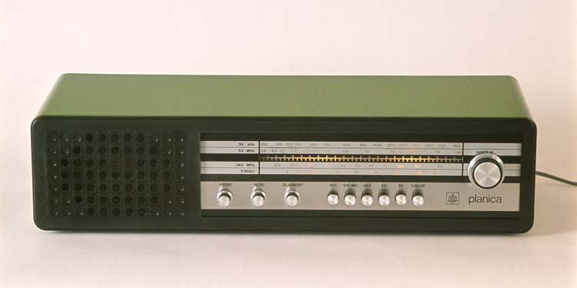
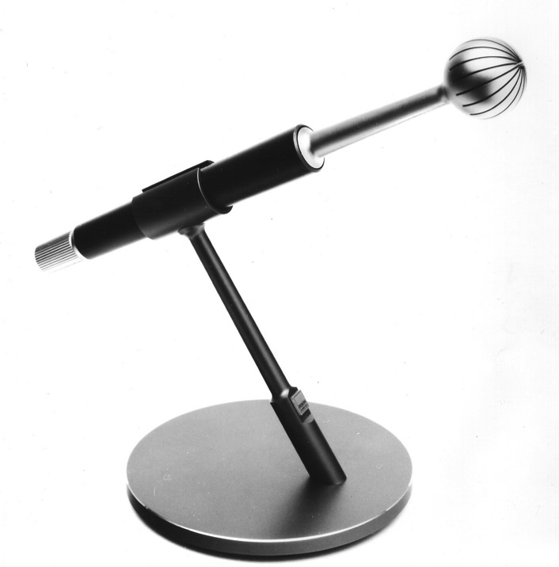
1972: founded by the City of Ljubljana
2010: national Museum of Architecture and Design
Collections: Architecture, Industrial Design and Visual communications, Photography …
Collections: 74.000+ objects
Authors: 1.000+
100.000+ of events, workshops, exhibitions …

Slide 4

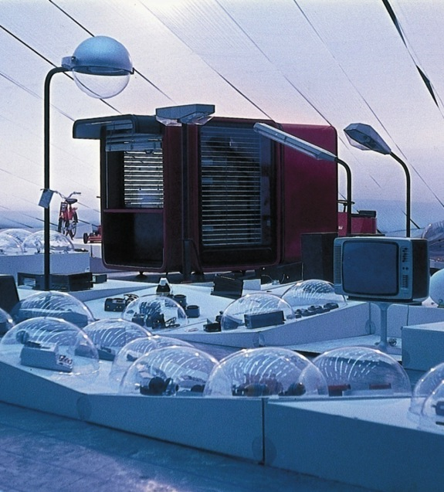
Special exhibition: Biennial of Design (BIO), 1964
In 2014 celebrating 50th Anniversary
www.bio.si
Notes:
We are also an organizer of a special exhibition - Biennial of Design (BIO)
one of the oldest design biennials in the world,
Which will mark its 50th Anniversary next year
I am happy to say the curator of next edition Jan Boelen, director of Z33
Is here today
So please be welcome to follow this special edition of BIO.

Slide 5
A place where
PAST
PRESENT
& POSSIBLE FUTURES can interact

Slide 6



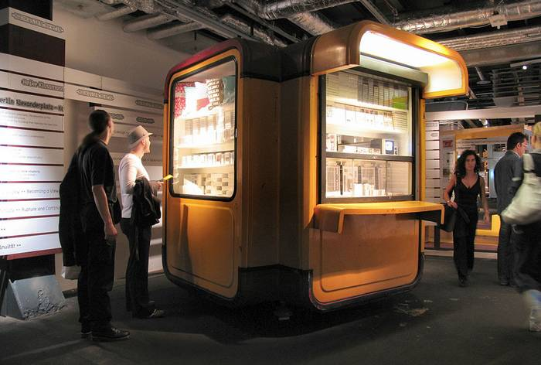
Notes:
But we are also a country with an exceptional design history
And some products with its design and innovation set new worldwide standards
Those historic objects seen are also included in the Design Collection of the MOMA, New York.

Slide 7
A place where the past is
A BANK OF IDEAS
&
KNOWLEDGE
FOR THE FUTURE

Slide 8
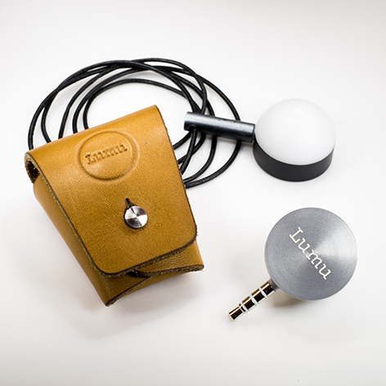
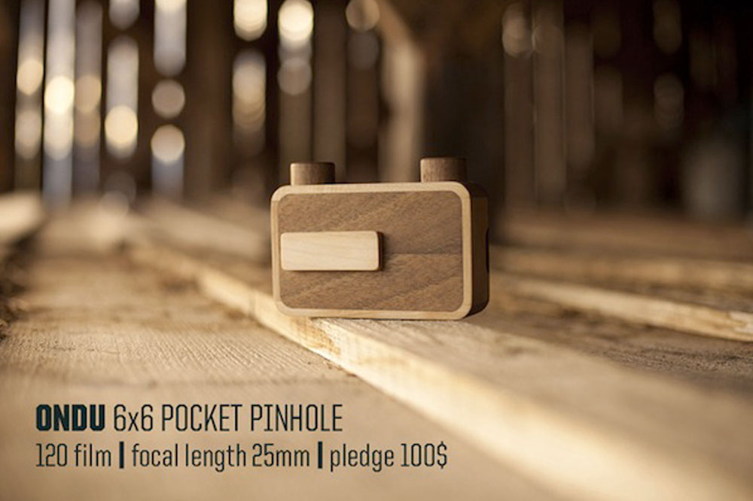
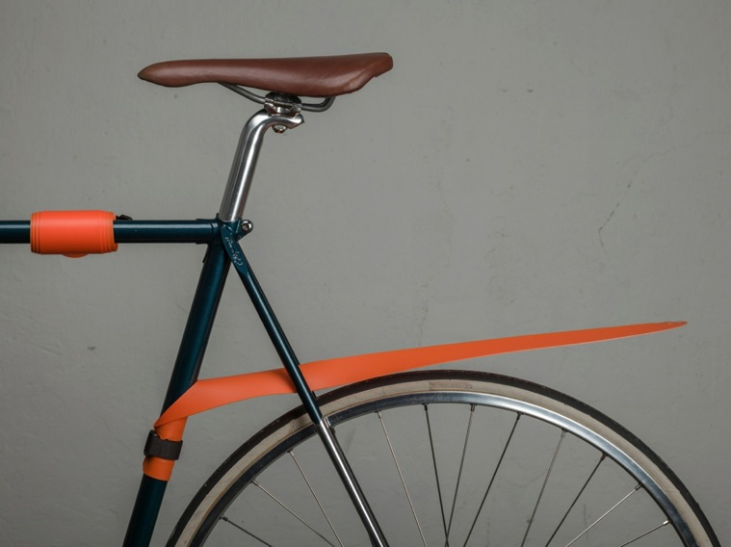
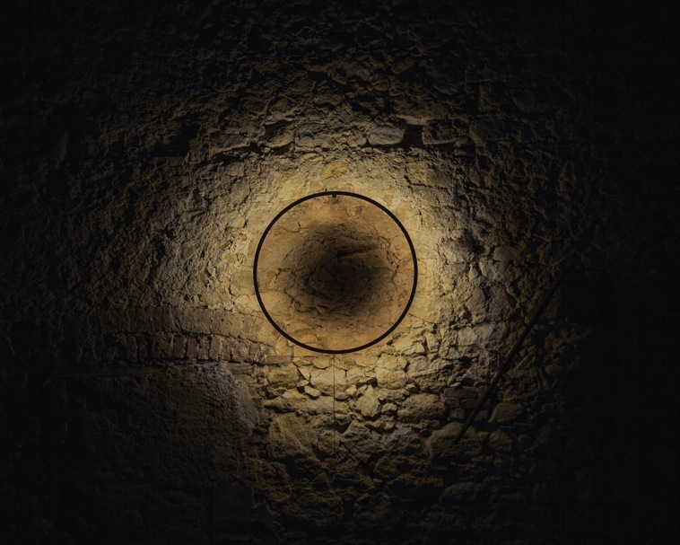
The New Platforms
Notes:
New platforms
with younger emerging designers
looking for alternative ways to position
Generating their own production, distribution and sells.
Musguard – ultra light and easy to handle roll-up bicycle fender,
Exposure meter Lumu - digital device that turns an iPhones or Androids into a high quality light meter.

Slide 9
CREATION
&
COOPERATION
A place of

Slide 10

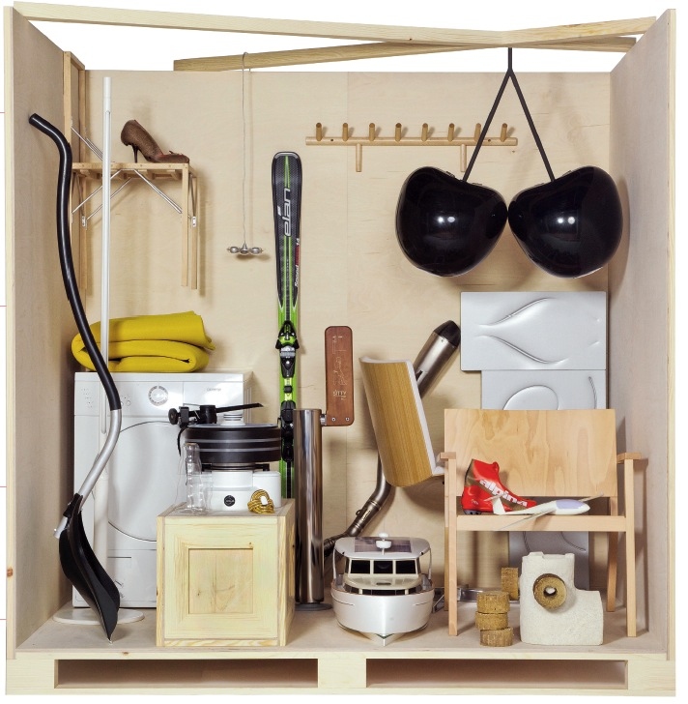
London Design Festival 2011
Dutch Design Week 2011
La Triennale di Milano 2012
Belgrade Design Week 2012
Maribor EU Capital of Culture 2012
Helsinki Design Week 2012
Designforum Vienna 2013
Moscow Design Week 2013
Swiss Forum 2014
And much more ....

Slide 11
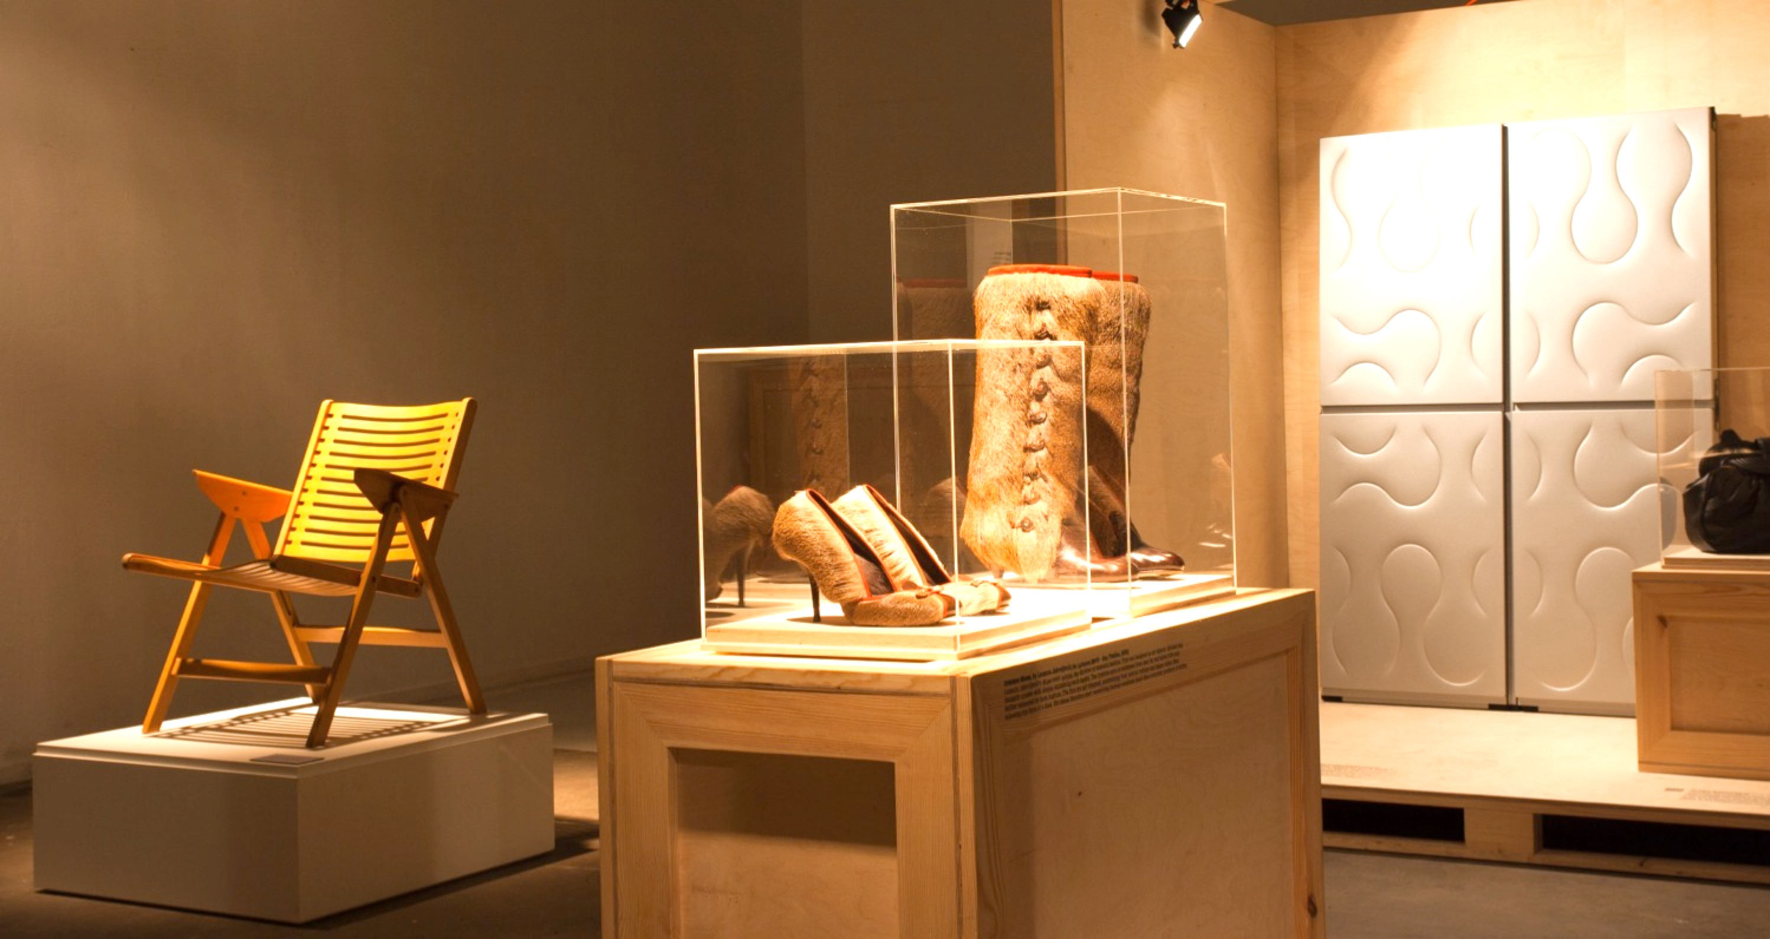
Notes:
Helsinki
Wien

Slide 12

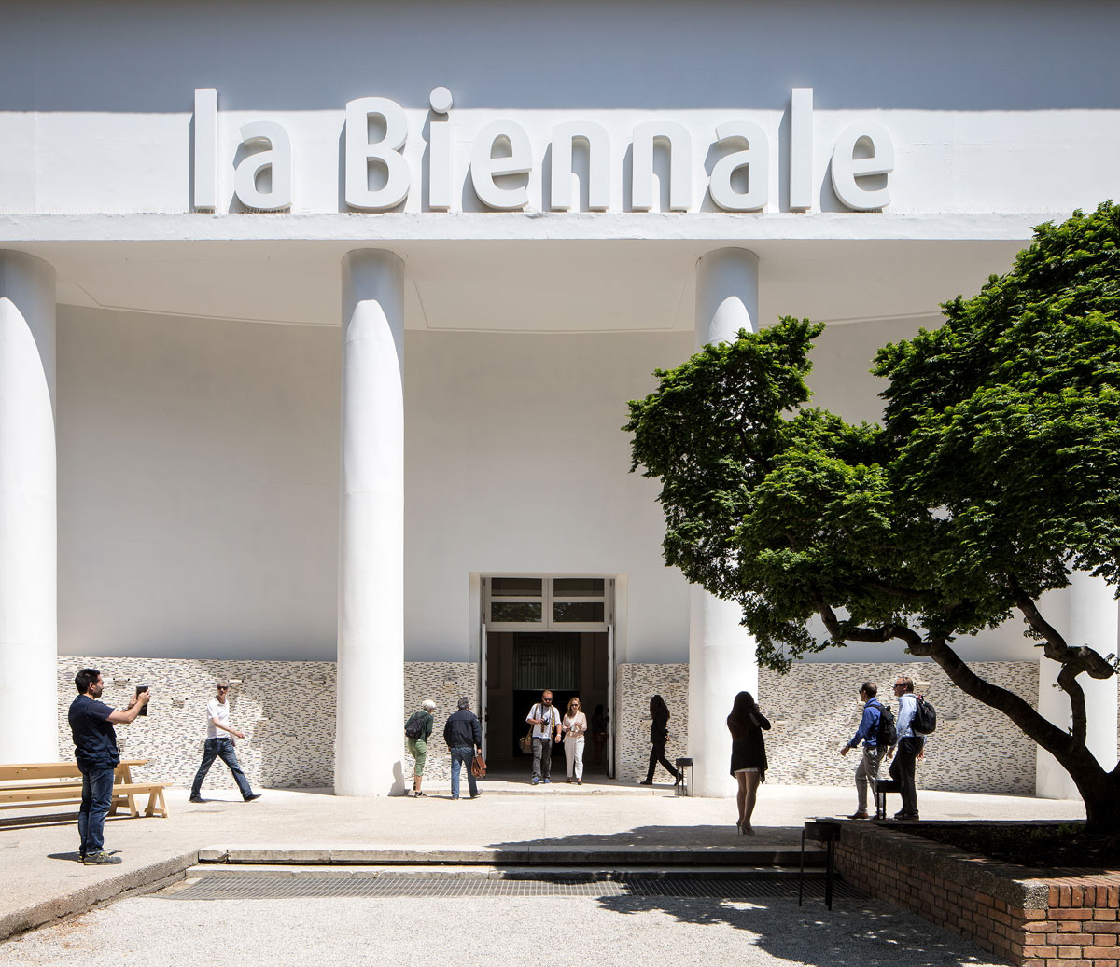
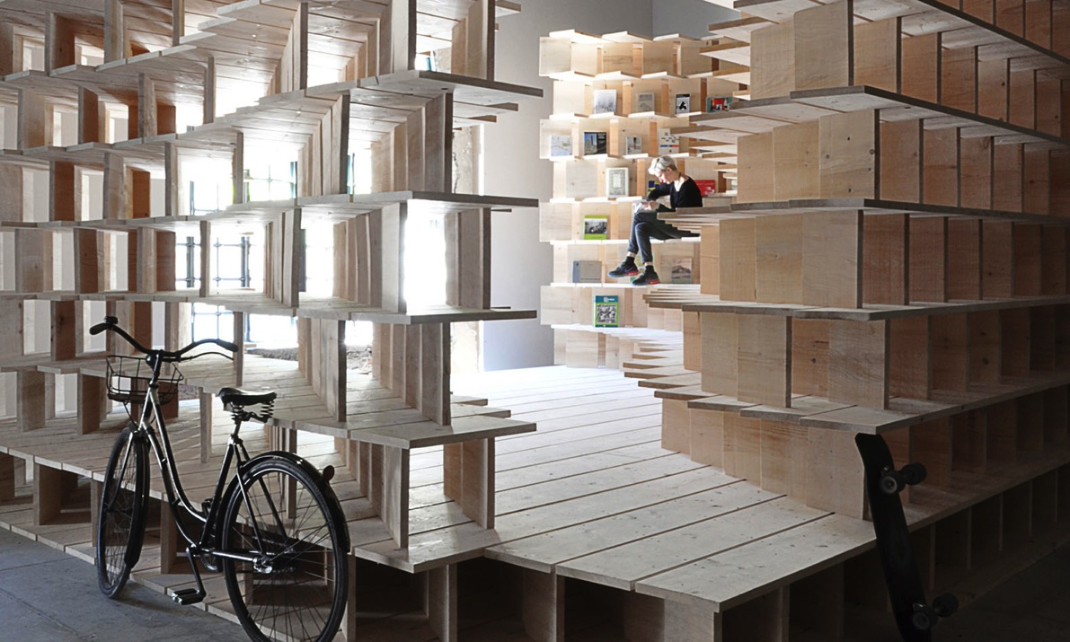
Commissioners
Slovenian Pavilion
2016, 2018
Home Arsenale 2016, Gregorič Dekleva Architects

Slide 13
INTERNATIONAL NETWORKS
&
PROJECTS

Slide 14

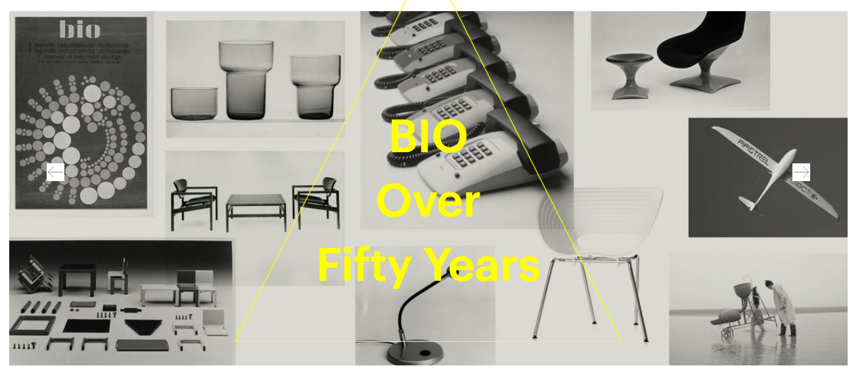
1963
Oldest design biennial
in the world
Once a classic comparative exhibition
of final products was transformed ...

Slide 15
INTERNATIONAL COMPETITION

Slide 16
INTERNATIONAL & LOCAL COOPERATION
&
MULTIDISCIPLINARY
PROCESS

Slide 17
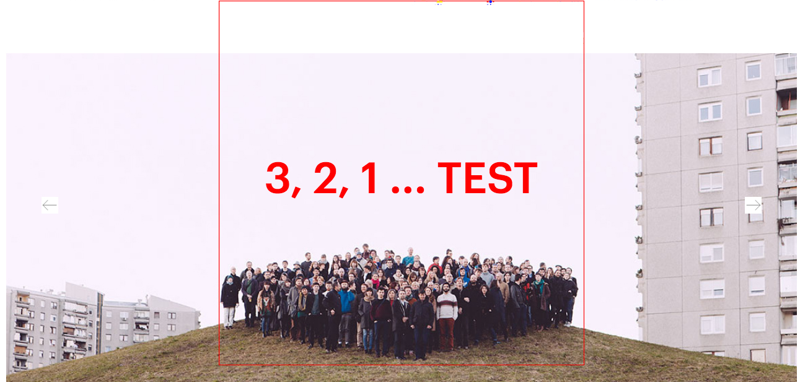
120 participants,
24 countries,
11 teams/topics,
40+ partners
… of a 8 + months long process of international and local
co-operation.

Slide 18
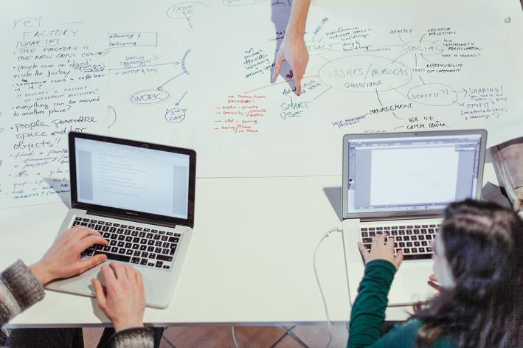
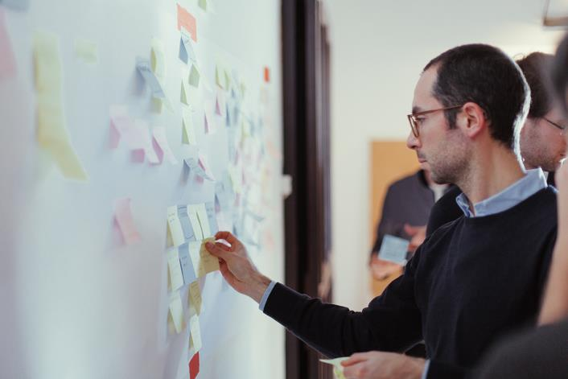
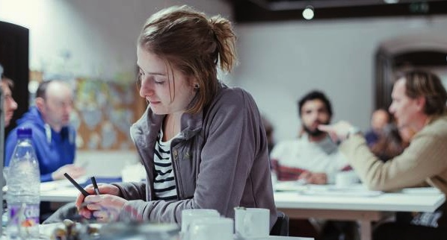
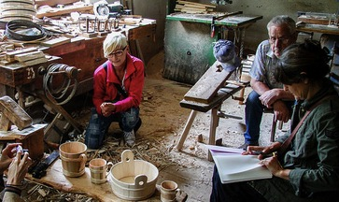
Meetings and workshops in Ljubljana, Slovenia and the EU, meetings with partners, craftsmen, companies, organizations ...

Slide 19
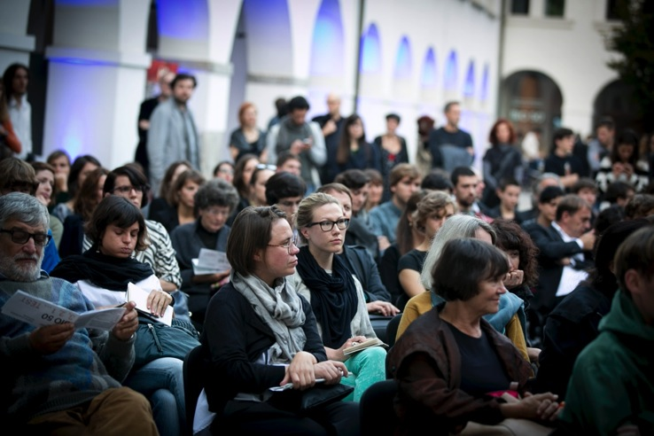
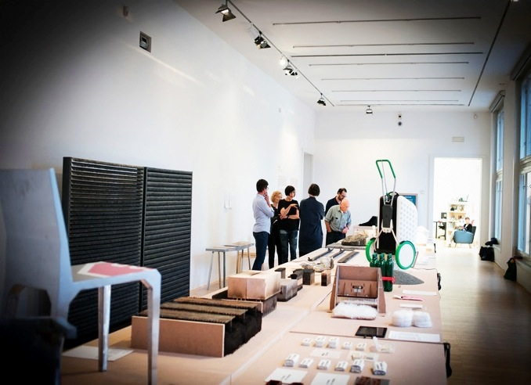
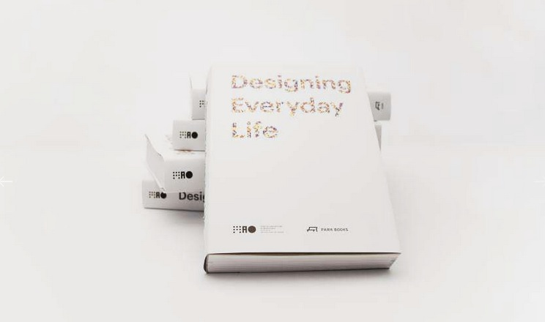
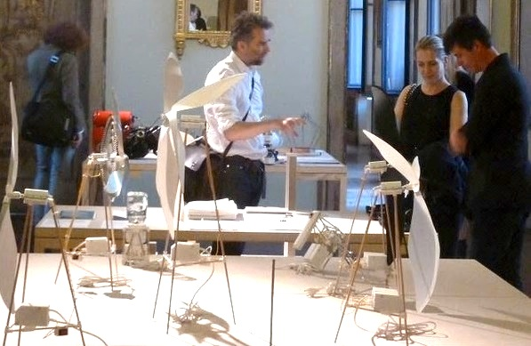
Opning, events, book, traveling exhibition ... Milano Design Week, 2015

Slide 20



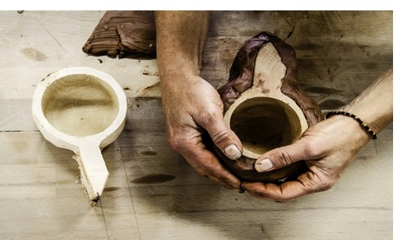

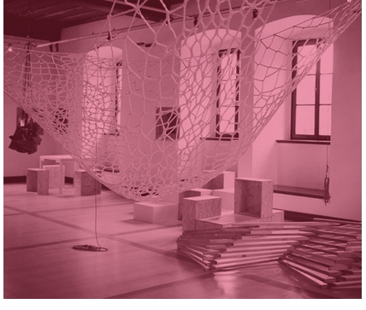
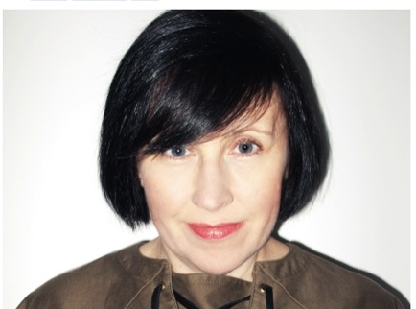

…. This Biennale is a journey through Slovenia’s present ... one of the best exhibitions of 2014.
Marco Sammicheli
….. a number of small-but-feisty cultural events are becoming increasingly influential within design discourse, as the Ljubljana and Istanbul design biennials demonstrated last year.
Alice Rawsthorn, critic for International New York Times
… BIO 50 sparks the energy that is currently missing in most of the international design fairs.
Louise Schouwenberg, a design critic,
head of the design masters programme
Design Academy Eindhoven
…. one of the most intriguing dates in the design calendar.
Sophie Lovell

Slide 21
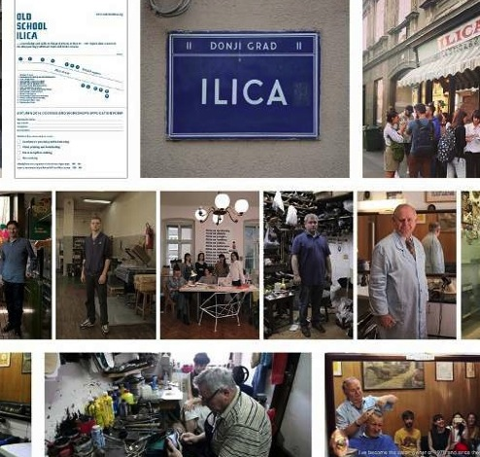
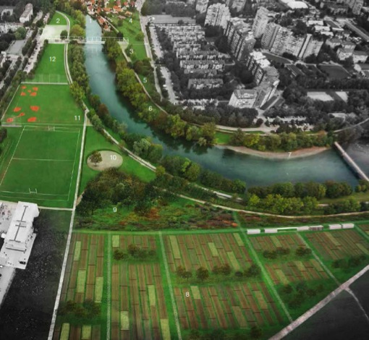
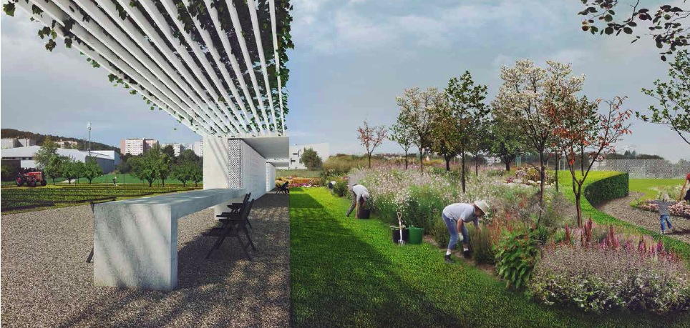
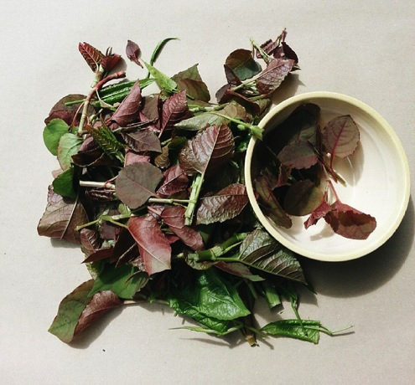

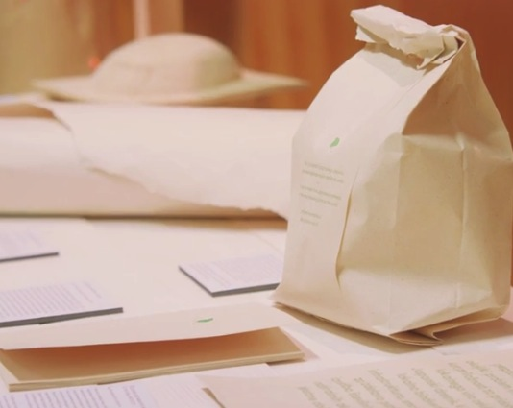
Project Ilica Street - Methodology for economic revival of old city centers; Eatable Garden – to be implemented by the Municipality of Ljubljana
Japanese knotweed project developing with different partners for the paper production, industry and other usage.

Slide 22
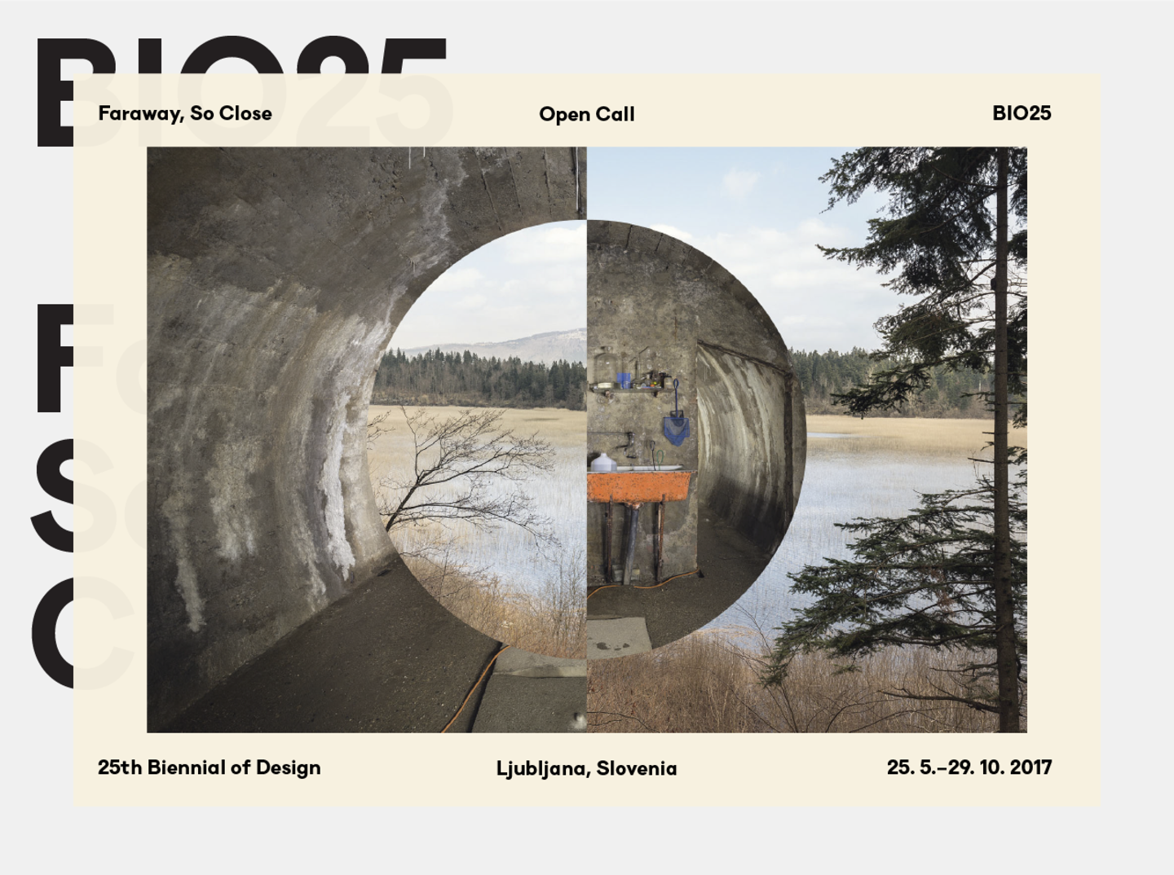

Slide 23
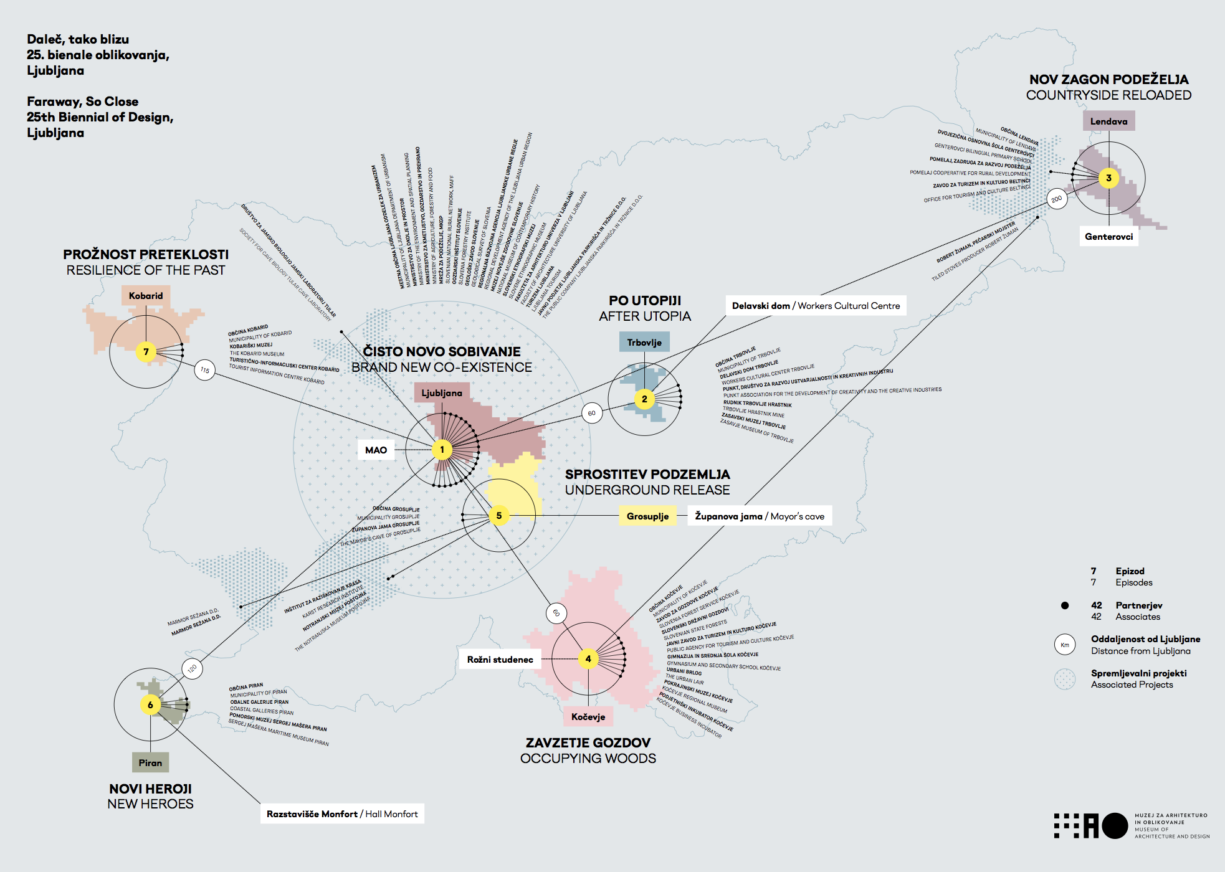

Slide 24
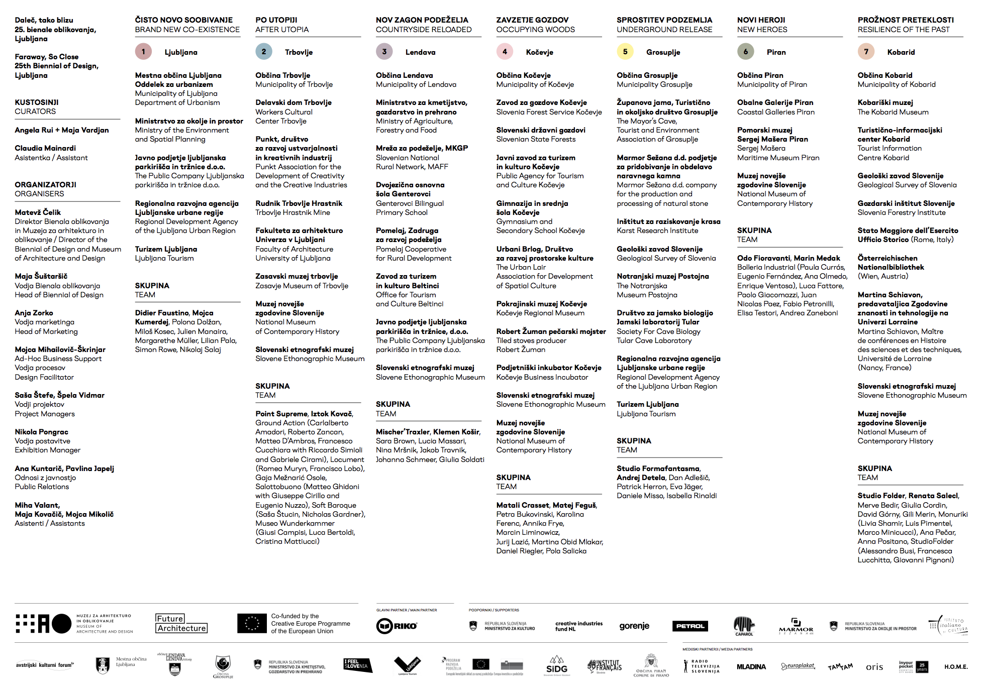

Slide 25

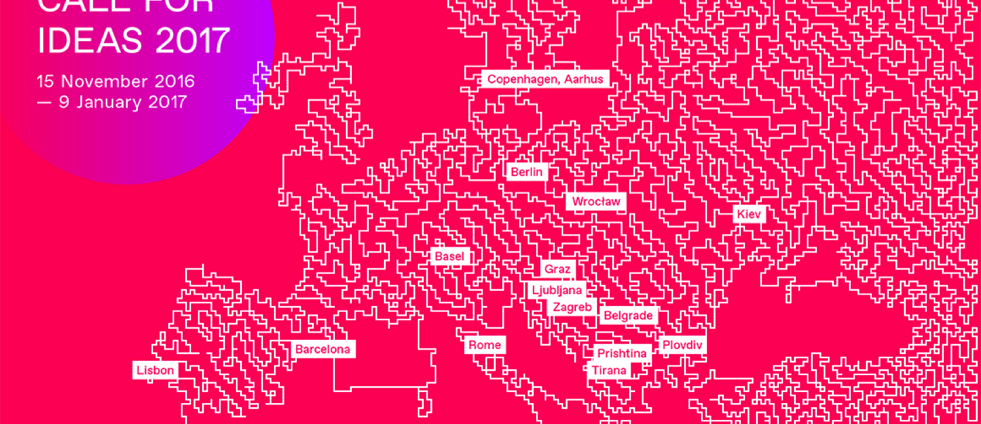
1 of 13 EU platforms
Authors & leaders
19 organizations, 15 countries 2015-2020 - 4 MIO €
National Museum of XXI Century Arts, Rome
Museum of Architecture and Design (MAO), Ljubljana
Oris House of Architecture, Zagreb
Museum of Architecture in Wrocław
Belgrade International Architecture Week
House of Architecture, Graz
Copenhagen Architecture Festival
Tirana Architecture Week
Design Biotop, Ljubljana
Lisbon Architecture Triennale
dpr-barcelona, Barcelona
CANactions, Kiev
Bureau N, Berlin
One Architecture Week, Bulgaria
Swiss Architecture Museum, Basel
Prishtina Architecture Week
Calouste Gulbenkian Foundation, Lisbon
Forecast platform, Berlin

Slide 26
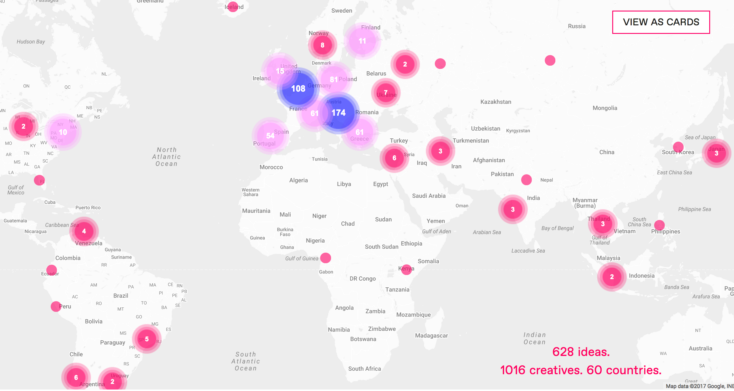
628 ideas
1016 creatives
60 countries
100 events in Europe

Slide 27
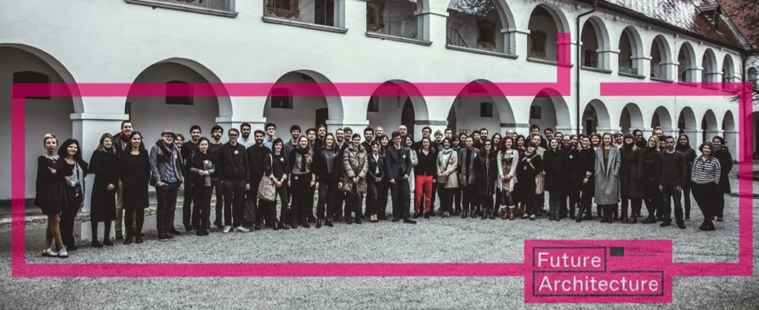
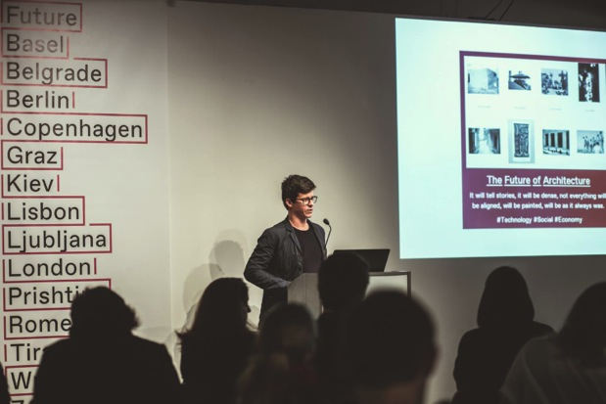
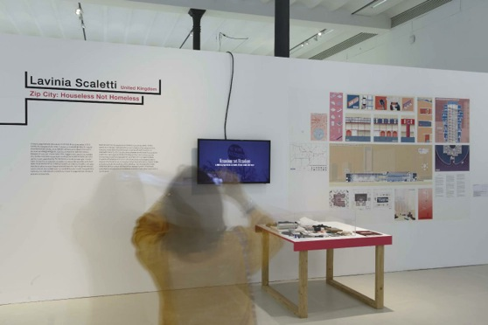
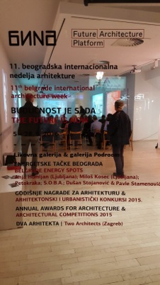
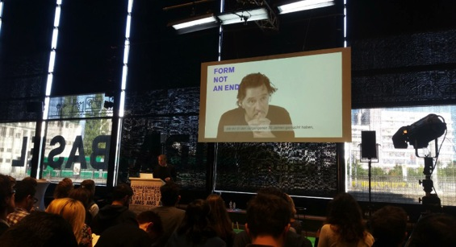
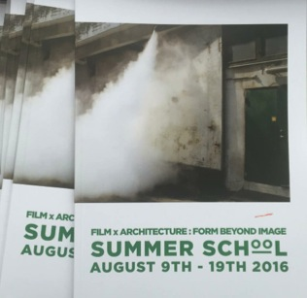
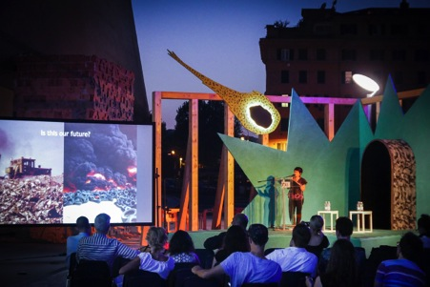
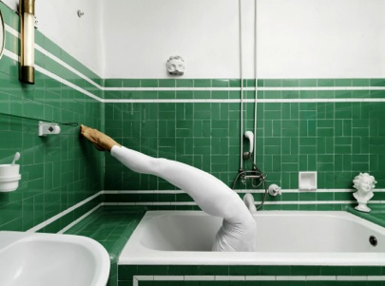
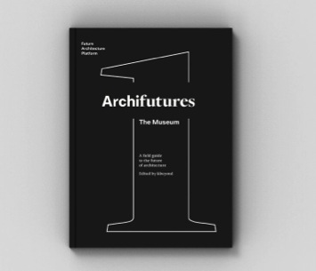
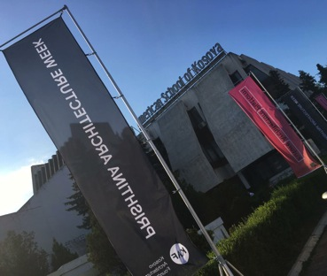

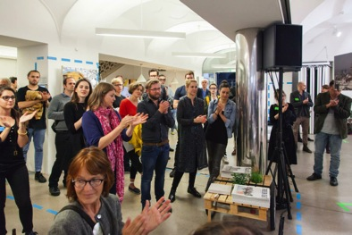
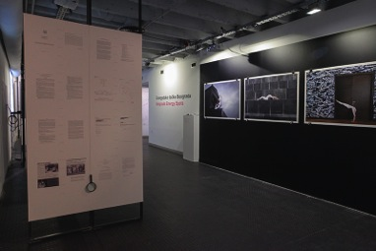
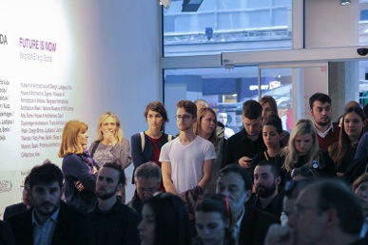

Slide 28
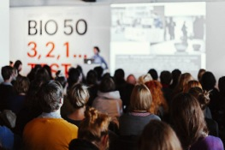














Centre For Creativity Slovenia
2017-2022

Slide 29
Why MAO and CzK?
2017-2022
National Slovene institution for the fields of architecture and design. The CzK project fulfills the goals of the Republic of Slovenia set out in the MAO Establishment Act:
“Building upon the long-standing activities of MAO in the field of cultural and creative sector (CCS) as one of the national hubs that promotes, represents and promotes the activities and development of the sector and links it with economy, science, education and other sectors”.

Slide 30

Centre For Creativity Slovenia
EU Regional Development Fund and the Republic of Slovenia
Operational Program for the Implementation of the EU Cohesion Policy 2014-2020
Maribor
East Region Office
34,54%
WEST
COHESION
REGION
65,46%
EAST
COHESION
REGION
Ljubljana
Museum of Architecture and Design (MAO)
West region Office

Slide 31
Funding
2017-2022
End of May 2017, the Government Office for Development and European Cohesion Policy financial support to the 1st part of the CzK project prepared the Museum of Architecture and Design and in whole worth almost 11 MIO EUR.
1st part: Platform CzK, 5.628.094 EUR, implemented and led by MAO
2nd part: Financial support to CCS projects, 5.290.000 EUR, implemented by Slovenian Entrepreneurship Fund (in preparation, led by Ministry of Culture)
Public tenders to complement the objectives of the whole project CzK

Slide 32
Our goals
2017-2022
Integrated support environment for the development of the CCS sector
Empower the CCS, with entrepreneurial and creative skills
Support crossovers, multidisciplinary work, connect CCS’s with business, public and other sectors - transferring creativity to other sectors & the knowledge from other sectors to CCS.
Development of new projects, products, services or processes that are a result of multidisciplinary cooperation between the CCS and other sectors.
Higher employment through supported projects, promoting innovation, social progress, development of higher added value and socially useful products and services, the visibility of domestic brands.
Growth of new CCS companies, sustainable development of existing, employment increase.
International cooperation, CSCs on national and international markets.

Slide 33
Centre For Creativity Slovenia
Operational tasks & actions
DEVELOPMENT OF NEW PRODUCTS
&
SERVICES
Preselections, matchmaking
Project developed by CzK
Finacnial supports
Concepts
Creative Start Ups
Creative accelerators
Testing of the
concept
Start Up’s
Acceleration
Seed
Start Up
Growth
Development
Experiment, research
New ideas
Ideas/prototypes
→ creating a business
New products/services;
new markets

Slide 34
Centre For Creativity Slovenia
Content sections → Operational tasks & activities
DEVELOPMENT OF NEW PRODUCTS
&
SERVICES
EDUCATION
&
MENTORING
NETWORKING
Consulting, Research
&
analysis
DIGITAL
SERVICES
&
PRODUCTS
COMMUNICATI
&
PROMOTION
Preselections, matchmaking
Project developed by CzK
Finacnial supports
Concepts
Creative Start Ups
Creative accelerators
Annual trainings
Educational modules, conferences,
mentoring,
creative management modules; training for future local trainers ...
Presentations abroad (exhibitions ...)
International projects
National events (creative networking's, presentations)
Consultancy to the selected projects in CzK;
Research / market analysis/toolkits
Support to national policy making
Common CCS online platform - database and information platform
Support for online development, sales of products and services CCS
National and international promotion (PR, advertising, social media, e-bulletin ...)
Presentation of results at events and exhibitions

Slide 35
Centre For Creativity
Crossowers
Regional
National
International
Cultural and creative sectors (CCS) – architecture; design & visual arts, archives, libraries, cultural heritage; books & press; cultural education; advertising; music; performing arts & artistic creation; radio & TV; software & games; as well as video & film …
Other stakeholders – public sector, non profit, private sector, education, NGO, private organizations; freelance cultural workers; micro, small and medium-sized enterprises (MSME) and the public sector. government/decision makers/ministries, municipalities, science, education/universities, regional development agencies, technological parks; SME, business incubators, traditional industry, industry associations, chambers of commerce, service and manufacturing companies; enterprise funds … Fields of health, social, science, tourism, financial institutions, IT, robotics, computer; international organizations and partners …

Slide 36
www.mao.si I www.bio.si I www.futurearchitectureplatform.org

Slide 37
Centre For Creativity Slovenia
Operational tasks & actions
DEVELOPMENT OF NEW PRODUCTS
&
SERVICES
Project developed by CzK (multidisciplinary groups/projects, differnet topics)
Financial support of the CCS projects (different phases of lifecycle) - SPS
Project developed by CzK
Preselections, matchmaking
Public funding
Experiments, concepts
Creative Start Ups
Creative accelerators
Testing of the
concept
Start Up
Acceleration
Seed
Start Up
Growth
Development
Experiment, research
New ideas
Ideas/prototypes
→ creating a business
New products/services;
new markets
Support system to CCS’s applying to financial support, mentorship, education…

Slide 38
Centre For Creativity Slovenia
DEVELOPMENT OF NEW PRODUCTS
&
SERVICES
EDUCATION
&
MENTORING
NETWORKING
Consulting, Research
&
analysis
ONLINE
SERVICES
&
PRODUCTS
COMMUNICATI
&
PROMOTION
Financial support to CCS’s in different life cycles
Conducted by SPS - Slovenian Entrepreneurship Fund,
Measures, goals & preselection processe by MAO
Support to CCS’s applying to financial supports
Mentorship, info, reporting, education, promotion…
Creativity in companies, public and other sectors
Projects developed by the CzK (MAO and partners)
Multidisciplinary groups, social challenges with public and private sector …
Entrepreneurial skills & knowledge in CCS
From idea to bussines and internationalisation, cooperation with different partners
Development of creative skills & projects
Skills and knowleedge lacking in regular educational system, cooperation with different partners

