Slide 1


Slide 2



























.-Catalonia: A Country of Clusters
Lighting
Agricultural Production
Means
Advanced Materials
Furniture
Fashion
Nutrition and Health
Optics & Photonics
Packaging
Kids Related Products
Mental Health
Health Technology
Education ICT
Wine
Population: 7,539,618
16% of the Spanish population, similar to the population of Switzerland
Area: 32,106 km2
GDP: € 223 bn
20% of Spanish GDP
GDP per capita : € 28,997
Water
Media
Automotive
Beauty
Biomass
Biotechnology
Pork meat
Digital
Smart Housing
Energy Efficiency
Solar Power
Sports Industry
Railway
Foodservice
Logistics
Nautical
Gourmet Food
Home Products
Catalonia
Catalonia: a cluster pioneer
Aprox. More than 3.000 initiatives in different countries and regions (*)
31 Clusters
More than 2.200 companies
Agregated turnover 70.000M€
29% Catalan GDP
More than 250.000 workers in Clusters
+
Sweden
Turkey
Lithuania
CLUSTERS IN THE WORLD
Austria
Jordanian
México
South Africa
....
Pakistan
Kazakhstan
Poland
….
Regions and countries with initiatives
based on cluster development
Basque Country
Scotland
Arizona
Catalonia
Massachusetts
France
Estonia
Denmark
Slovenia
UK
Minas Gerais
...
Emilia-Romagna
Toscana
New Zealand
Costa Rica
California
....
-
1980
1990
1992
1997
2001
2003
2005
2017
(*) Estimation from TCI,European Cluster Observatory 2011

Slide 3



.-The Audiovisual Sector in Catalonia. Figures
Gross Added Value 513 M€
Turnover 1,7 M€
Employees 14.047
Companies 2.235

Slide 4
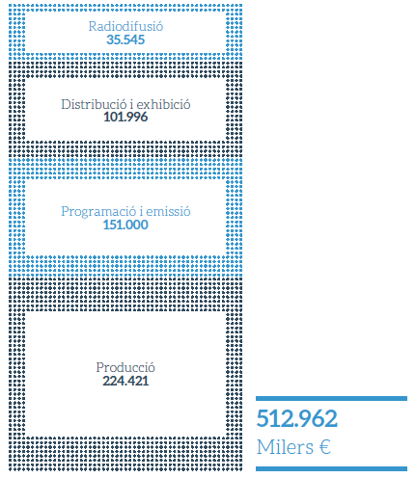

Radio 36 M€
6%
Exhibition 102 M€
20%
TV Operators150 M€
30%
GAV
44%
Production 225 M€
513 M€

Slide 5
The Catalan Audiovisual Cluster is a group of companies
and institutions in the audiovisual and multimedia sector
who cooperate in order to grow.

Slide 6
Putting the audiovisual industries at the core of the country’s industrial, economic and cultural strategy.
Increasing competitiveness, efficiency and innovation. New opportunities and new investment.
Turning Catalonia into an international reference of new media field.

Slide 7
AV traditional core
Digital Content
Creative Industries
Media
Video games
UNIVERSITY
SOCIAL AND ECONOMIC ENTITIES
PROFESSIONAL ASSOCIATIONS
RESEARCH CENTERS
GOVERNMENT
OTHERS

Slide 8
.- Types of members from all of the value chain
The cluster is formed of companies in the fields of:
PRODUCTION
VFX
POST-PRODUCTION
SCREENINGS
RADIO AND TV OPERATORS
AUDIOVISUAL TECHNOLOGY
PHOTOGRAPHY
VIRTUAL REALITY
ADVERTISING
AUDIOVISUAL PARCS
UNIVERSITIES OF COMMUNICATION
VIDEOGAMES
DISTRIBUTION
TELE-
COMMUNICATIONS
connected to each other

Slide 9
















































































Slide 10
.-Why Form a cluster
The audiovisual sector is undergoing diversification
and the nature business is more varied
.-Therefore , it is necessary to integrate companies form along
the entire chain of value and create new synergies
Audiovisual usage is extending in many areas and new sectors.
.-Is necessary to create connections and build bridges.
Talent is emerging from universities at an increasing rate.
.-We must strengthen the collaboration between academic
Institutions and the industry, and establish channels to promote
expertise.
The audiovisual sector industry is intensive and has a Highly-qualified workforce,
.-We must innovate and find new business models.
The audiovisual market is global.
.-We must promote the opening of the entire sector to international
markets.

Slide 11
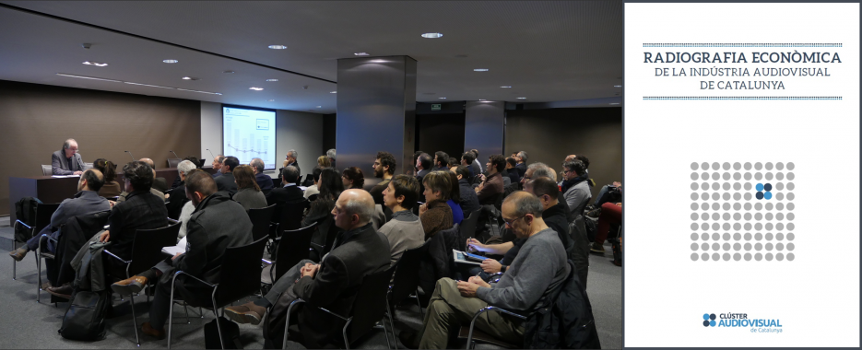
.-What we offer ? :
A network to connect with other companies through exclusive networking activities for members
Shaping the sector in order to bring together different point of view
The opportunity for dialogue that integrates the various fields
of the audiovisual industry.

Slide 12
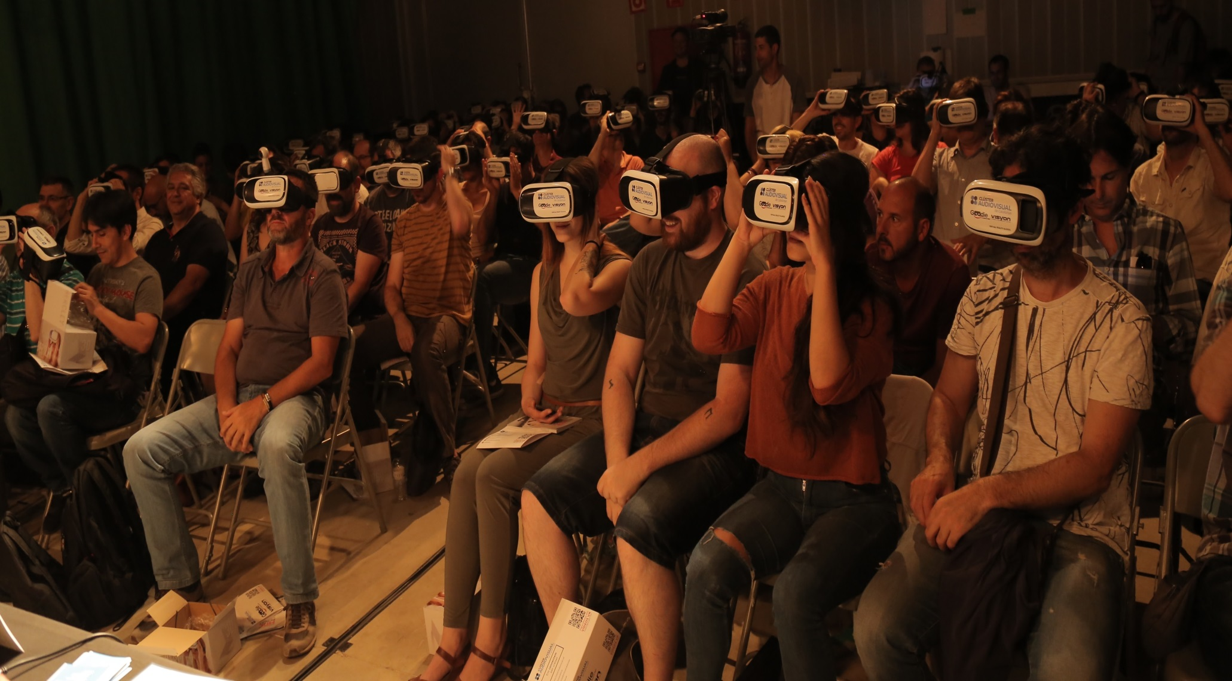
.-What we offer:
A platform to stimulate entrepeneurship and innovation

Slide 13
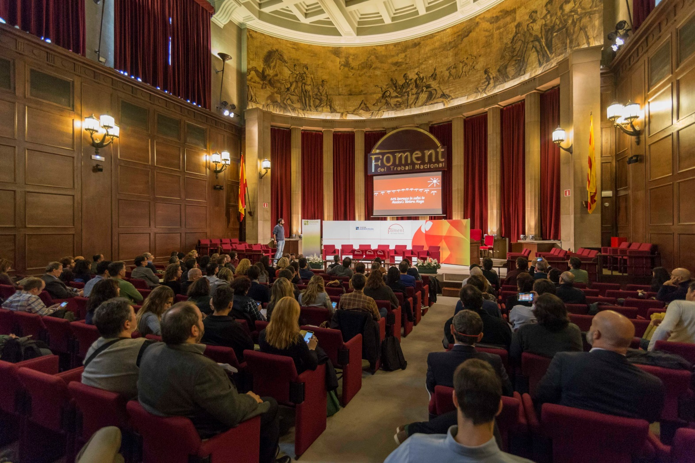
.-What we offer ? :
Relationships
between the Cluster and the leading economic, political and
social institucions, as well as networds of other clusters
Specific sessions on business management as well the opportunity to take part in the most importants events.

Slide 14
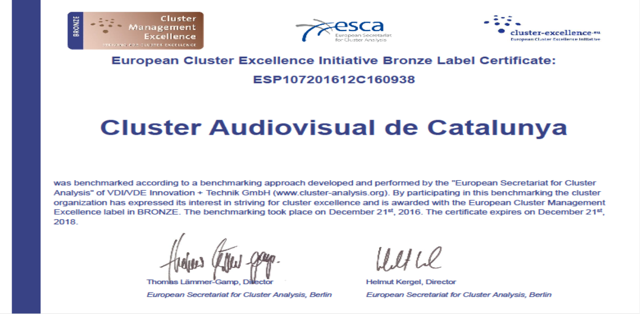


.-Cluster Quality Certified

Slide 15
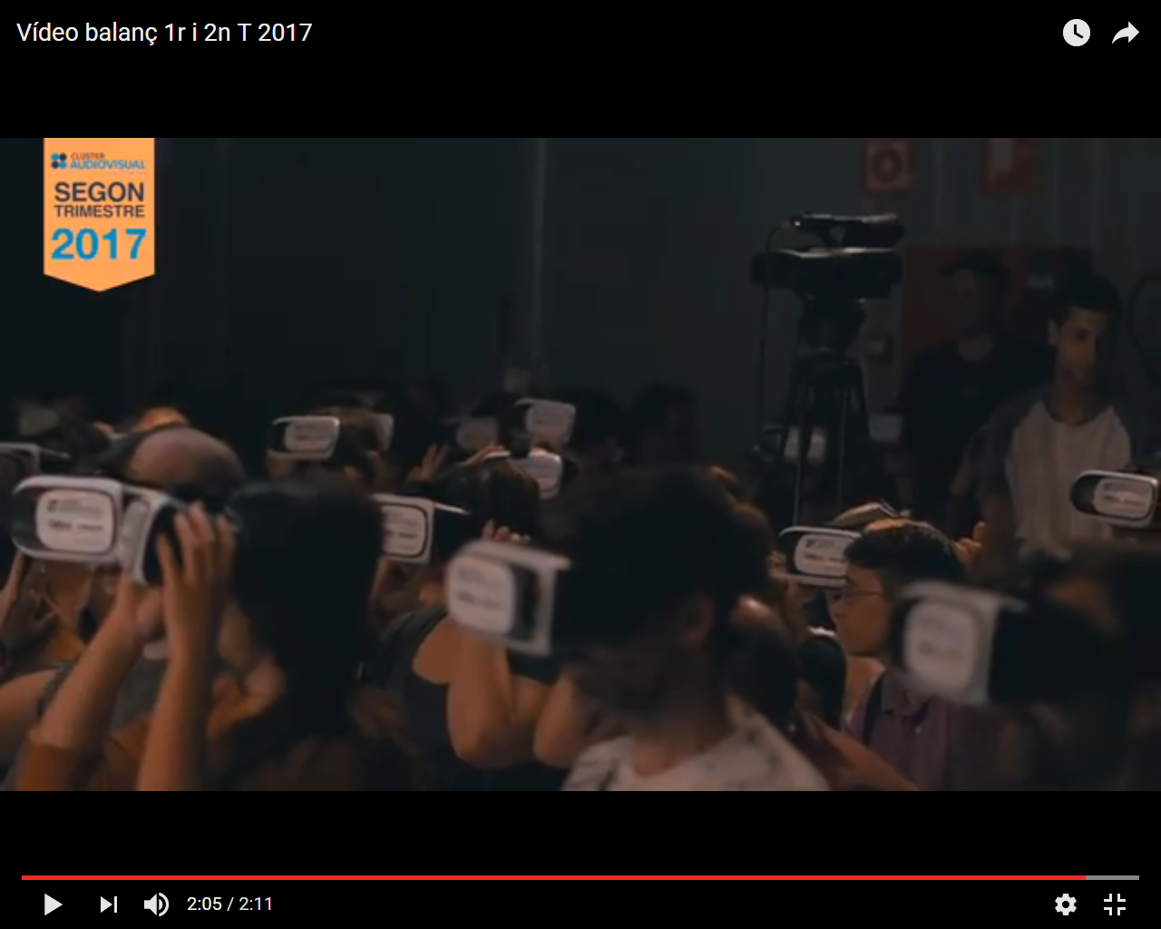
.-VideoBalance 1ers Semester 2017

Slide 16
Digital
Media Forum
Talent Media
Communication
and
Marketing
Enterprise
Invigorate

Slide 17
Talent Media
.- The audiovisual talent week
.- Pitching Audiovisual
.- Videogames and audiovisual.
.- Youtubers.
.- The talent pact.

Slide 18
Digital
Media Forum
.- Virtual Reality.
.- Online Distribution.
.- Innovating seminars.
.- Digital transformation of the sector.
.- Professional Sessions in the festivals.
.- VFX (Visual efects) fields.
.- Drones.
.- Analysis of different audiovisual models from other countries.
.- Music and Audiovisual: new narratives.
.- Zoom vs Brands.
.- Participation of clusters partners in the Mobile World Congress
.- Indie Videogames and audiovisual.
.- Postproduction.
.- Shaping the Industry.
.- The future of connected TV.
.- Audiovisual gamification.

Slide 19
Industry Networking: Breaksfast meetings of members. A selection of partners in the Cluster are presented to the others members.
This is a networking session to share projects and promote collaborative ventures.
.-Economic Scan of the audiovisual industry.
.-Funding sources and business management.
.-Meetings with audiovisual companies
from other countries.
.-Audiovisual production, an opportunity
for investment.
.-Strategic reflection.
.-Creative Start-up meetings.
.-Talent pact.
.-Special guest business lunch
.-International missions.
.-Professionals Sessions into universities.
.-Job market.
.-Mentoring.
Enterprise
Invigorate

Slide 20
.-Annual report of the audiovisual cluster.
.-Newsletters for partners.
.-Social net: Facebook, Twitter, Instagram, YouTube,
.-Press conferences
.-TV programs.
Communication
and
Marketing

Slide 21

Example of Good Practices implemented
by the Organization:
Universities and industries hold an annual meeting organized
by Audiovisual Cluster of Catalonia where students take the leading role.
New talents present their projects to a wide range of producers,
transmedia and video game companies with the
aim of promoting new productions.

Slide 22
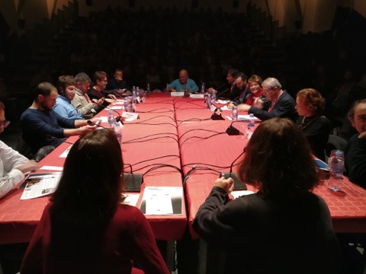
Video

Slide 23
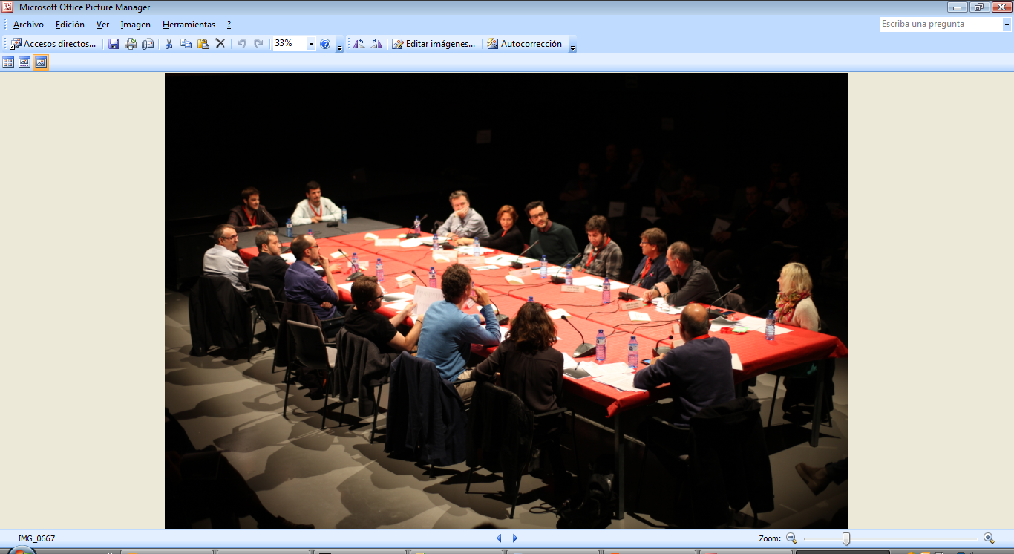
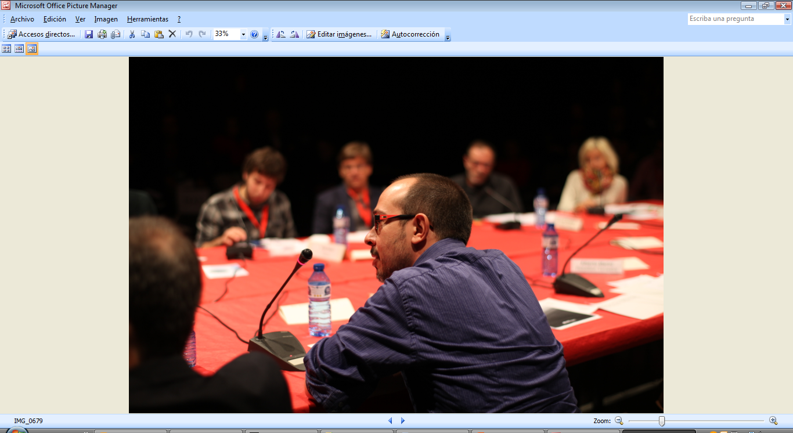

Its objectives are to bring near talent emerging from the university to the industry, to detect innovative projects to promote employability of the new generations and to strengthen the relationship between University and Industry.
Throughout the year, the participating universities make a first selection of those works produced by the students. Later, a professional committee chooses the most relevant selected projects and undergo a training process with the students to improve their presentations. Finally, the projects are presented and discussed in public sessions during two days.

Slide 24

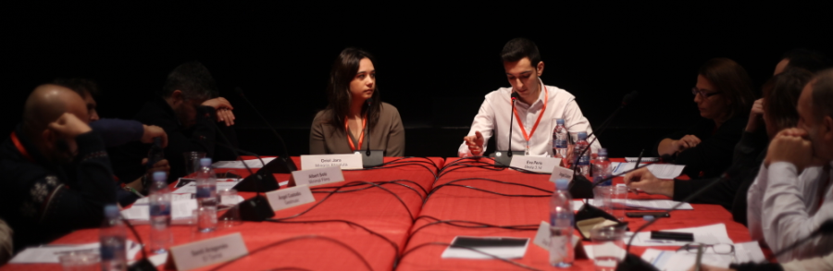

The third edition of the Audiovisual Pitch will be celebrated from 28th of November to 1st of December 2017.
2016 overview
622 assistants attended
110 one to one meetings took place between the producers and the students
80 audiovisual companies attended the Audiovisual Pitch
15 universities participated
The event included a study case about a successful Catalan TV series and also a networking meeting.

Slide 25
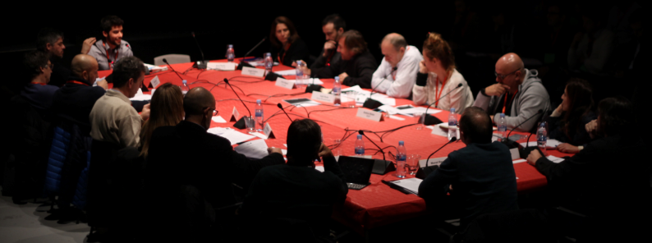
Project Categories of the Audiovisual Pitch
Fiction | Feature films, short films, TV movies, TV series, animation
Non-Fiction | Documentaries, short documentaries, documentary series
New formats | Web series, webdoc, transmedia, gaming…
TV programs | Game shows, entertainment programs…
Technology | Technology tools for audiovisual content

Slide 26



















Universities participating
Universities guest:

Slide 27
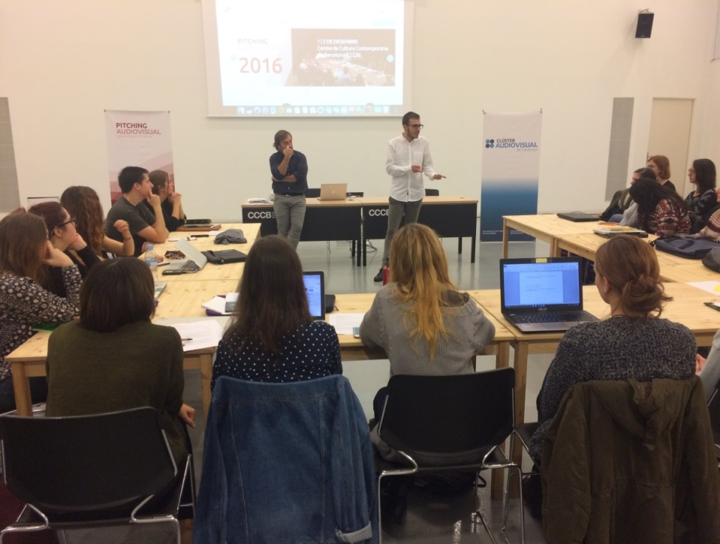
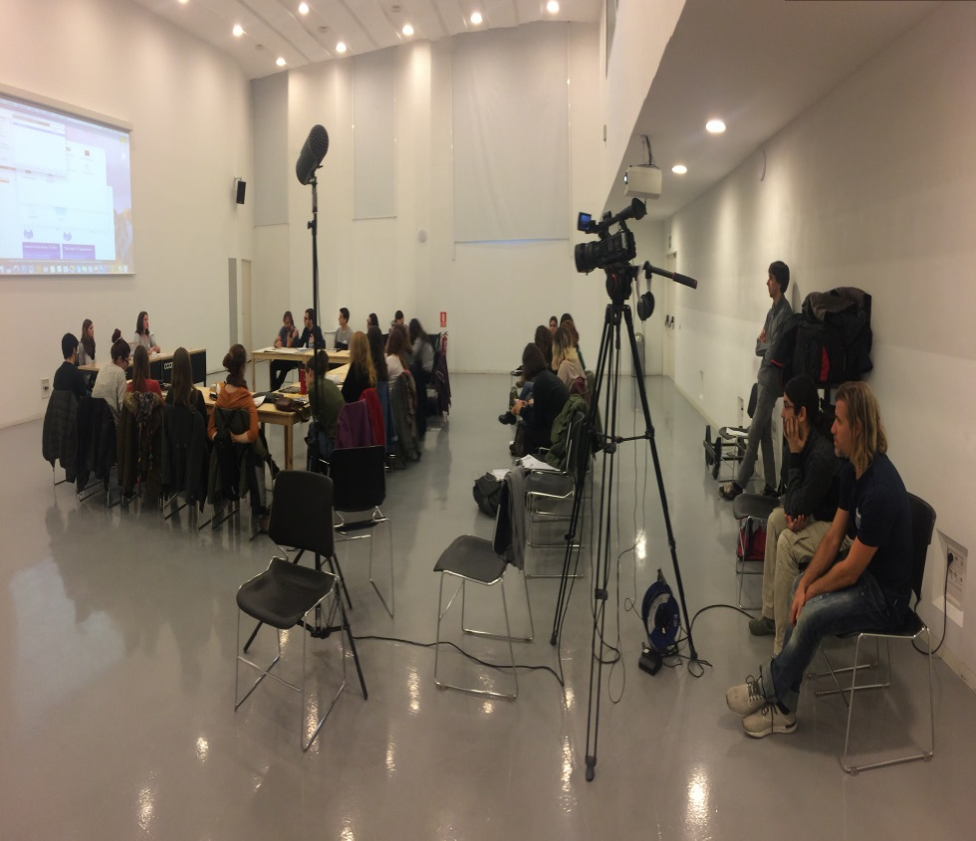
Workshop
A workshop will take place one week before the Audiovisual Pitch. During two days, the students will work intensively on improving their project presentation with the aid of the tutors, who have an extensive industry experience.

Slide 28
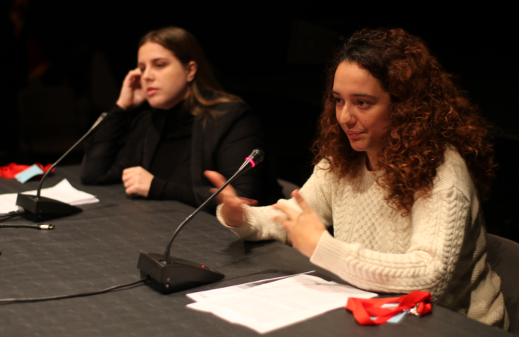
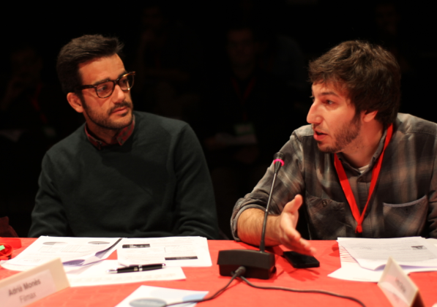
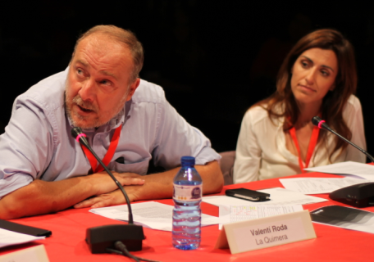
Activities
Audiovisual Pitch
Around twenty projects will be presented in front of members of audiovisual sector. Students will have 7 minutes to explain their projects (teaser included) and the professionals will have 7 minutes to make comments and questions.

Slide 29
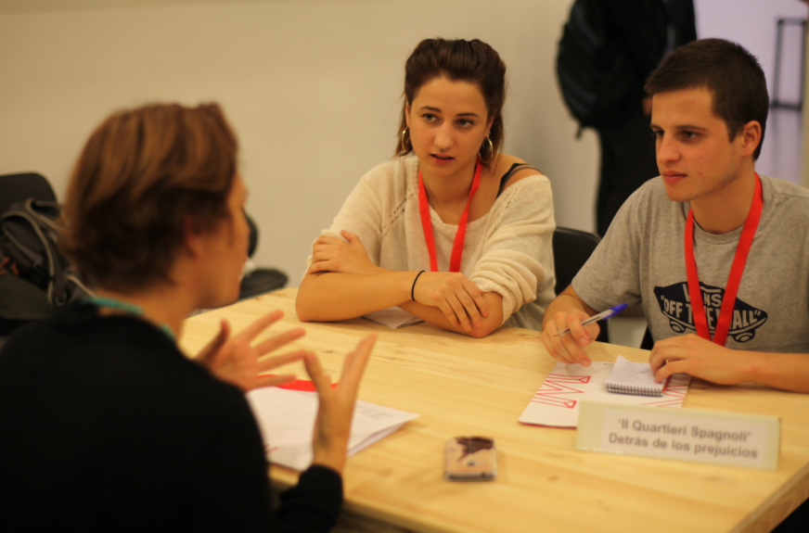
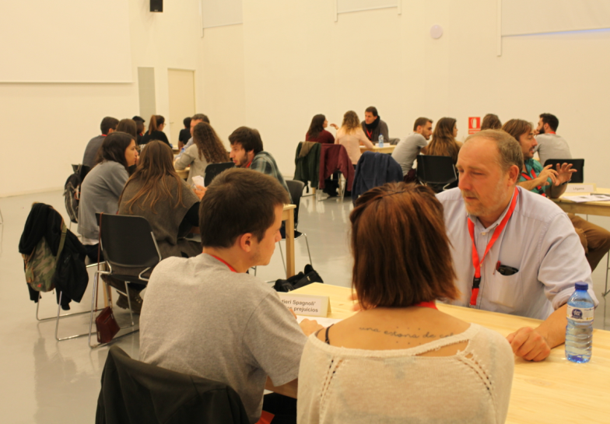
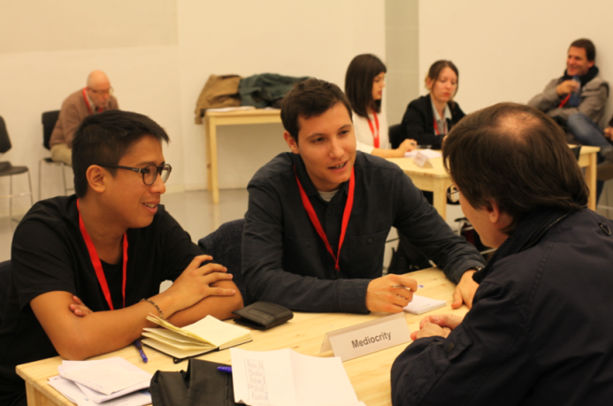
Individual meetings
Activities
After the Pitching the individuals meetings will take place between students and professionals

Slide 30
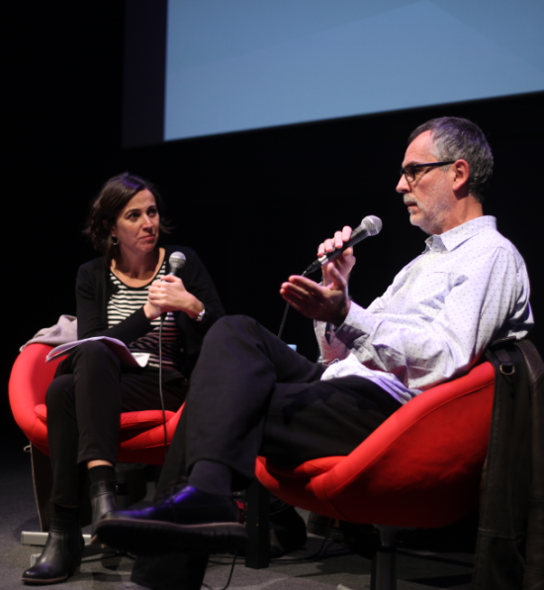
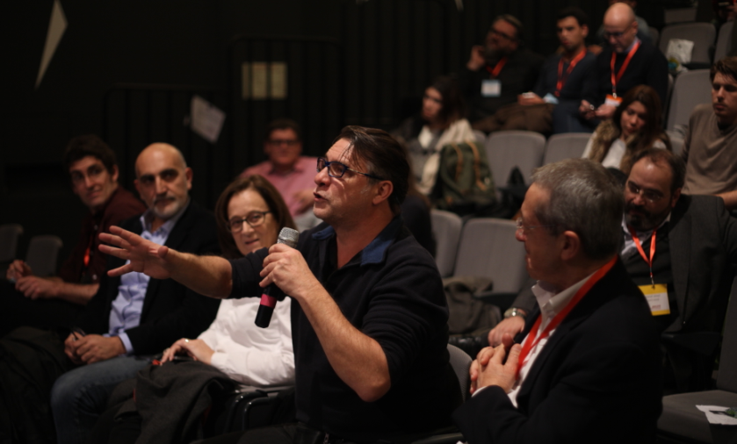
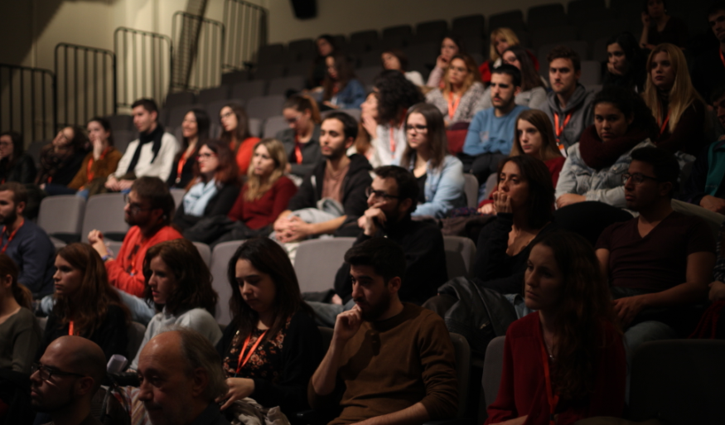
Study Case-Conference
Study case with directors of a successful Catalan TV, and conferences about our audiovisual sector.

Slide 31
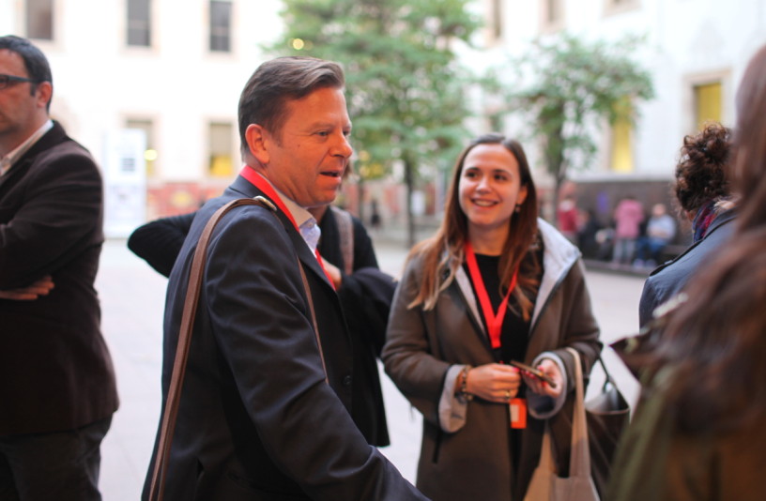
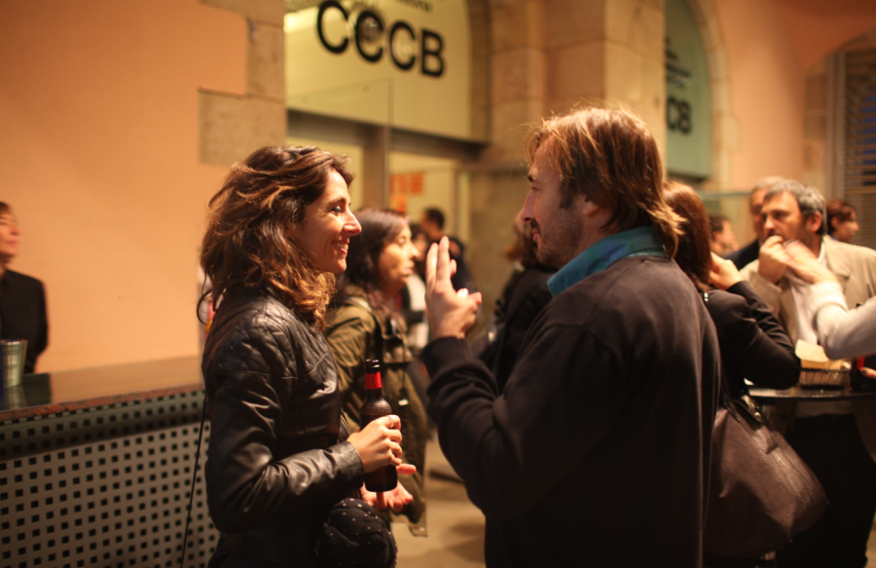
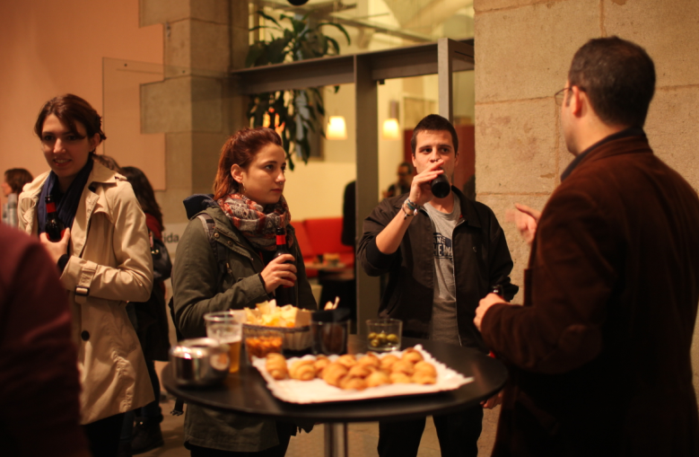
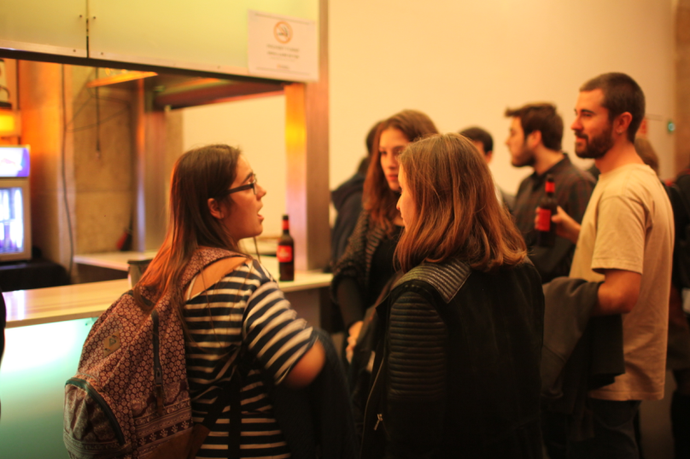
After Pitch
Activities
Networking and meeting point

Slide 32
Thanks for your attention
Contact:
Eduard Gil
Cluster Manager
egil@clusteraudiovisual.cat
+34 616 663 567
www.clusteraudiovisual.cat

